Slide 1
zekeLabs Spark - Partitioning
Learning made Simpler ! www.zekeLabs.com

Slide 2
What are Partitions ?
Partition properties
Default partitiong behaviours
Optimal Number of Partitions
Optimizing data shuffling
Types of Partitioning in Spark
Agenda

Slide 3
Partitions
Logical chunk of large distributed dataset
There is a one-to-one correspondence between how data is laid out in data storage like HDFS or Cassandra
Every machine in a spark cluster contains one or more partitions.
The number of partitions in spark are configurable and having too few or too many partitions is not good.
Partitions in Spark do not span multiple machines.

Slide 4
Partitions - Contd.
Spark can only run 1 concurrent task for every partition of an RDD, up to the number of cores in your cluster.
So if you have a cluster with 50 cores, you want your RDDs to at least have 50 partitions (and probably 2-3x times that).

Slide 5
Partitioning Properties
partitions.size - returns number of partitions
partitioner - HashPartitioner, RangePartitioner, CustomPartitioner
defaultParallelism - returns default level of parallelism
Number of Partitions equals to number of tasks per stage basis

Slide 6
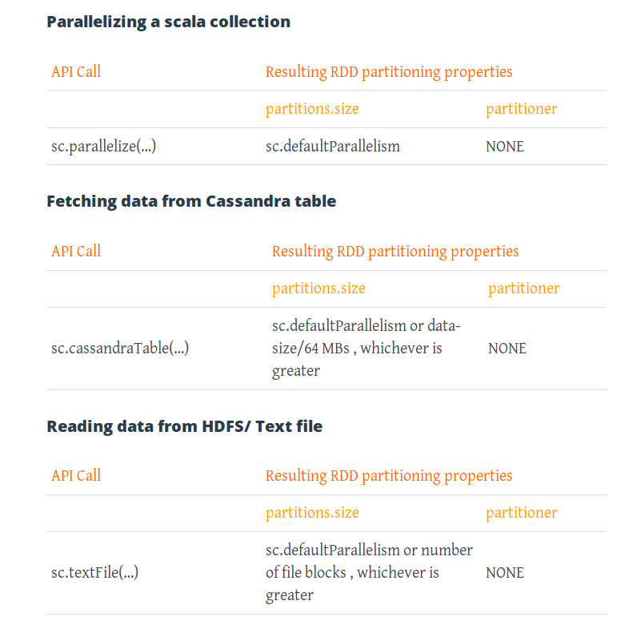
Default Partitioning Behavior

Slide 7
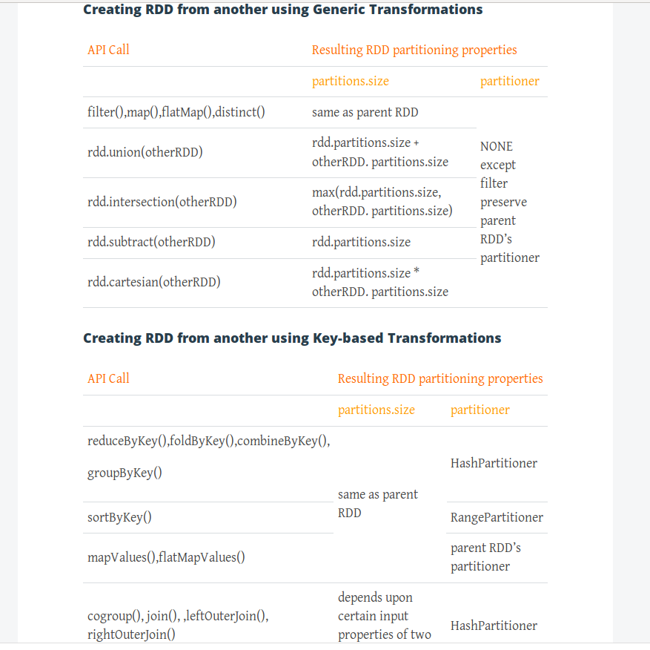
More ...

Slide 8
Optimal Number of Partitions
Disadvantages of too few partitions
Less concurrency - worker nodes sitting ideal
Data skewing - Improper distribution of data across different partitions
Disadvatages of too many partitions
Task scheduling may take more time than actual execution time.

Slide 9
Optimal Number of Partitions
Usually between 100 and 10K partitions depending upon cluster size and data.
Lower bound – 2 X number of cores in cluster available to application
Upper bound – task should take 100+ ms time to execute.If it is taking less time than your partitioned data is too small and your application might be spending more time in scheduling the tasks.

Slide 10
Optimizing data shuffling
If we perform these *ByKey operations directly on source RDD, it would involve lots of data shuffling which will slow down the performance
Instead of it, if we re-partition the RDD using HashPartitioner it would partition the data in such a way that data belonging to same keys will go in one partition and hence during task execution no data shuffling will happen.
Now if we want to perform multiple *ByKey operations, it is advisable to cache the repartitioned RDD and then perform the operations.

Slide 11
Types of Partitioning
Hash Partitioning - Attempts to spread data evenly across various partitions based on key.
Range Partitioning - Tuples having keys within the same range will appear on the same machine. Keys in a range partitioner are partitioned based on the set of sorted range of keys and ordering of keys.
Custom Partitioning - Available only for Pair RDD

Slide 12
Thank You !!!

Slide 13
THANK YOU
Let us know how can we help your organization to Upskill the employees to stay updated in the ever-evolving IT Industry.
Get in touch:
www.zekeLabs.com | +91-8095465880 | info@zekeLabs.com
Visit : www.zekeLabs.com for more details

