Slide 1


NOVATECH SOLUTIONS
Marketing Proposal
SaaS | Lead generation, Sales, Brand awareness
PPC (Google Ads), Paid Social (Meta/TikTok/LinkedIn), SEO & Content Marketing, Email Marketing
Prepared by Cohorts | 1 July 2026

Slide 2
Table of Contents
2
01
Company & Market Overview
03
Scope of Services
Executive summary, company background, and market analysis
Detailed breakdown of services and deliverables
02
Strategy & Approach
04
Budget & ROI Projections
Proposed marketing strategy, target audience, and campaign structure
Investment breakdown and projected return on investment
NovaTech Solutions
2 / 22

Slide 3

01
Company & Market Overview
Executive summary, company background, and market analysis
NovaTech Solutions
3 / 22

Slide 4

We will generate 150 qualified leads in 90 days
4
150
£67
12%
Qualified leads in 90 days
Target cost per lead
Month-over-month lead growth
Launch PPC campaigns targeting high-intent keywords within 2 weeks.
Implement LinkedIn lead gen ads to reach B2B marketing managers.
Optimise landing pages for a 15% conversion rate improvement.
Our integrated strategy targets a 40% reduction in cost per lead.
NovaTech Solutions
4 / 22
Notes:
We focus on high-intent channels to drive leads efficiently. This plan aligns with your budget and timeline, delivering measurable results from day one.

Slide 5

Low brand awareness is costing you 60% of potential leads
5
Current State
Proposed State
Low brand awareness limits reach to 20% of target market.
High cost per lead of £112 due to inefficient targeting.
Low lead volume of 50 per month from current channels.
Increase brand awareness to 50% of target market within 6 months.
Reduce cost per lead to £67 through refined targeting.
Generate 150 qualified leads per month by month 3.
Closing the awareness gap unlocks a 3x increase in lead volume.
NovaTech Solutions
5 / 22
Notes:
Your current challenges stem from limited visibility. Our strategy builds brand presence across key channels, directly addressing these gaps.

Slide 6

Marketing managers at 50-200 employee firms seek efficiency
6
65%
3
40%
Prefer LinkedIn for B2B research
Average decision-makers per deal
Use Google for initial vendor search
Persona: Marketing Manager, aged 30-45, focused on lead quality and ROI.
Channel preference: LinkedIn for thought leadership, Google for solution searches.
Targeting these managers requires a multi-channel approach with clear ROI.
NovaTech Solutions
6 / 22
Notes:
Our audience values time-saving solutions. We will reach them on LinkedIn and Google with content that highlights efficiency gains.

Slide 7

02
Strategy & Approach
Proposed marketing strategy, target audience, and campaign structure
NovaTech Solutions
7 / 22

Slide 8
Three-pillar strategy drives leads, sales, and awareness
8
Pillar 1: Paid media generates 100 leads monthly via Google and LinkedIn ads.
Pillar 2: SEO and content marketing builds organic traffic by 50% in 6 months.
Pillar 3: Email marketing nurtures leads to a 20% conversion rate.
Allocate 50% of budget to PPC and paid social for quick wins.
Invest 30% in SEO and content for sustainable growth.
Use 20% for email marketing and CRO to optimise conversions.
Key Takeaway
A data-driven approach ensures every decision is backed by insights, not assumptions.
This integrated approach maximises your £10,000 monthly budget.
NovaTech Solutions
8 / 22
Notes:
Each pillar reinforces the others. Paid media drives immediate leads, while SEO and email build long-term pipeline.

Slide 9
Execution roadmap delivers results within 4 weeks
9
Phase 1 (Weeks 1-2): Audit current accounts, set up analytics, and launch initial PPC campaigns.
Phase 2 (Weeks 3-4): Deploy LinkedIn and Meta ads, begin SEO keyword research.
Phase 3 (Weeks 5-8): Launch content marketing, start email sequences, and optimise landing pages.
Phase 4 (Weeks 9-12): Full optimisation cycle, first performance review, and scaling.
Week 1: Analytics setup and account audit completed.
Week 4: All paid channels live and tracking.
Week 12: First full optimisation review.
We will have campaigns live within 2 weeks of start date.
NovaTech Solutions
9 / 22
Notes:
This phased approach ensures quick activation while building for long-term growth. We prioritise high-impact actions first.

Slide 10
Google and LinkedIn will drive 80% of new leads
10
At a Glance
Channel 1: Google Ads targeting high-intent keywords for a 5% conversion rate.
Channel 2: LinkedIn Ads reaching marketing managers with a 2% click-through rate.
Channel 3: Meta Ads retargeting website visitors for a 10% conversion rate.
Google Ads budget: £4,000 per month for search and display.
LinkedIn Ads budget: £3,000 per month for lead gen and retargeting.
Meta Ads budget: £1,000 per month for retargeting.
This channel mix balances immediate lead generation with brand building.
NovaTech Solutions
10 / 22
Notes:
Google and LinkedIn are proven for B2B SaaS. Meta supports retargeting to maximise conversions from existing traffic.

Slide 11
Data-driven creative and content will boost engagement by 30%
11
Creative approach: A/B test 4 ad variants weekly, focusing on pain points and ROI.
Content strategy: Publish 2 blog posts and 1 case study per month for SEO.
Testing framework: Run 3 landing page variants per campaign to find top performers.
Ad copy highlights time savings and lead quality improvements.
Blog posts target long-tail keywords with 1,500+ words each.
Landing pages include clear CTAs and social proof.
Key Takeaway
A data-driven approach ensures every decision is backed by insights, not assumptions.
Our testing methodology ensures continuous improvement in ad performance.
NovaTech Solutions
11 / 22
Notes:
We use audience insights to craft messaging that resonates. Regular testing refines creative for higher click-through and conversion rates.

Slide 12
Continuous optimisation will reduce cost per lead by 40%
12
Current State
Proposed State
At a Glance
Current cost per lead of £112 with no systematic testing.
Landing page conversion rate of 2% due to poor design.
Weekly bid adjustments and ad copy testing to lower cost per lead.
Monthly CRO audits to improve landing page conversion to 3.5%.
Budget
£10,000
Engagement
Ongoing monthly support
Our optimisation process targets a 40% reduction in cost per lead within 3 months.
NovaTech Solutions
12 / 22
Notes:
We don't set and forget. Regular reviews of campaign data allow us to reallocate budget to top performers.

Slide 13
Transparent reporting with weekly dashboards and monthly reviews
13
Weekly
10
Month 1
Key Takeaway
A data-driven approach ensures every decision is backed by insights, not assumptions.
Reporting cadence
KPIs tracked
First review
KPI framework: Cost per lead, conversion rate, click-through rate, and lead volume.
Reporting dashboard: Live access via Google Data Studio with custom views.
You will have real-time access to all campaign performance data.
NovaTech Solutions
13 / 22
Notes:
We provide clear, actionable reports. Weekly dashboards show progress, and monthly reviews focus on strategic adjustments.

Slide 14
Dedicated team with 5+ years of B2B SaaS experience
14
Team structure: Account manager, PPC specialist, SEO strategist, and content writer.
Relevant experience: Managed £50,000+ monthly budgets for B2B SaaS clients.
Communication: Weekly status calls and monthly strategy meetings.
Account manager serves as your single point of contact.
PPC specialist has 7 years of Google Ads experience.
SEO strategist has driven 3x organic traffic growth for past clients.
Key Takeaway
A data-driven approach ensures every decision is backed by insights, not assumptions.
Our team has delivered 200+ leads per month for similar SaaS clients.
NovaTech Solutions
14 / 22
Notes:
We understand the B2B SaaS landscape. Our team has a proven track record of reducing cost per lead and increasing pipeline.

Slide 15
Risk mitigation ensures consistent performance and budget efficiency
15
Current State
Proposed State
At a Glance
Common risk: Budget wasted on underperforming channels without oversight.
Risk mitigation: Weekly budget reallocation based on real-time performance data.
Budget
£10,000
Engagement
Ongoing monthly support
We proactively manage risks to protect your budget and timeline.
NovaTech Solutions
15 / 22
Notes:
We identify underperforming campaigns early and shift budget to top performers. This minimises waste and maximises ROI.

Slide 16
Start within 2 weeks and see first results in 30 days
16
2 weeks
30 days
90 days
Key Takeaway
A data-driven approach ensures every decision is backed by insights, not assumptions.
Time to launch
First results
Full optimisation
Sign proposal and provide account access by [date].
Schedule kickoff call within 3 business days.
Approve initial ad copy and landing page designs within 1 week.
We are ready to begin immediately and deliver early wins.
NovaTech Solutions
16 / 22
Notes:
We need access to your ad accounts and analytics within 1 week. Our team will then launch campaigns within 2 weeks of start date.

Slide 17

03
Scope of Services
Detailed breakdown of services and deliverables
NovaTech Solutions
17 / 22

Slide 18
Scope of Services
18
Service | What's Included | Status
PPC (Google Ads) | Search & display campaigns, keyword strategy, bid management, landing page optimisation | Included
Paid Social (Meta/TikTok/LinkedIn) | Audience targeting, creative testing, retargeting funnels, lookalike audiences | Included
SEO & Content Marketing | Technical SEO, content calendar, organic growth strategy, link building | Included
Email Marketing | Automation flows, segmentation, lifecycle campaigns, A/B testing | Included
NovaTech Solutions
18 / 22

Slide 19

04
Budget & ROI Projections
Investment breakdown and projected return on investment
NovaTech Solutions
19 / 22

Slide 20
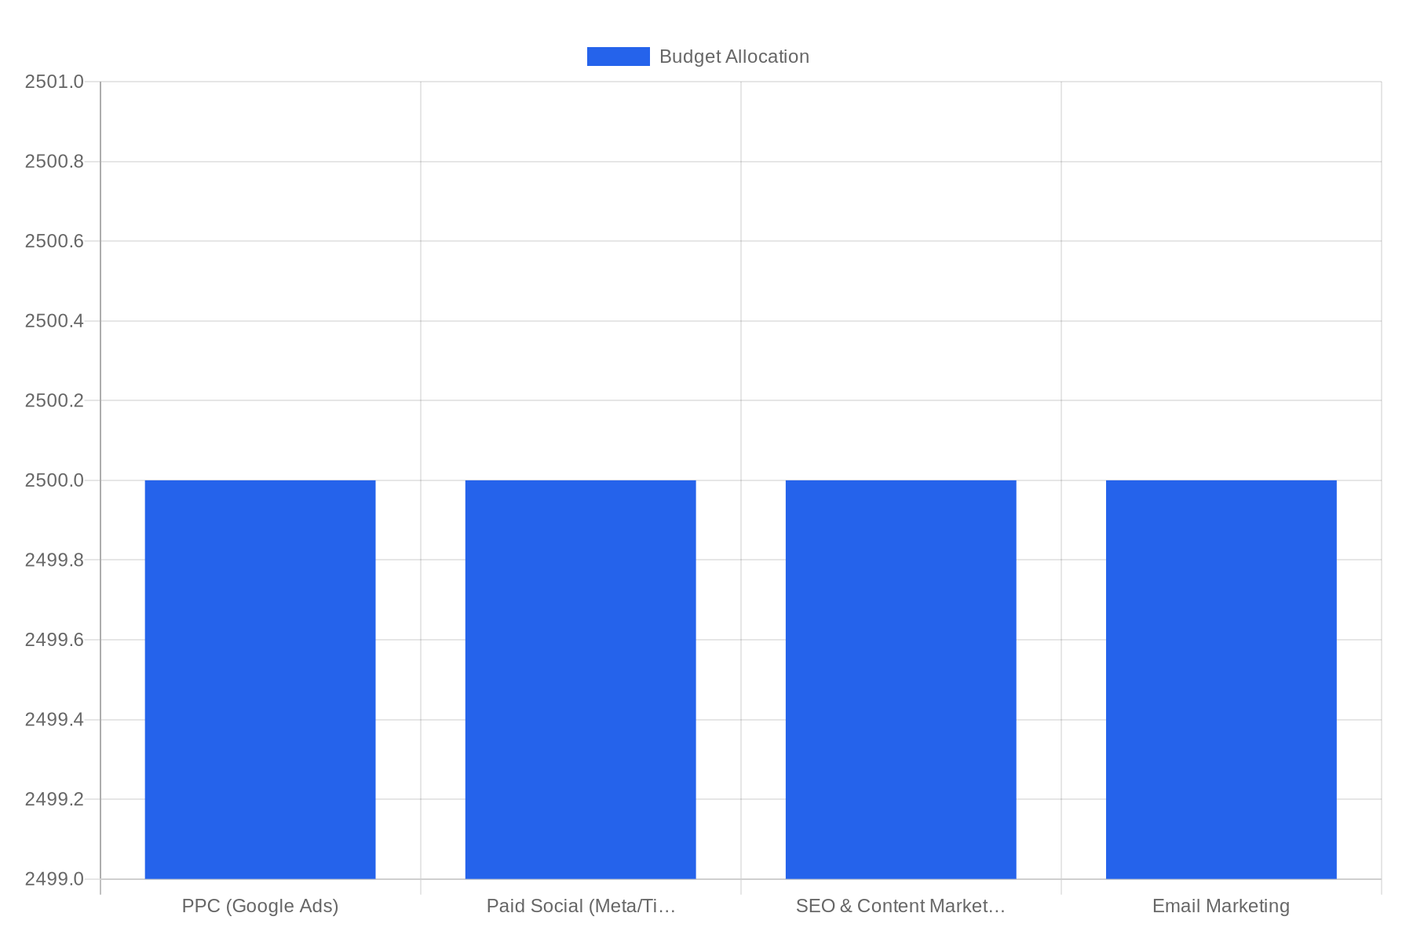
Budget Allocation
20
MONTHLY INVESTMENT
£10,000
ENGAGEMENT
Ongoing monthly support
START TIMELINE
Within 1 month
PROJECTED ANNUAL
£120,000
NovaTech Solutions
20 / 22

Slide 21
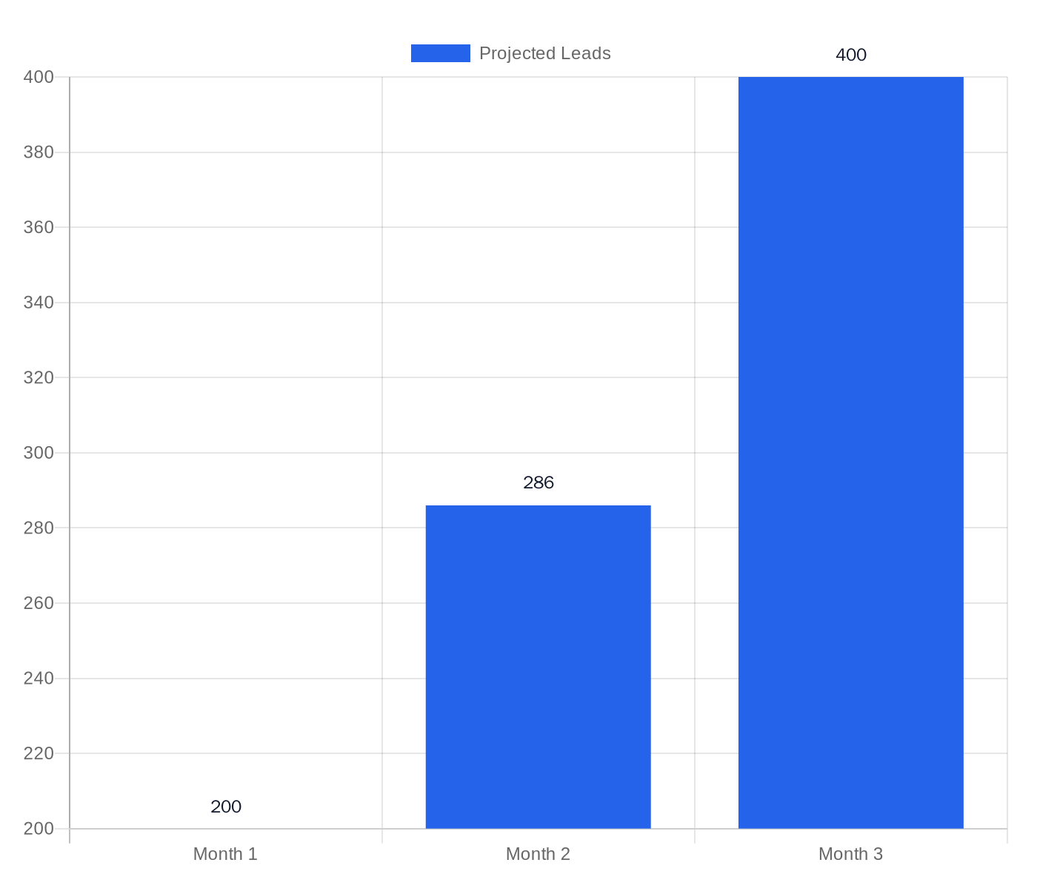
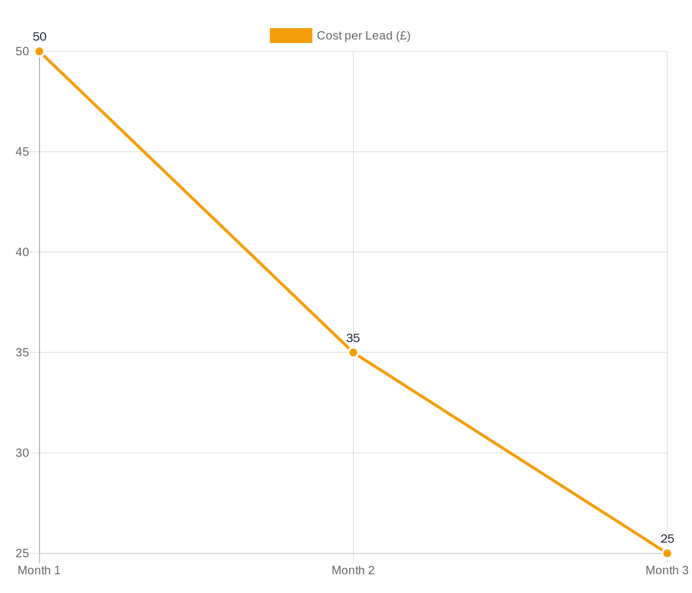
Projected ROI (90-Day Outlook)
21
NovaTech Solutions
21 / 22

Slide 22

Next Steps
Let's build something great together.
1
2
3
4
Review this proposal and share feedback
Schedule a kickoff call to align on goals
Approve scope and finalise engagement terms
Launch campaign within agreed timeline
Prepared for NovaTech Solutions

