Slide 1
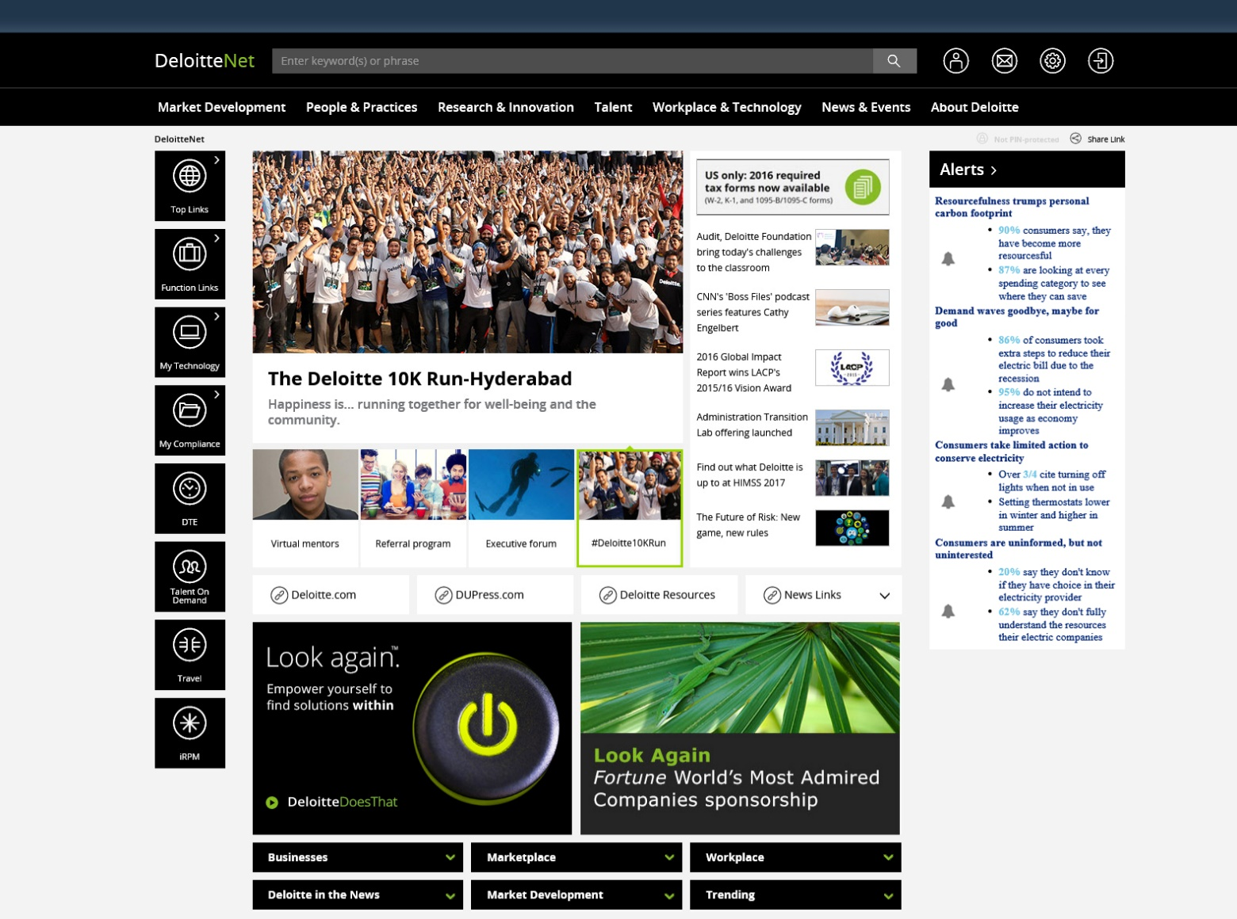
This section should be an image slider, connected to the thumbnails.
The large image should change according to the thumbnail.
This should be a vertical scrolling section.
News items should scroll from bottom to top.
Both these sections should display a pop-up box, when clicked on them.
You can use any large image or combination of image and text in the pop-up box.
When clicked on any of these six boxes, it should display a drop-down box as shown in the next slide.
You can use any image and text in the drop-down box.

Slide 2

Important things to be noted while sending the assignment back to us:
The Page should be responsive.
All the .js files should be renamed as .txt files, while sending it through mail. (Outlook will not accept the script files to send through)

