Slide 1
Online Examination
SWEN 6837.02
Software Engineering Capstone Project
Team 5 (SPRING 2017)
KARTHIK PALAKURTHI
SAI KIRAN IPPILI
CHANDRA MOULI ADDANKI
RAMPRASAD SHANKARRAMAN
Dr. Michael J. Findler
Instructor

Slide 2
Agenda
Introduction
Project Description
Use Case Scenarios and Synthesized Use cases
Class Diagram
Task Analysis
Sequence Diagrams
Activity Diagrams
Summary

Slide 3
Introduction
Project Description
Use Case Scenarios and Synthesized Use cases
Class Diagram
Task Analysis
Sequence Diagrams
Activity Diagrams
Summary

Slide 4
Introduction
This project is about online examination, which is evolved in order to suppress the paper examination which has many disadvantages,
like:
Hard retrieval and reviewing of data
No long storage
No backups
Filtering

Slide 5
Introduction
Project Description
Use Case Scenarios and Synthesized Use cases
Class Diagram
Task Analysis
Sequence Diagrams
Activity Diagrams
Summary

Slide 6
Project Description
The project is a web based application.
Project has 4 main actors
a) Student
b) Faculty
c) Admin
d) Reminder

Slide 7
Introduction
Project Description
Use Case Scenarios & Synthesized Use cases
Class Diagram
Task Analysis
Sequence Diagrams
Activity Diagrams
Summary

Slide 8
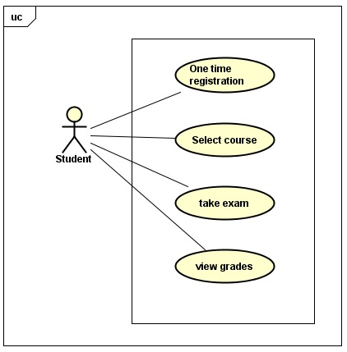
SYNTHESIZED USE CASE STUDENT

Slide 9
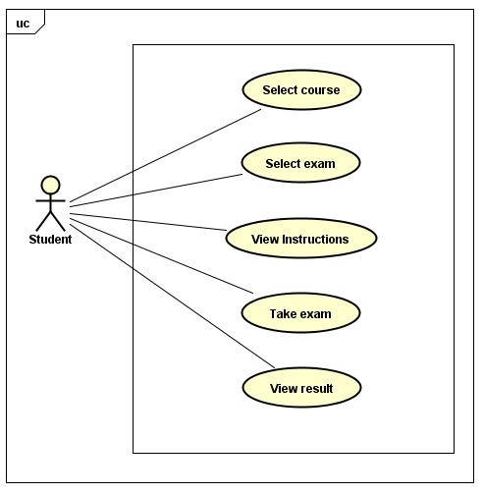
USE CASE FOR STUDENT TAKE EXAM

Slide 10
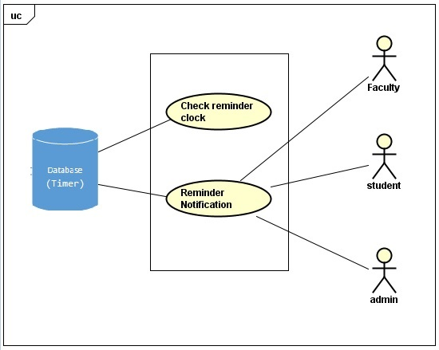
SYNTHESIZED USE CASE REMINDER

Slide 11
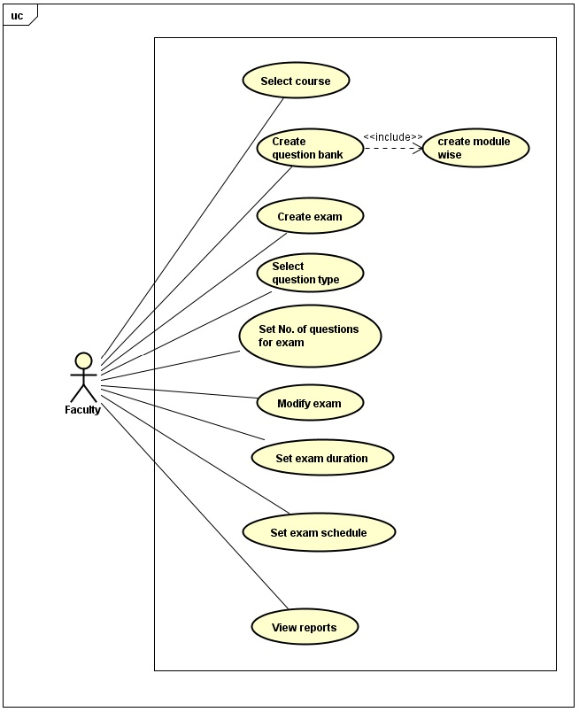
SYNTHESIZED USE CASE FACULTY

Slide 12
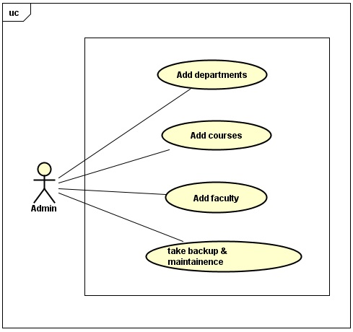
SYNTHESIZED USE CASE ADMIN

Slide 13
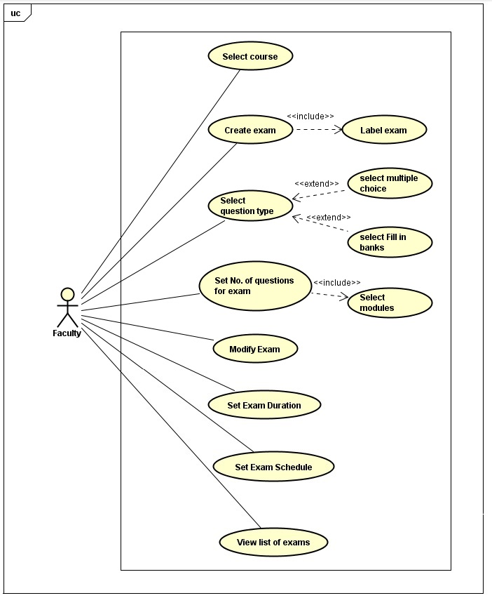
USE CASE FOR FACULTY CREATE EXAM

Slide 14
Introduction
Project Description
Use Case Scenarios & Synthesized Use cases
Class Diagram
Task Analysis
Sequence Diagrams
Activity Diagrams
Summary

Slide 15
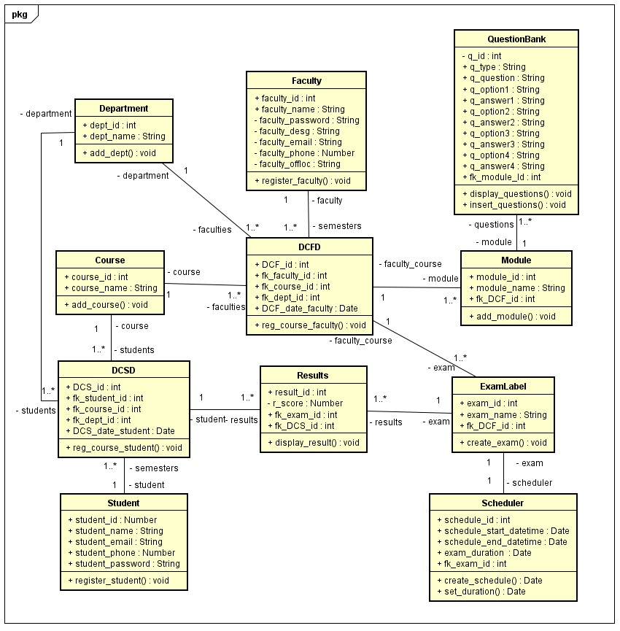
Class Diagram – Online Examination

Slide 16
Introduction
Project Description
Use Case Scenarios & Synthesized Use cases
Class Diagram
Task Analysis
Sequence Diagrams
Activity Diagrams
Summary

Slide 17
Task Analysis Hierarchy – Online Examination
0 Online Examination
1 Faculty
2 Student
3 Admin
1.1 Select Course
1.2 Create Question bank
1.3 Create Exam
1.4 Modify Exam
1.5 View Reports
2.1
Registration
2.2
Take Exam
2.3
View Grades
3.1 Add departments
3.2 Add Courses
3.3 Add Faculty
3.4 Add faculty to course
3.5 Take backup
3.6 Maintenance
4 Send Reminders
4.1 Reminder to Faculty
4.2 Reminder to Student
4.3 Reminder to Admin
2.2.1
Select Course
2.2.2
Start Exam
1.2.1 Upload questions from spread sheet
1.2.2 Enter questions manually
1.3.1 Label Exam
1.3.2 Select Question type
1.3.3 Set No. of Questions
1.3.4 Set Exam Duration
1.3.5 Set Exam Schedule
1.4.1Modify Label Exam
1.4.2 Modify Select Question type
1.4.3 Modify No. of Questions
1.4.4 Modify Exam Duration
1.4.5 Modify Exam Schedule
1.5.1 Print Questions
1.5.2 Print Student results

Slide 18
Task Analysis High Level – Online Examination
0 Online Examination
1 Faculty
2 Student
3 Admin
4 Send Reminders

Slide 19
1 Faculty
0 Online Examination
1 Faculty
2 Student
3 Admin
4 Send Reminders
1 Faculty
1.1 Select Course
1.2 Create Question bank
1.3 Create Exam
1.4 Modify Exam
1.5 View Reports

Slide 20
1.2 Create Question Bank
1 Faculty
1.1 Select Course
1.2 Create Question bank
1.3 Create Exam
1.4 Modify Exam
1.5 View Reports
1.2 Create Question Bank
1.2.1 Upload questions from spread sheet
1.2.2 Enter questions manually
1.2.2.1 Enter Question type
1.2.2.1.1 Multiple Choice Questions
1.2.2.1.2 Multiple answers
1.2.2.1.3 True or False
1.2.2.1.4 Fill in the blanks

Slide 21
1.3 Create Exam
1 Faculty
1.1 Select Course
1.2 Create Question bank
1.3 Create Exam
1.4 Modify Exam
1.5 View Reports
1.3 Create Exam
1.3.1 Label Exam
1.3.2 Select Question type
1.3.3 Set No. of Questions
1.3.4 Set Exam Duration
1.3.5 Set Exam Schedule
1.3.2.1 Multiple Choice Questions
1.3.2.2 Multiple answers
1.3.2.3 True or False
1.3.2.4 Fill in the blanks

Slide 22
1.4 Modify Exam
1 Faculty
1.1 Select Course
1.2 Create Question bank
1.3 Create Exam
1.4 Modify Exam
1.5 View Reports
1.4 Modify Exam
1.4.1Modify Label Exam
1.4.2 Modify Select Question type
1.4.3 Modify No. of Questions
1.4.4 Modify Exam Duration
1.4.5 Modify Exam Schedule
1.4.2.1 Multiple Choice Questions
1.4.2.2 Multiple answers
1.4.2.3 True or False
1.4.2.4 Fill in the blanks

Slide 23
1.5 View Reports
1 Faculty
1.1 Select Course
1.2 Create Question bank
1.3 Create Exam
1.4 Modify Exam
1.5 View Reports
1.5 View Reports
1.5.1 Print Questions
1.5.2 Print Student results

Slide 24
2 Student
0 Online Examination
1 Faculty
2 Student
3 Admin
4 Send Reminders
2 Student
2.1
Registration
2.2
Take Exam
2.3
View Grades

Slide 25
2.2 Take Exam
2 Student
2.1
Registration
2.2
Take Exam
2.3
View Grades
2.2 Take Exam
2.2.1
Select Course
2.2.2
Start Exam

Slide 26
0 Online Examination
1 Faculty
2 Student
3 Admin
4 Send Reminders
3 Admin
3 Admin
3.1 Add departments
3.2 Add Courses
3.3 Add Faculty
3.5 Take backup
3.6 Maintenance
3.4 Add faculty to course

Slide 27
4 Send Reminders
0 Online Examination
1 Faculty
2 Student
3 Admin
4 Send Reminders
4 Send Reminders
4.1 Reminder to faculty
4.2 Reminder to student
4.3 Reminder to admin

Slide 28
Specification : Create Exam
What is the goal of the task?
The goal of the task is to create an exam on the website for a particular course.
What subtasks define this task?
The following are the subtasks:
Label exam, Select question type, Set number of questions, Set exam duration,Set exam schedule
Is this task a sub unit of larger task?
No
What non interface functions does this task require?
None
What kind of inputs or actions does this task require from the user?
The faculty after logging in to the website, selecting the course and uploading the question bank will create an exam.
What kind of outputs/results are expected by performing this task?
Create an exam is a larger task and several other sub tasks needs to be completed before the exam is created on the website.
What automatic actions does this expect from the system?
None

Slide 29
What special Characteristics of the task should we record?
None
In this sub tree, is there a task that must come before this one?
No
In this sub tree, is there a task for which this one is required to be immediately preceding? Is there any specific sequence in which the task must be performed?
No
Which if any primary, classes/ entities are involved in this subtask?
Database
How can this task fail (or end in non-completion)?
NA
How frequently is this task performed?
The task is performed before an exam is scheduled for the students.
How open is this task especially in terms of its sequence and inputs?
This task is performed when an exam needs to be scheduled for the students who are registered for a course and based on the course’s schedule the faculty creates the exam whenever necessary.
What if any, are the specific usability expectations (e.g. Ease of Use) for this task and do we anticipate determining if we have satisfied the user expectations?
None

Slide 30
Introduction
Project Description
Use Case Scenarios & Synthesized Use cases
Class Diagram
Task Analysis
Sequence Diagrams
Activity Diagrams
Summary

Slide 31
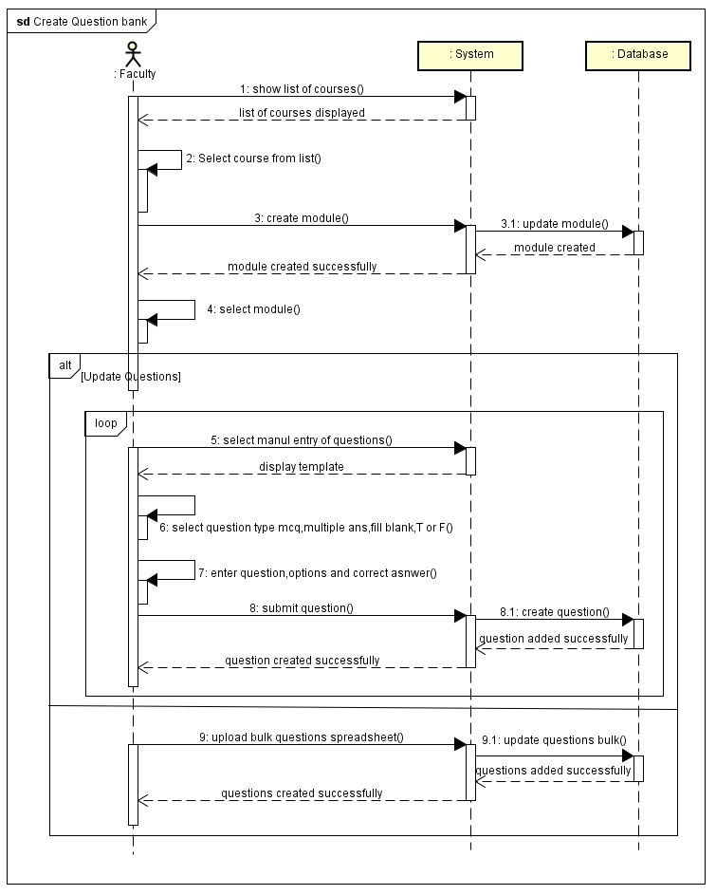
Sequence Diagram – Faculty Create Question Bank

Slide 32
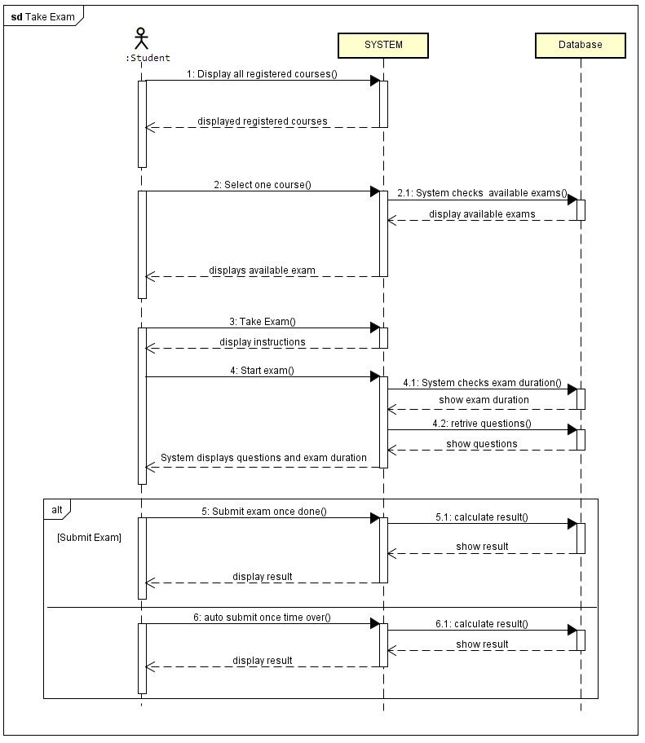
Sequence Diagram – Student Take Exam

Slide 33
Introduction
Project Description
Use Case Scenarios & Synthesized Use cases
Class Diagram
Task Analysis
Sequence Diagrams
Activity Diagrams
Summary

Slide 34
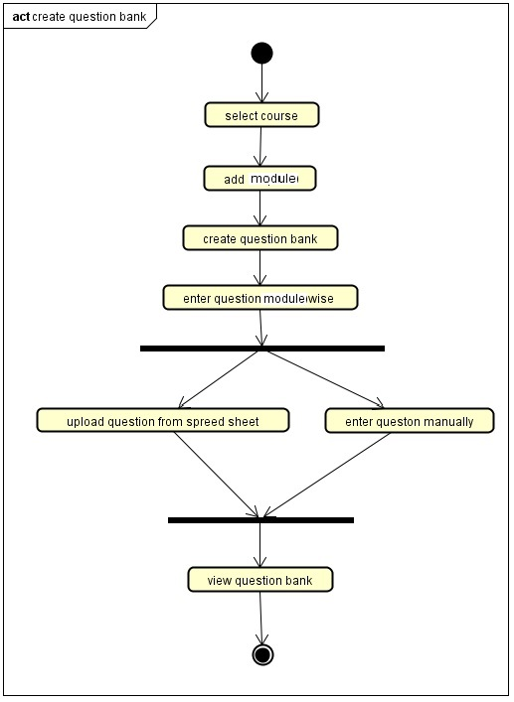
Activity Diagram – Student Create Question Bank

Slide 35
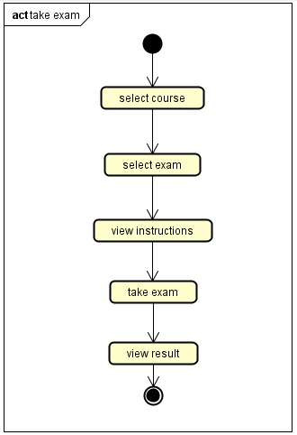
Activity Diagram – Student Take Exam

Slide 36
Introduction
Project Description
Use Case Scenarios & Synthesized Use cases
Class Diagram
Task Analysis
Sequence Diagrams
Activity Diagrams
Summary

Slide 37
Summary
This web application provides facility to conduct online examination worldwide.
It saves time as it allows number of students to take exam at a time and displays the results as the test complete. Results are automatically generated by the server.
Administrator is provided with privileges of managing all faculty user accounts.
Faculty have a privilege to create, modify and delete the test and its particular questions.
Student can register, login and give the test with his specific id, and can see the result immediately.

