Slide 1
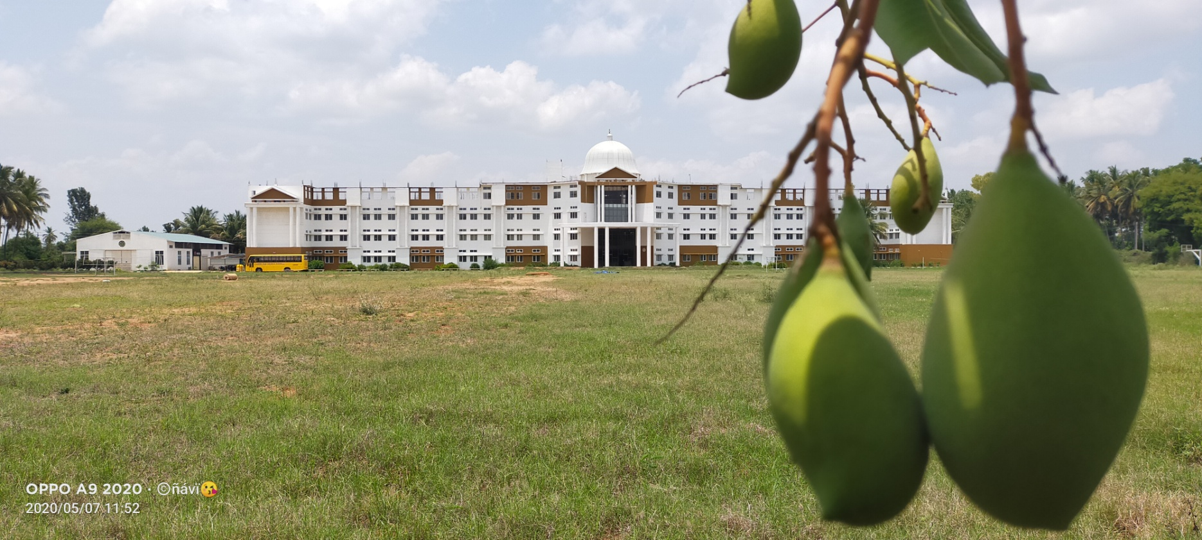


Maharaja Institute of Technology
Thandavapura
Guided by
Dr. Srinivasa M G
Associate Professor
Dept of ECE
MIT, Thandavapura
SKIN CANCER DETECTION USING DIGITAL IMAGE PROCESSSING
Team Members
17ECP78 Project Work
Deekshitha K J:4MN17EC009
Karthik P R:4MN17EC012
Kavya N:4MN17EC013
Nagarathna P:4MN18EC403
Dept of ECE
MIT, Thandavapura

Slide 2
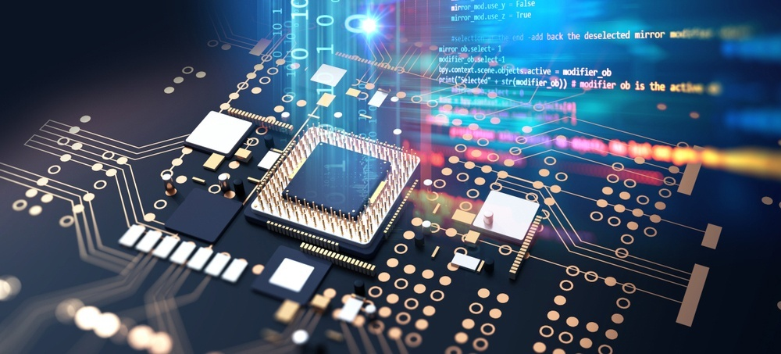
Contents
Abstract
Introduction
Literature survey
Block diagram
Specification
Problem statement
Proposed work
Proposed algorithm

Slide 3

Abstract
Human cancer is one of the most dangerous disease which is mainly caused by genetic instability of multiple molecular alterations.
Among many forms of human cancer, skin cancer is the most common one.
To identify skin cancer at an early stage we will study and analyze them through various techniques named as segmentation and feature extraction.
In this, lesion characterization i.e, first the Image Acquisition Technique, pre-processing, segmentation, define feature for skin feature selection determines lesion characterization, classification methods.
In the Feature extraction by digital image processing method includes, symmetry detection, Border Detection, color, and diameter detection and also we used LBP for extract the texture based features.

Slide 4

Introduction
Skin is largest part of our organ and plays as vital a role in maintaining our lives.
Cancer is abnormal division of cells without control and can invade near by tissue.
The abnormal growth of skin cells is known as skin cancer.
The types of skin cells are:Melanoma cell
Basal cell
Squamous cell
In the world, many people each year die from skin cancer, and the statistic is raising steadily each year .(Squamous:20,000, Melanoma : square of squamous, Basal:15,000)s
If skin cancer is detected early, the mortality is low.
Dermatologists have been trying methods to aid in the detection of the rapid growing skin cancer threat.

Slide 5
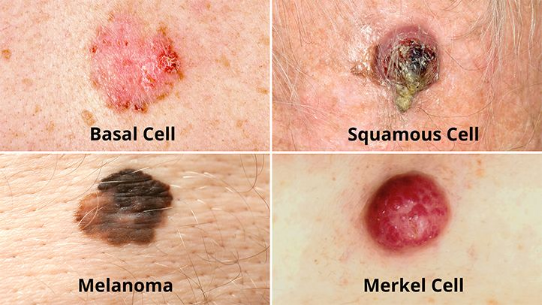
Introduction
Type of skin cancer image :-

Slide 6
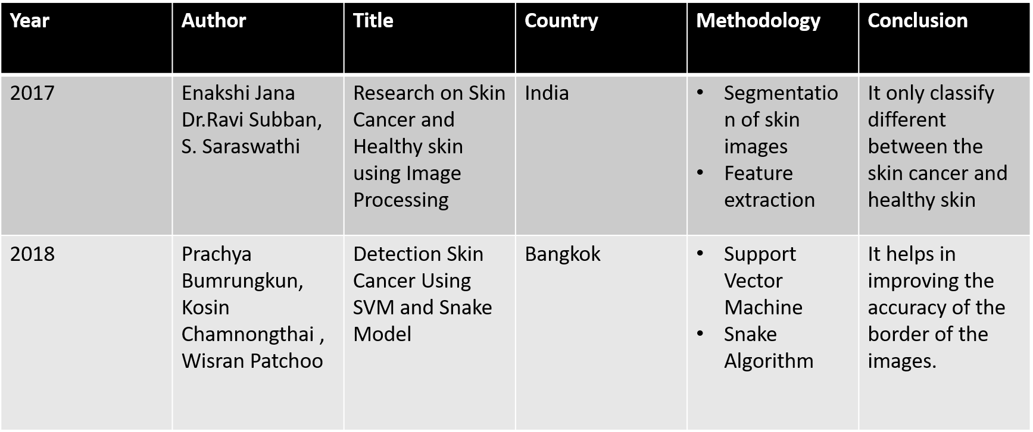
Literature Survey

Slide 7
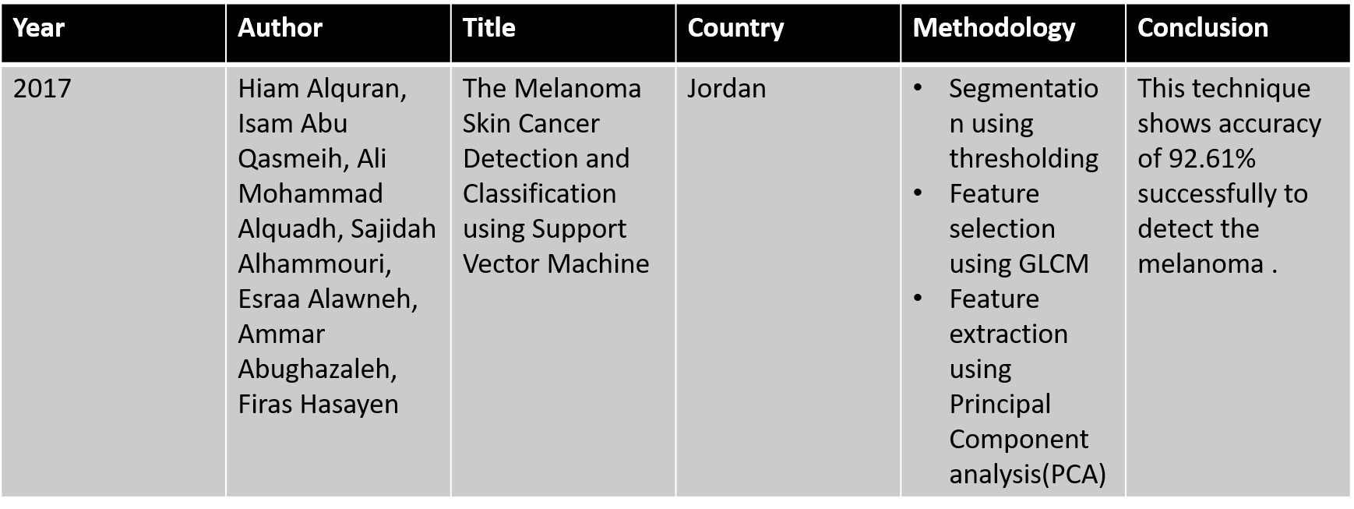
Literature Survey

Slide 8
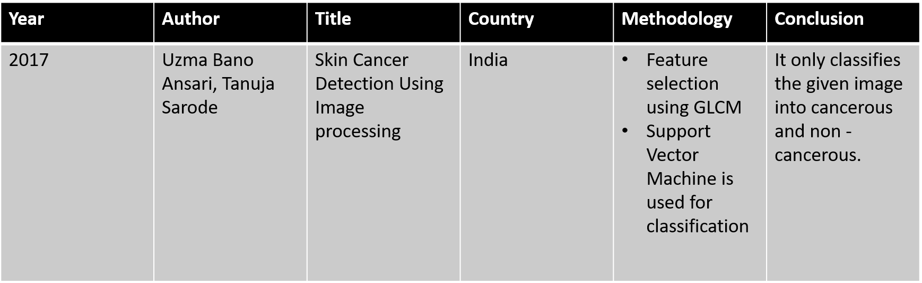
Literature Survey

Slide 9
Input image
RGB2HSV
GLCM
Features
Threshold Segmentation
ABCD
Parameters
Combined Features
Database
Features
Extraction
SVM
Benign
Melanoma/Basal cell/Squamous cell carcinoma
Block diagram for Skin Cancer detection

Slide 10
Workflow diagram
Image Acquisition
Image Preprocessing
Image Segmentation
Feature Extraction
Image Classification

Slide 11
Specification
MATLAB-R2016a
Collect the input data as a image from the user and perform pre-processing on the given image to detect skin cancer.
To identify and extract features like benign and texture of the skin.
To develop a efficient algorithm to detect and classify the different types of skin cancer.

Slide 12
Problem Statement
Skin cancer is one of the dangerous disease among the different types of cancer.
It effects human being like burning sensation on the skin , freckles , skin redness easily or becomes painful when the radiation of the sun radiated on the skin.
Solution:
So presently, it affects more to humans and difficulty to find early hence, we using skin cancer detection using MATLAB based on Image processing.
This paper focused on detection system has been designed for diagnosing skin cancer in early stages by using digital image processing techniques.
It has many steps like pre-processing, segmentation, feature extraction and detection process which give the acceptable results for skin cancer detection problem.

Slide 13
Proposed work
We have to collect some skin cancer images and normal skin images from renowned resources.
It goes under some pre-processing techniques, segmentation, feature extraction etc.,
All these features are given to SVM to classify cancerous and non-cancerous image.
If the cancerous image is found then it shows which type of skin cancer like Melanoma/Basal cell/Squamous cell carcinoma
At last, it shows the type of skin cancer.
We are adding Asymmetry , Border structure, Color variation and Diameter of leison (ABCD) parameter for more edge detection it helps in classification of different types of cancer via SVM algorithm

Slide 14
Proposed Alogrithms
We are using Support Vector Machine algorithm for this project.
The reason we have choosen SVM over other algorithm is because of its accuracy , sensitivity and specificity.
SVM provide 95.4% of sensitivity ,89.3% of specificity and 96.8% of accuracy.
Where as the other popular algorithms like Back Propagation Neural Network(BPN),Artificial Neural Network(ANN) and Convolutional Neural Network(CNN) do not have that much accuracy , sensitivity and specificity.

Slide 15
Proposed Alogrithms
Algorithm | Specificity | Sensitivity | Accuracy
Artificial Neural Network(ANN) | 78% | 56% - 66% | 80% - 85%
Back Propagation Neural Network(BPN) | 70% | 60% | 88%
Convolution Neural Network(CNN) | 80% | 81% | 91%
Support Vector Machine(SVM) | 89.3% | 95.4% | 96.8%

Slide 16
JPEG
JPEG : Joint Photographic Experts Group
It’s a standard image format for containing lossy and compressed image data .
Huge reduction in file size JPEG image maintain reasonable image quality .
JPEG , a joint working group of International Standardization Organization (ISO) and International Electrotechnical Commission(IEC).
It is used most often with its file name extension .jpg or jpeg .

Slide 17
It can reduce up to 5% of the actual size with the loss of some information .
It supports a maximum image size of 65535*65535 pixels .
It can be converted to many formats .
Mostly used extensions for JPEG format is : .jpeg, .jpg, .jpe , .jif , .jfif .
The data format is independent from resolution , image contents and aspect ratio .
It compressed into either full-color or grayscale images.
In color images , RGB is transformed into a luminance or chrominance color space .

Slide 18
JPEG vs other Image format
Some of the Image format are given below:
PNG-Portable Network Graphics
GIF-Graphics Interchange Format
TIF-Tagged Image File
PSD-Photoshop Document
PDF-Portable Document Format
EPS-Encapsulated Postscript
AI-Abode Illustrator Document

Slide 19
INDD-Abode Indesign Document
RAW-Raw Image Formats
Comparison
PNG:
It uses lossless compression algorithm.
Image size is large due to lossless compression algorithm.
Supports transparency in the images.
Used in image creation.

Slide 20
GIF:
It uses lossless compression algorithm.
It supports only 256 colors.
Supports single bit transparency in the images.
used in computer generated images and logos.
TIF
TIF files can have a bit depth of either 16-bits per channel or 8-bits per channel, and multiple layered images can be stored in a single TIF file.

Slide 21
TIF files are much larger than JPEGs making them harder to upload or email .
Not supported by most photo sharing websites but is supported by most software .
PSD
Document format for Photoshop.
Can not viewed in a lot of applications.
It supports layers.
Not supported by gadgets.

Slide 22
PDF:
Suitable for printing.
Image quality is high.
Sending texts, images, 3D objects, digital signatures, encryption and other data formats.
RAW:
RAW files are unprocessed and un-compressed data files that contain all of the “image information” available to the camera sensor.

Slide 23
SVM Algorithm
SVM algorithm is invented by Vlamidir Vapnik in 1992 at AT &T Bell Laboratories.
A support-vector machine constructs a hyperplane or set of hyperplanes in a high or infinite dimensional space , which can be used for classification ,regression or other tasks like outliers detection.
SVM based classification is slow , the result , is however highly accurate.
SVM is less prone to over fitting than other methods. It also facilitates compact model for classification.

Slide 24
SVM Algorithm
In SVM algorithm there are two types of model:-
Linear SVM
Non Linear SVM
Figure 1 shows the Linear SVM graph.
Figure 2 shows the Non Linear graph.
Mathematical equation of a plane in 2-D space
W0 + W1X1+W2X2 = 0

Slide 25
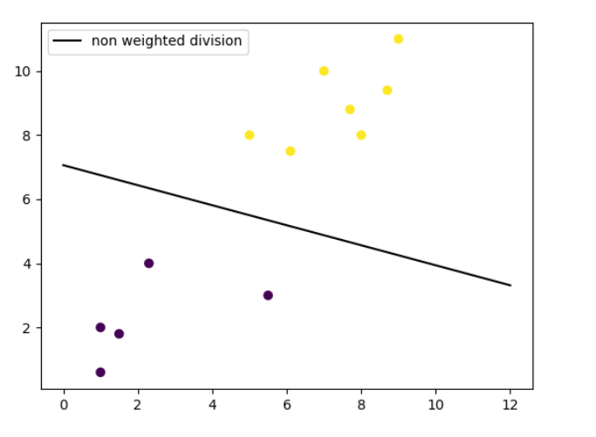
SVM Algorithm
Figure 1 Linear SVM

Slide 26
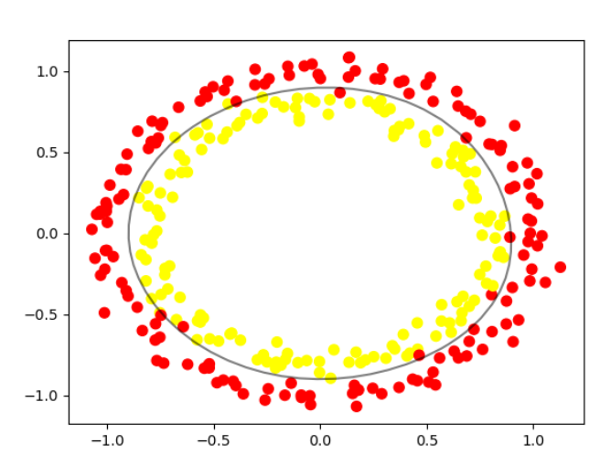
SVM Algorithm
Figure 2 Non Linear SVM

Slide 27
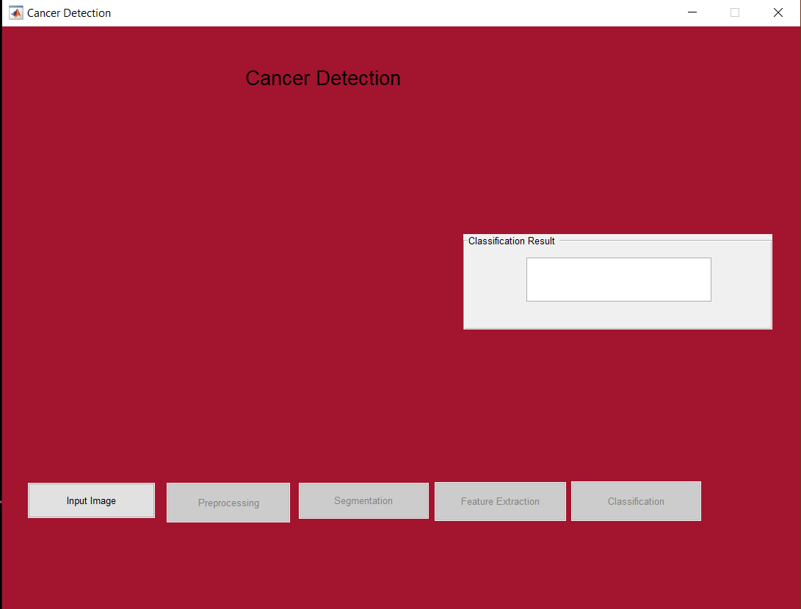
Project Screenshot
Step – 1:

Slide 28
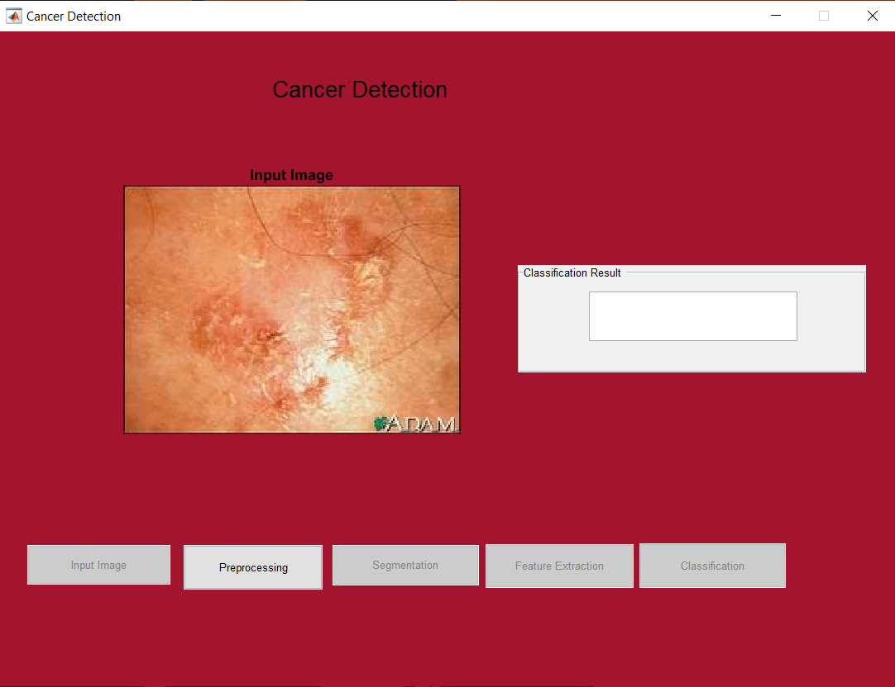
Project Screenshot
Step - 2

Slide 29
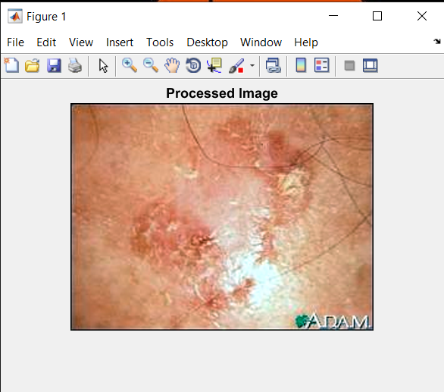
Project Screenshot
Step - 3

Slide 30
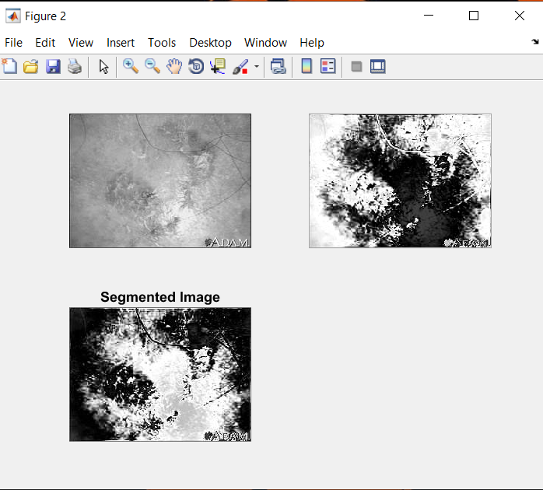
Project Screenshot
Step - 4

Slide 31
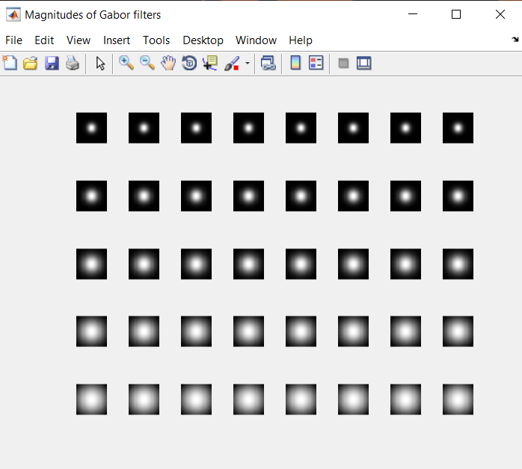
Project Screenshot
Step - 5

Slide 32
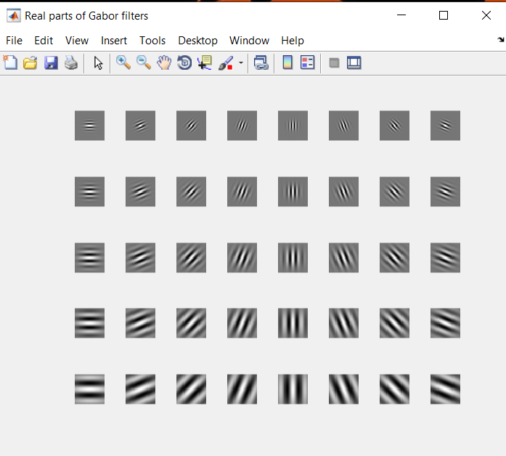
Project Screenshot
Step - 5

Slide 33
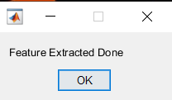
Project Screenshot
Step - 5

Slide 34
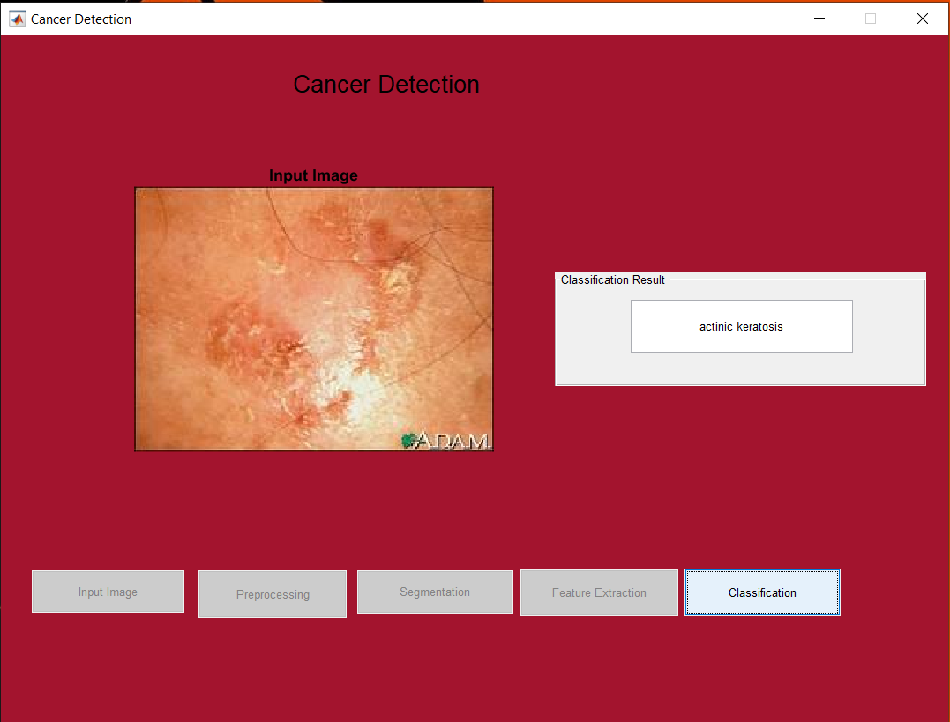
Project Screenshot
Step - 6

Slide 35
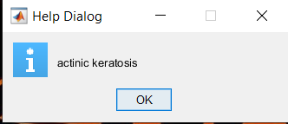
Project Screenshot
Step - 6

Slide 36
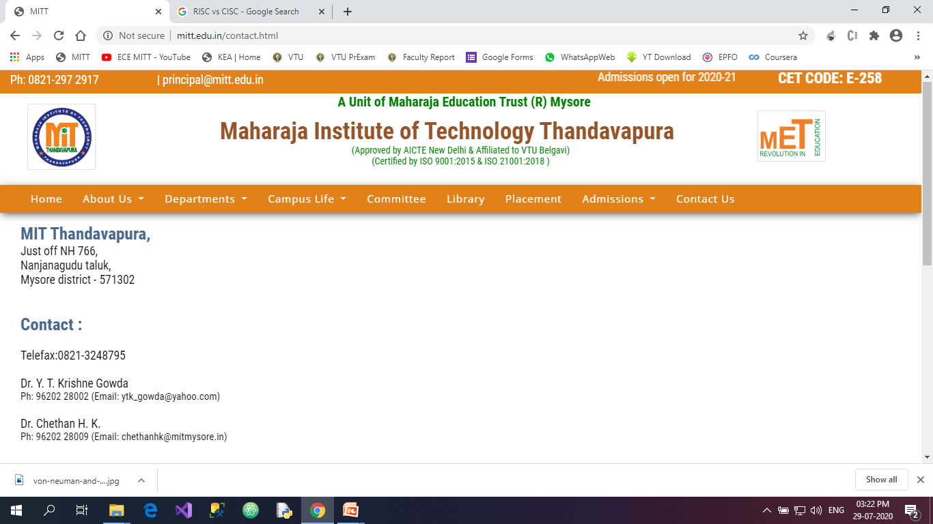

Just off NH 766, Nanjanagudu taluk, Mysore district - 571302
Thank You!
Department of Electronics & Communication Engineering

