Slide 1

Tandem Code
Karthik 2021.10.07
AMLL

Slide 2
Overview
Goal: train tandem model on sine wave dataset
Backwards model
Boundary loss
Without hyperparameter exploration, seem to have obtained expected results
Used hyperparameters specified in NA paper, for others relied on saved model in Ben’s git repo

Slide 3
Model
Code based on NN code I had for gradient ascent
Forward model
2 inputs, 4 layers of 500 nodes, 1 output
Backward model
2 inputs, 4 layers of 500 nodes, 1 output

Slide 4
Model
Code based on NN code I had for gradient ascent
Forward model (g -> s)
2 inputs, 4 layers of 500 nodes, 1 output
Backward model (s -> g)
2 inputs, 4 layers of 500 nodes, 1 output
Train forward model, then set forward to eval and train backward model
500 epochs

Slide 5
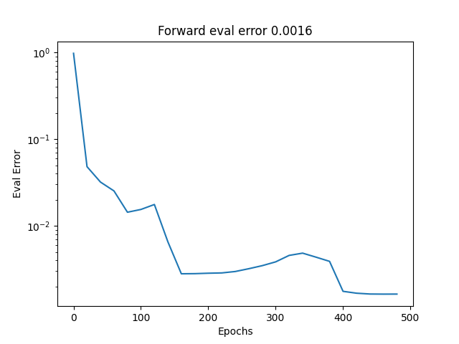
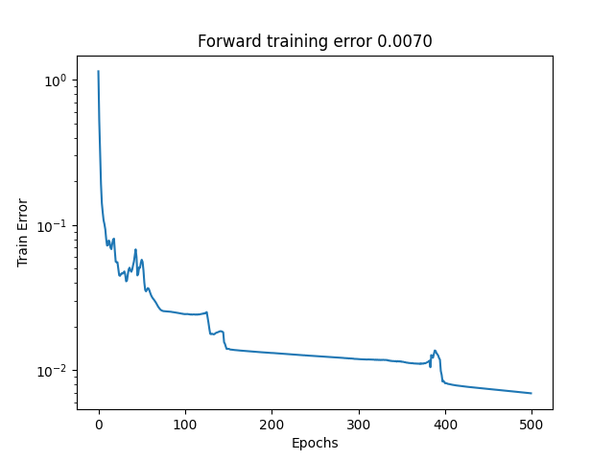
Results – forward model
Forward model converges as expected; mean eval error of 0.0019 across 3 trials

Slide 6
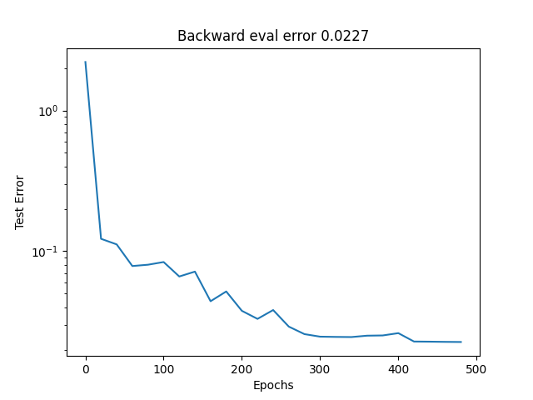
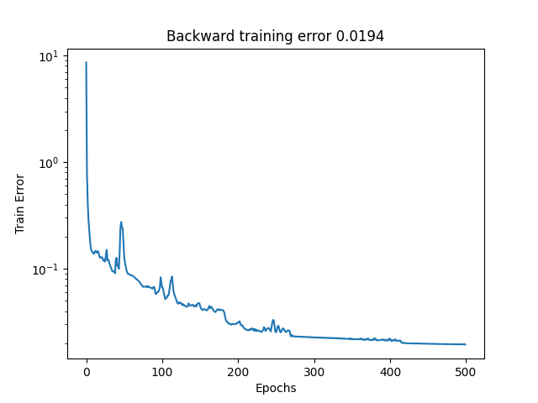
Results – backward model
Backward model also converges; average eval error of 0.028 across 3 trials in comparison to 0.012 in the NA paper
Difference could be due to mild code differences, random error, or random differences in each run

Slide 7
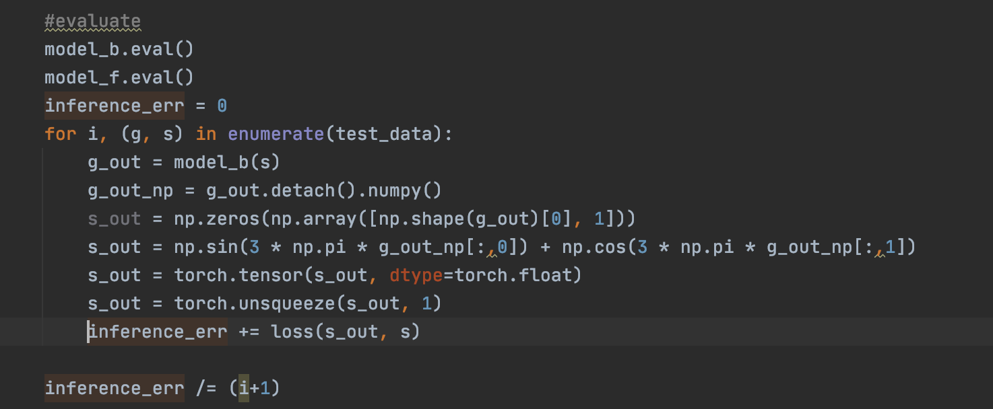
Inference Step
Used simulator to add single inference step across test data
Arrived at mean of 0.0247007168
Implementation to right (and on Github), unsure if correct

Slide 8
Questions
First two steps of tandem model are clear
Train model_f
Set model_f to eval, train model_b
Unsure how to differentiate third step of only training model_f – how do I calculate the loss here using a real simulator as opposed to model_f?
Checked Ben’s code and don’t see this step either in his repo – am I missing something? Did I finish this properly?

Slide 9
Next steps
Assuming these results look correct, would imagine 3 possible next steps
Train on a more complex dataset
Work on NA implementation
Work on mixture manifold model
Would imagine I’d work on either 1 or 3 – model description that Jordan sent seems like a logical extension of existing code
Code at github.com/karthikr13/Tandem

