Slide 1

Independent Study Update: MMTN Week 3
Karthik 2021.11.05
AMLL

Slide 2
Overview
More geometry visualization
More sweeps

Slide 3
Geometry Exploration (I/III)
Big question from last week: saw MSE spike for model 2’s predictions near jump points – what is causing this?
Does a single model’s learned manifold intersect with itself (it should not be)

Slide 4
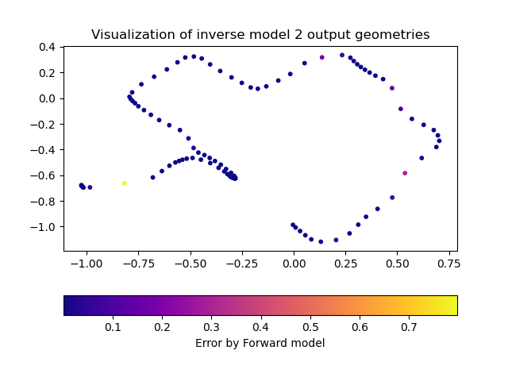
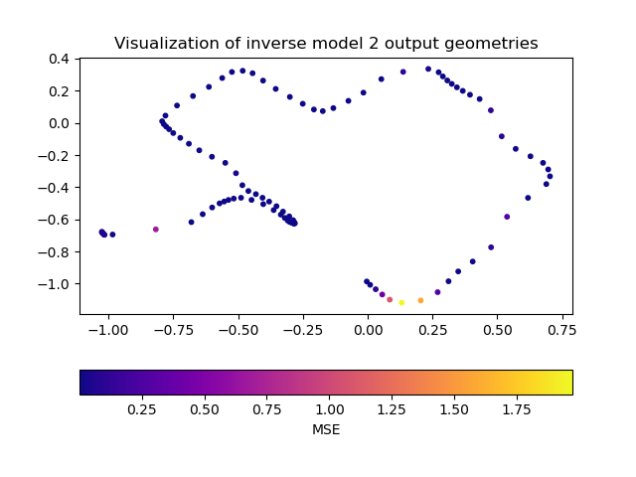
Geometry Exploration (II/III)
Seems like the error is not necessarily centered around jumps on the graph with the simulator but that pattern does seem to exist on the left graph
Most error on the right graph is not caught by forward model; both observations suggest we need to train forward model on larger dataset
Have the larger dataset ready and wanted to confirm this path before starting – what hyperparameters? How much bigger?

Slide 5
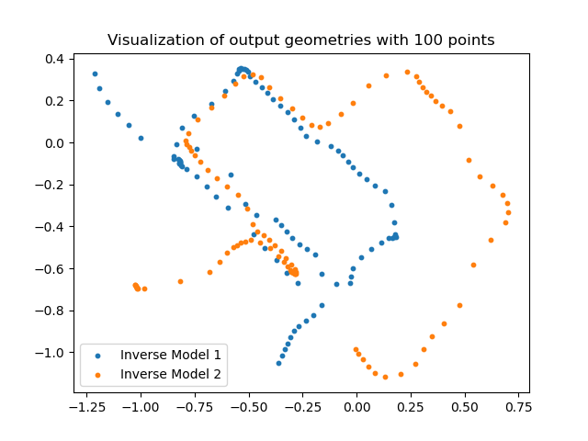
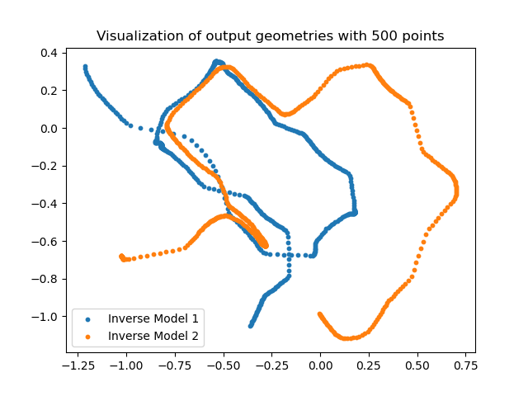
Geometry Exploration (III/III)
When I zoom really closely into the 500 points visualization it seems like the manifold isn’t perfectly crossing itself – it’s coming close but not perfectly touching existing points
Unsure how to further investigate this

Slide 6
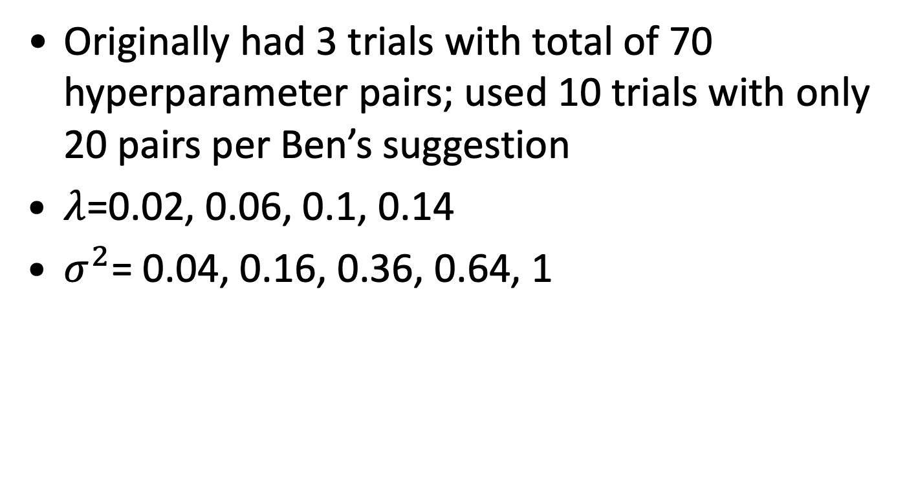
Hyperparameter sweep
Originally had 3 trials with total of 70 hyperparameter pairs; used 10 trials with only 20 pairs per Ben’s suggestion
$λ$=0.02, 0.06, 0.1, 0.14
$σ^{2}$= 0.04, 0.16, 0.36, 0.64, 1

Slide 7
Hypersweep results
Heatmap of the lowest error across 10 trials for each pair, per Ben’s suggestion
Seems like bottom left (low lambda, high sigma squared) works best
Not sure how confident I am in this – last week’s results suggested top left would be best
But, it is clear that low lambda is definitely key
Proposed next step: rerun on lambda = 0.02 and 0.06 with the full set of sigma squared values I originally used (0.01 through 1)

Slide 8
Next Steps
Immediate next steps outlined in previous slides
Generating new data to train inverse models with? (discussed last week)
Want to start thinking about adding annealing to repulsion term as well

