Slide 1

Independent Study Update: MMTN Week 6.5
Karthik 2021.11.22
AMLL

Slide 2
Overview
More trials building on last week’s 3 trials
Next step – lambda = 0 with different dataset

Slide 3
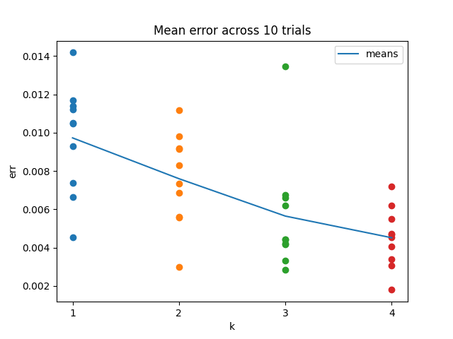
Multiple values of k
10 trials for k = 1, 2, 3, 4 inverse models
Mean error clearly goes down in expected pattern – diminishing return
Fairly noisy still

Slide 4
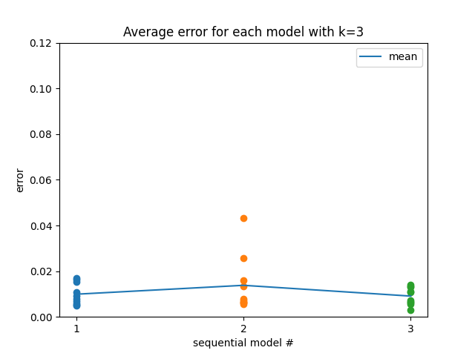
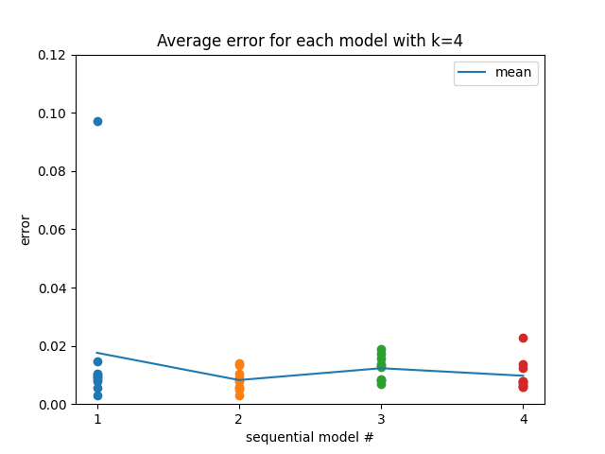
Multiple values of k
Was curious to see if each subsequent model’s inference error in a given set was increasing due to being pushed away from existing models
Doesn’t appear to be the case – seems like a good thing?

