Slide 1

Independent Study Update: MMTN Week 6.5 part 2
Karthik 2021.11.23
AMLL

Slide 2
Overview
More trials building on last week’s 3 trials
Lambda = 0 on robot arm dataset

Slide 3
Sine Wave: Multiple values of k (I/II)
10 trials for k = 1, 2, 3, 4 inverse models
Mean error clearly goes down in expected pattern – diminishing return
Fairly noisy still

Slide 4
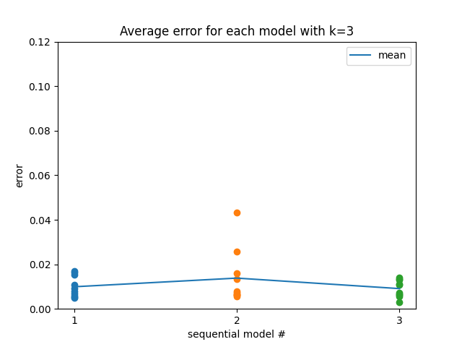
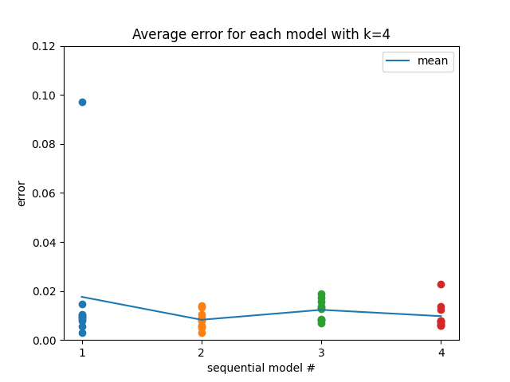
Sine Wave: Multiple values of k (II/II)
Was curious to see if each subsequent model’s inference error in a given set was increasing due to being pushed away from existing models
Doesn’t appear to be the case – seems like a good thing?

Slide 5
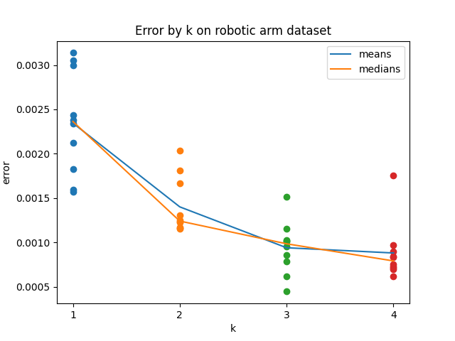
Robot: Multiple values of k (I/II)
10 trials for k = 1, 2, 3, 4 inverse models
Mean error clearly goes down in expected pattern – diminishing return (more dramatic flattening for k=4 than sine wave)

Slide 6
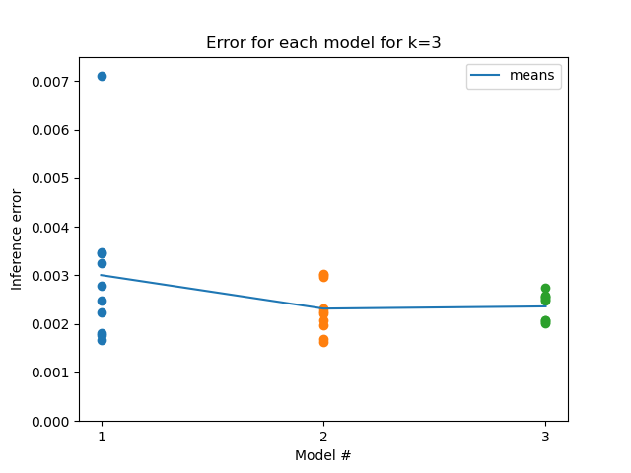
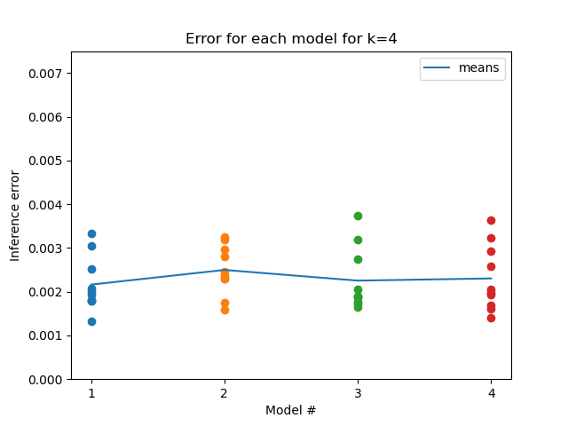
Robot: Multiple values of k (II/II)
Individual losses across each model within the k=3/4 set seem fairly consistent (this is a pretty useless graph given there’s no repulsion term here, so there’s no reason for losses to differ significantly)

Slide 7
Next steps
No clue how to visualize geometries on the new dataset
Repeat on ballistics dataset?
Unsure what to do about noise

