Slide 1

Independent Study Update: MMTN
Karthik 2021.12.17
AMLL

Slide 2
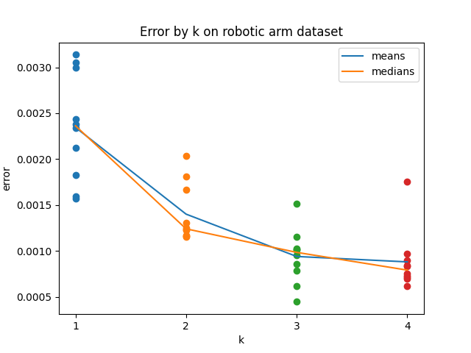
Robot: Multiple values of k (I/II)
10 trials for k = 1, 2, 3, 4 inverse models
Mean error clearly goes down in expected pattern

Slide 3
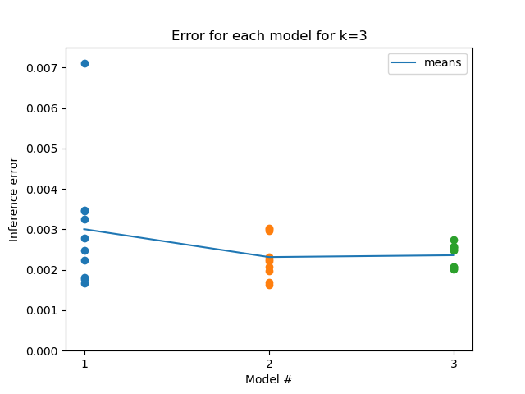
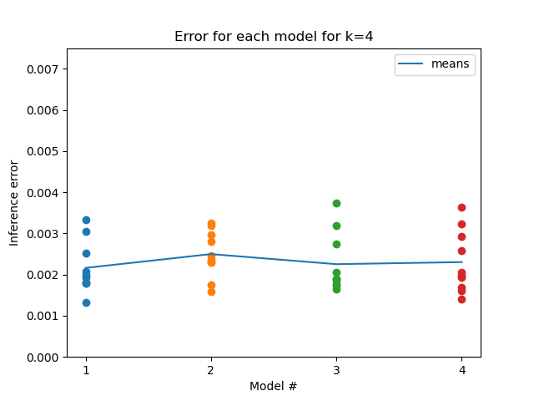
Robot: Multiple values of k (II/II)
Error for individual models is between 0.001 and 0.004 consistently; Ben achieved loss on order of 10^-4, unsure how to improve further (believe I’m using similar hyperparameters)

Slide 4
Robot with repulsion term (I/II)
lambda = 0.02, sigma squared = 0.04
Error ends up being higher than with no repulsion term – doing worse?
Need to investigate if
Bug
Bad hyperparameters

Slide 5
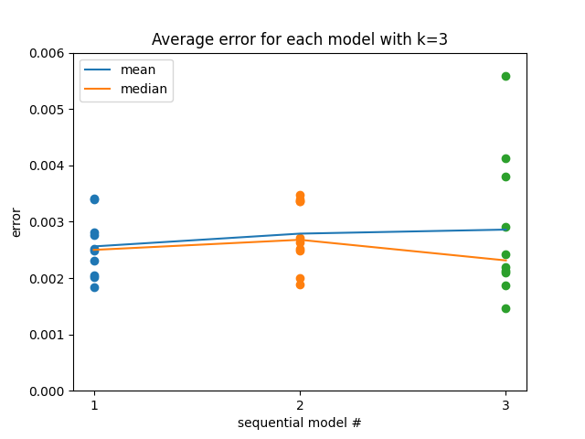
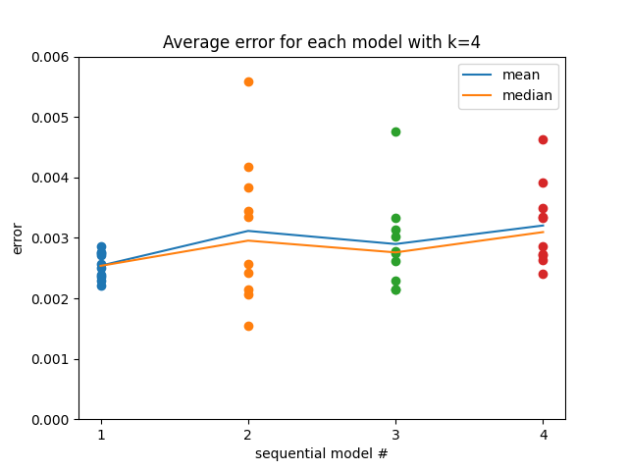
Robot with repulsion term (II/II)
Error clearly increasing for each subsequent model but not sure how significant this increase is

Slide 6
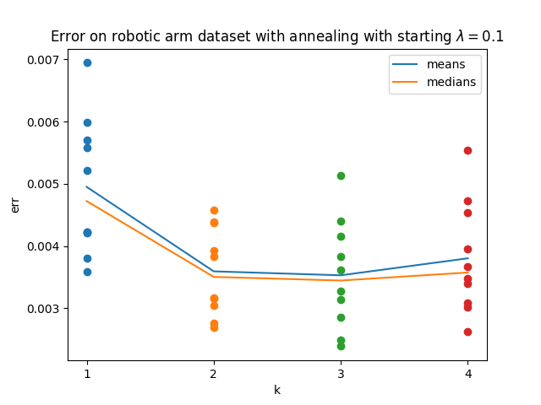
Robot with annealing (I/II)
Started lambda = 0.1, sigma squared = 0.04, repulsion term multiplied by (500-epoch)/500
Does a lot worse
Pretty sure starting lambda = 0.1 makes it do a lot worse – area to explore

Slide 7
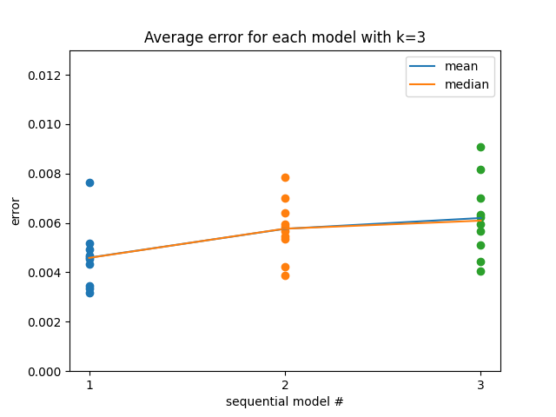
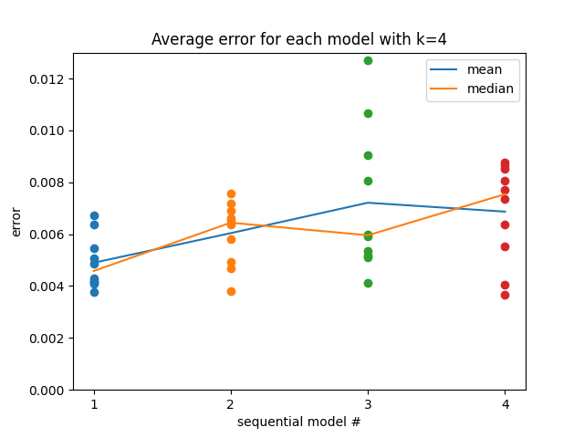
Robot with annealing (II/II)
Error clearly increasing for each subsequent model again

Slide 8
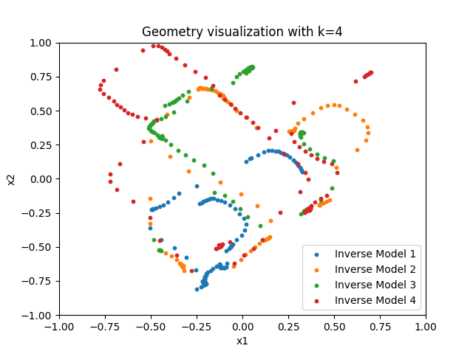
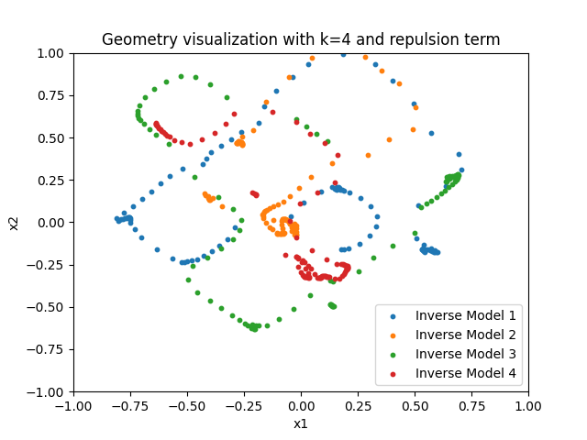
Sine wave
Left is with no repulsion; right is with repulsion

Slide 9
Next steps
New dataset?
Severity of difference in robotic arm performance?
Generate data using forward model to train backwards models
How do I actually do this – random number generation over some x range? If so, what range?
Bigger hypersweep to better see if repulsion term is actually making things worse

