Slide 1


RNS INSTITUTE OF TECHNOLOGY
BENGALURU - 98
DEPARTMENT OF INFORMATION SCIENCE & ENGINEERING
Presentation on Internship
Heart Failure Analysis
Team members:
Karthik Raj R USN: 1RN19IS068
M Balakrishna Kamath
USN: 1RN19IS074

Slide 2
AGENDA
Abstract
About the Company
Introduction
Literature Survey
Requirements
System Design
Detailed Design
Implementation
Results
Conclusion and Future Enhancements
References

Slide 3
ABSTRACT
Heart failure is a condition in which the heart can't pump enough blood to meet the body's needs. Heart failure does not mean that your heart has stopped or is about to stop working. It means that your heart is not able to pump blood the way it should. It can affect one or both sides of the heart.
In the present age, heart failure is not only common among senior citizens but also amongst the younger and middle age group.
Unhealthy lifestyle and prolonged medical conditions such as smoking, elevated Blood Pressure, Anaemia, Diabetes and so on.
The analysis done through various models can warn the medical officials about the likeliness of a heart failure based on their report.

Slide 4
ABOUT THE COMPANY
NASTECH – New Age Solutions & Technologies
NASTECH is formed with the purpose of bridging the gap between Academia and Industry.
Nastech is one of the leading Global Certification and Training service providers for technical and management programs for educational institutions.
They collaborate with educational institutes to understand their requirements and form a strategy in consultation with all stakeholders to fulfill those by skilling , reskilling and upskilling the students and faculties on new age skills and technologies.
Industry and project oriented student training programs.
Certification programs mapped to Global Certification Exams from Microsoft/EC- Council/Google/AWS/ Adobe).

Slide 5
INTRODUCTION
A better prediction for this disease is one of the key approaches of decreasing its impact. Both linear and machine learning models are used to predict heart failure based on various data as inputs, e.g., clinical features.
The proposed project will help in studying and analysing various models to predict if a person is prone to heart failure or not based on his or her medical report.
The analysis has been done with the help of multiple ML algorithms namely Logistic Regression, K-nearest neighbors, Random forest Regression, Decision tree, SVC to compare and choose the optimum result.

Slide 6
LITERATURE SURVEY
In [1], taking advantage of 299 patients who have cardiac failure in 2015. Those data have 13 features for example high blood pressure, sex, and smoking. The authors utilized some different classifiers of Machine Learning to forecast the proportion of survivors, and rank the features corresponding to the most important risk factors. They find serum creatinine and ejection fraction are the most important factor to forecast the proportion of survivors.
In [2], Senthil Kumar Mohan proposed Effective HeartDisease Prediction Using Hybrid Machine LearningTechniques in which the objective is to findcritical points by applying Machine Learning to initiate exactness in the expectation of cardiovascular malady. The expectation model is createdwith various blends of highlights and a few known arrangement strategies.
We produce an improved exhibitionlevel with a precision level of 88.7% through the prediction model for heart failure with random forest with alinear model (RFLM). They likewise educate aboutDiverse data mining approaches and expectation techniques,Such as, KNN, LR, SVM, and various other approaches have been fairlyfamous of late to distinguish and predict heart failure.

Slide 7
LITERATURE SURVEY
In [3], the authors use some data which are from electronic health record (EHR) and use some models about Machine Learning and Deep Learning. The results show novel machine learning models is possible to change the prediction accuracy of model.
In [4], taking advantage of dataset which is from EHR data and has 26,575 patients who have cardiac failure in 2018. Finally, the results show age of patients, creatinine, body mass index, and levels of blood pressure were significant factors in predicting mortality within one year among heart failure patients.

Slide 8
REQUIREMENTS
HARDWARE REQUIREMENTS
Processor : i5 or ryzen 5 or above
RAM : 512Mb
Hard Disk : 4 GB
Input device : Standard Keyboard and Mouse
Output device : VGA and High Resolution Monitor
SOFTWARE REQUIREMENTS
Operating system : Windows 10
IDE : Jupyter Notebook
Tools/Technologies : Python, Pandas, Sklearn, Streamlit, Seaborn, Matplotlib library

Slide 9
SYSTEM DESIGN
Take the data and create a dataframe
Preprocessing – filtering of data
Data Visualisation
Divide into input & output
Fit the model
Creating a model
Normalise the data
Train & test variables
Predict the output
Evaluating : Accuracy score

Slide 10
SYSTEM DESIGN
Retrieve the data and create a dataframe.
Filtering the data – Datacleaning, encoding, dropping values, missing values.
Data Visualisation – Plotting different graphs to compare the different fields in the dataset.
Divide the dataset into inputs and outputs by selecting the required columns.
Splitting the dataset into train and test set.
Normalise (Scaling) the input data (if required).
Run the classifier/regressor.
Fitting the model ( map inputs with output).
Predict the output.
Evaluation : Accuracy score ( shows how accurate the result of the model is).
10

Slide 11
DETAILED DESIGN
MODELS USED FOR ANALYSIS
Logistic Regression (LR): Logistic regression which is a classification model, and it is often used in dichotomy. Logistic Regression is one of algorithms of ML to solving binary (0 or 1) problems, which is used to estimate the likelihood of some things.
K Nearest Neighbour (KNN): KNN is one of easiest algorithms in data analysis and it is a nonparametric statistical method for classification and regression.
Support Vector Classifier : SVC is one of supervised learning methods, can be widely used in statistical classification and regression analysis. SVM belongs to generalized linear classifiers, which are characterized by their ability to minimize empirical error and maximize geometric edge region at the same time.
Decision Tree (DT): Decision Tree is a tree structure which is binary or non-binary. Each non-leaf node represents a test on a feature attribute, each branch represents the output of this feature attribute on a range of values, and each leaf node stores a category.
Random Forest (RF): Random forest is a classifier which includes a lot decision trees, and its class of output is decided by mode of class of outputs of individual trees.
11

Slide 12
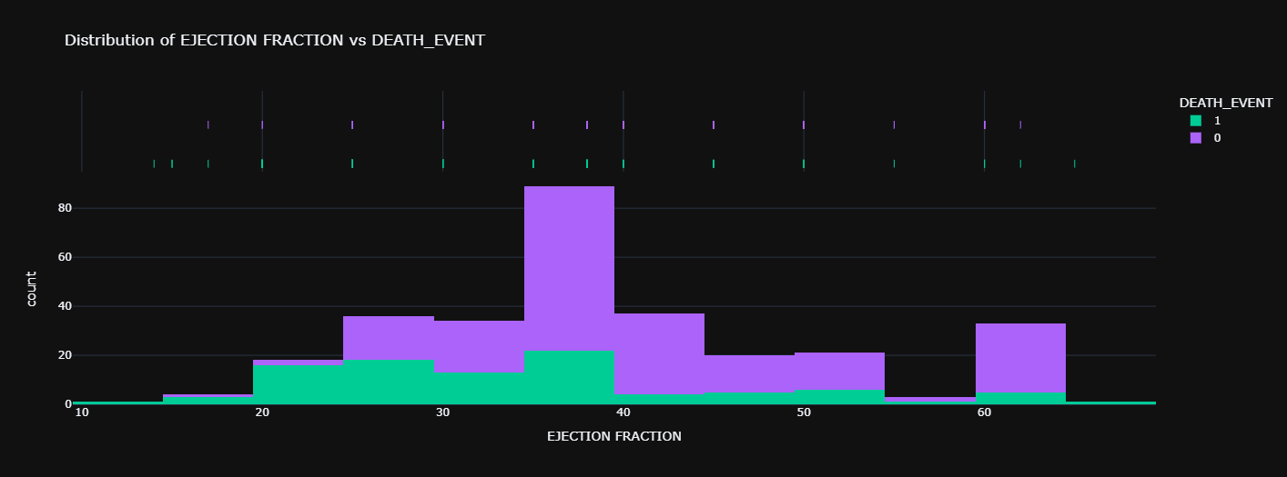
IMPLEMENTATION
Creation of data frame
dataset = pd.read_csv('/content/heart_failure_clinical_records_dataset.csv’)
Preprocessing – filtering of data
dataset = dataset[dataset['ejection_fraction']<70]
Data visualization

Slide 13
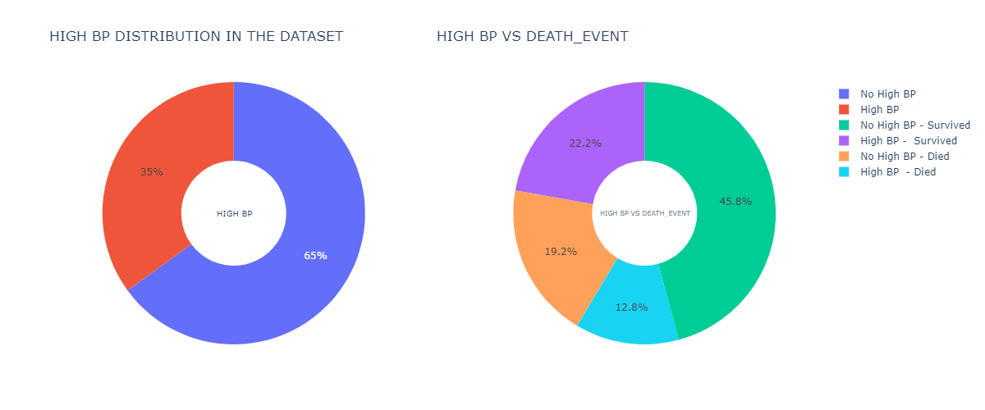
Divide into input and output
x = dataset.iloc[:, [4,7,11]].values
y = dataset.iloc[:,-1].values
Splitting the dataset into train and test sets
from sklearn.model_selection import train_test_split
x_train, x_test, y_train, y_test = train_test_split(x, y, test_size = 0.2, random_state =0)

Slide 14
Normalising the inputs (Scaling for KNN & SVC)
from sklearn.preprocessing import StandardScaler
sc = StandardScaler()
X_train1 = sc.fit_transform(x_train)
X_test1 = sc.transform(x_test)
Creating the models
clf = LogisticRegression()
clf = KNeighborsClassifier(n_neighbors=params['K'], metric='minkowski')
clf = SVC(C=params['C'],random_state=0, kernel = 'rbf’)
clf = DecisionTreeClassifier(max_leaf_nodes = params['M’],
random_state=0, criterion='entropy’)
clf = RandomForestClassifier(n_estimators = params['E'], criterion='entropy’,
random_state=0)
Fit the model
clf.fit(X_train, y_train) //Logistic, Decision Tree, Random Forest clf.fit(X_train1, y_train) //KNN & SVC
Predict the output
y_pred=clf.predict(x_test) //Logistic, Decision Tree, Random Forest
y_pred=clf.predict(x_test1) //KNN & SVC
print(y_pred)

Slide 15
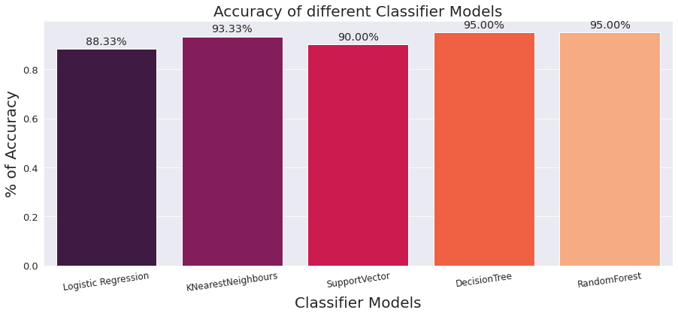
Evaluation : Accuracy Score of all models
res=[]
for all models:
acc = accuracy_score(y_test, y_pred)
res.append(acc)

Slide 16
RESULTS
The below conclusions can be made from the accuracy score graph:
The accuracy of Logistic Regression is 88.33%.
The accuracy of K-Nearest Neighbors is 93.33%.
The accuracy of Support Vector Classifier is 90%.
The accuracy of Decision Tree is 95%.
The accuracy of Random Forest Regression is 95%.
It can be observed that Random forest and Decision tree gives the best accuracy score amongst
all the tested models.
The UI implemented using Streamlit is show in the diagram below.

Slide 17
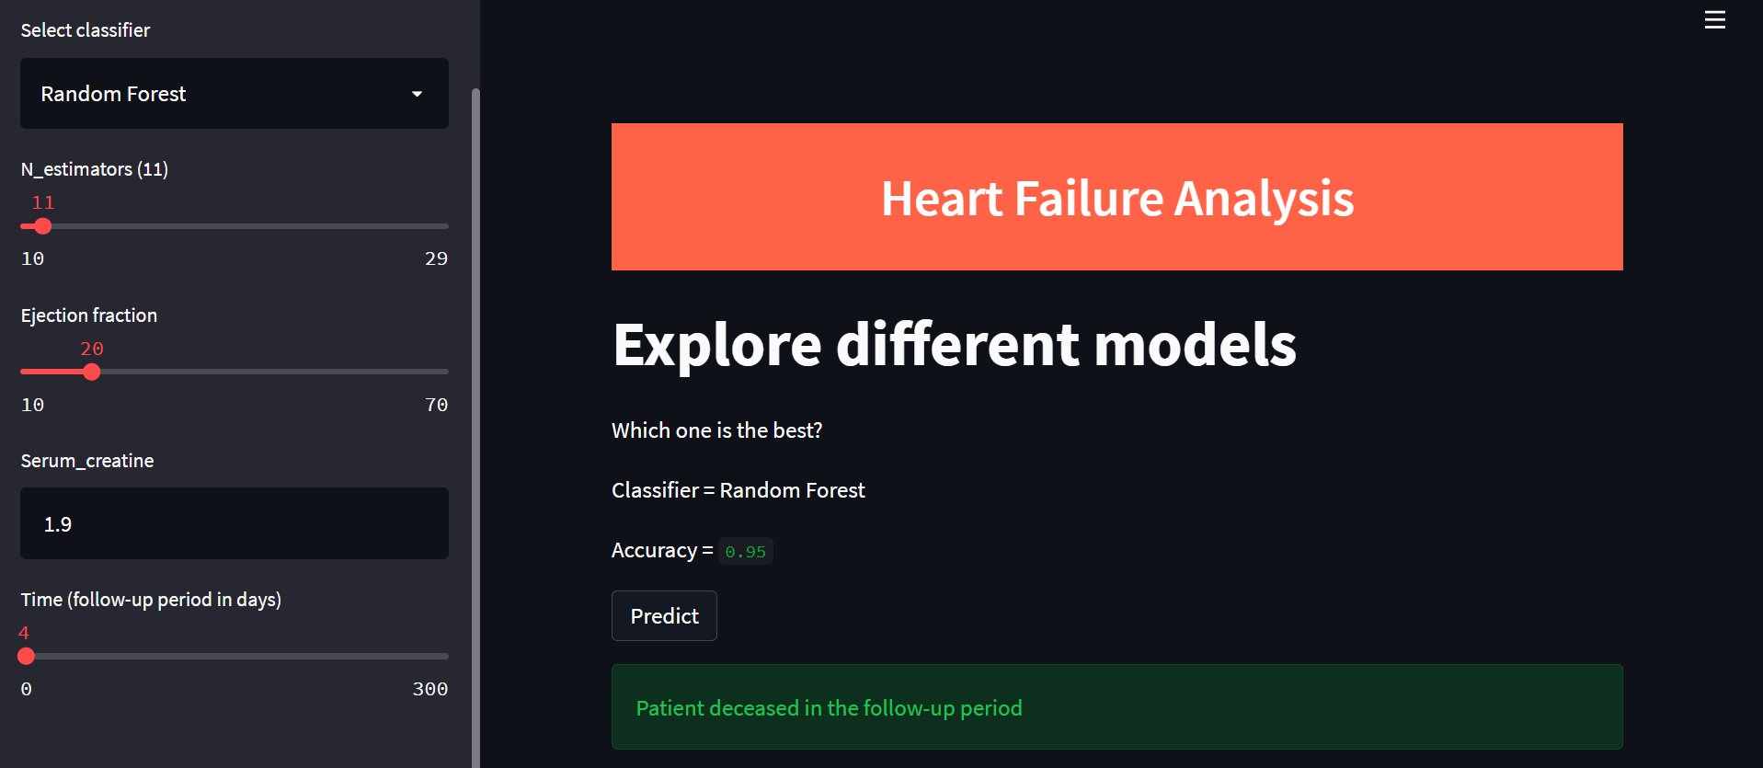
RESULTS

Slide 18
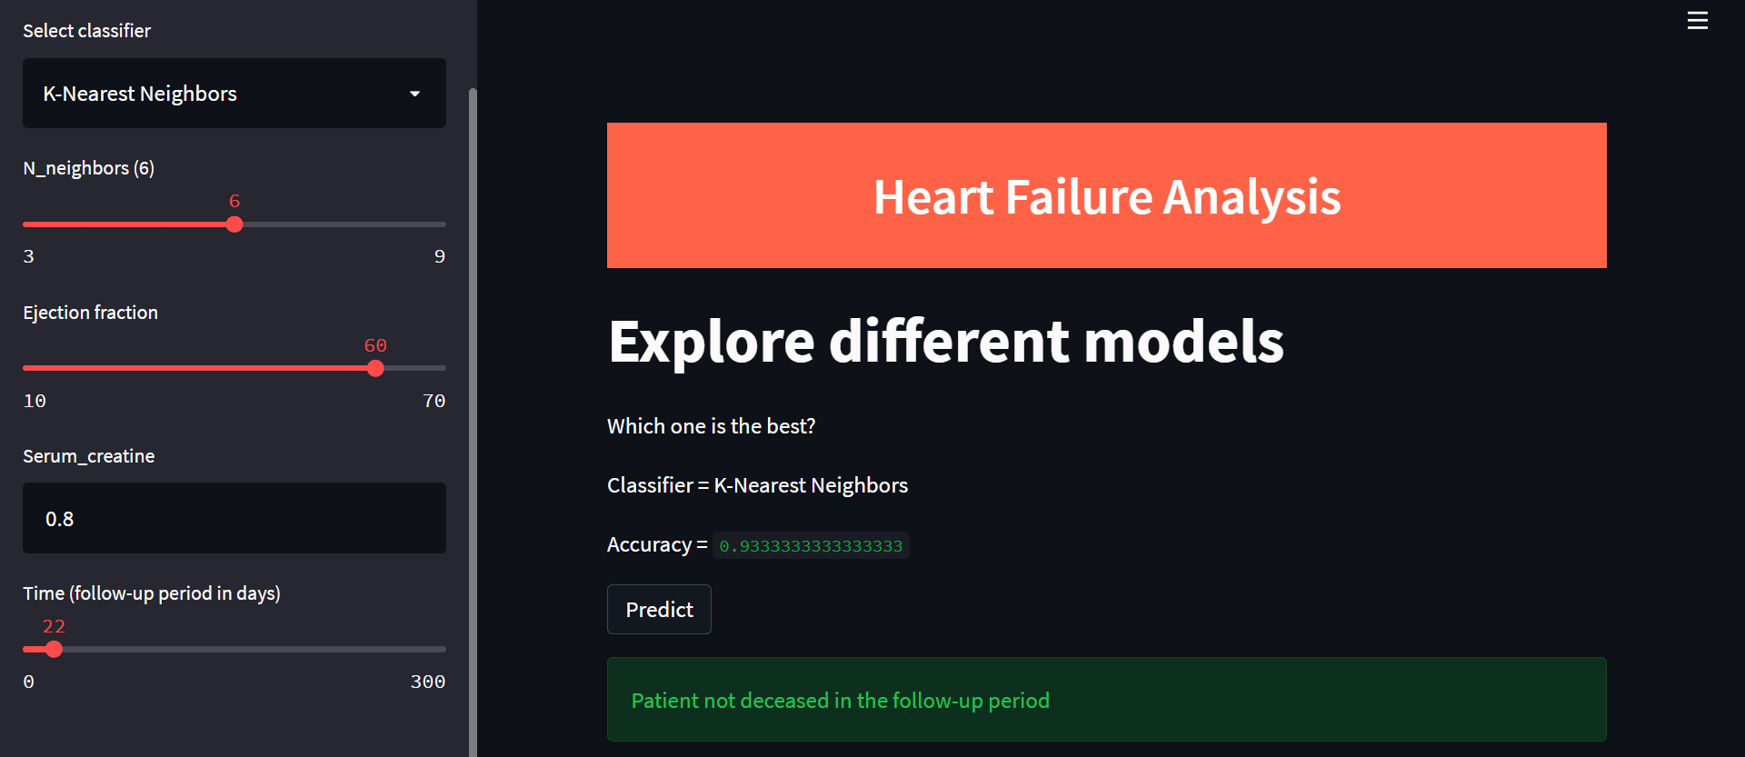
RESULTS

Slide 19
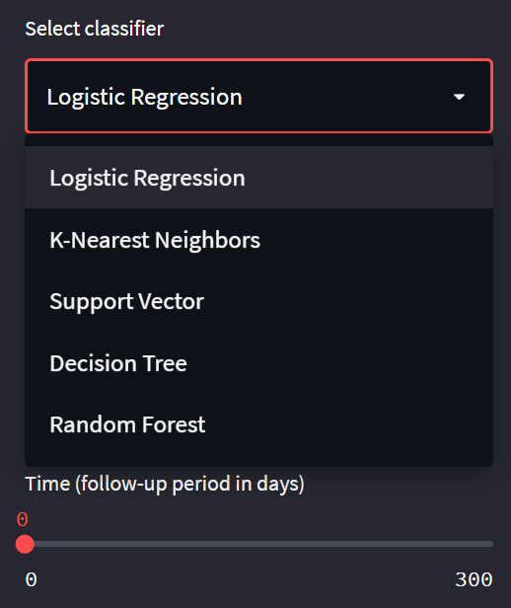
RESULTS
Select classifier provides a drop down list from which we can choose a desired model to predict the likeliness of a heart failure occurring during the follow-up period.
Based the selected model we get the appropriate input parameters to provide for the prediction.
We get the accuracy score of the selected model and its prediction (deceased or not deceased).

Slide 20
CONCLUSION
Given the present scenario where heart failures are becoming common, the project was an attempt to create a prediction system for the same.
To increase the exactness of the result, different models have been used for thorough analysis and prediction.
The system has 2 models that give an accuracy score of 95% but the other models give a considerable score as well.
Medical science will be helped with similar analysis or prediction systems that can help save lives.

Slide 21
FUTURE ENHANCEMENTS
An improved analysis system can be made after a thorough research in medical science wherein the most important factors can be considered to predict the chances of a heart failure occuring.
An improved system can be made by applying same analysis to other cardiac diseases datasets and the performance of these classifiers to classify and predict these diseases.
An future work, considering the more attributes as input data can expand this study. Furthermore, this could be done on early detection of heart failure by processing family’s historical data.
There are many possible improvements that could be explored to improve the scalability and accuracy of this prediction system.

Slide 22
LIMITATIONS
When the input domain is increased, the accuracy score decreases by quite a bit.
This limitation is due to the fact that the analysis can be done using various other criterias because heart failure can occur due to multiple reasons.
There can be cases where a person that isn't prone to have a heart failure may be shown to have one because of the imperfect accuracy score.
The system aims to predict whether or not there is even a slightest chance of a person being a victim of a heart failure in the follow up period.

Slide 23
REFERENCES
[1] Chicco, Davide, and Giuseppe Jurman. "Machine learning can predict survival of patients with heart failure from serum creatinine and ejection fraction alone." BMC medical informatics and decision making ..
[2] https://www.kaggle.com/datasets
[3] https://docs.streamlit.io/
[4] https://scikit-learn.org/stable/user_guide.html
[5] https://matplotlib.org/stable/users/getting_started/

Slide 24
THANK YOU

