Slide 1
DATABASE MANAGEMENT SYSTEMS (DBMS) | MINI PROJECT PRESENTATION
Hospital Management Database System
A simple and reliable web-based system to manage patients, doctors, appointments, and medical records.
PROJECT TEAM MEMBERS:
• Abinash Muthuramalingam — 125A9002
• Jatin Kumar — 125A9009
• Vishnu Devendra — 125A9010
• Karthik Raja — 125A9018
TEACHER IN-CHARGE / GUIDE:
Prof. Sumedha A. Maindalkar
Academic Year: 2025 – 2026
Database: PostgreSQL 16
Frontend: Next.js Web Application

Slide 2
BACKGROUND & PURPOSE
Why We Built This System
Problems with Manual Paper & Excel Files
• Lost or Damaged Paper Files
Physical files in cabinets get misplaced easily, and water or accidents can destroy old patient records permanently.
• Double Booking for Doctors
Without an automatic check, two receptionists might book the same doctor for two patients at the very same time.
• Slow in Emergencies
Doctors have to wait 15–20 minutes while staff search for a patient's old medical history folder.
• Accidental Overwriting in Excel
When multiple people edit a spreadsheet, someone's changes get accidentally deleted or overwritten.
How Our New System Solves This
✓ All Data in One Safe Place
All patients, doctors, and visit notes are stored securely in one central PostgreSQL database.
✓ Instant Patient Search
Doctors and receptionists can find any patient's records and prescriptions in less than a second.
✓ Zero Double Bookings
The system automatically prevents booking a time slot that is already taken by another patient.
✓ Safe Login with Passwords
Patients, doctors, and admins have separate accounts so personal medical details stay private.

Slide 3
USER PORTALS
Main Features for Patients, Doctors & Admins
1. For Patients
• Browse Doctors
Filter doctors by specialty like Cardiology, Neurology, Pediatrics, or Dermatology.
• Book Appointments
Pick an available doctor, select a convenient date, and submit the visit reason online.
• View Prescriptions
Check past visits, doctor advice, and prescribed medicines anytime from home.
• Simple Sign-up
Create a profile with phone number, blood group, and address in seconds.
2. For Doctors
• Today's Patient Queue
See a clear list of all scheduled appointments for the day.
• One-Click Status
Mark patient visits as Completed or Cancelled with a single click.
• Digital Prescriptions
Type symptoms, final diagnosis, medicine dosage, and extra notes directly into the system.
• Past Medical History
Quickly review previous notes written by other specialists for the same patient.
3. For Hospital Admins
• Hospital Stats Overview
See total registered patients, active doctors, visits today, and collected fees.
• Manage Patient Records
View all patient records in PostgreSQL with complete phone numbers and blood groups.
• Add New Doctors
Easily register new doctors, assign departments, and set consultation fees.
• Zero Blank Fields
Our automatic database trigger ensures every newly added patient appears with full details.

Slide 4
SYSTEM DESIGN
How the System Works (Architecture)
Step 1: Website on Browser
• Built with Next.js & React:
The user opens the clean website on their computer, tablet, or smartphone.
• Fast & Easy to Use:
Simple buttons to book appointments, search doctors, and login without confusing menus.
• Instant Form Validation:
Checks email and required fields immediately before submitting.
Step 2: Server & Security
• Checks Login & Roles:
Verifies whether the person logged in is a Patient, Doctor, or Admin so they only see their own data.
• Scrambles Passwords (Bcrypt):
Never saves plain text passwords; converts them into secure cryptographic hashes.
• Prisma Bridge:
Safely translates user actions into clean, error-free database commands.
Step 3: PostgreSQL 16
• Reliable Relational Engine:
Stores data into 5 linked tables with rules that stop mistakes before they happen.
• Connected Foreign Keys:
If a doctor is assigned to an appointment, the system guarantees that doctor truly exists.
• Automatic Trigger:
When a new patient is created, PostgreSQL automatically creates their profile and login details together.

Slide 5
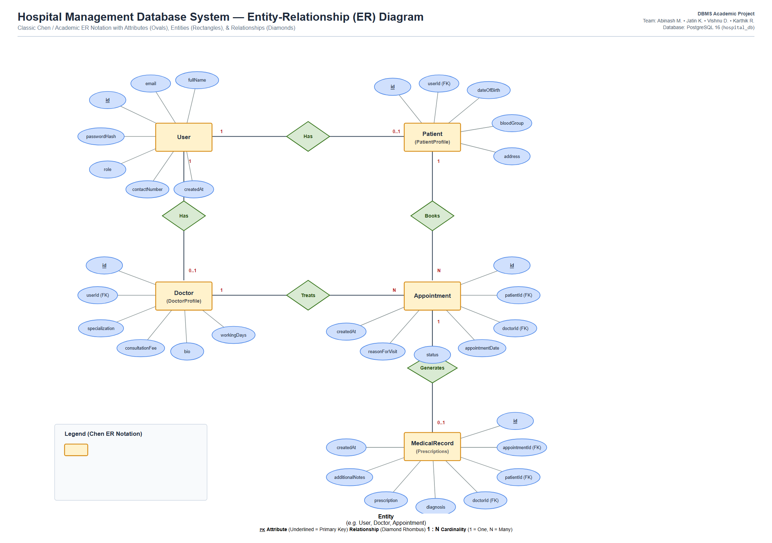
DATABASE DESIGN
Entity-Relationship (ER) Diagram
Understanding the ER Diagram Simply
• Rectangles (Main Items):
The 5 core objects: User, Doctor, Patient, Appointment, and Medical Record.
• Ovals (Details):
Information about each object like Name, Email, DOB, Fees, and Diagnosis. Underlined items are unique IDs.
• Diamonds (Connections):
Shows how objects link together:
• Patient books Appointment (1 : Many)
• Doctor conducts Appointment (1 : Many)
• Appointment generates Prescription (1 : 1)
• Key Benefit:
Prevents duplicate records and keeps patient history cleanly organized.

Slide 6
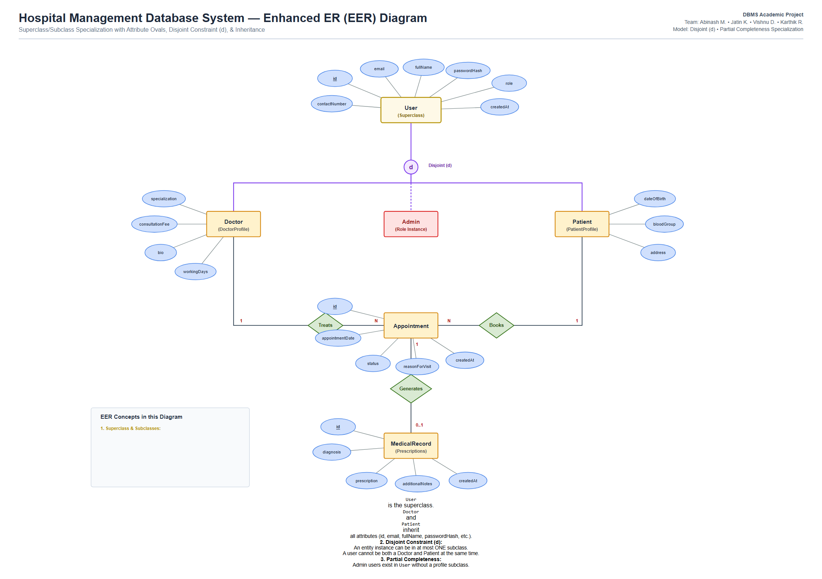
SPECIALIZATION & ROLES
Enhanced Entity-Relationship (EER) Diagram
Understanding the EER Diagram Simply
• Main Superclass (User):
Every person has common basic info: ID, Name, Email, Password, and Role.
• Special Subclasses:
• Doctor gets extra doctor details: Specialization, Consultation Fee, Bio.
• Patient gets extra patient details: Birth Date, Blood Group, Address.
• Disjoint Circle (d):
The letter 'd' means a user can only be one role at a time: strictly a Doctor OR a Patient, never mixed up.
• Admin User:
Hospital Admins exist directly as Users to manage the system without needing patient or doctor clinical profiles.

Slide 7
DATA ORGANIZATION
Database Tables & Keeping Data Clean
The 5 Database Tables We Created
• 1. users
Stores login details: id, full name, email, password, and role (PATIENT, DOCTOR, ADMIN).
• 2. doctor_profiles
Stores doctor information: specialization, fees, working days, and bio.
• 3. patient_profiles
Stores patient health info: birth date, blood group, address, and contact number.
• 4. appointments
Stores scheduled visits: appointment date, doctor chosen, patient, and status.
• 5. medical_records
Stores doctor prescriptions: symptoms, final diagnosis, and medicine notes.
Why We Normalized the Data (1NF, 2NF, 3NF)
✓ Step 1 (1NF): Single Values Only:
No multiple phone numbers or lists of medicines shoved into one cell. Every piece of info has its own clean column.
✓ Step 2 (2NF): Separate Tables for Separate Things:
We separated Patient details from Appointment details. If an appointment is cancelled, the patient's record is NOT deleted.
✓ Step 3 (3NF): No Indirect Dependencies:
Doctor details belong in the doctor table, not repeated across every appointment row. If a doctor updates their fee, it updates everywhere automatically.

Slide 8
BACKEND FUNCTIONALITY
Database Queries & Automatic Trigger Fix
Automatic Trigger Fix (trg_patient_insert)
• The Problem We Solved:
When adding a patient directly in pgAdmin, the website was only showing the new patient's ID, leaving other fields blank.
• Our Solution: Database Trigger:
We created an automatic PostgreSQL trigger ('trg_patient_insert') and view ('public.patients').
• How It Works:
The moment any new patient row is inserted, the trigger instantly creates their login account and patient record together.
• The Result:
Now, every new patient shows their full name, phone number, blood group, and age immediately on the website without any blanks!
How the System Fetches Information
✓ Connecting Tables (JOIN):
Combines patient name, doctor name, and visit date in one single quick query to display on the screen.
✓ Department Visit Count (GROUP BY):
Counts how many visits each department handled so the hospital can see which specialists are busiest.
✓ Instant Calculation (SUM):
Automatically adds up consultation fees from completed appointments to show the hospital's total earnings.

Slide 9
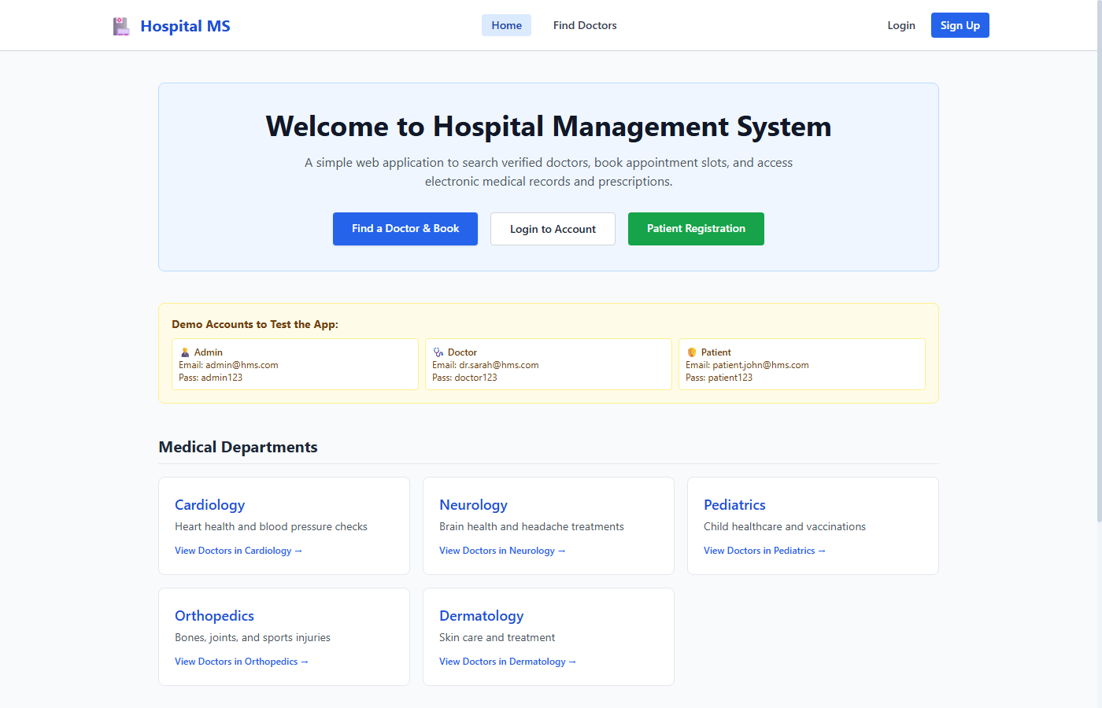
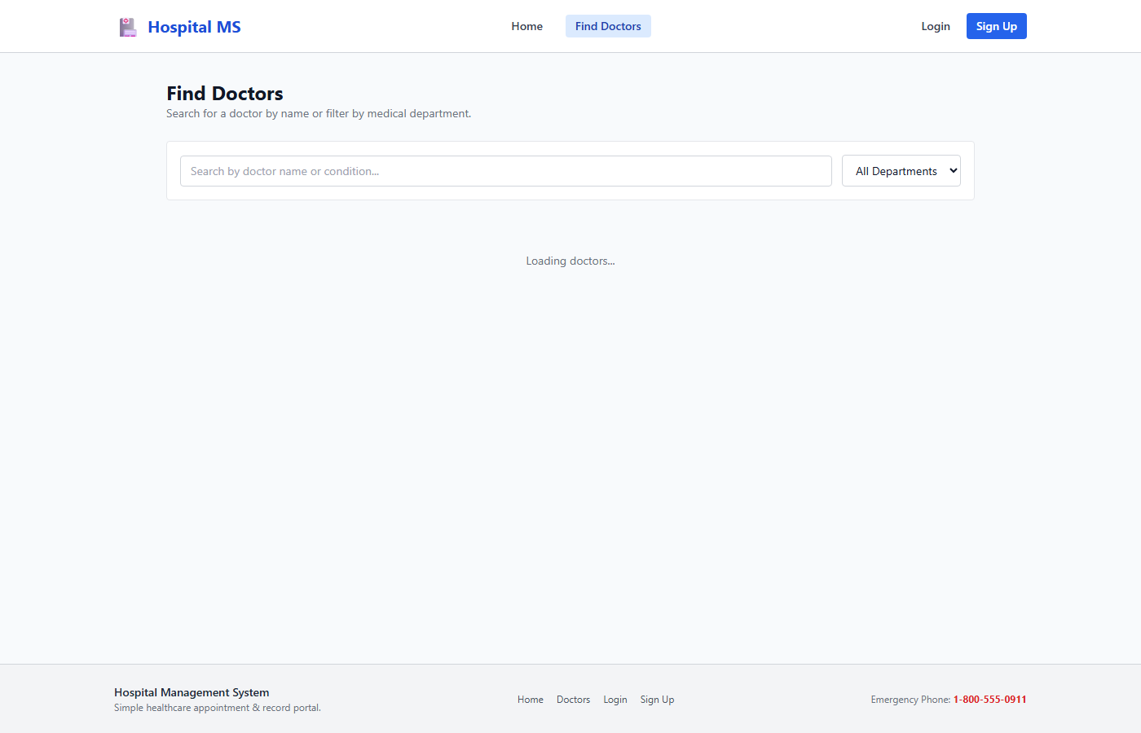
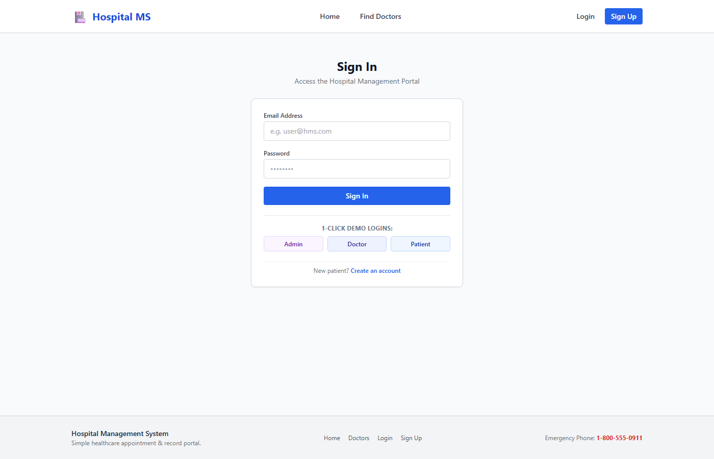
APPLICATION SCREENSHOTS
Live Website: Patient & Doctor Pages
1. Homepage
Clean, welcoming landing page where patients can explore hospital services, read doctor bios, and click to book visits.
2. Find Doctors Page
Allows patients to filter certified doctors by department (Cardiology, Neurology, Pediatrics) and check fees.
3. Secure Sign-In
Simple, secure sign-in page that directs Patients, Doctors, and Admins to their respective dashboards.

Slide 10
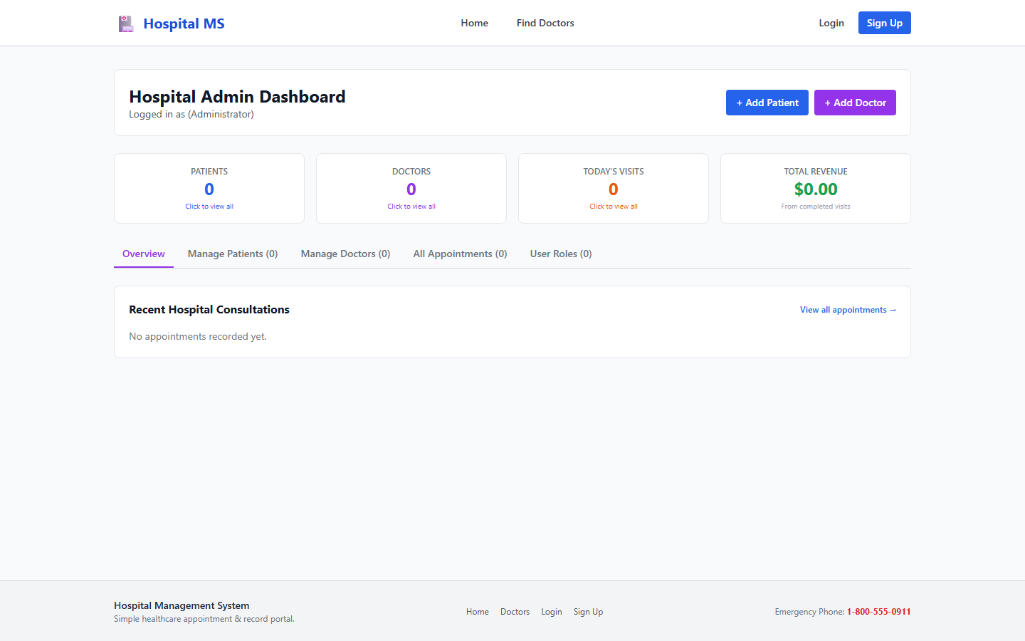
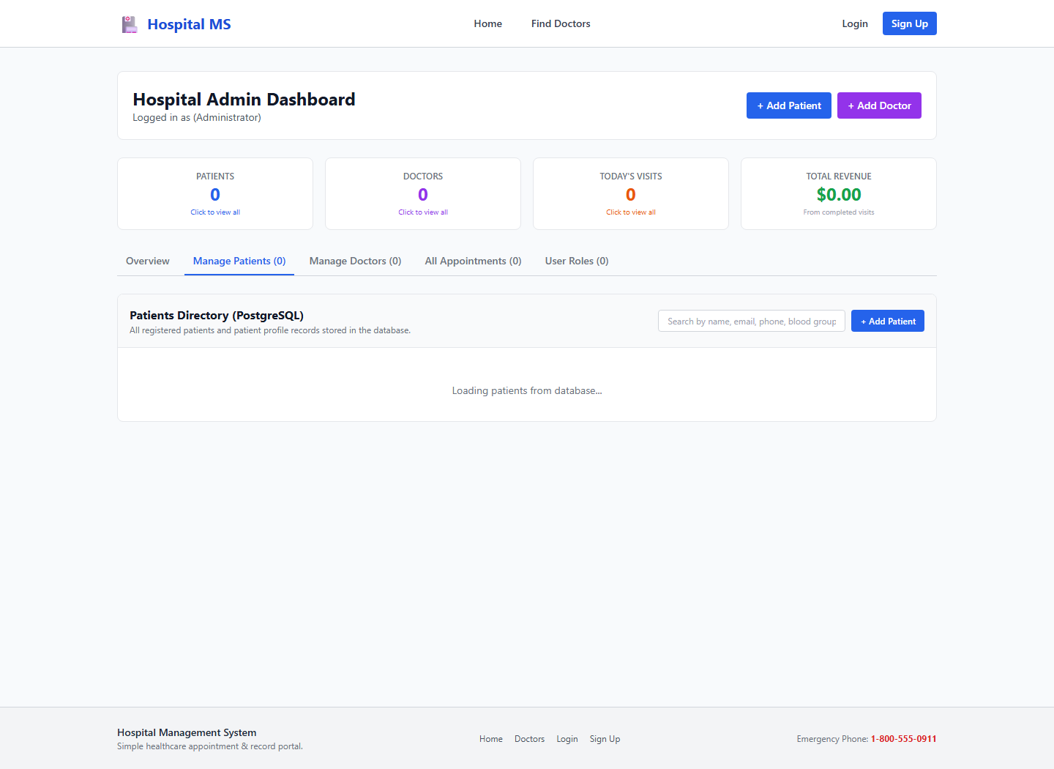
APPLICATION SCREENSHOTS
Live Website: Admin Dashboard & Fixed Patient Table
Hospital Admin Summary Dashboard
Gives the administrator a clear high-level view of hospital operations: Total Patients, Active Doctors on Duty, Today's Consultations, and Collected Revenue.
Live Patient Table (All Details Showing Correctly)
Verified fix: Newly registered patients in PostgreSQL appear immediately with all their details (Name, Phone, Blood Group, Address) without any blank cells.

Slide 11
SUMMARY
Conclusion & Future Enhancements
What We Achieved
✓ No More Lost Records:
All hospital data is stored safely in PostgreSQL 16, eliminating paper clutter and missing files.
✓ Clean & Organized Schema:
Follows proper Chen ER & EER design, and is completely organized in 3NF without repeated duplicate data.
✓ Working Web Application:
Patients can book visits online, doctors can write digital prescriptions, and admins can monitor the entire hospital.
✓ Future Enhancements:
• Online video consultations for remote patient checkups.
• Automatic SMS reminders for upcoming appointments.
• Online payment integration for instant consultation fee receipts.
Thank You!
Any questions are welcome!
TEACHER IN-CHARGE / GUIDE:
Prof. Sumedha A. Maindalkar
PROJECT TEAM:
• Abinash Muthuramalingam (125A9002)
• Jatin Kumar (125A9009)
• Vishnu Devendra (125A9010)
• Karthik Raja (125A9018)

