Slide 1










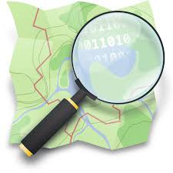




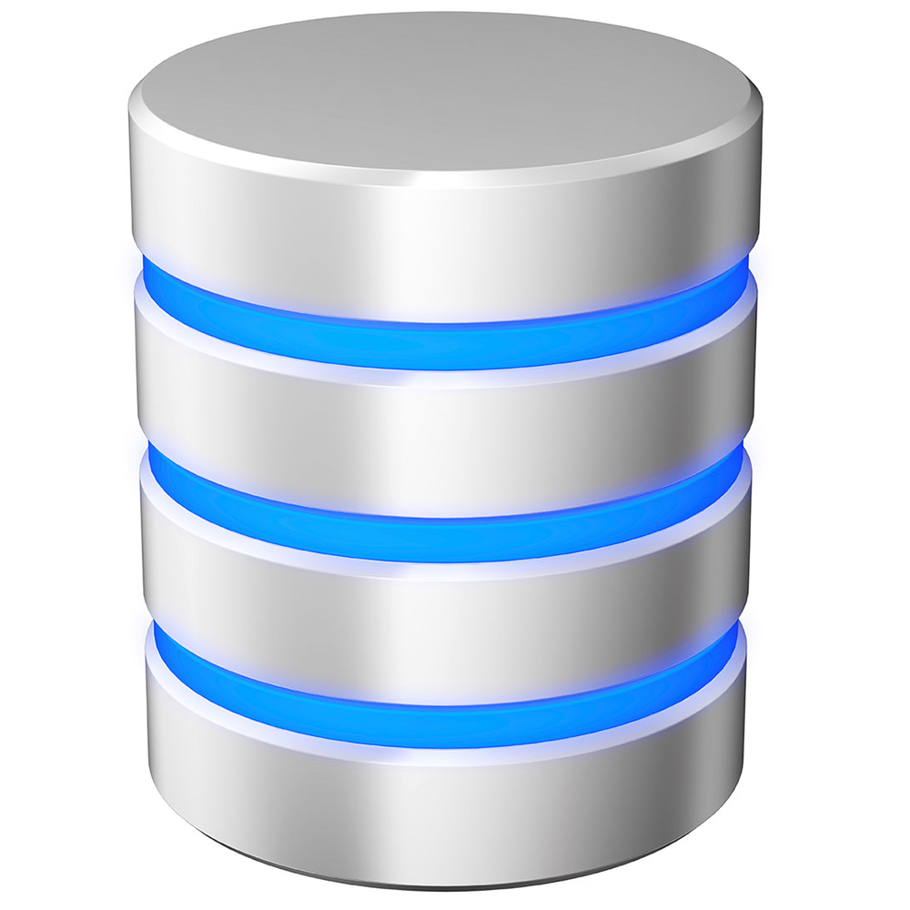


Python – For running agentic scrapers
for OCR table extraction from images
For Python-based front end in Browser
Technologies
For HTML parsing
Selenium & Chrome – for browser automation
For Scalable & Fast PostGreSQL
For coordination / location retrieval
Government
Public Tender Information
Project Data
Companies
Azure Power
Renew
Tata Power
National Statistics Data
Data Flow
International Organisations
StatisticTimes
INCED
Tender Data
DataBase
Academia
Geo-Data (UCDavis)
Topography Data
Online Sources
Raw Data Lake
Processed Data

