Slide 1

CLINICAL MACHINE LEARNING
MedBridge Cardiac
Readmission Analysis
Machine-learning risk stratification to flag high-risk cardiac patients before discharge
Group 1: Abhyudhay, Rishika, Emma, Karthik
19% 30-day readmission rate
10,000 patient records
4 models compared
Notes:
Hook: MedBridge readmits cardiac patients at 19% vs the 14% national average. We built ML on 10,000 records and compared 4 tree-ensemble models to flag high-risk patients before they leave the hospital. ~25 sec.

Slide 2


The Problem & The Data
MedBridge runs hot on readmissions
The dataset
19%
14%
10,000
patient records, 11 clinical + social features
MedBridge
National avg
80.9 / 19.1
class split — routine vs. readmitted (imbalanced)
+5 points above benchmark — every avoided readmission saves cost and improves outcomes.
Clinical + SDOH
age, BP, glucose, comorbidities, compliance, insurance, ZIP
Notes:
MedBridge is 5 points above the national benchmark. We have 10,000 records with 11 features blending clinical signals and social determinants of health. Note the imbalance: only 19% are readmissions, which shapes how we evaluate models. ~30 sec.

Slide 3

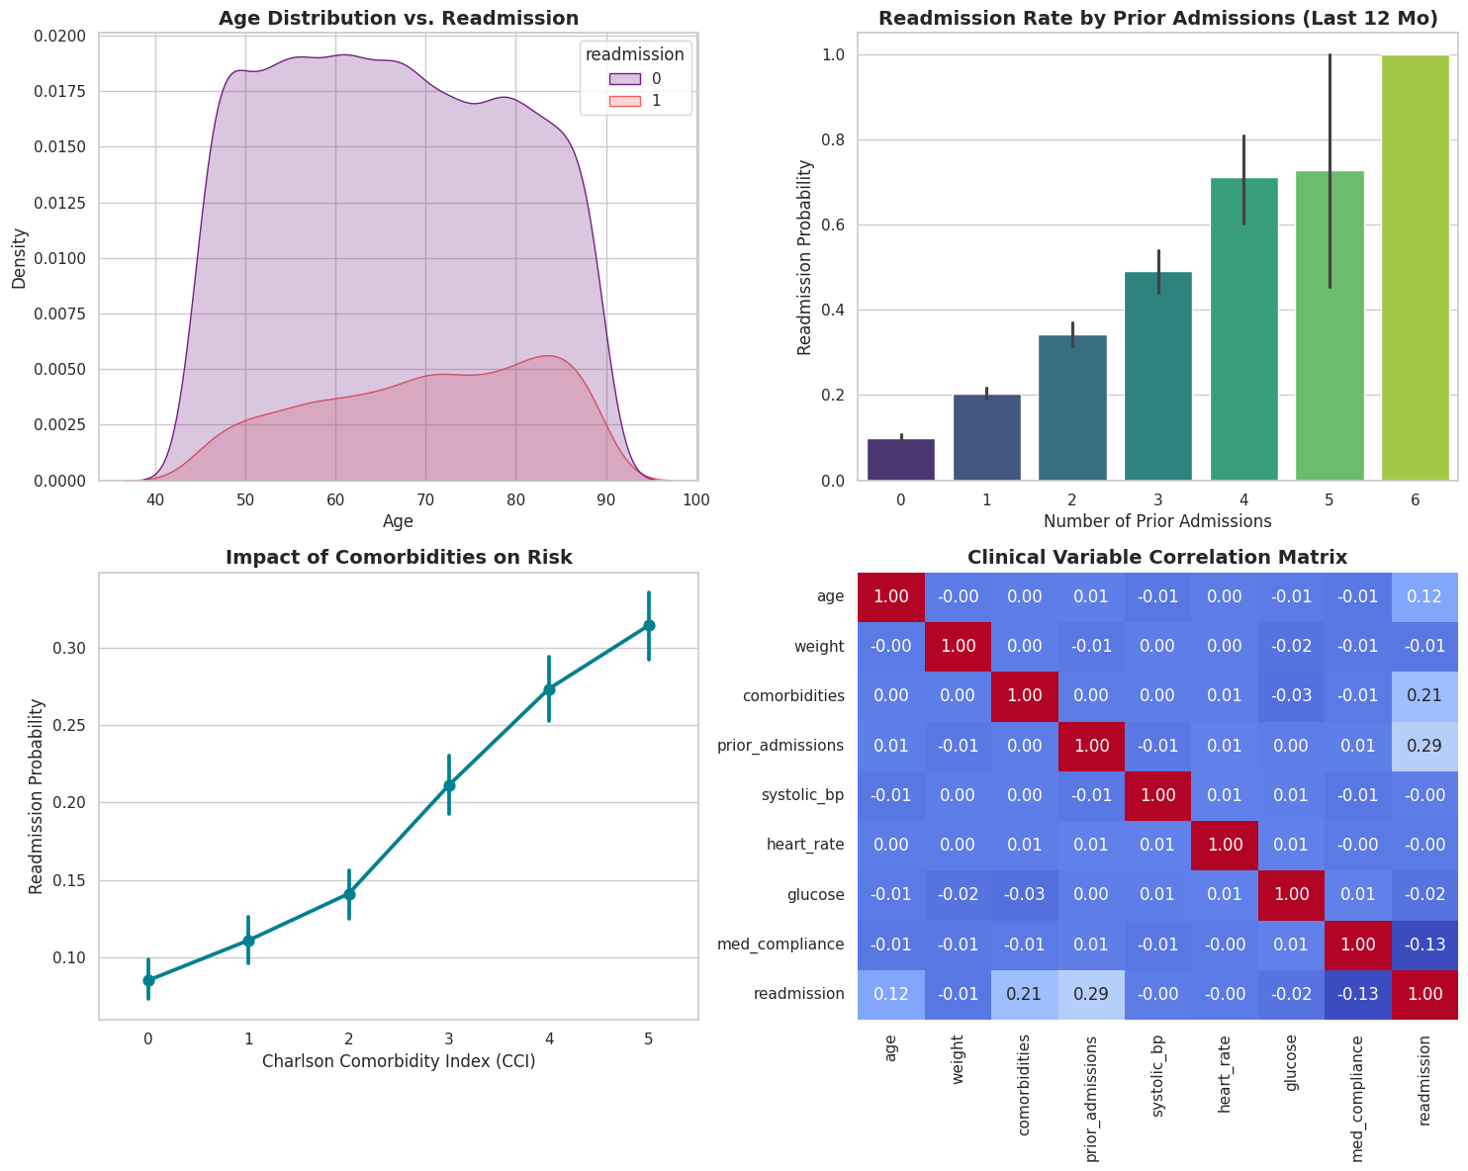



What the Data Shows
Risk rises with history & complexity
Readmitted patients skew older — risk concentrates in the 75–90 age band.
Prior admissions is the steepest gradient: ~10% risk with none, climbing past 70% at 4+.
A higher Charlson Comorbidity Index lifts risk steadily — roughly 8% up to 31%.
Correlations agree: prior admissions (0.29), comorbidities (0.21), age (0.12) lead; better med adherence is protective (−0.13).
Notes:
Four exploratory views tell a consistent story. The age curve shows readmitted patients skew older. Prior admissions is the sharpest signal — risk climbs from ~10% with none to over 70% at four or more. Comorbidity burden pushes risk up the same way. And the correlation matrix confirms the ranking: prior admissions, comorbidities and age lead, while better medication adherence is protective. ~35 sec.

Slide 4


Comparing Four Models
Model | Accuracy | Recall | F1 | AUC
Random Forest | 0.823 | 0.149 | 0.244 | 0.741
XGBoost | 0.760 | 0.414 | 0.397 | 0.710
LightGBM | 0.744 | 0.592 | 0.469 | 0.753
CatBoost ★ | 0.734 | 0.613 | 0.468 | 0.764
Why recall wins
In a hospital, a missed high-risk patient is far costlier than a false alarm.
0.61
CatBoost recall — it flags the most true readmissions, plus the top AUC (0.764).
Higher accuracy can hide missed patients — Random Forest scores 0.82 accuracy but catches only 15% of readmissions.
Notes:
We trained Random Forest, XGBoost, LightGBM and CatBoost. Random Forest looks best on accuracy but only catches 15% of true readmissions — useless clinically. Since missing a high-risk patient is the costly error, recall matters most. CatBoost leads on recall (0.61) AND AUC (0.76), so it's our pick. ~40 sec.

Slide 5
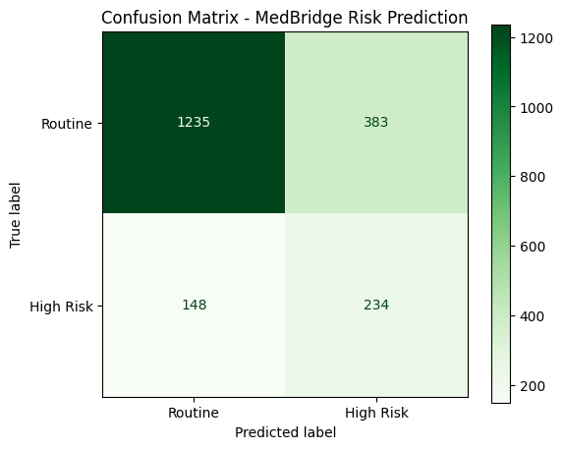


Best Model — CatBoost in Detail
Test set: 2,000 patients held out
234 caught
of 382 high-risk patients correctly flagged (61% recall)
148 missed
high-risk patients still slip through — the key gap to close
Trade-off: catching more true cases means more false alarms (precision 0.38). For a low-cost intervention like a follow-up call, that trade is clinically worth it.
Notes:
On 2,000 held-out patients, CatBoost correctly flags 234 of 382 true high-risk cases — 61% recall. It still misses 148, the gap we'd target next. The cost is lower precision: more false alarms. But when the intervention is a cheap follow-up call, over-flagging is acceptable. ~35 sec.

Slide 6

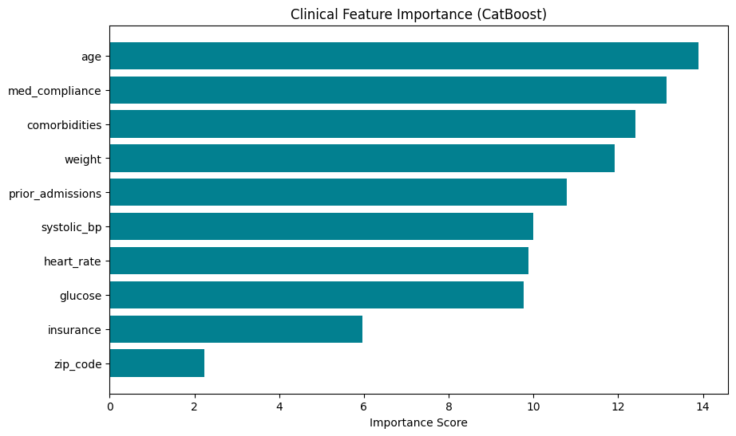

What Drives Risk — & What To Do
Recommendation
Deploy CatBoost as a discharge risk score — best recall + AUC, and it handles insurance/ZIP categories natively.
Risk is multifactor: age, adherence, and comorbidities lead, with social factors adding lift — target interventions accordingly.
Acts before discharge, unlike a static LACE score — enabling proactive follow-up for flagged patients.
Top drivers: age, medication adherence, comorbidity burden
Notes:
The model surfaces a multifactor risk profile — age, medication adherence and comorbidity burden lead, with social factors adding lift. Bottom line: deploy CatBoost as a pre-discharge risk score. Unlike a static LACE score, it works before the patient leaves, so the care team can act proactively. Closing. ~30 sec.

