Slide 1
REBOUND
Recovering revenue lost to
recurring-payment failures in India
A measured account of where the money actually is — and where it is not.
Simulation study · v0.4 · August 2026
Notes:
Frame at the top: this is a measurement study, not a product demo. The credibility of everything that follows rests on being straight about what is measured and what is assumed.

Slide 2
Recurring debits in India fail at scale
And the failures are concentrated in a category that is a timing problem, not a demand problem
808M
~20M
8–15%
<1% / <5%
mandate executions
per month (Jul 2025)
mandate revocations
per month
UPI AutoPay failure rate
vs 2–3% for card mandates
NPCI targets for technical
vs business declines
The split that matters
Technical declines are the bank's problem and largely solved — system-wide TD fell from 8–10% in 2016 to under 1% by 2025.
Business declines — overwhelmingly insufficient balance — are not solved, and they are a question of WHEN the debit is presented, not WHETHER the customer intends to pay.
NACH bounce data has been public and material for years: 32.98% by volume at the August 2021 reading.
Sources: NPCI monthly bank-wise decline and uptime data; NPCI Circular OC-149 (June 2022); NACH bounce statistics. Practitioner estimates for the UPI-vs-card gap.
Notes:
Do not oversell. The 8-15% figure is a practitioner estimate, flagged as such. The NPCI and NACH figures are primary.

Slide 3
The industry's numbers do not transfer to India
Recovery benchmarks quoted in this category are measured on a market that works differently
What vendors quote
Why they don't apply here
20–40% of subscription churn is involuntary
60–80% of it is recoverable
Smart retry alone recovers 40%
Retry + card-updater + email reaches 70%
Those baselines are driven by card expiry — a failure mode that barely exists on UPI or eNACH
Card-updater services have no meaningful Indian analogue
UPI is stateless and settles in real time; there is no pre-authorisation to lean on
Indian failures are dominated by balance timing and clearing calendars
Self-reported, US, card-centric.
Nobody has published rigorous, India-specific retry-lift data. That gap is what this study addresses.
Vendor figures as published by Stripe, Recurly, Churnkey and comparable providers. Cited to characterise the prevailing claim, not endorsed.
Notes:
This slide earns the right to the rest of the deck. The analytics head in the room has seen the vendor numbers. Telling them why those numbers are inapplicable is the credibility move.

Slide 4
A measurement instrument, not a model to believe
Discrete-event simulation of an Indian mandate book, with the measurement layer built and audited before any strategy
01
Synthetic book
Customers with banks, incomes, salary dates, balance processes and mandates across UPI AutoPay, eNACH and card e-mandate.
02
12 months of billing
Each debit checks mandate status, bank availability, caps, limits and balance — in order — and records WHY it failed.
03
Seven retry strategies
The same failure is handed to every strategy. Identical population, identical failures. Only the decisions differ.
04
Compliance gate
Every proposal passes a hard gate: notification timing, attempt caps, clearing calendars, absolute stop on hard declines.
05
Paired measurement
24 seeds, bootstrap confidence intervals, Bonferroni correction across all 72 segment tests.
Notes:
For the enterprise architect: the point of build order is that the measurement was trusted before anything was measured with it.

Slide 5
Why these numbers survive scrutiny
Four controls, each of which changed a conclusion during the study
Negative control
Multiplicity correction
A segmentation axis known to carry no signal is tested alongside the real ones. On the first run it produced two apparent winners at the raw level — both killed by correction. Proof the multiple-comparison machinery works, on data known to contain nothing.
One correction family across all 72 segment tests. No uncorrected column is published anywhere, because the uncorrected column is the one that ends up in a deck.
Sensitivity analysis
Reproducibility
Every load-bearing assumption swept at full power. The result names which assumptions the conclusion is fragile to — including our own weakest.
Same seed, identical output. Every export carries the config fingerprint it was produced under and refuses on mismatch.
Notes:
This is the slide that differentiates us from three ML-retry vendors. Anyone can produce a number. Very few produce one with a negative control attached.

Slide 6
Finding 1 — the money is in plumbing, not intelligence
Re-presenting a blocked retry is worth roughly four times the best retry logic, and it is the only lift significant under every failure profile
What rescheduling is
When a retry lands on a non-clearing day or past a batch cutoff, present it at the next valid slot instead of abandoning it. No reason codes. No inference. No model.
Why it is separated
The two figures are never summed, in the model or the interface. Quoting a combined number would sell scheduler plumbing as intelligence — and plumbing is what any competent stack can build.
Paired comparison, 400 mandates x 12 months x 24 seeds, 90% bootstrap intervals. Simulated result — see limitations.
Notes:
If the room takes one thing away, it is this slide. It also sets up the honest risk: plumbing is cheap to replicate, which is why validating whether PGs already do it is the critical path.

Slide 7
Finding 2 — intelligence pays only for some books
Strategy lift varies roughly 17-fold with a merchant's dominant failure reason. This is a qualifying question, not a footnote.
Failure profile
Rescheduling lift
Strategy lift
Verdict
Insufficient-funds dominant
₹11,486 – ₹15,375
₹2,862 – ₹12,123
Both tiers pay
As shipped (mixed)
₹6,998 – ₹10,144
₹990 – ₹5,903
Plumbing dominates
Technical dominant
₹11,982 – ₹14,704
₹71 – ₹1,803
Plumbing only
Net annual value per 400-mandate book, after performance fee, at 90% confidence.
Commercial consequence:
one question — what is your dominant failure reason code — determines which tier a customer needs before any commercial conversation begins.
Notes:
For the ops head: this is the segmentation that decides deployment scope. For sales: this is the discovery question.

Slide 8
Finding 3 — the obvious idea does not work
Salary-timed retries cannot be built from a merchant's own data. This is a structural limit, not a tuning problem.
The identifiability failure
Measured against a coin flip
Every mandate bills on one calendar day, so its observable history is that same day repeated. Nothing in it separates 'payday is the 25th' from 'payday is the 5th'. The estimator collapses onto the billing day for 94% of mandates.
14.2%
17.9%
inferred within
2 days of true payroll
a uniform random
guess over 28 days
Why this is worth more than a positive result
Insufficient funds is the largest failure segment at 39.9% of episodes — and no strategy beats the baseline in it after correction.
The largest pocket of opportunity is therefore blocked on external data, not on better algorithms.
Unlocking it requires account-aggregator consent, a signup declaration, or an issuer signal — a different product with a different regulatory surface.
Notes:
Reporting a negative result is the strongest available signal that the positive ones were not tuned into existence.

Slide 9
The headline, visible at row level
Same mandate. Same cycle. Same failure. One re-presents; one abandons.
FixedSchedule att 2 2026-11-09 rescheduled 11-08 → 11-09 SUCCESS ₹499
NoReschedule att — 2026-11-08 blocked presentation_window ₹0
Saturday BANK_UNAVAILABLE · T+1 falls on Sunday · eNACH does not clear at weekends
Nothing in those two rows involves a reason code, an inference, or a model. Quoting this gap as intelligence is refutable from the export itself.
Auditable
Attributable
Reproducible
Every aggregate reconciles to the per-attempt rows that produced it
Every retry carries the rule that proposed it and the guard verdict that allowed it
Seed and config fingerprint on every exported row
Notes:
Hand this row pair to a skeptical engineer. It explains the entire product without a chart.

Slide 10
How it deploys
Two separable components. The scoring service is the product; the simulator is how its value is quantified and qualified.
Simulator
Scoring service
Offline · no customer data
Real failures in · recommended times out
Six inputs: book size, ticket, rail mix, failure mix, fee
Outputs the two lift figures with intervals
Segment report with multiplicity correction
Per-attempt trace for audit
REST: single failure or batch CSV
Returns retry time, the rule that produced it, and the measured evidence for that segment
Refuses rather than defaults on any field it cannot populate
Emits no success probability — there is no oracle outside the simulator
Read-only. No funds movement, no mandate mutation, no PII beyond a merchant-supplied reference. Execution stays entirely in the merchant's stack.
Notes:
For the enterprise architect and InfoSec: emphasise read-only and no funds movement. That materially shortens security review.

Slide 11
What we need from you
Two tiers. The minimum tier answers today; the extended tier unlocks the strategies that measured best.
Minimum tier
Extended tier
Mandate reference
Rail
Reason code
Failure timestamp
Amount and mandate cap
Attempt number
Notification timestamp
Everything above, plus:
Bank identifier
Full attempt history for the cycle
Batch cutoff (eNACH)
Serves reason-aware and baseline scheduling.
Unlocks bank-aware and blended — the measured winners in 48% of a representative book.
No behavioural or balance data is required to begin. Where a field is missing, the service names the strategy it could not run and the fields that would unlock it — rather than quietly returning a weaker answer.
Notes:
For the ops head: this is the integration ask. Deliberately small to start.

Slide 12
What this study does not yet establish
Stated in full, because a number you cannot interrogate is a number you should not act on
1
Every figure is simulated
No merchant's real book has been measured. These are the outputs of a model whose assumptions are documented, not observations of your business.
2
The most fragile assumptions are the least grounded
Sensitivity analysis names the balance-process parameters as the ones the conclusion depends on most — and they have no empirical basis in the current model.
3
Clearing and notification rules are unverified
The rescheduling result rests on eNACH clearing calendars and pre-debit notification timing that have not been confirmed against primary regulatory sources.
4
The reason-code mix is unknown until you share data
Strategy value swings 17-fold on it. Yours is the input that would move our estimate most.
Notes:
Do not soften this slide. It is the reason the rest of the deck is credible, and it sets up the pilot ask as the natural next step.

Slide 13
The ask: a four-week measurement pilot
Not a purchase. A test of whether the finding holds on your book.
Week 1
Week 2
Week 3
Week 4
Failure export
Calibration
Backtest
Read-out
A read-only extract of failed recurring debits — 90 days, minimum tier. No PII beyond your own mandate reference.
Your reason-code mix, bounce rate and rail split replace three estimated assumptions with measured ones.
How many of your retries landed outside a clearing window and were abandoned. This is measurement of your data, not simulation.
Two figures with intervals, the assumptions behind them, and a plain statement of what remains unproven.
Success criterion agreed in advance:
if your retries are already calendar-aware, the pilot says so and we stop. A negative result delivered honestly is worth more to both of us than a deployment built on one.
Notes:
Naming the kill criterion up front is the single most persuasive thing in this deck for a skeptical CXO.

Slide 14
What we are claiming
Recurring-payment recovery in India
is a scheduling problem before it is
an intelligence problem.
We have a rigorous model that says so, an honest account of what it rests on, and a four-week test that would replace the model with measurement.
The next step is your data, not our code.
Notes:
Close on the pilot ask. Do not close on a price.

Slide 15
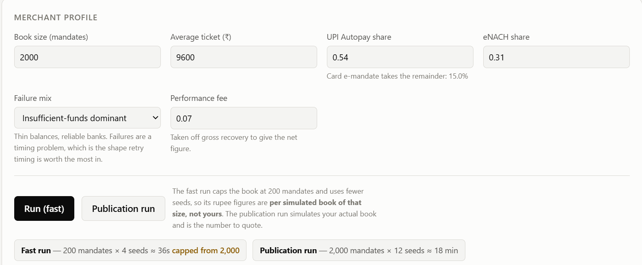
Test Run 1

Slide 16
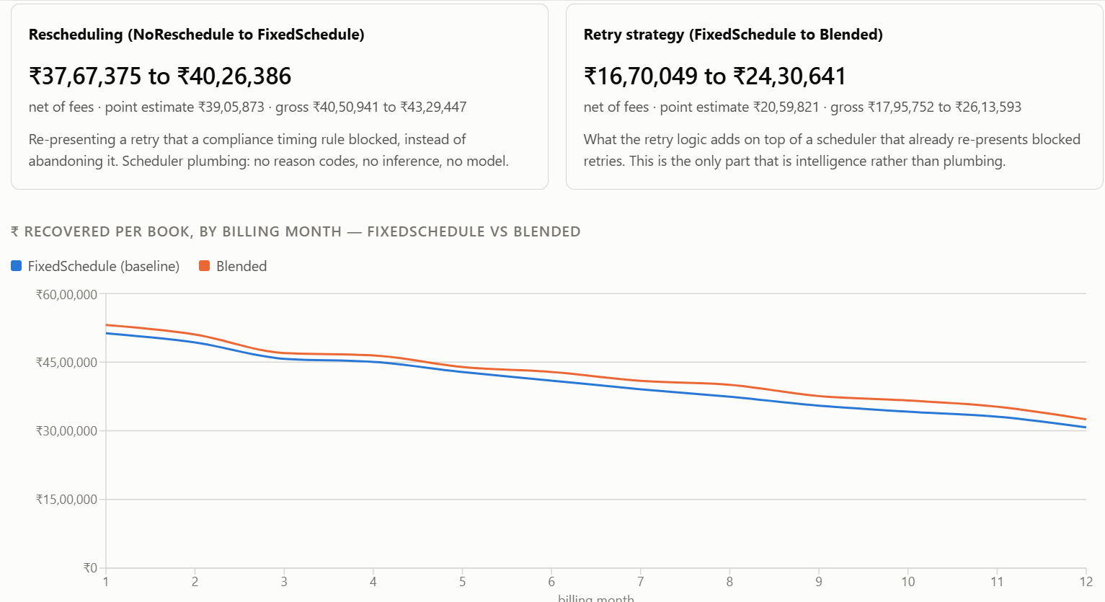
Test Run 1

Slide 17
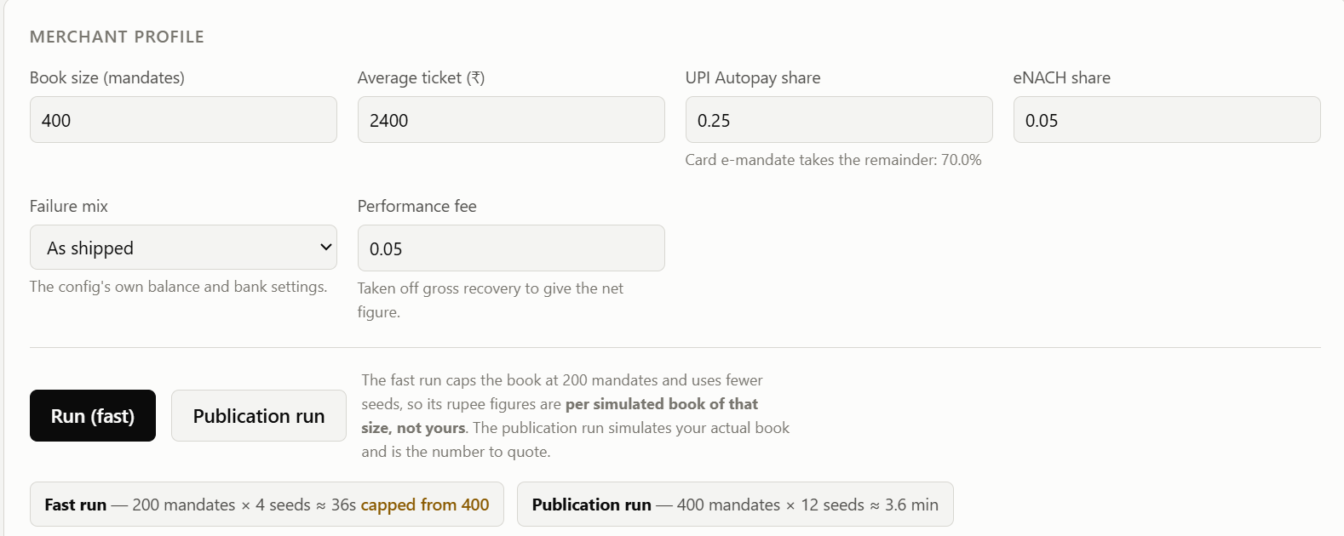
Test Run 2

Slide 18
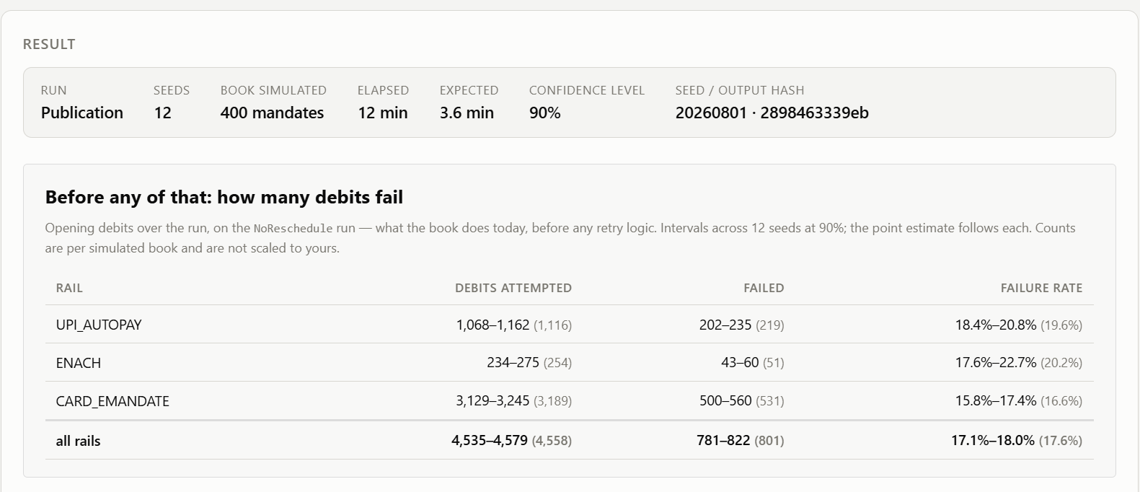
Test Run 2

Slide 19
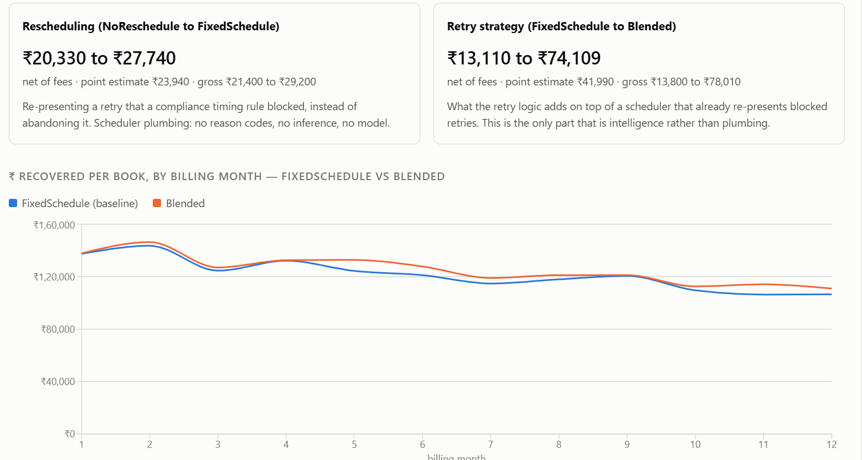
Test Run 2

