Slide 1

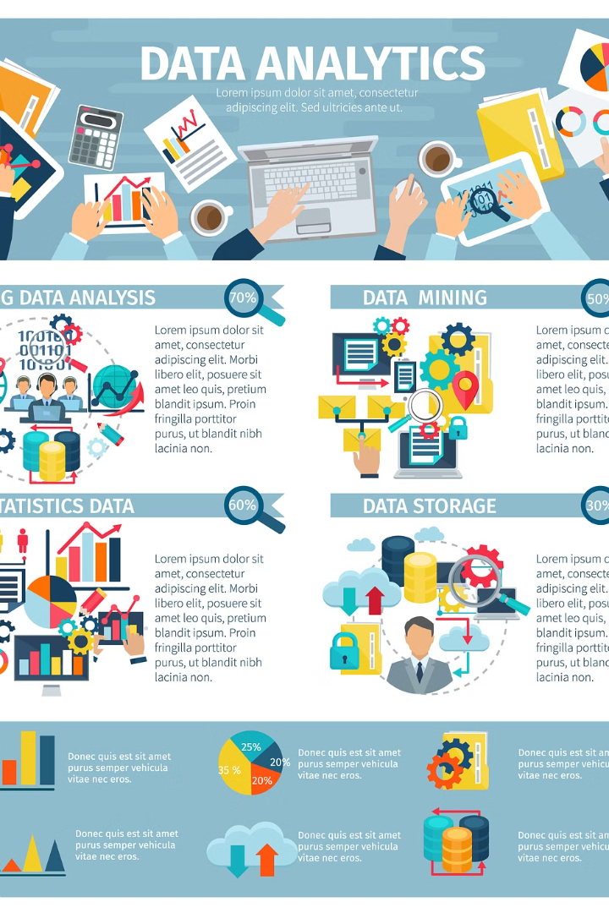
Sentiment Analysis: Unveiling the Emotions Behind Big Data
Sentiment analysis, a branch of Natural Language Processing, delves into the emotional tone of text data. It analyzes user opinions, reviews, and social media posts to understand public perception and trends.
KR

Slide 2
NLP Techniques for Sentiment Analysis
1
Lexicon-Based Approach
2
Machine Learning Algorithms
This method relies on pre-defined sentiment lexicons, which contain words and their associated sentiment scores (positive, negative, or neutral).
Machine learning models, such as Naive Bayes, Support Vector Machines, and Deep Learning networks, can be trained on labeled datasets to classify sentiment.
3
Contextual Analysis
4
Hybrid Approaches
Advanced NLP techniques, like word embeddings and sentiment-specific transformers, consider the context of words and phrases to improve accuracy.
Combining multiple techniques can enhance the overall performance of sentiment analysis models by leveraging the strengths of each approach.

Slide 3
Data Preprocessing and Feature Engineering
Data Cleaning
1
Removing noise, inconsistencies, and irrelevant data from the dataset is crucial for model accuracy.
2
Tokenization
Splitting text into individual words or phrases, known as tokens, enables further analysis.
Stop Word Removal
3
Eliminating common words, like "the," "a," and "an," that provide little semantic value.
4
Stemming and Lemmatization
Reducing words to their base forms for better representation and comparison.
Feature Extraction
5
Creating features from the preprocessed data, such as word counts, TF-IDF scores, or sentiment scores.

Slide 4
Model Selection and Training
Model Selection
Model Training
Hyperparameter Optimization
The choice of model depends on the specific task, data size, and desired performance. Common choices include: Naive Bayes, Support Vector Machines, Logistic Regression, and Deep Learning models.
Training the model involves feeding it with labeled data to learn patterns and relationships between features and sentiments. The model adjusts its parameters to minimize errors and maximize accuracy.
Fine-tuning the model's hyperparameters, such as learning rate and regularization strength, to improve its performance.

Slide 5
Evaluating Model Performance
Metric
Description
Accuracy
The proportion of correctly classified instances.
Precision
The proportion of correctly predicted positive instances among all instances predicted as positive.
Recall
The proportion of correctly predicted positive instances among all actual positive instances.
F1-score
The harmonic mean of precision and recall, providing a balanced measure of performance.

Slide 6




Handling Big Data Challenges
Distributed Computing
Data Sampling
Incremental Learning
Model Compression
Selecting representative subsets of data to reduce computation time and memory usage.
Utilizing parallel processing techniques to handle large datasets efficiently.
Training models on smaller batches of data iteratively to handle continuous data streams.
Reducing the size of models to improve storage and processing efficiency.

Slide 7




Case Study: Application in a Real-World Scenario
Customer Feedback Analysis
Social Media Monitoring
News Sentiment Analysis
Market Research
Analyzing online reviews and customer feedback to understand market trends, customer preferences, and competitor analysis.
Tracking public sentiment towards specific brands, products, or events on social media platforms to identify potential issues and respond accordingly.
Analyzing news articles and blog posts to understand the public perception of various topics and events, providing valuable insights for decision-making.
Sentiment analysis can be used to analyze customer feedback on products, services, or brands to understand customer satisfaction and identify areas for improvement.

Slide 8

Conclusion and Future Directions
Sentiment analysis plays a crucial role in understanding public opinion and trends. As NLP techniques continue to evolve, we can expect even more sophisticated and accurate sentiment analysis models. Future research areas include: improving sentiment analysis for multi-lingual text, handling sarcasm and irony, and integrating sentiment analysis with other NLP tasks.

