Slide 1
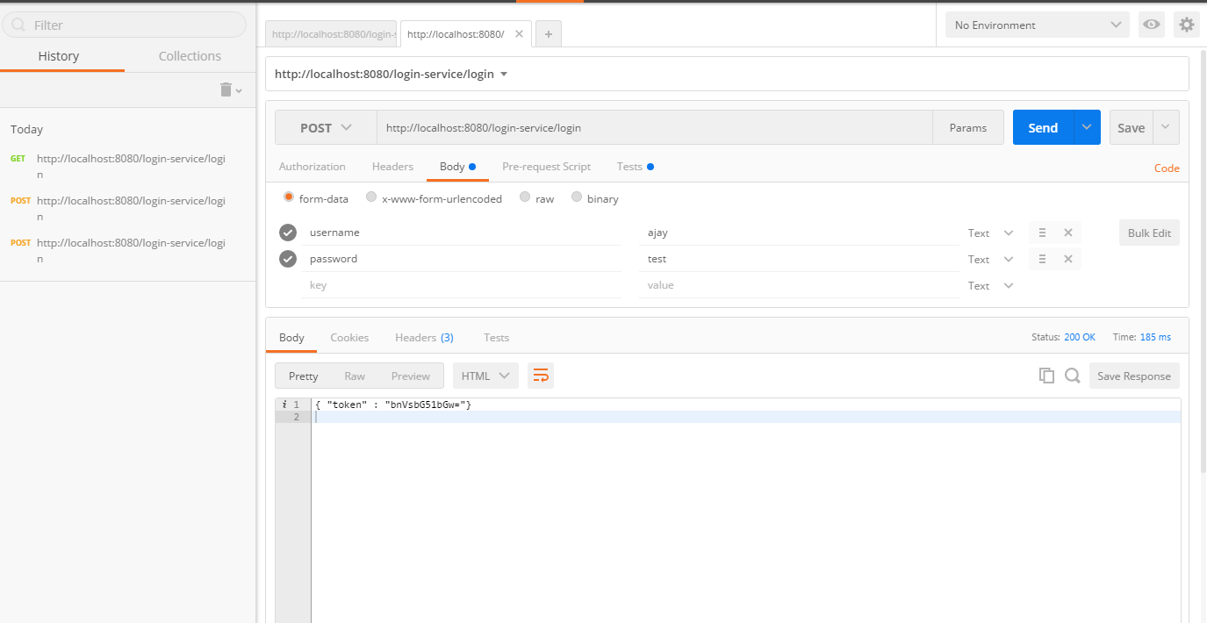
TEST LOGIN - REST - POST

Slide 2
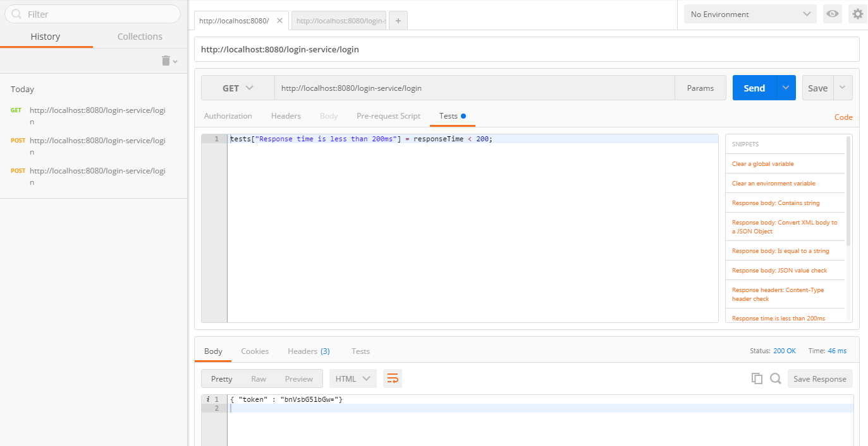
TEST LOGIN - REST - GET

