Slide 1
Research
Internship
Diabetes
(130 US Hospitals for years 1999-2008)
By
Karthik Reddy Mathuru

Slide 2
Agenda
Introduction to the problem
Objective
Data Description
Pre Processing
Visualizations
Model Building
Conclusion

Slide 3
Diabetes is a disease that occurs when your blood glucose, also called blood sugar, is too high. Blood glucose is your main source of energy and comes from the food you eat. We have two types
Type 1 Diabetes : Glucose comes from the foods you eat. Insulin is a hormone that helps the glucose get into your cells to give them energy. With type 1 diabetes, your body does not make insulin, also known as prediabetes.
Type 2 Diabetes : The more common type, your body does not make or use insulin well. Without enough insulin, the glucose stays in your blood.

Slide 4
Glucose serum test result :
The results of a fasting test with respect to glucose levels in the body are as follows:
Normal glucose reading | < 140 mg/dL
Chance of impaired glucose tolerance (prediabetes) | 140 mg/dL to 199 mg/dL
Chance of diabetes | > 200 mg/dL

Slide 5
A1C test :
An A1C level below 5.7 percent is considered normal.
An A1C between 5.7 and 6.4 percent signals prediabetes.
Type 2 diabetes is diagnosed when theA1C is over 6.5 percent.

Slide 6
Agenda
Introduction to the problem
Objective
Data Description
Pre Processing
Visualizations
Model Building
Conclusion

Slide 7
Objective:
To Classify whether the patient should be prescribed with diabetes medication or not.
Diabetes is a serious disease and a diabetic person is more prone to illness.
Better classification is essential as it may cost a person’s life.

Slide 8
Agenda
Introduction to the problem
Objective
Data Description
Pre Processing
Visualizations
Model Building
Conclusion

Slide 9
Data Description :
The dataset represents 10 years (1999-2008) of clinical care at 130 US hospitals.
It includes over 50 features and 101766 records representing patient and hospital
outcomes.
Number Of Attributes | 50
Number Of Numerical Attributes | 11
Number Of Categorical Attributes | 39
Number of rows | 1,01,766

Slide 10
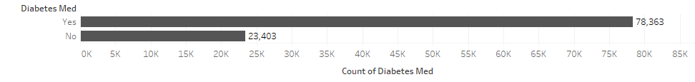
Class Imbalance :
We use SMOTE /Up sampling/Stratified splits to handle class imbalance. There is no class Imbalance.

Slide 11
Agenda
Introduction to the problem
Objective
Data Description
Pre Processing
Visualizations
Model Building
Conclusion

Slide 12
Pre Processing :
Changing the attributes to relevant data types (Numeric, categorical, string …)
There are 3 variables which has NA’s (Null/Missing Values) greater than 50 % and 2 Variables which has no variance. So, omitted these columns.
As we have huge data omitting the NA values (which are of less than 2% )is the best thing to do.
No Standardization was required.

Slide 13
Feature Engineering :
Number of outpatient Visits
Number of inpatient Visits
Number of emergency Visits
Total Number of Visits
Number of Lab
Procedures
Number of procedures
Total Number of Procedures

Slide 14
Agenda
Introduction to the problem
Objective
Data Description
Pre Processing
Visualizations
Model Building
Conclusion

Slide 15
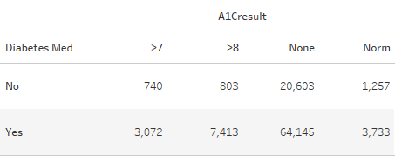
Visualizations :
This table tells us about the relationship between diabetes medications and A1C test results.

Slide 16
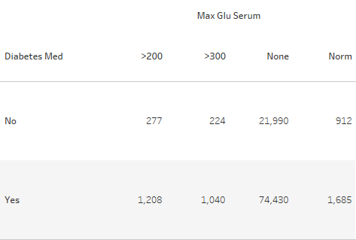
This table tells us about the relationship between diabetes medications and glucose serum
test results.

Slide 17
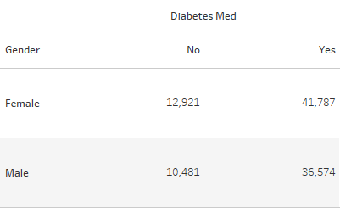
This table tells us about the relationship between diabetes medications and Gender.
By this table we can observe
that females are prone to have
Diabetes compared to male.

Slide 18
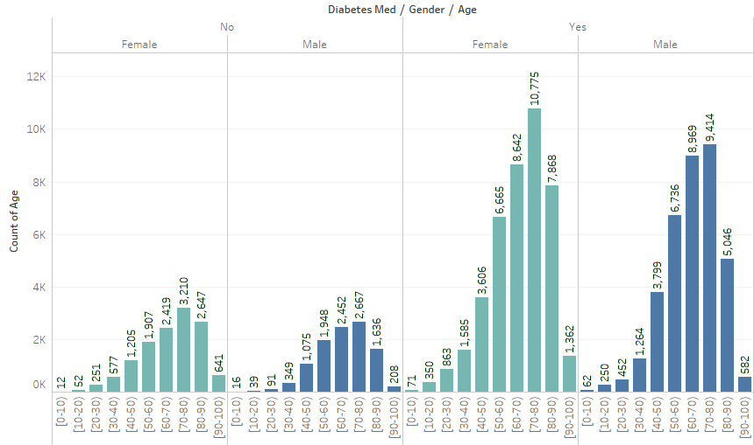
By this graph we
can observe that
there is a constant
Increase the people
With respect to their
Ages till (70-80).

Slide 19
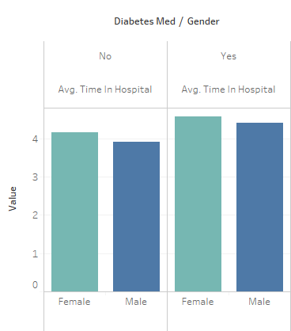
Average time a patient spends
In a hospital is 4-5 days

Slide 20
Agenda
Introduction to the problem
Objective
Data Description
Pre Processing
Visualizations
Model Building
Conclusion

Slide 21
Model Building :
Logistic Regression
Decision Tree
Support Vector Machine
Random Forest
Gradient Boost Classification
Majority Voting

Slide 22
Train – Test – Validation :
Train – 60 %
Validation – 20 %
Test – 20 %

Slide 23
Error Metric :
F1 Score = 2* (Recall * Precision) / Recall + Precision
we cannot wrongly predict patient does not have diabetes
we cannot wrongly predict that patient have diabetes (they can have side effects).

Slide 24
MODEL | F1 SCORE
Logistic | 99.8%
Decision Tree | 100%
Support Vector Machine | 99.17%
Random Forest | 99.9%
Gradient boosting classifier | 99.5%
Majority Voting | 99.8%

Slide 25
Agenda
Introduction to the problem
Objective
Data Description
Pre Processing
Visualizations
Model Building
Conclusion

Slide 26
Conclusion :
Decision Tree (Classification And Regression Tree) is giving the best score.
SVM with radial-Kernel is giving low score as it is overfitting, linear- Kernel
is better.

Slide 27
Thank You

