Slide 1
Research
Internship
Diabetes
(130 US Hospitals for years 1999-2008)
By
Karthik Reddy Mathuru

Slide 2
Agenda
Objective
Data Description
Pre Processing
Visualizations
Model Building
Conclusion

Slide 3
Objective:
Problem Statement:
To predict, whether a patient is readmitted to hospital or not with respect to various factors.
Business Problem:
Main problem of insurance company in this case is to know whether readmission of patient is fraud or not. This model helps insurance companies to solve this problem, which saves lot of money and time.
Analysis also helps them in their medical aid schemes.

Slide 4
Agenda
Objective
Data Description
Pre Processing
Visualizations
Model Building
Conclusion

Slide 5
Data Description :
The dataset represents 10 years (1999-2008) of clinical care at 130 US hospitals.
It includes over 50 features and 101766 records representing patient and hospital
outcomes.
Number Of Attributes | 50
Number Of Numerical Attributes | 11
Number Of Categorical Attributes | 39
Number of rows | 1,01,766

Slide 6
Tests:
Max Glucose serum test
A1C test
Medications:
We have 24 medications, during the encounter these are values in it
“up” if the dosage was increased
“down” if the dosage was decreased
“steady” if the dosage did not change
“no” if the drug was not prescribed

Slide 7
Diagnosis:
Tells about the cause of the disease, there are three diagnosis done for each and every patient, they are diagnosis -1,diagnosis -2, diagnosis -3.
Readmitted :
“<30” if the patient was readmitted in less than 30 days.
“>30” if the patient was readmitted in more than 30 days.
“No” for no record of readmission.

Slide 8
Agenda
Introduction to the problem
Objective
Data Description
Pre Processing
Visualizations
Model Building
Conclusion

Slide 9
Pre Processing :
Changed the attributes to relevant data types (Numeric, categorical, string …)
There are 3 variables which has NA’s (Null/Missing Values) greater than 50 % and 2 Variables which has no variance. So, omitted these columns.
As we have huge data omitting the NA values (which are of less than 2% )is the best thing to do.
Standardization was required, as we require all numeric attributes on same scale.

Slide 10
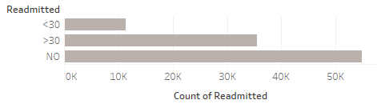
Class Imbalance :
SMOTE (Synthetic Minority Over-sampling Technique) is used to overcome class imbalance. It uses k-nearest neighbours and over samples records with high similarity.

Slide 11
Feature Engineering :
Number of Lab
Procedures
Number of procedures
Total Number of Procedures

Slide 12
Agenda
Objective
Data Description
Pre Processing
Visualizations
Model Building
Conclusion

Slide 13
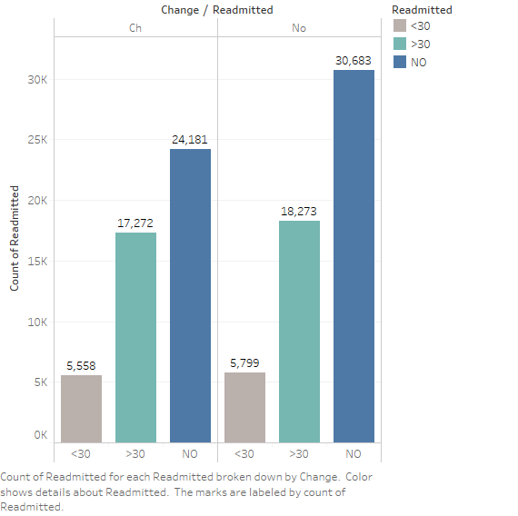
Visualizations :
This graph shows us about the relationship between change of medication and readmission rate.

Slide 14
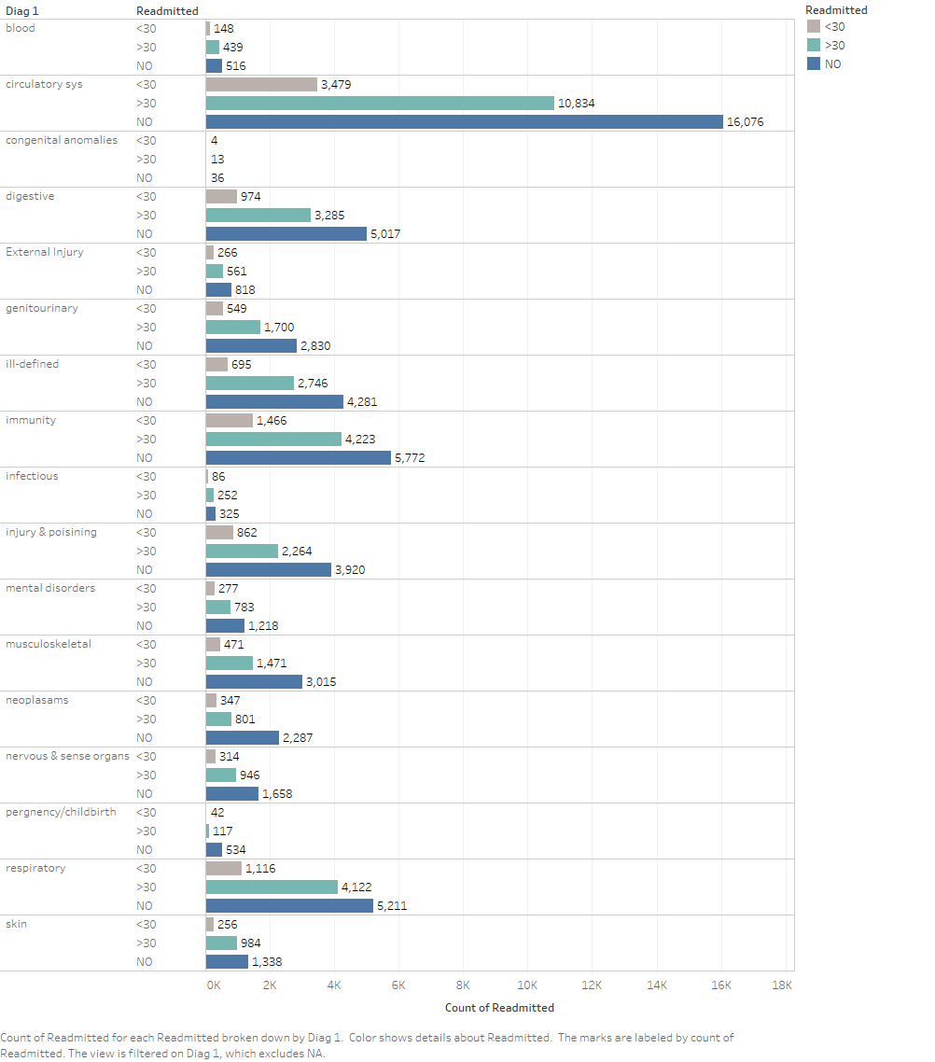
This table tells us about the relationship between diagnosis 1 and readmission rates, which shows that most of the patients have the cause as circulatory system.

Slide 15
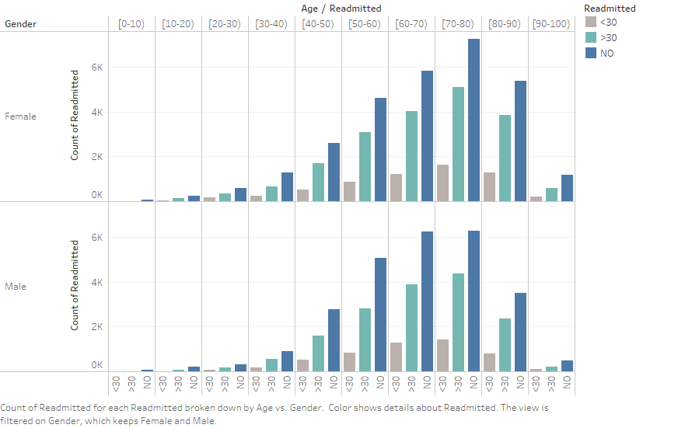
This graph tells us about the relationship between Age and readmission rates, which shows that there is a constant increase in readmission with respect to their age.

Slide 16
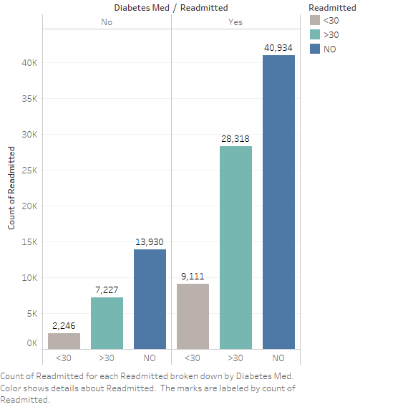
By this graph, we know that patients prescribed ‘yes’ with diabetes medication are readmitted most when compared to patients prescribed ‘no’ with diabetes medication.

Slide 17
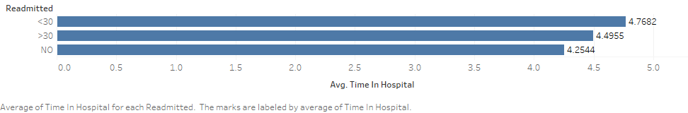
Average time spent by a patient in a hospital is 4-5 days

Slide 18
Agenda
Introduction to the problem
Objective
Data Description
Pre Processing
Visualizations
Model Building
Conclusion

Slide 19
Train – Test – Validation :
Train – 60 %
Validation – 20 %
Test – 20 %

Slide 20
Error Metric :
Recall is the appropriate error metric
Recall = True Positive/Total Actual Positive
We should correctly classify a patient’s readmission, so that right person gets the insurance with right plans/schemes.

Slide 21
Approach – 1 :
Handling the class imbalance using SMOTE, which over samples the minority class.
Approach – 2 :
In this approach, only the important variables are taken into consideration and applied models on it.
Approach – 3 :
In this approach, target variable is made to binary class from multiclass
Target as Yes or No.
Target as >30 or <30.

Slide 22
Approach – 1 :
Handling the class imbalance using SMOTE, which over samples the minority class.
When do you apply SMOTE, “before or after train-test split” ?

Slide 23
The following are the models built using approach – 1 :
Model | Accuracy | Precision | F1 – score | Recall
Logistic Regression | 47.5 | 51 | 48 | 48
Decision Tree | 52 | 50 | 50 | 52
Random Forest | 58 | 56 | 52 | 58
XG Boost | 58 | 54 | 54 | 58
Majority Voting | 52 | 53 | 50 | 52
Stacking | 58 | 70 | 62 | 58

Slide 24
Results of the models built using approach – 2 are as following
Model | Accuracy | Precision | F1 – score | Recall
Logistic Regression | 48 | 51 | 48 | 48
XG - Boost | 59 | 71 | 63 | 59

Slide 25
>30
<30
No
Approach – 3:
Yes
Target
Target
Target – Yes / No
Model | Accuracy | Precision | F1 – score | Recall
Logistic Regression | 60 | 62 | 59 | 61
Random Forest | 62 | 60 | 61 | 62
Target - >30 / <30
Model | Accuracy | Precision | F1 – score | Recall
Logistic Regression | 76 | 93 | 86 | 76
Random Forest | 77 | 95 | 87 | 77

Slide 26
Agenda
Objective
Data Description
Pre Processing
Visualizations
Model Building
Conclusion

Slide 27
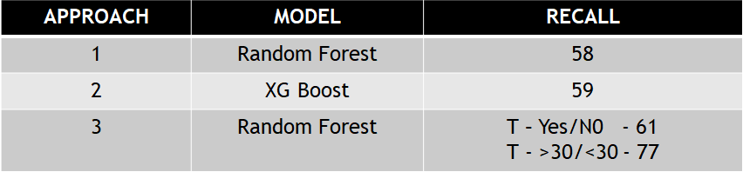
Conclusion :
Based on the approaches made during model building, it can be concluded that these models can be used by the client to predict hospital readmission

Slide 28
Thank You

