Slide 1



AI/ML App for Radioactive Water Contamination Detection
Developed by: Karthikeyan

Slide 2

Learning Objectives
To study the impact of radioactive contamination in water.
To build an AI/ML-based detection system for water safety.
To use Streamlit for creating an interactive web app
.To integrate real-time sensor values into the system.
To provide visual alerts (gauges, meters, graphs) for users.
To maintain a database of regional water quality data.
To create awareness about radiation hazards in humans & animals.
GOAL
Source :
www.freepik.com/

Slide 3
Tools and Technology used
Python 3.11 – programming language for backend logic
Streamlit – for building the interactive web application
Plotly – for visualization and gauge meters
Pandas – for handling and storing datasets
SQLite / CSV – database for storing water quality data with location
Sensors (pH, TDS, Nitrate, Hardness) – to collect real-time values
GitHub – for project hosting and version control
Streamlit Cloud – for public deployment of the web app

Slide 4
Methodology
Collect water parameters (pH, TDS, Hardness, Nitrate).
Compare values with WHO safe standards
Apply AI/ML logic to classify water as Safe/Not Safe
Display results with visual gauges/meters.
Store readings (value + location) in a database file.
Provide download option for future use.
Educate users with tabs on radiation hazards.

Slide 5
Problem Statement:
Groundwater contamination due to industrial & nuclear waste is a growing threat.
Radioactive substances are colorless, tasteless, and invisible.
Lack of awareness & detection tools for local communities.
Need for a low-cost, accessible solution for monitoring water safety.

Slide 6
Solution:
Developed an AI/ML-powered Streamlit app.
Accepts water quality inputs or sensor data
.Provides instant classification: Safe / Not Safe.
Uses visual meters & graphs for better understanding.
Database of local readings → can be shared with authorities.
Awareness tab: Effects of radiation on humans & animals.

Slide 7
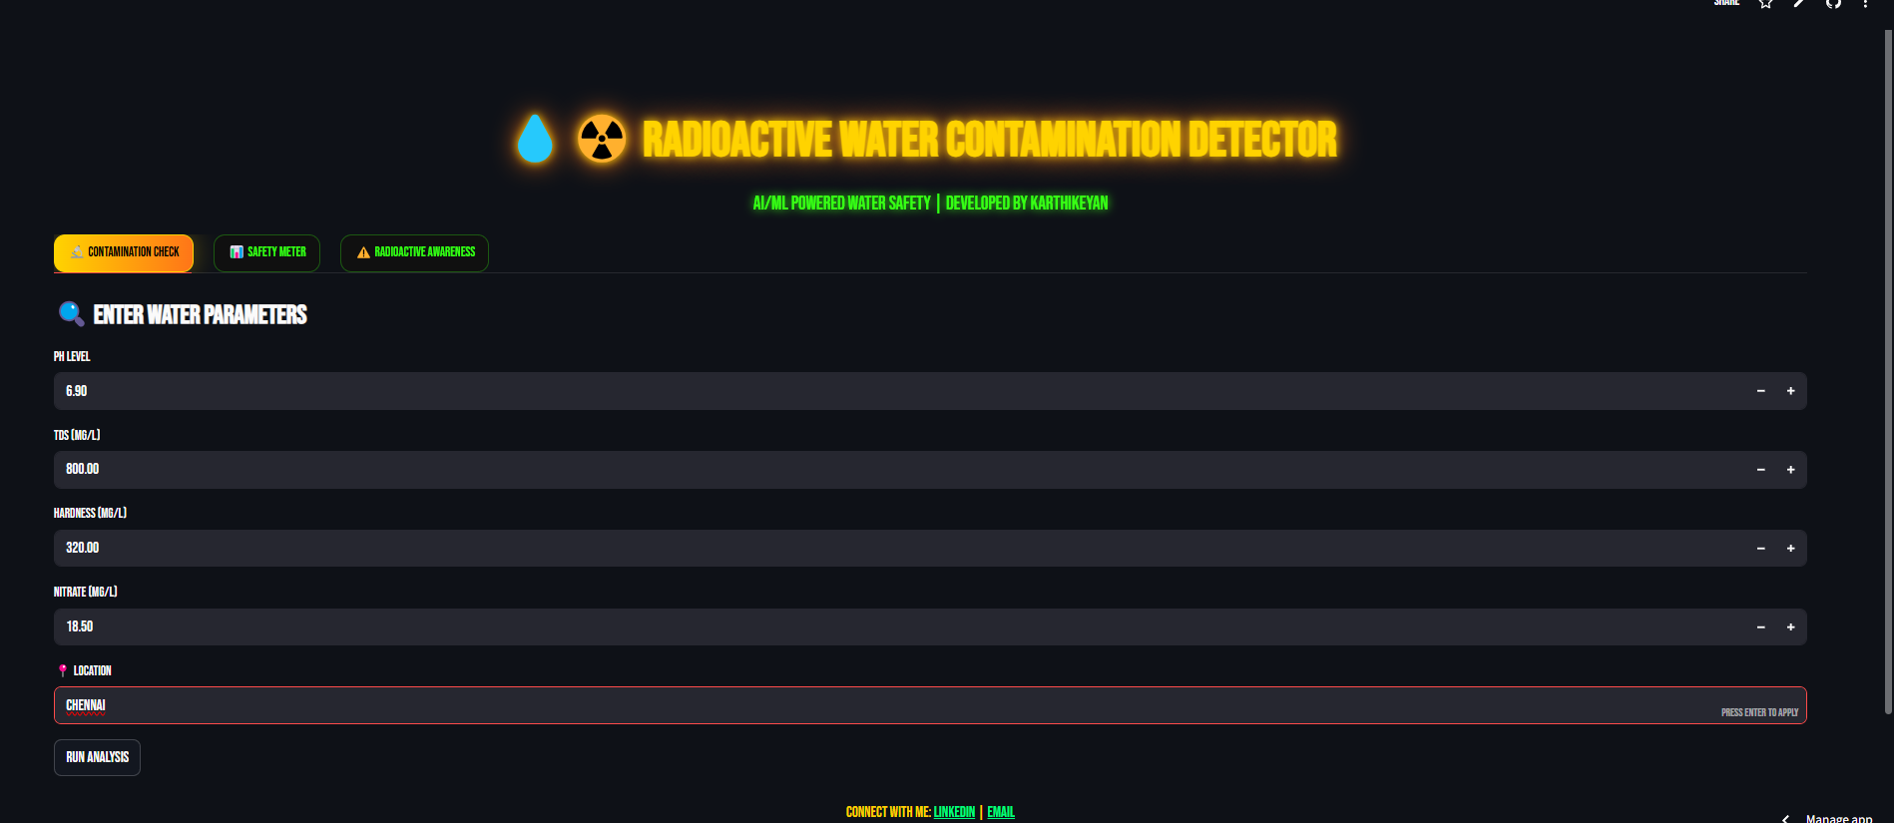
Screenshot of Output:
Step 1: Enter the water parameters.
Step 2: Run analysis.

Slide 8
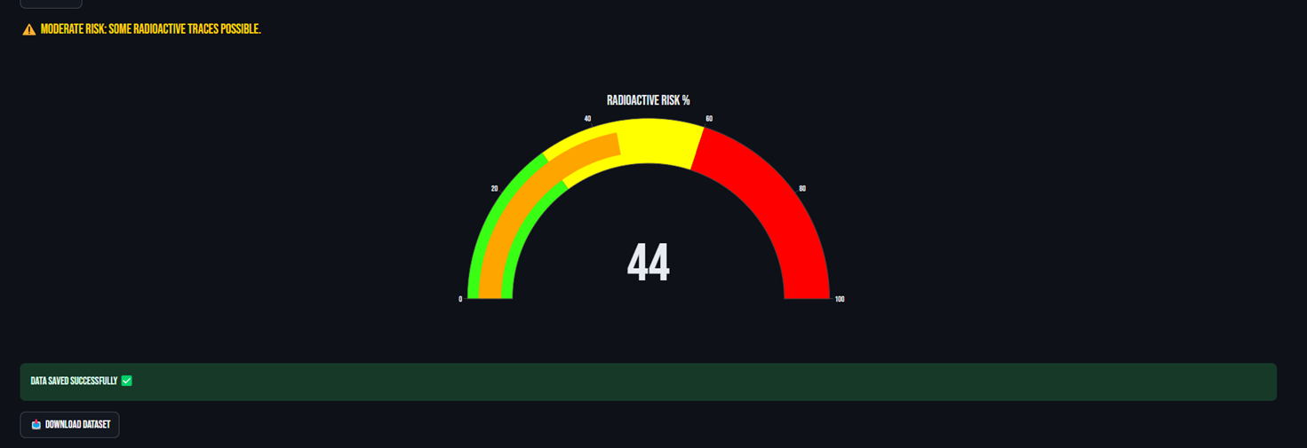
Step 3:Risk meter measures the safety level and gives a risk score.
Step 4:Download dataset.

Slide 9
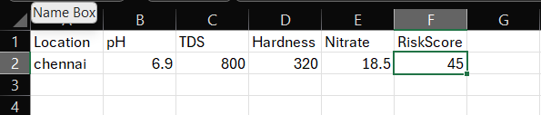
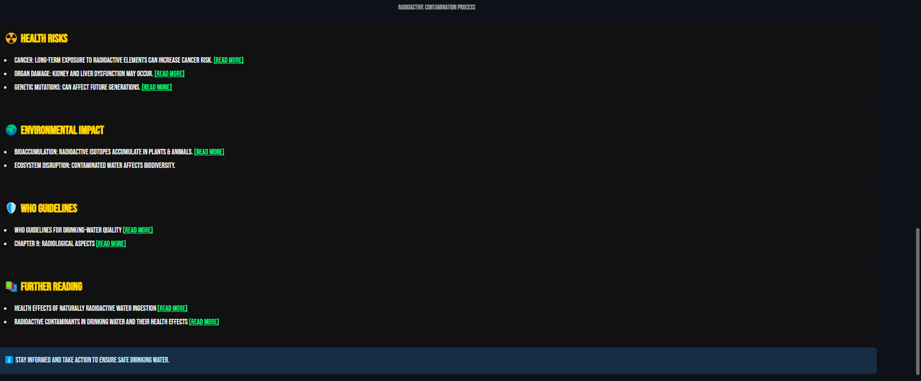
Step 5: The datas are stored in a excel sheet for further research purposes.
Step 6: Awareness tab

Slide 10
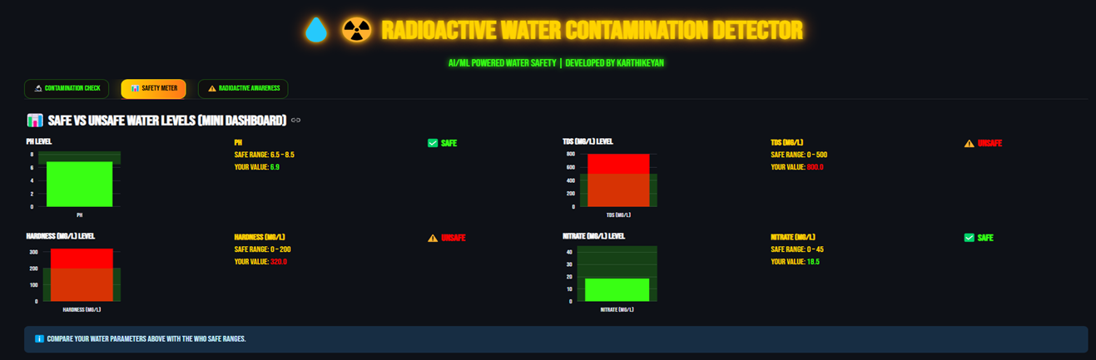
Step 7:Safety meter tab shows the analysis of PH,TDS,HARDNESS,NITRATE.

Slide 11
Conclusion:
Built an interactive app for radioactive water contamination detection.
Highlights the importance of AI/ML in environmental safety.
Can integrate real-time IoT sensors for practical deployment.
Supports data collection & awareness campaigns.
Future scope: Advanced ML models for specific radionuclide detection.

