Slide 1
CONFIGURATION OF TELECOMMUNICATION NETWORK IN A COMPANY
22071A3204 – Anirudh
22071A3209 – Akhil Karthik
22071A3214 – Sai Sreeja
22071A3217 – Sai Nikhilesh

Slide 2
Agenda
Problem Statement
Abstract
Introduction
Objectives
Software and tools required
Network Design
Output screen
Conclusion

Slide 3
Problem Statement
The company faces the challenge of creating a reliable and secure network infrastructure to support diverse departmental needs and services. The solution must ensure uninterrupted communication, including telephony and internet, while maintaining redundancy and scalability for future growth. Departments require efficient resource sharing and centralized management, necessitating a robust and secure design. The network must handle various traffic types, including Voice over IP and wireless connectivity, while leveraging efficient IP segmentation for enhanced security and optimized performance.

Slide 4
Abstract
The project aims to design and implement a secure and efficient network infrastructure for a telecommunication company, distributed across two floors. The first floor houses departments like HR and Finance, Product Marketing, and Admin, while the second floor supports IT Network, Software Engineering, and Cloud Engineering teams. To meet the company's operational needs, Cisco technologies, including ASA Firewalls, switches, Voice Gateway, WLC, and LAPs, are deployed to enable services like VoIP, WLAN, and centralized management. The network prioritizes performance, scalability, redundancy, and high availability, with specific IP allocations for LAN, WLAN, DMZ, and public access.

Slide 5
Introduction
The project focuses on designing and implementing a secure and efficient telecommunication network for a multi-department organization. The network infrastructure is distributed over two floors, with distinct departments requiring tailored communication and IT services. Leveraging Cisco technologies such as ASA Firewalls, Wireless LAN Controllers (WLCs), and Voice Gateways, the network is designed to deliver high performance, scalability, and reliability. The primary aim is to provide seamless connectivity, including VoIP services, robust wireless coverage, and centralized management while maintaining redundancy and security.

Slide 6
Objectives
Design and implement a secure telecommunication company network spanning two floors.
Assign specific departments to each floor:
First floor: HR & Finance, Product Marketing, Admin, and Corporate.
Second floor: IT Network & Support, Software Engineering, and Cloud Engineering.
Integrate Cisco devices (ASA Firewall, switches, Voice Gateway, WLC, and LAPs) for secure and centralized management.
Provide VoIP and wireless LAN services across the network.
Emphasize high performance, redundancy, scalability, and availability.
Use defined IP address ranges for WLAN, LAN, Voice, DMZ, and public network access.

Slide 7
Software and Tools Required
Cisco Packet Tracer:
Used for designing, simulating, and testing the network topology
Cisco IOS Software:
Essential for configuring and managing Cisco devices like routers, switches, firewalls, and WLCs.
Network Configuration Tools:
For managing and automating network device configurations.
Documentation Tools:
Tools like Microsoft Word or Google Docs for project documentation.

Slide 8
Features
Hierarchical Network Design: Structured layers (core, distribution, and access) for scalability and management.
Secure Communication: Implementation of VLANs, Cisco ASA Firewall, ACLs, and NAT for traffic control and security.
Dynamic Routing: Use of OSPF for efficient and scalable routing.
Wireless Access: Centralized WLAN management via WLC and LAPs for employees and guests.
VoIP Services: Configured Voice Gateway for telephony with IP phones.
Redundancy and Performance: Enabled EtherChannel and STP for fault tolerance and optimized performance.
DHCP Management: Dynamic IP allocation for user devices and static IPs for servers.

Slide 9
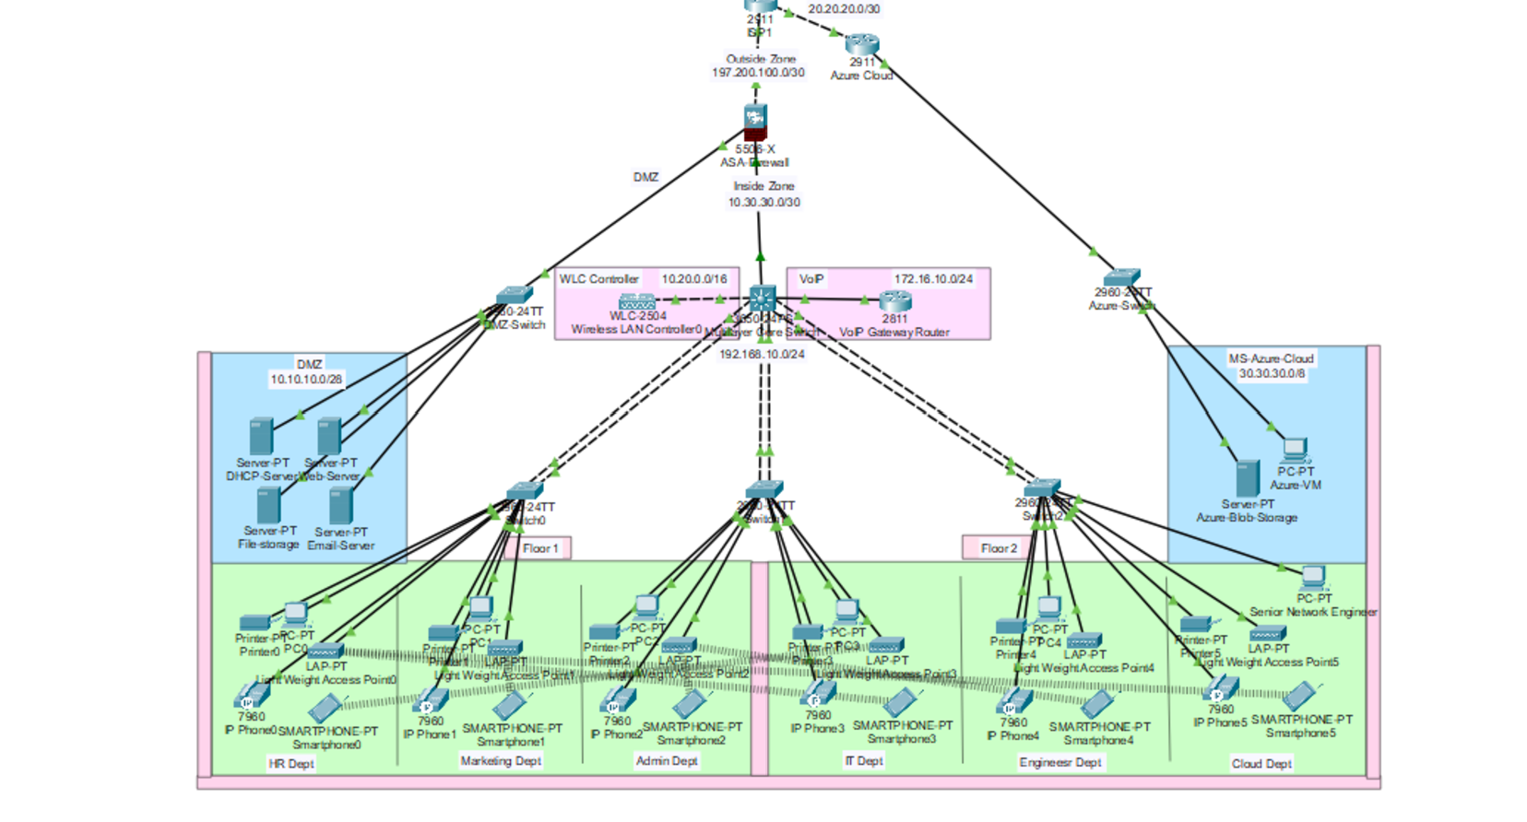
NETWORK DESIGN
ACCESS

Slide 10

Output Screens
Check VLAN connectivity(pinging pc’s in between HR and Marketing department)

Slide 11
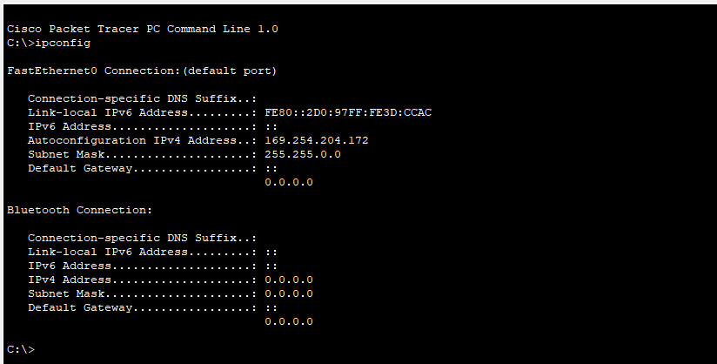
Output Screens
DHCP Test(for a pc in HR department)

Slide 12
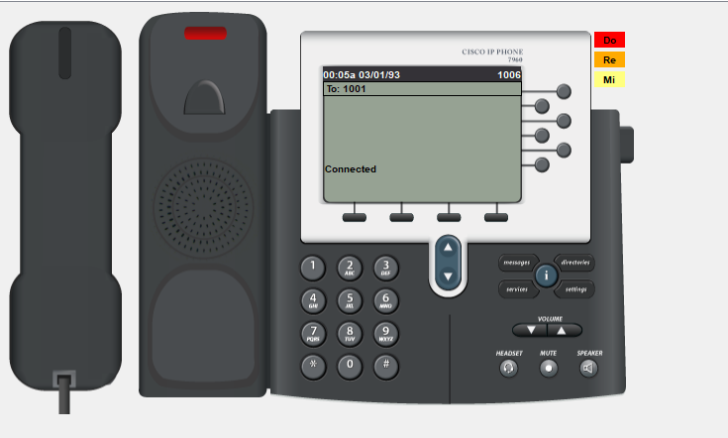
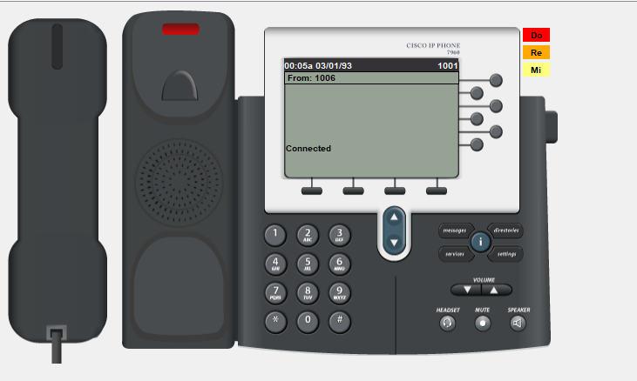
Output Screens
DHCP Test(for a pc in HR department)

Slide 13
Conclusion
Using Cisco Packet Tracer, the project successfully designed and simulated a secure, high-performance network for the telecommunication company. By incorporating Cisco technologies like ASA Firewalls, switches, Voice Gateway, WLC, and LAPs, the network supports VoIP, WLAN, and centralized management while ensuring scalability, redundancy, and high availability. Proper IP allocation and effective configurations ensure a robust, efficient, and future-ready infrastructure tailored to the company’s needs.

Slide 14
Thank you

