Slide 1

Cvs database design

Slide 2
Problem statement
Design and develop a comprehensive database solution for CVS Health to streamline data management, improve operational efficiency, and enhance decision-making processes across the organization's diverse healthcare services and retail operations.

Slide 3
Users
Employees: CREATE USER 'employee'@'localhost' IDENTIFIED BY '12345’;
Administrator: Create user ‘administrator@localhost’ identified by ‘54321’;
Manager: CREATE USER 'Manager'@'localhost' IDENTIFIED BY '13579';

Slide 4
Entities and relationships
• Customer • Transaction • Employee • Insurance • Prescription • Location • Product • Appointments • Cart • Contract • Departments • Distributor • Doctor • Doctor_has_Hospital • DoctorCheck • EmployeeRole • FullTime • HealthRecords • Hospital • InPerson • InStore • Insurance • Location • LocationHasProduct • Manufacturer • Online • PartTime • PayPal • Prescription • Product • Savings • WorkHistory
Each entity has either one-to-one, one-to-many, many-to-one, many to many cardinalities with the other entities as given in the Project Report.

Slide 5
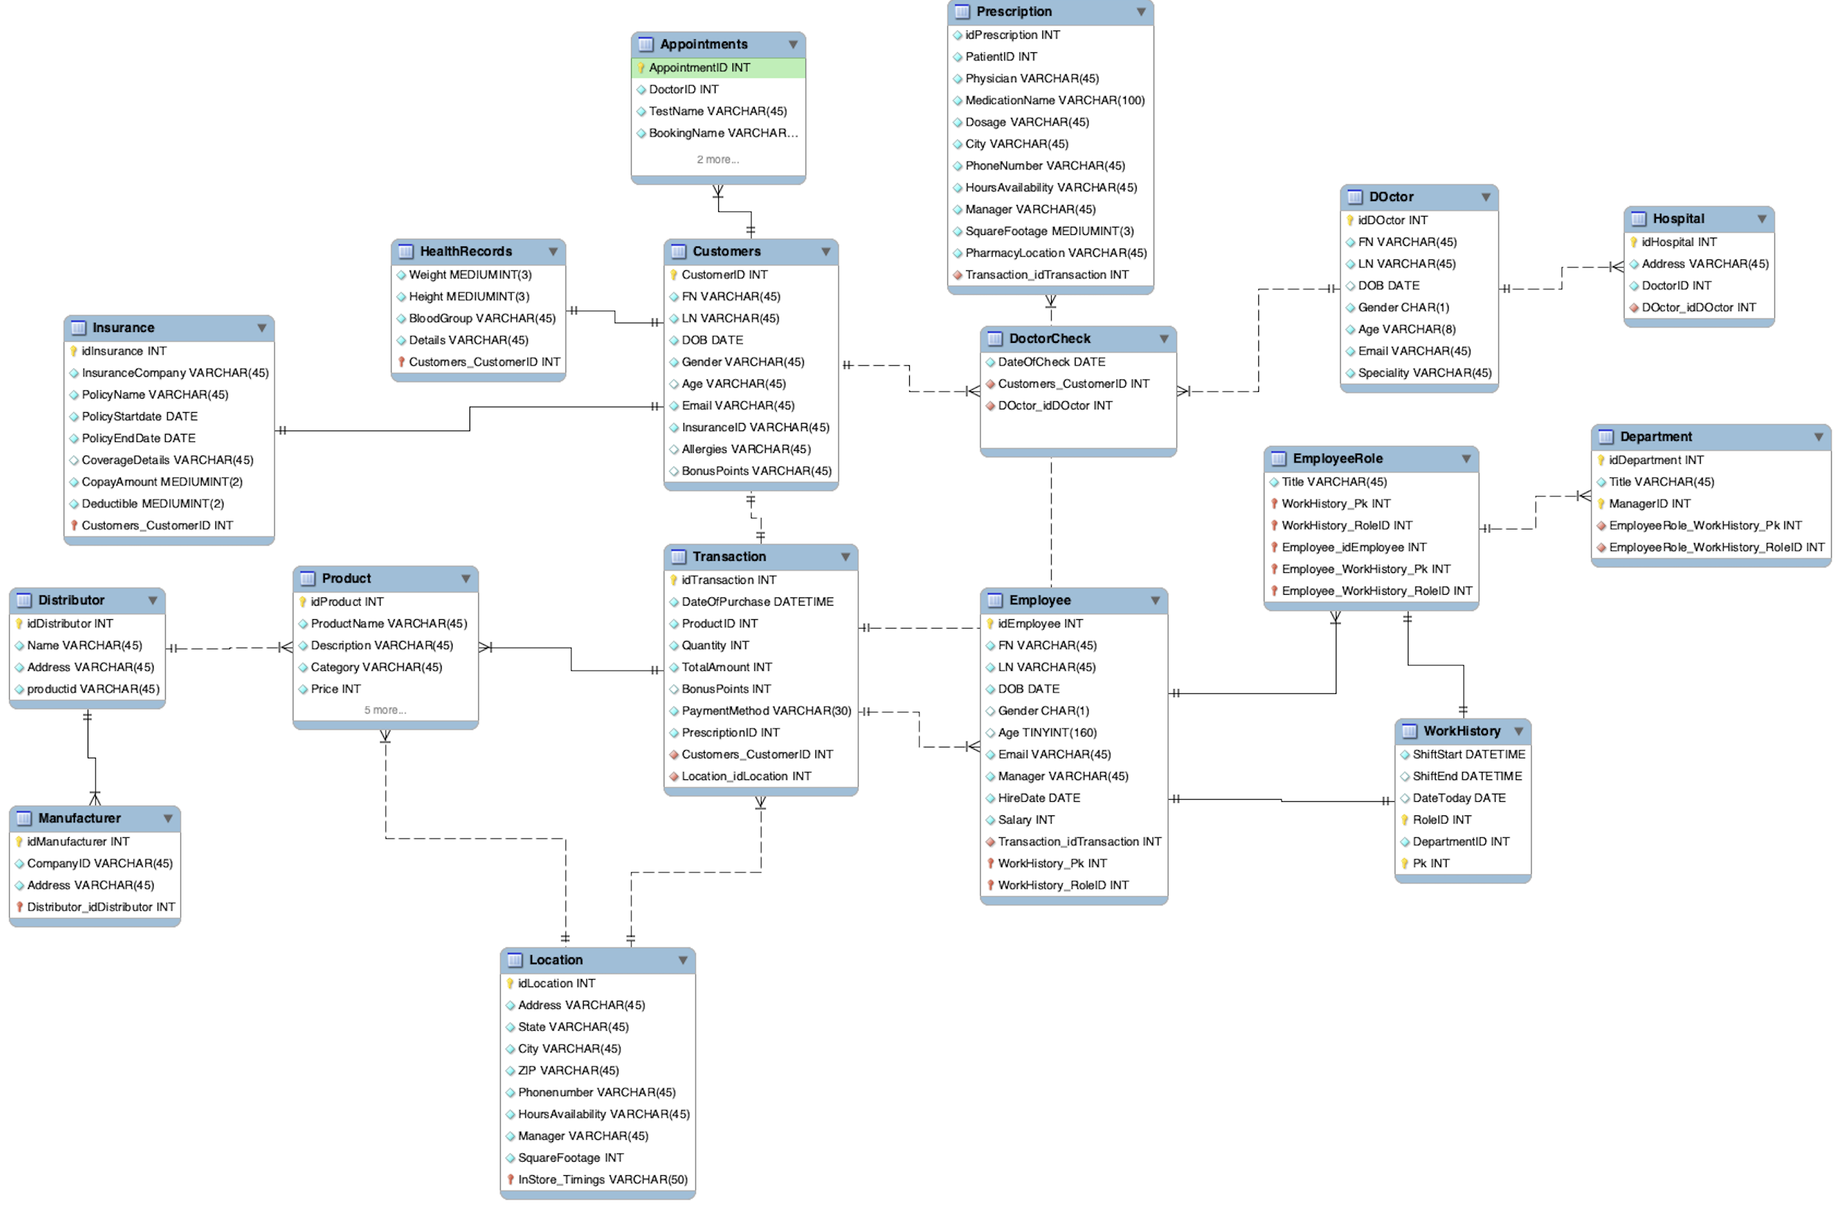
EERD
Before Normalization

Slide 6
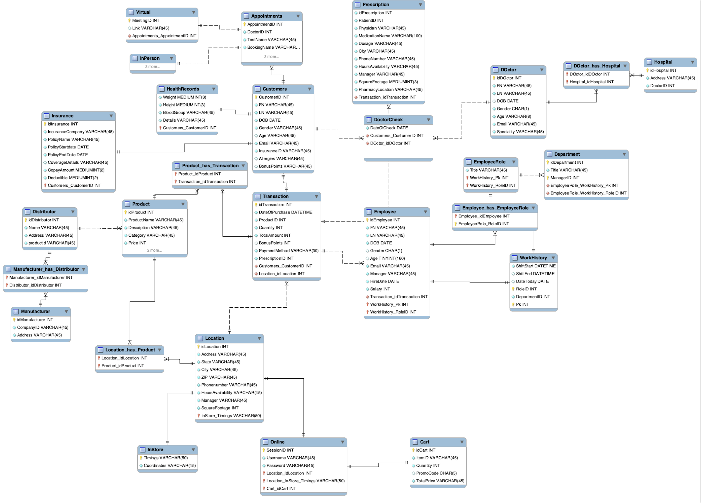
EERD
After Normalizing

Slide 7
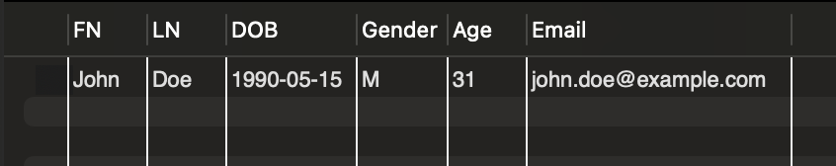
Views
Retrieving employees from Marketing Department from department table and employee table

Slide 8
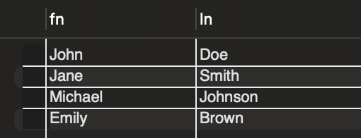
VIEWS
Retrieving customers who purchased one time from customer and transaction tables

Slide 9
triggers
Prevent deleting customers record with a transaction pending
We achieve this by creating a trigger which checks for pending transaction associated with a customer before deleting the customer record from the database
Prevent inserting transaction with total amount lesser than or equal to zero
We achieve this by creating a trigger which checks the transaction amount before logging the transaction to make sure the total amount of purchase is not zero or negative

Slide 10
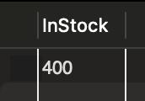
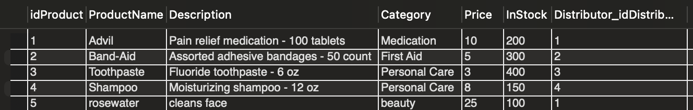
Procedures
Check Medication Stock
We create a procedure that can be called to check the remaining stock of the given product, we can achieve this by using the command call CheckMedicationStock(‘Toothpaste’)
Add New Medication
We create a procedure that can be called to add a new product, we can achieve this by using the command call AddNewMedication(5,'rosewater','cleans face','beauty',100,25 )

Slide 11
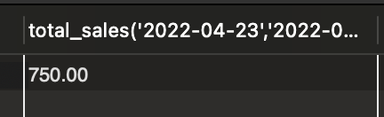
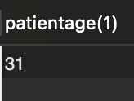
Functions
Function to Calculate Total Sales for a Given Date Range: select total_sales('2022-04-23','2022-06-23');
Function to Retrieve Patient Age: select patientage(1);

Slide 12
Privileges
GRANT ALL PRIVILEGES ON mydb.* TO 'administrator'@'localhost';
GRANT SELECT ON mydb.transaction TO 'employee'@'localhost';
GRANT SELECT ON mydb.product TO 'employee'@'localhost';
GRANT ALL PRIVILEGES ON mydb.* TO 'manager'@'localhost’;
Flush privileges;

Slide 13
Backup data
Backedup Data = Github

Slide 14

Thank you ☺

