Slide 1
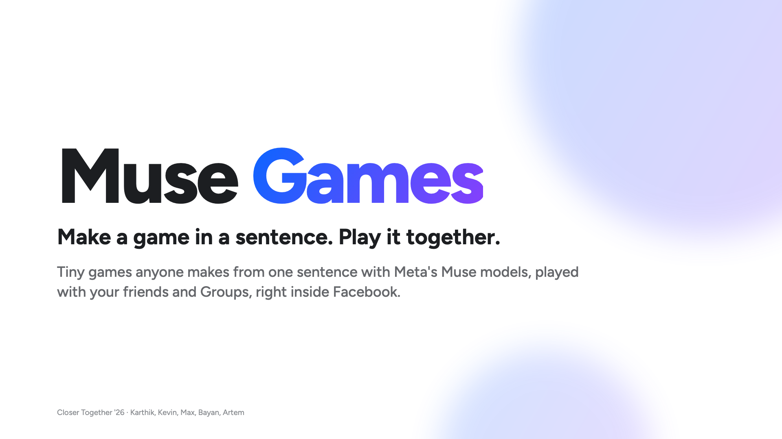
Notes:
Hi, we're Muse Games. Make a game in a sentence, and play it together, right inside Facebook. *(Say "dodge the fog over Twin Peaks", tap Make, agree the plan.)*

Slide 2
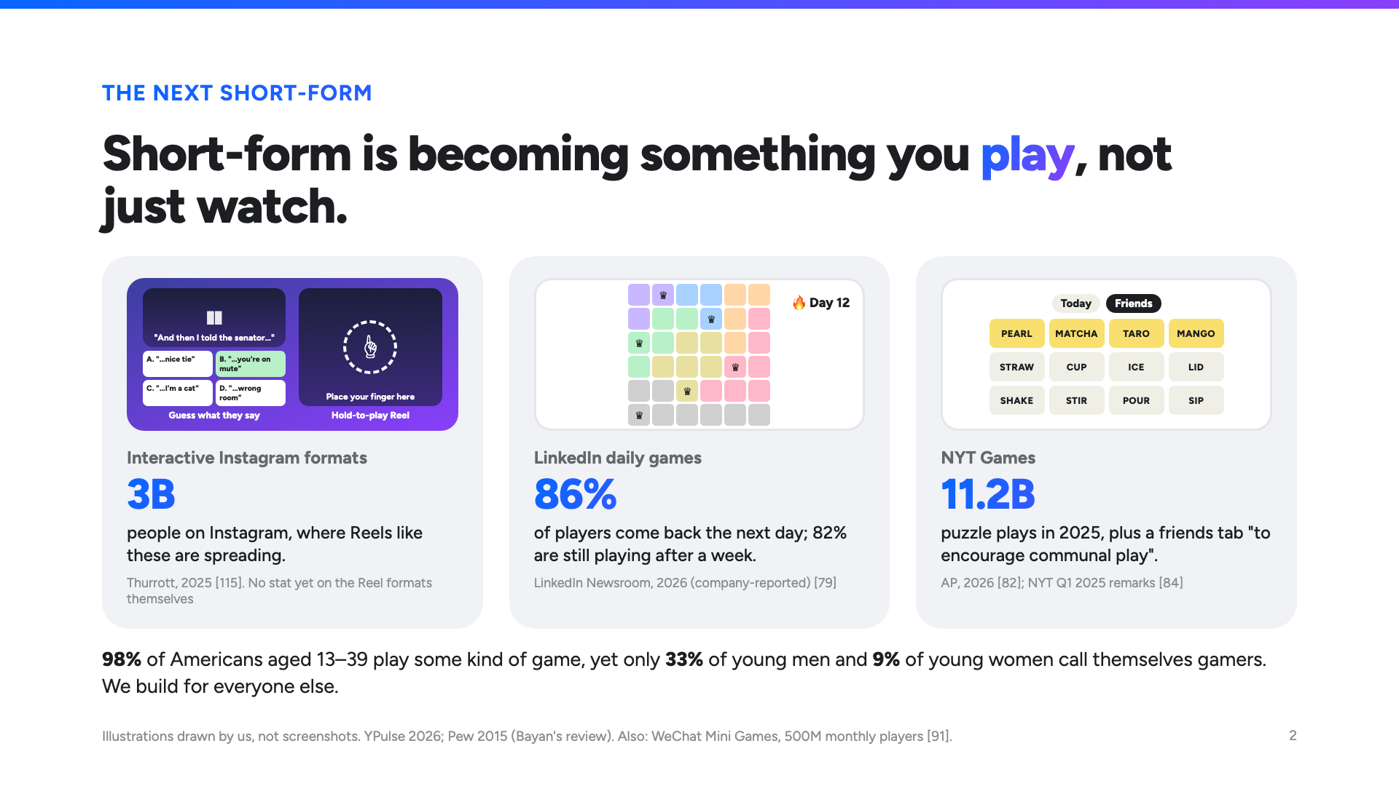
Notes:
Short-form is becoming something you play. LinkedIn's daily players come back the next day 86% of the time; NYT puzzles were played 11 billion times last year. And nearly everyone plays, but almost nobody calls themselves a gamer. We build for everyone else.

Slide 3
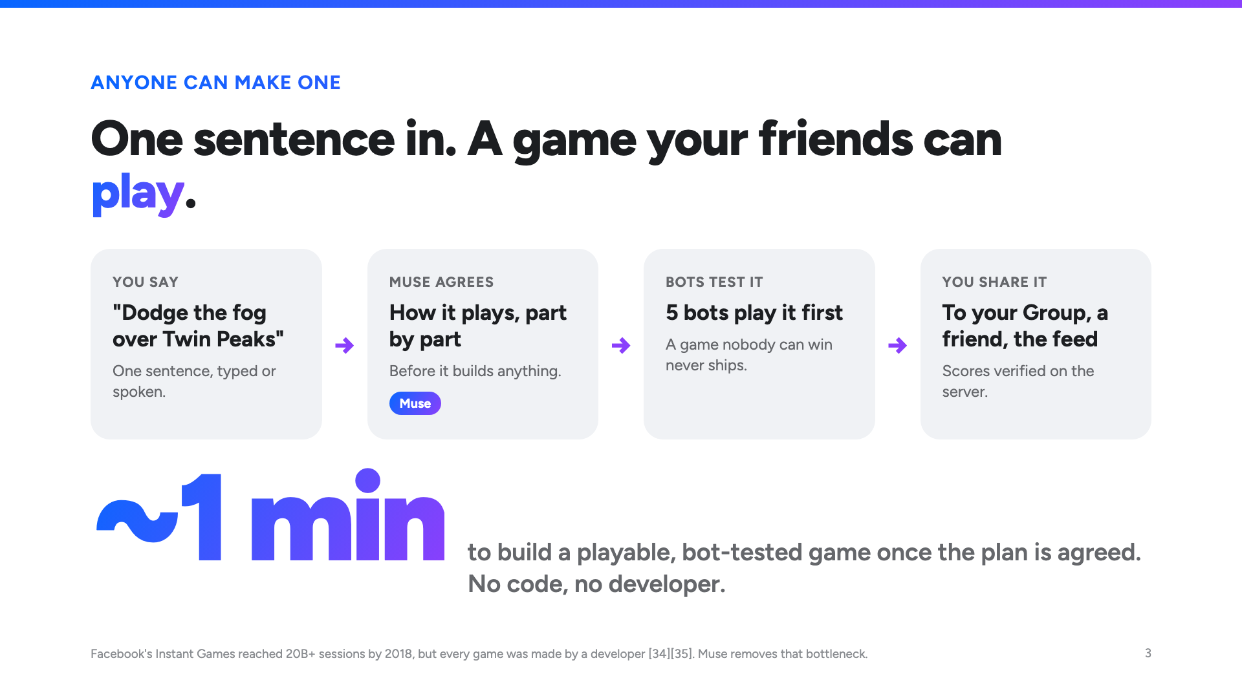
Notes:
What's new: anyone can make one. One sentence; Muse agrees with you how it plays, five bots test it, and about a minute later your friends can play it. Mine is building right now; we'll come back to it.

Slide 4
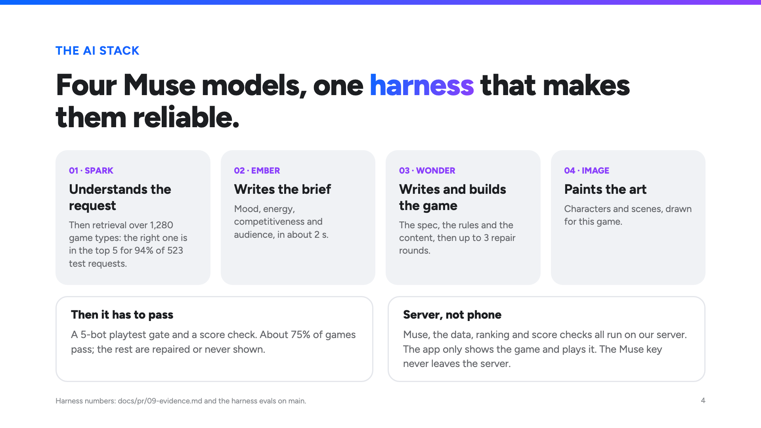
Notes:
Four Muse models. Spark understands the request, grounded in 1,280 game types. Ember writes the brief, Wonder writes, builds and repairs the game, Image paints the art. A five-bot gate decides if it ships. It all runs on our server; the phone just plays.

Slide 5
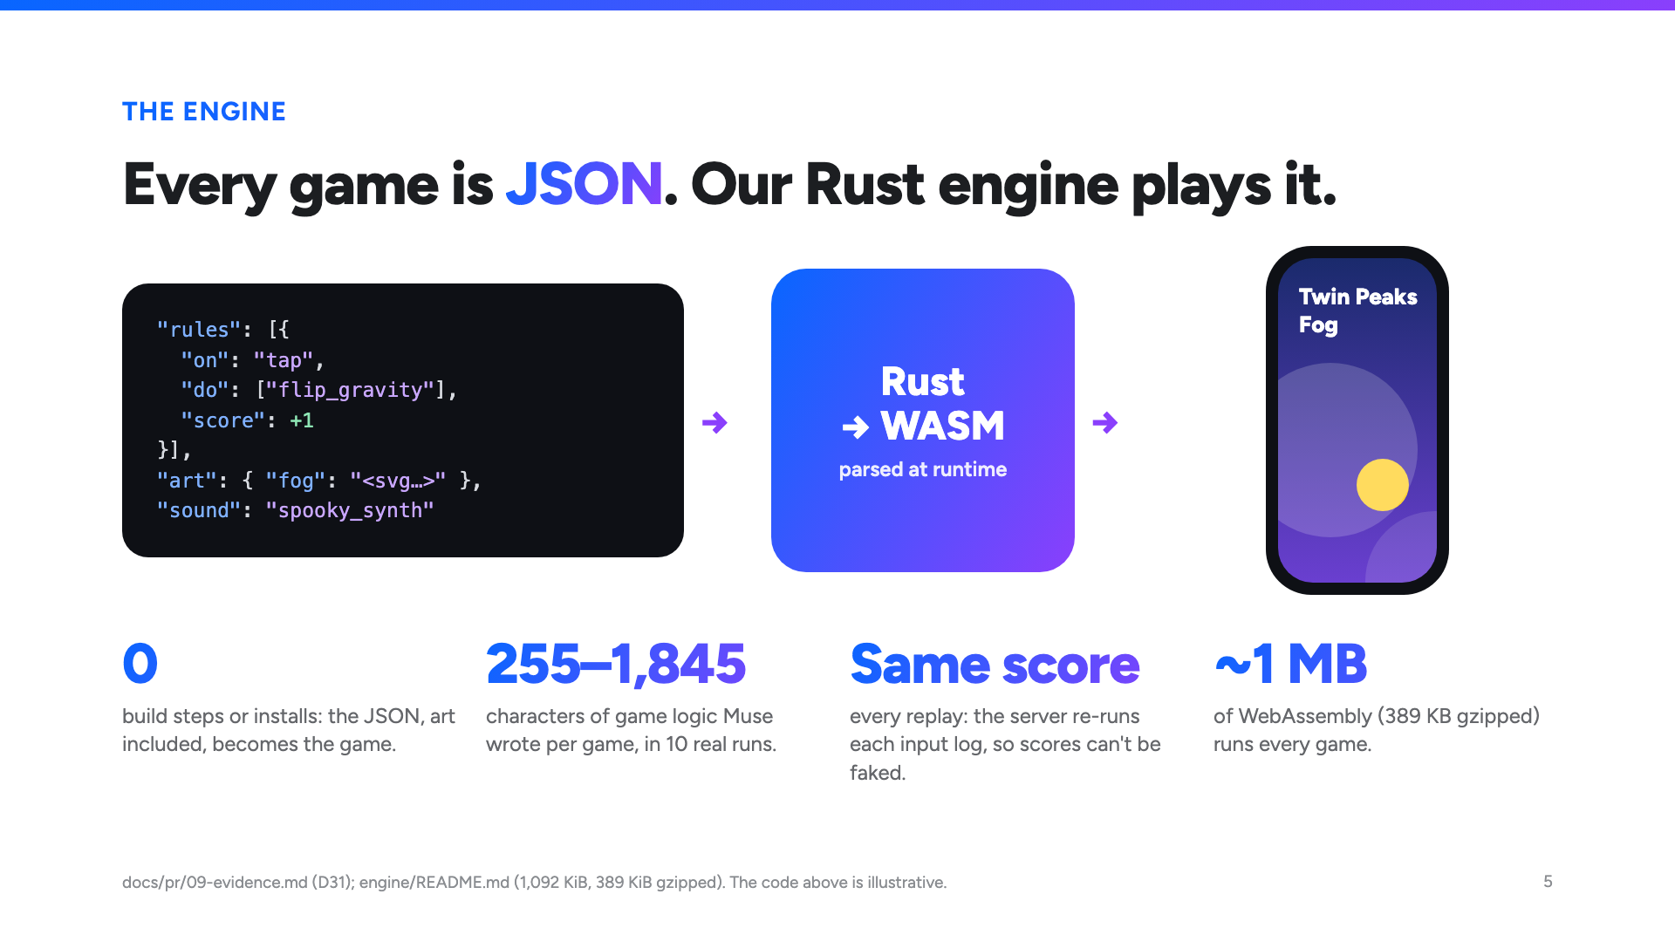
Notes:
Every game is just JSON, art included. Our Rust engine, compiled to WebAssembly, reads it at runtime and turns it into the game: no build step, about one megabyte. It's deterministic, so the server replays every score to check it. And here's the game I started. *(Demo 1, 40 s.)*

Slide 6
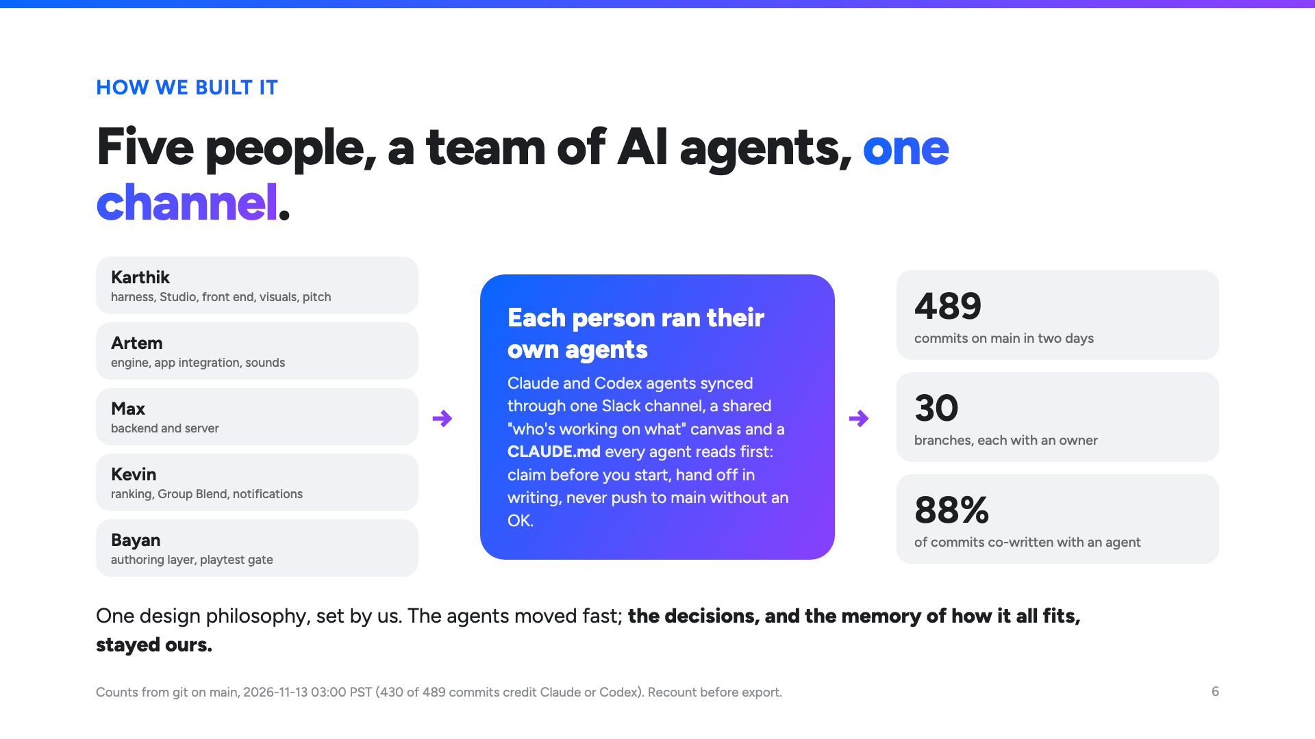
Notes:
Five of us built this, each running our own AI agents, all synced through one Slack channel, a shared board and one CLAUDE.md. 489 commits in two days. The agents moved fast; the decisions stayed ours.

Slide 7
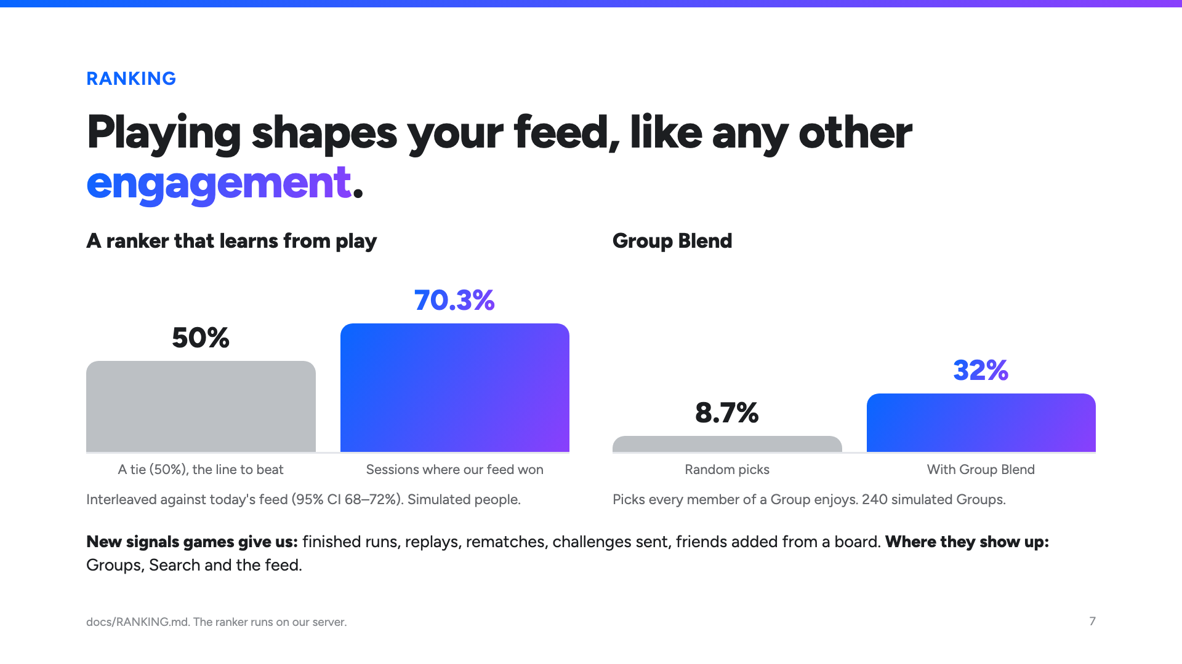
Notes:
Games are a new signal for the feed: finished runs, replays, rematches, friends added from a board. In simulation, our ranker beat today's feed in 70% of sessions, and Group Blend took games everyone in a Group enjoys from under 9% to 32%. *(Demo 2, 25 s.)*

Slide 8
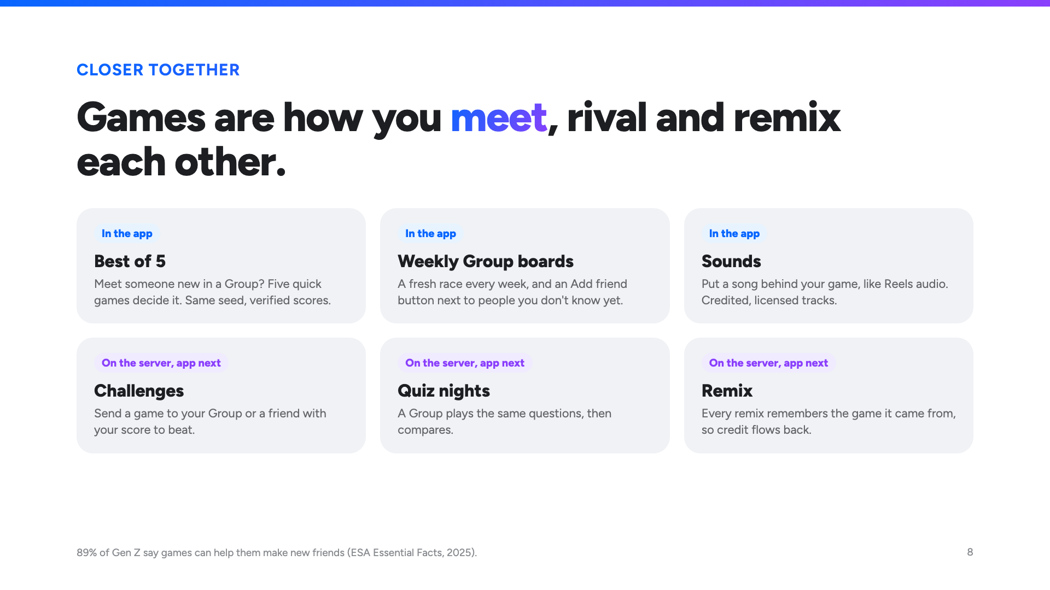
Notes:
And it brings people closer. Every Group gets a weekly board; meet someone new on it, and a best of 5 settles it. Challenges, quiz nights and remixes are built on the server and coming to the app next. *(Demo 3, 30 s.)*

Slide 9
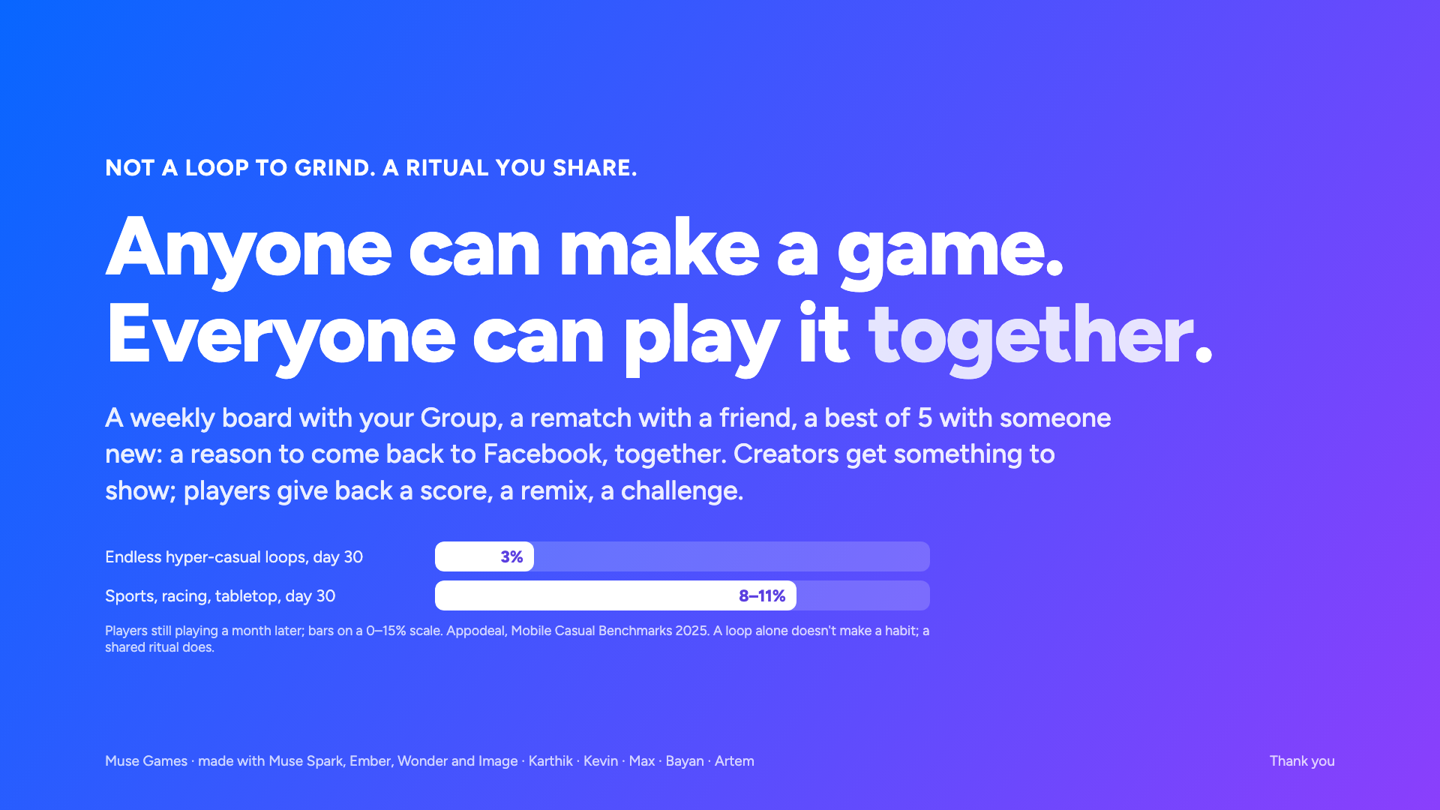
Notes:
Endless loops lose people: about 3% are still playing a month later. A shared ritual is different: a weekly board with your Group, a rematch with a friend. Anyone can make a game. Everyone can play it together. Thank you.

