Slide 1
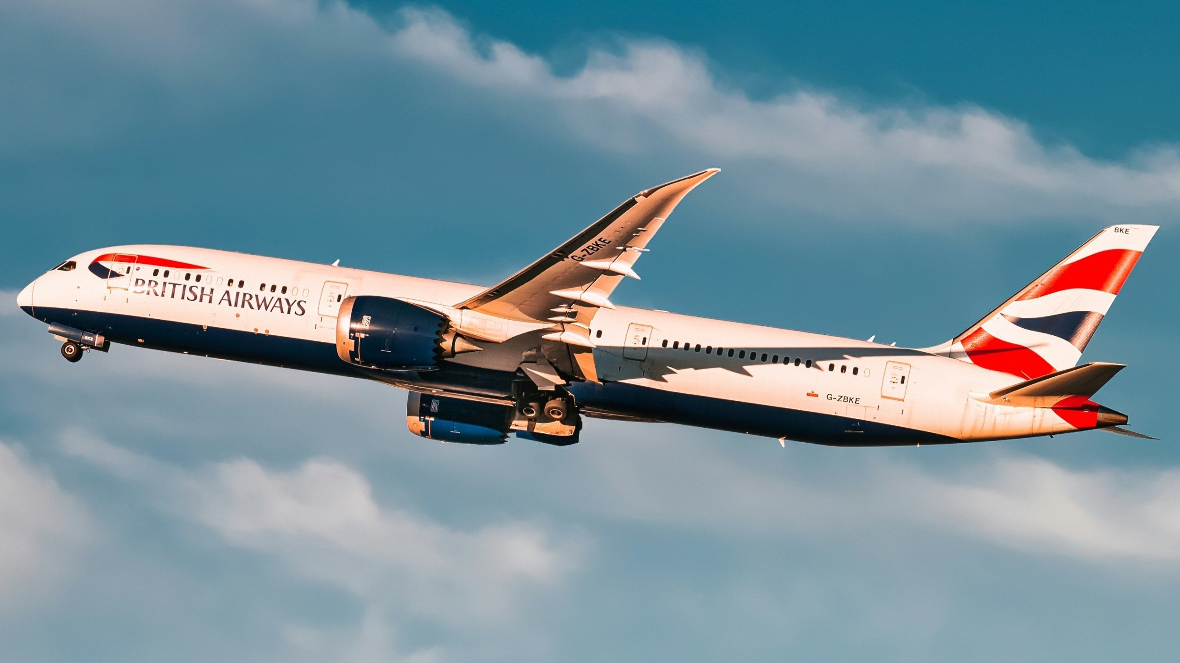
British Airways
Predicting customer buying behaviour

Slide 2
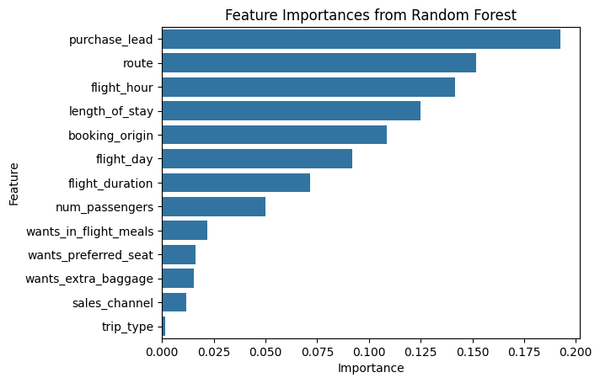
Predictive Model To Understand Factors That Influence Buying Behaviour
Target Imbalance Observed
84% of samples are non-bookings, causing skewed predictions
Feature Importance (via Correlation)
Top correlated features with booking completion:
flight_duration: -0.11
wants_extra_baggage: 0.07
wants_preferred_seat: 0.05
All features show low correlation, suggesting potential for non-linear models or feature engineering
Model Performance (Confusion Matrix)
Accuracy: 85%
Precision (Class 1): 54%
Class Imbalance Impact: Model predicts class 0 well, but misses most booking completions
Fig 1: Feature Importances from Random Forest
Most important predictors: purchase_lead, flight_hour, route, and customer preferences.
Model performed with decent accuracy and revealed interpretable insights using feature importances.

