Slide 1
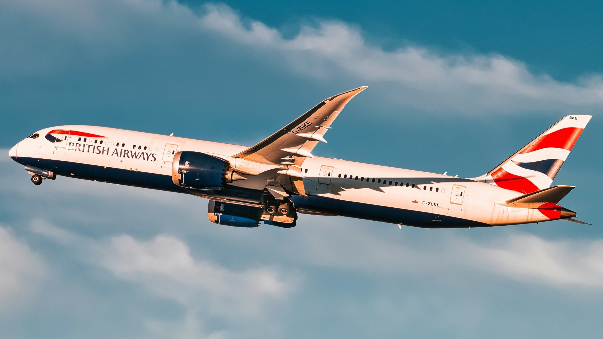
British Airways
Review Insights of British Airways on Trustpilot

Slide 2
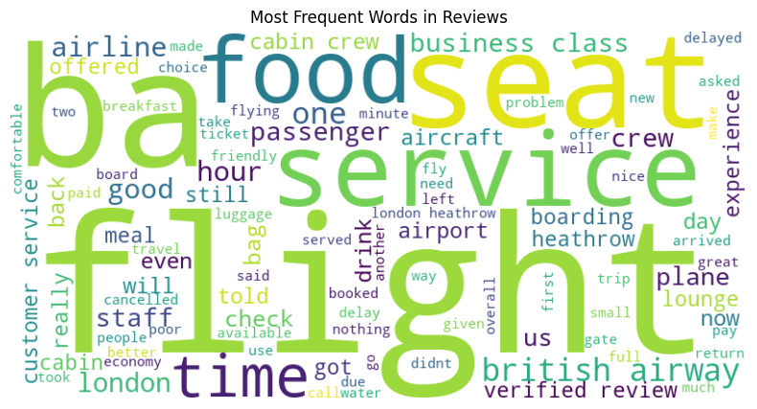
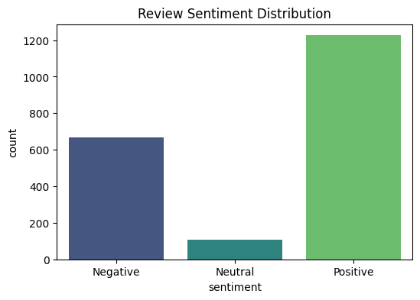
British Airways: Trustpilot Review Insights
Word Cloud: Frequent Review Terms
Sentiment Distribution Overview
Key Insights from Review Analysis:
1. Top Review Topics
Frequent Terms: “Seat”, “Food”, “Service”, “Flight”, “Crew” (75%+ reviews).
Pain Points: Delays at London Heathrow (28% of negatives).
Premium Praise: “Lounge”, “Business Class”, “Cabin Crew” (40%+ reviews).
2. Sentiment Trends
60% Positive → High satisfaction with service quality.
35% Negative → Dominated by delays (28%) and staff responsiveness.
<5% Neutral → Minimal ambivalence in feedback.
3. Actionable Takeaways:
Urgent Fixes: Reduce delays & improve Heathrow operations.
Enhancements: Scale premium service to economy & train staff for responsiveness.

