Slide 1
Evaluation in IR

Slide 2
Evaluation
User happiness
Quality of results –
Accuracy ; Diversity ; Novelty …
Speed of response
User interface

Slide 3
System Evaluation
Efficiency: time, space
Effectiveness:
How is a system capable of retrieving relevant documents?
Is a system better than another one?

Slide 4
Kinds of efficiency measures
Unranked retrieval
Ranked retrieval

Slide 5
Evaluation of unranked retrieval

Slide 6
Evaluation System
To measure ad hoc information retrieval effectiveness in the standard way, we need a test collection consisting of three things
A document collection
A test suite of information needs, expressible as queries
A set of relevance judgments, a binary assessment of either relevant or non relevant for each query-document pair.

Slide 7
Precision and Recall
Precision
Fraction of retrieved docs that are relevant = P(relevant | retrieved)
Recall
Fraction of relevant docs that are retrieved = P(retrieved | relevant)
 | Relevant | Nonrelevant
Retrieved | A | B
Not Retrieved | C | D
Precision P = A/(A+B)
Recall R = A/(A+C)
Accuracy = (A+D) / (A+B+C+D)

Slide 8
Example 1
Consider the following table of retrieval results from a collection of 16 documents, D1 through D16, for two different retrieval algorithms in response to some specific query.
A 1 in each row entry for either of the algorithms indicates that the algorithm retrieved the specified document in response to the query.
In the last row, a y indicates the actual relevance judgment that the specified document is relevant to the query (n means not relevant).
D1 D2 D3 D4 D5 D6 D7 D8 D9 D10 D11 D12 D13 D14 D15 D16
------------------------------ --------------------------------------------------------------
Alg1 1 1 0 1 0 1 1 0 0 1 1 0 1 1 0 0
Alg2 1 0 1 1 1 1 1 1 1 1 1 1 0 1 0 1
--------------------------------------------------------------------------------------------------
Relv y y n n y y y n y y y n n n y y
Alg1 : precision = 6 / 9 (66%) recall = 6 /10 (60%)
Alg2: precision = ? recall = ?

Slide 9
Example 2
The table shows how two human judges assigned documents to the class
“English” (0 = is not written in English
1 = is written in English).
docID 1 2 3 4 5 6 7 8 9 10 11 12
Judge1 0 0 1 1 1 1 1 1 0 0 1 0
Judge2 0 0 1 1 0 0 0 0 1 1 1 0
Let us assume that you’ve written a classifier that assigns the documents {2, 5, 6, 7, 8} to “English”.
Precision = 0/5 Recall = 0/3 (both agree)
Precision = 4/5 Recall = 4/9 (either agree)

Slide 10
Example 3
An IR system returns 8 relevant documents, and 10 nonrelevant documents. There are a total of 20 relevant documents in the collection.
Precision ? Recall ?
Example 4
N = 10,000; No of relevant documents = 1
Retrieved documents = 10,000 → Recall = 100%
Precision = 1/10000 = 0.0001.

Slide 11
Precision Vs Recall
Recall can be 100% by selecting all the documents
Recall is a non decreasing function of the number of documents retrieved
In a good system, precision decreases as either the number of docs retrieved or recall increases

Slide 12
Trade-off between Recall and Precision
Returns relevant documents but
misses many useful ones too
The ideal
1
Precision
0
1
Recall
Returns most relevant
documents but includes
lots of junk

Slide 13
A single measure
Arithmetic mean of recall and precision
effectiveness= (P+R )/2
Weighted average
Example:
1) P= 1% Recall = 100% mean = 50%
2) Consider that 1 document out of 10,000 is relevant to a query
Precision = 1/10000 = 0.0001 Recall = 100% = 1
Mean = (1+.0001)/2= 1.0001/2 ≈.500
Harmonic mean = .02%

Slide 14
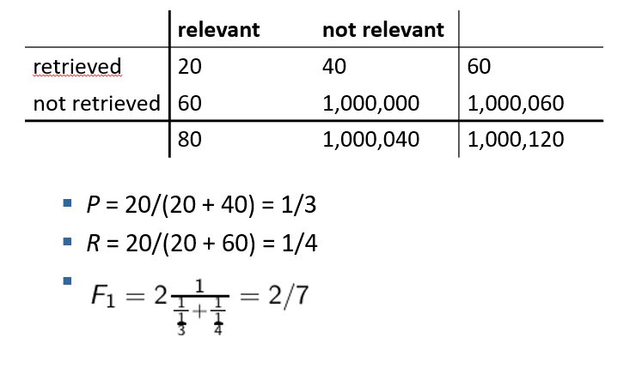
Example 5

Slide 15
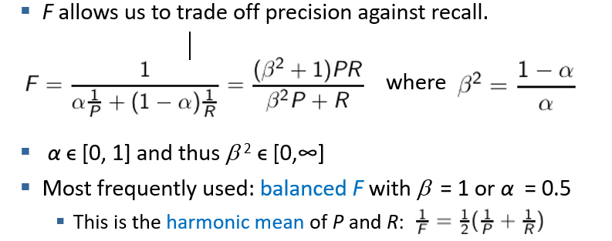
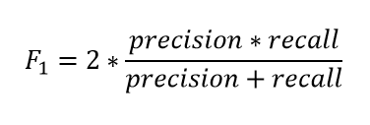
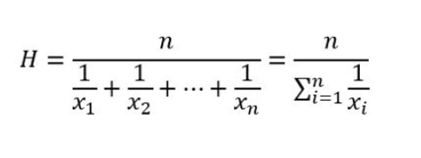
Harmonic mean
Punish really bad performance on either precision or recall.

Slide 16
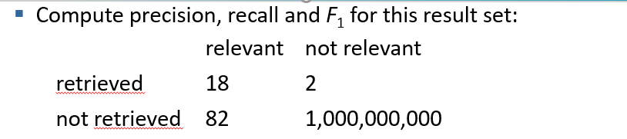
Why Accuracy is not good?
Consider a search engine which returns 0, (no results ) for any query
Simple trick to maximize accuracy in IR: always say no and return nothing
You then get 99.99% accuracy on most queries.
Searchers on the web (and in IR in general) want to find something and have a certain tolerance for junk.
It’s better to return some bad hits as long as you return something.
→We use precision, recall, and F for evaluation, not accuracy

Slide 17
Summary
Effectiveness
Efficiency
Metrics for unranked retrieval
Precision
Recall
Trade-off of P &R
F measure
Accuracy

