Slide 1
Evaluation of ranked retrieval

Slide 2
Ranked Evaluation
Precision, recall and F measure are set based measures. They are computed for un ordered set of documents.
In search engines, (in ranked retrieval) the relevant documents are expected at the top end of the list.

Slide 3
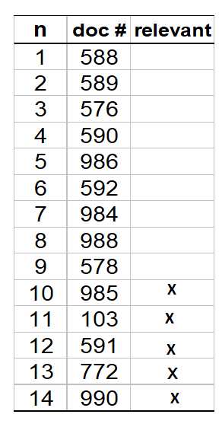
Ranked Evaluation
Let total # of relevant docs = 6
Precision = 5/14
Precision = 5/14
Recall= 5/6
Recall= 5/6

Slide 4
Ranked Evaluation
Precision at k
How many good results are in the first page
Number of relevant documents in the top k results
Advantage: does not require the size of the relevant documents
Precision@10

Slide 5
Precision@k
Precision at the k th position in the ranking of results for a query.
Precision@k = 4/8 = 0.5
k=8

Slide 6
Ranked Evaluation
R – Precision
R → total number of relevant documents
Precision of the top-relevant documents returned.
If we have a known set of relevant documents of size Rel, then calculate precision of the top Rel docs returned
Perfect system could score 1.0.

Slide 7
R- Precision
Precision at the R-th position in the ranking of results for a query that has R relevant documents.
R = # of relevant docs = 6
R-Precision = 4/6 = 0.67

Slide 8
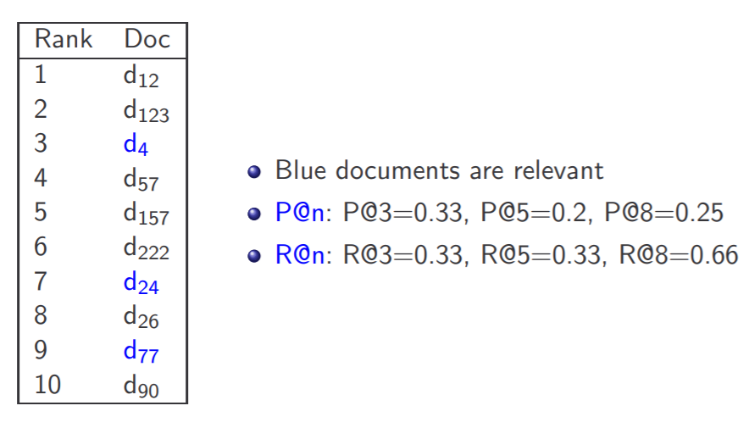
Precision/Recall @K

Slide 9
PR curve
PR curve
Precision
Recall

Slide 10
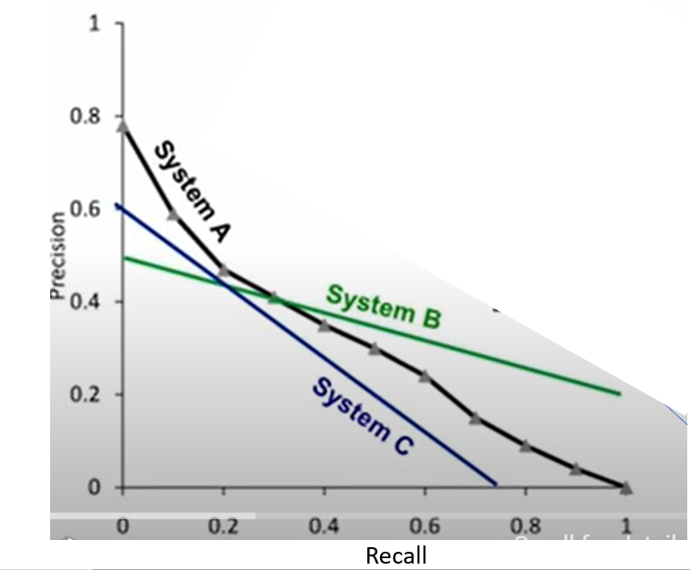
PR curve
Systems comparisons
System A is worse than System B if recall is important
System A is always better than C
Recall

Slide 11
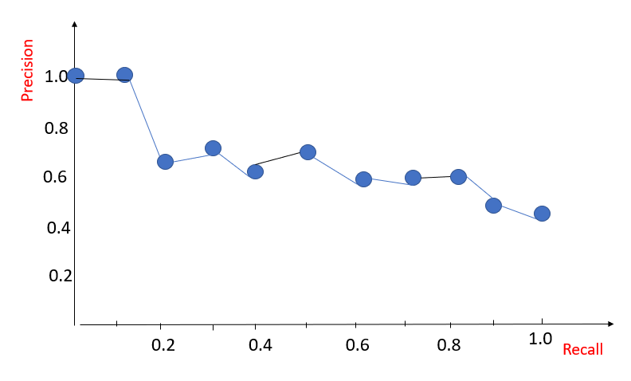
11 point PR curve
Position | Doc id | Relevance
1 | 24 | R (1)
2 | 23
3 | 56 | R (2)
4 | 1 | R (3)
5 | 78
6 | 76 | R (4)
7 | 34 | R (5)
8 | 8
9 | 9 | R (6)
10 | 11
11 | 2 | R (7)
12 | 89 | R (8)
13 | 66
14 | 44
15 | 33
16 | 17 | R (9)
17 | 58
18 | 80
19 | 49
20 | 29 | R (10)
Recall | Precision
0 | 1
0.1 | 1
0.2 | 0.67
0.3 | 0.75
0.4 | 0.67
0.5 | 0.71
0.6 | 0.67
0.7 | 0.64
0.8 | 0.67
0.9 | 0.56
1.0 | 0.5

Slide 12
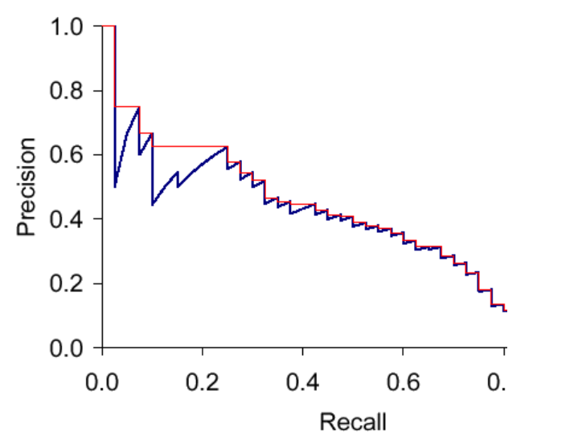
If the retrieved document is relevant, then both precision and recall increase, and the curve jags up and to the right.
It is often useful to remove these jiggles and the standard way to do this is with an interpolated precision

Slide 13
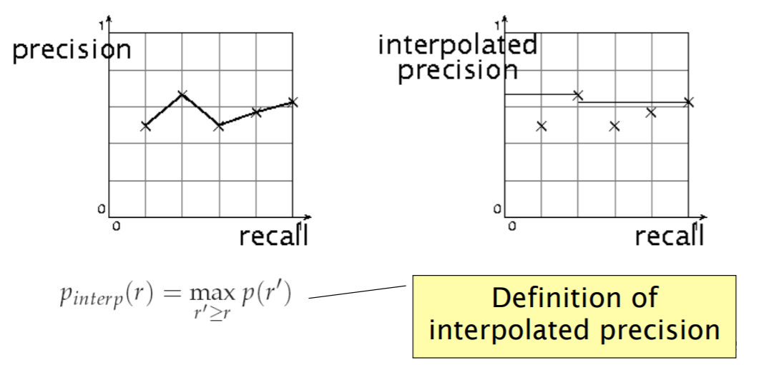
Interpolated precision
If locally precision increases with increasing recall, then you should get to count that…
So you take the max of precisions to right of value

Slide 14
Computing Recall/Precision Points: Example 1
Let total # of relevant docs = 6
Check each new recall point:
R=1/6=0.167; P=1/1=1
R=2/6=0.333; P=2/2=1
R=3/6=0.5; P=3/4=0.75
R=4/6=0.667; P=4/6=0.667
Missing one
relevant document.
Never reach
100% recall
R=5/6=0.833; p=5/13=0.38

Slide 15
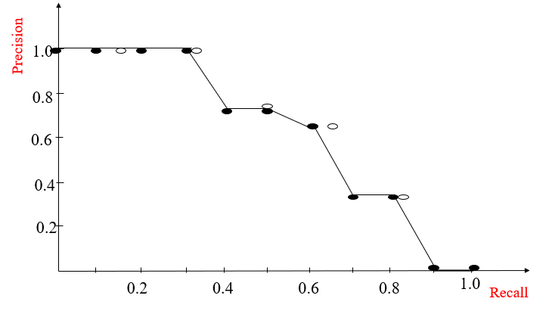
Interpolating a Recall/Precision Curve: Example1
known recall
.167
.333
Interpolated precision
.50
.667
.833

Slide 16
Computing Recall/Precision Points: Example2
Let total # of relevant docs = 6
Check each new recall point:
R=1/6=0.167; P=1/1=1
R=2/6=0.333; P=2/3=0.667
R=3/6=0.5; P=3/5=0.6
R=4/6=0.667; P=4/8=0.5
R=5/6=0.833; P=5/9=0.556
R=6/6=1.0; p=6/14=0.429

Slide 17
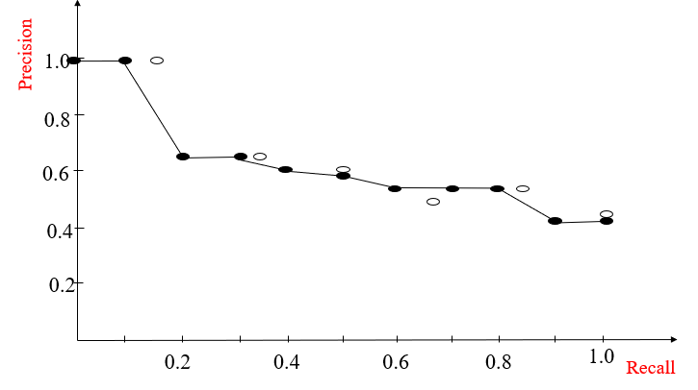
Interpolating a Recall/Precision Curve: Example2

Slide 18
Mean Average Precision (MAP)
Average Precision: Average of the precision values at the points at which each relevant document is retrieved.
Ex1: (1 + 1 + 0.75 + 0.667 + 0.38 + 0)/6 = 0.633
Ex2: (1 + 0.667 + 0.6 + 0.5 + 0.556 + 0.429)/6 = 0.625
Mean Average Precision: Average of the average precision value for a set of queries.

Slide 19
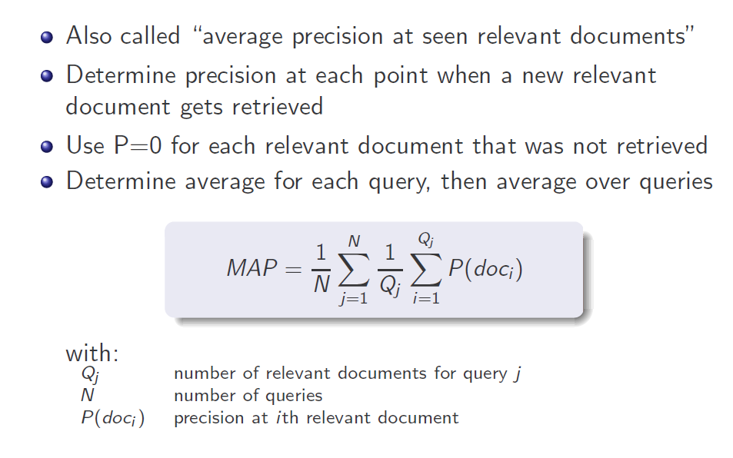
Mean Average Precision (AP)

Slide 20
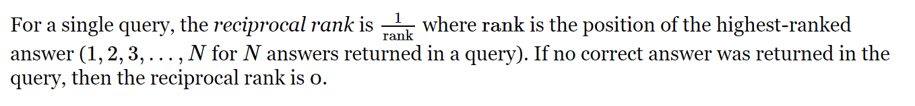
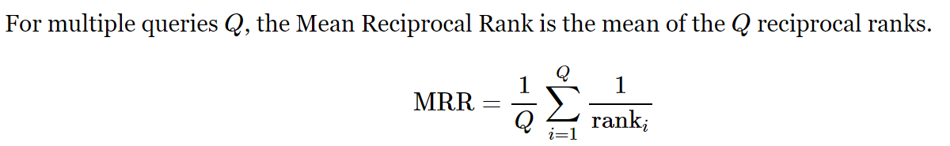
Mean Reciprocal Rank
The Reciprocal Rank (RR) information retrieval measure calculates the reciprocal of the rank at which the first relevant document was retrieved. “Where is the first relevant item?”.

Slide 21
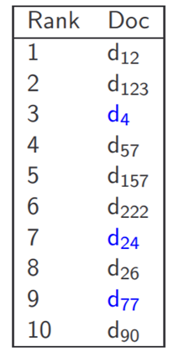
Example1
d4, d24 and d77 are relevant documents
, because 3 is rank at which the first relevant document is received
RR of the system is 1/3
MRR of the system is 1/3 , since there is only one query,
so RR and MRR are same
Example 2
(d3, d5, d6, d7, d11, d12, d23, d1) is the ranking,
left is the top most result,
the relevant documents are d5, d23, RR = ½
because at second rank the first relevant document is received

Slide 22
Non-Binary /Graded Relevance
Many sources of graded relevance judgments
Relevance judgments on an k -point scale
Actual Ranking
Ideal Ranking
Doc Id | Grade
D1 | 4
D2 | 1
D3 | 3
D4 | 2
Doc Id | Grade
D1 | 4
D3 | 3
D4 | 2
D2 | 1

Slide 23
nDCG (Normalized Discounted Cumulative Gain)
Discounted Cumulative Gain
Popular measure for evaluating web search and related tasks
Two assumptions
Highly relevant documents are more useful than marginally relevant document
The lower the ranked position of a relevant document, the less useful it is for the user, since it is less likely to be examined

Slide 24
Discounted Cumulative Gain
Uses graded relevance as a measure of usefulness, or gain, from examining a document
Gain is accumulated starting at the top of the ranking and may be reduced, or discounted, at lower ranks
Typical discount is 1/log (rank)

Slide 25


Discounted Cumulative Gain
Discounted Gain can be computed using

Slide 26
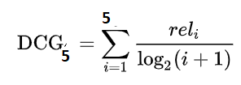
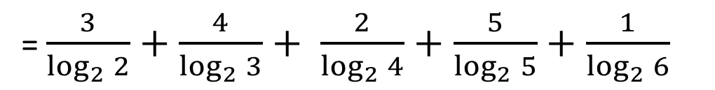
Discounted Cumulative Gain
Algorithm 1
Document | Relevance
D1 | 3
D4 | 4
D5 | 2
D2 | 5
D3 | 1
Gain : 3 , 4 , 2 , 5 , 1
Cumulative Gain = 3+4+2+5+1 = 15
Discounted Cumulative Gain
= $\frac{3}{\log_{2}{2}}+\frac{4}{\log_{2}{3}}+ \frac{2}{\log_{2}{4}}+\frac{5}{\log_{2}{5}}+\frac{1}{\log_{2}{6}}$
= 9.064

Slide 27
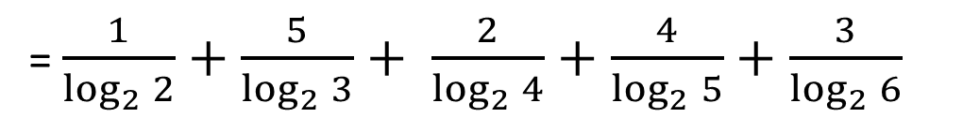
Discounted Cumulative Gain
Algorithm 2
Document | Relevance
D3 | 1
D2 | 5
D5 | 2
D4 | 4
D1 | 3
Gain : 1 , 5 , 2 , 4 , 3
Cumulative Gain = 1+5+2+4+3 = 15
Discounted Cumulative Gain
= $\frac{1}{\log_{2}{2}}+\frac{5}{\log_{2}{3}}+ \frac{2}{\log_{2}{4}}+\frac{4}{\log_{2}{5}}+\frac{3}{\log_{2}{6}}$
= 8.094

Slide 28

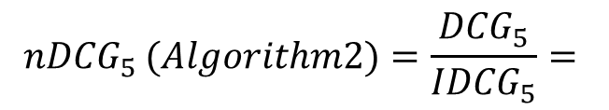
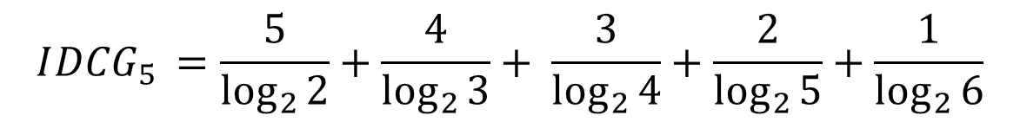
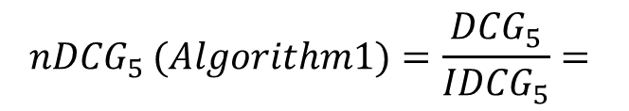
Normalized Discounted Cumulative Gain
Ideal ranking
Cumulative Gain = 5+4+3+2+1 = 15
Document | Relevance
D2 | 5
D4 | 4
D1 | 3
D5 | 2
D3 | 1
Ideal Discounted Cumulative Gain
$$I{DCG}_{5 }=\frac{5}{\log_{2}{2}}+\frac{4}{\log_{2}{3}}+ \frac{3}{\log_{2}{4}}+\frac{2}{\log_{2}{5}}+\frac{1}{\log_{2}{6}}$$
= 10.272
Normalized Discounted Cumulative Gain
$${nDCG}_{5 }(Algorithm1)=\frac{{DCG}_{5}}{{IDCG}_{5}}=$$
0.882
$${nDCG}_{5 }(Algorithm2)=\frac{{DCG}_{5}}{{IDCG}_{5}}=$$
0.787

Slide 29
Example 2
The table shows how two human judges assigned documents to the class
“English” (0 = is not written in English
1 = is written in English).
docID 1 2 3 4 5 6 7 8 9 10 11 12
Judge1 0 0 1 1 1 1 1 1 0 0 1 0
Judge2 0 0 1 1 0 0 0 0 1 1 1 0
Let us assume that you’ve written a classifier that assigns the documents {2, 5, 6, 7, 8} to “English”.
Precision = 0/5 Recall = 0/3 (both agree)
Precision = 4/5 Recall = 4/9 (either agree)

Slide 30
Kappa measure for inter-judge (dis)agreement
Kappa measure
Agreement measure among judges
Designed for categorical judgments
Corrects for chance agreement
Kappa = [ P(A) – P(E) ] / [ 1 – P(E) ]
P(A) – proportion of time judges agree
P(E) – what agreement would be by chance
Kappa = 0 for chance agreement, 1 for total agreement.

Slide 31
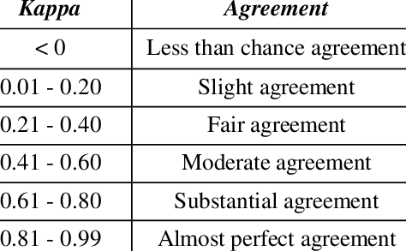
Kappa measure for inter-judge (dis)agreement
JUDGE 1
P(A) = 370/400 = 0.925
 | Relevant | Non Relevant
Relevant | 300 | 20
Non Relevant | 10 | 70
P(E) = ((320*310)+(80*90)) / (400*400) = 0.665
320
80
JUDGE 2
Kappa = (0.925 – 0.665)/(1-0.665) = 0.776
400
310 90

Slide 32
Summary
Metrics for unranked retrieval
Precision@k
Recall@k
Precision@R
PR Curve
Mean Average Precision
Metrics for non Binary/Graded Relevance
nDCG
Kappa Statistic

Slide 33
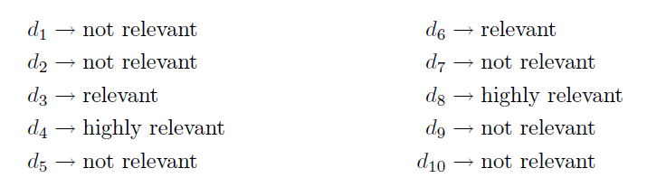
Exercise 1
Consider the following document collection with the relevance information for a query and answer the questions given below:
Consider the grades for nDCG 3: highly relevant; 2: relevant; 1 : non-relevant)
A1: { d2, d5, d6, d9, d10} A2: {d3, d7, d8, d2, d9, d4, d5}
Precision at rank 5 ; Recall at rank 5 ; Average precision ; R-precision; nDCG5

Slide 34
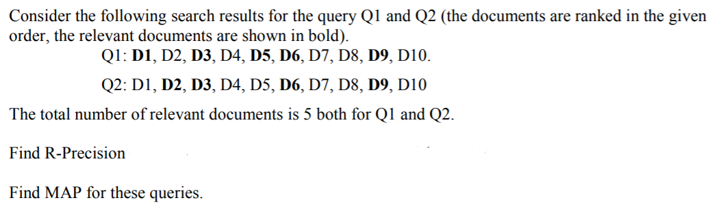
Exercise 2
Find MRR for the queries

Slide 35
Exercise 3
Why doing normalization in the vector space model makes sense? Is it always a good Idea?
What is the idea of TF-IDF? What motivates its use?
Explain the assumptions of the vector space model that do not hold in general.
Compare IDF of a term in VSM and trk of a term in BIM.
Justify : P(R) is directly proportional to O(R)

