Slide 1
Recommender Systems

Slide 2
What is ‘recommendation’ ?
A recommendation system identifies sets of items that would be interesting to a certain user, exploiting a variety of information resources related to both the user and the content items.
Notes:
A recommender system identifies set of items that would be
interesting to the user by using a variety of information recourses
about users and items

Slide 3








Recommender systems are one of the valuable applications of machine learning
Recommender system has become an essential business tool to re-shape the world of electronic commerce.

Slide 4
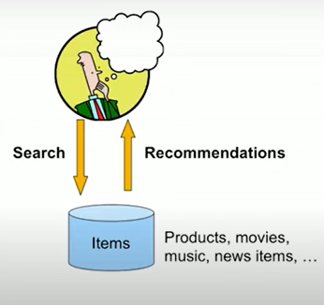
Search Vs Recommendation
Recommender systems represent the new paradigm of search: interesting items find the user instead of the user explicitly searching for them.

Slide 5
The problem of information overload
The growth of WWW resulted in large amount of information available online, too difficult for individual users to process all the information
Recommendation and personalization are important approaches to combating information over-load problem
Due to the important application value of recommender systems, there have always been emerging works in this field

Slide 6
What can be recommended?
Investment choices
Books
New articles
Music tracks
Research papers
TV programs
Cloths
Programmers
Code segments
Goods
Courses in E- learning
Jokes
Movies
Citations
Drug components
Cafes
Future friends
……

Slide 7
Recommender System Services
Recommender systems are beneficial to both service providers and users (Pu et al. 2011).
Electronic service providers :
Increase number of items sold
sell more diverse items
Increase user satisfaction and fidelity
better understand what the user wants (Linden et al. 2003)
User community adopts recommender systems
help them find all interesting and appropriate products
locate novel and diversified list of products
fulfil their personal/unique needs (Hill et al. 1995)
Notes:
Recommender systems are useful for both service providers and users
Electronic service providers use recommender systems as they increase
the number of items sold,
sell more diverse items,
increase user satisfaction and fidelity
and better understand what the user wants
User community adopts recommender systems as they help them to find
all interesting and appropriate products,
locate novel and diversified list of products
and fulfil its personal/unique needs

Slide 8
Recommender System Applications
Ecommerce
Media
Travel and Real Estate
Medical Applications
Education
Product recommendations
Recommend news, video on demand, music
Places, Events, Hotels, Restaurants, Flights, Car rentals
Matching patients to doctors, clinical trials, …
Personalizing education materials

Slide 9
Some evidences ?
Netflix - 2/3 rented movies are from
recommendation
Google News – 38% of click-through are due to
recommendation
Amazon – 35% of sales are from recommendation

Slide 10

Netflix Challenge
The Netflix challenge
$1M prize competition
Input : huge training data set
Goal: reduce prediction error rate by 10%
186 countries
Begins in 2006 , Winners in 2009

Slide 11
Recommendation Approaches
Recommender System
Content Based Filtering Technique
Collaborative Filtering Technique
Hybrid filtering technique
Model Based Filtering technique
Clustering techniques,
Association Techniques,
Bayesian Networks,
Neural Networks
Memory-based Filtering technique
Nearest Neighbour approaches
Item based approaches
User based approaches
Slope one Predictors
Matrix Factorization approaches
Notes:
Recommendation approaches are broadly classified into
CF, CB and a combination of the two namely hybrid approaches
CF approaches are further classified into model based
and memory based approaches.
Some of the model based approaches are
clustering techniques,
Association techniques
Bayesian network
Neural network
Memory based approaches can be
User-based collaborative filtering
Item based collaborative filtering

Slide 12
Recommender System tasks
Score Prediction
Top K recommendations
Explainable recommendations

Slide 13
Recommender System tasks
Score Prediction
User might give for a product (rating prediction)
 | I1 | I2 | I3 | I4 | I5 | I6
U1 | 1 | ? |  | 3 |  | 2
U2 |  | 3 | 4 | 5 |  | 1
U3 | 2 |  | 4 |  | 5 | 3
U4 | 4 | 4 |  | 3 |  | 2
U5 | 2 |  | 3 |  | 5 | 4

Slide 14

Recommender System tasks
Top k Recommendations
List the most relevant items (top-n recommendation)

Slide 15
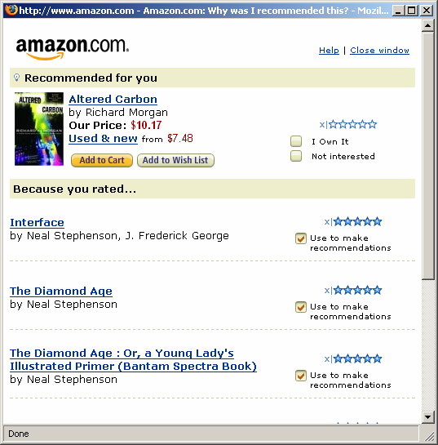
Recommender System tasks
Explainable recommendations
Explanation for predictions (trust in the system)

Slide 16
Recommendation Categories
Content Based Filtering
Collaborative Filtering
Hybrid Approaches
Content based algorithms recommend items similar to the items the user liked in the past
CF algorithms recommend items based on
- User who likes product A will like product B also
- Users with similar taste behave in a similar way

Slide 17
First Recommendation application
The first applications of recommender technologies were the personalized recommendation of news and Web sites; the former application is often based on collaborative filtering, and the latter is based on content-based filtering.

Slide 18
Content based Filtering
The user is recommended items similar to the ones he liked in the past.
Matching of the attributes of a user profile in, with the attributes of a content object (item), in order to recommend to the user new interesting items.
It might be reasonable to recommend fantasy novels to people who liked fantasy novels in the past

Slide 19
Content based recommendation
 | Julius Caesar | Antony and Cleopatra | The Tempest | Hamlet | Othello | Macbeth
Antony | 2 | 1 | 0 | 0 | 0 | 3
Brutus | 3 | 3 | 0 | 3 | 0 | 0
Caesar | 4 | 1 | 0 | 4 | 1 | 4
Calpurnia | 0 | 5 | 0 | 0 | 0 | 0
Cleopatra | 2 | 3 | 0 | 0 | 0 | 0
Mercy | 1 | 0 | 5 | 3 | 4 | 5
Worser | 3 | 2 | 4 | 2 | 3 | 0
U: User profile ( Antony, Caesar, Mercy, Worser )
(1, 0, 1, 0, 0, 1, 1)
D1: Julius Caesar (2, 3, 4, 0, 2, 1, 3)

Slide 20
Vector representation
Antony
Antony and Cleopatra
User profile
Julius Caesar
Macbeth
Brutus
Caesar

Slide 21
Examples - CBF
Letizia
Personal WebWatcher
NewT
NewsDude
Daily Learner
Citeseer
Friend of a Friend (FOAF)
News@hand

Slide 22
Input to Content Based Filtering
Web Page : words, hyperlinks, tags, comments, Titles, topic …
Music: Genre, rhythm, melody, harmony, lyrics, meta data, artist, mood, tempo …
User : age, gender, job, location, income, education, language, family status, hobbies, general interest, opinion, comments …..
Books: author(s), publication, year, title, prize contents(words)…

Slide 23
Input to Collaborative Filtering
The frame work of CF consists of I= {I₁ , I₂ , I₃ , … I_{m} }
U = {U₁, U₂, U₃, … U_{n} }
R = {1, 2, 3, … #r}
 | I1 | I2 | I3 | I4 | I5 | I6 | I7
U1 |  | 5 |  | 4 |  | 3
U2 | 3 |  | 4 |  | 1 |  | 5
U3 | 2 | 3 |  | 5 | 1 |  | 3
U4 |  | 3 | 4 | 1 | 2 | 1
U5 | 1 |  | 2 | 3 |  | 4 | 5
U6 | 2 |  | 4 | 5 | 4 |  | 2
U7 | 2 |  | 3 |  | 5 |  | 1
Explicit
Users preferences - ratings
Implicit
User’s past experience (browse history / purchase history)

Slide 24
Neighborhood based Approaches
I1
U1
I3
U2
I2
U3
User Based approaches
Item Based approaches

Slide 25
Neighborhood based Approaches
Nearest neighbors
Cosine similarity
Adjusted cosine similarity
Pearson correlation coefficient
Euclidean distance
Jaccard similarity …
Item based CF
Item-Item similarity, Predictions
User based CF
User-User similarity, Predictions
The underlying assumption of CF approach is that those who agreed in the past tend to agree again in the future.

Slide 26
Prediction Generation
Item based nearest neighbour CF
User based nearest neighbour CF
Calculate pair wise similarity of the target item with each item of the data set.
Select k nearest neighbours of the target item based on the similarity score
Compute prediction using the weighted average of the ratings given by the active user for those neighbours
Calculate pair wise similarity of the active user with each user of the data set.
Select k nearest neighbours of the active user based on the similarity score
Compute prediction using the weighted average of the ratings given by the those users for the target item
Notes:
This is the pseudo code for item based CF
The first step is to compute the pair wise similarity between items of the data set.
Next, select top k neighbours of the target item.
And then compute prediction as the weighted average of the
ratings provided by the active user for those items.

Slide 27
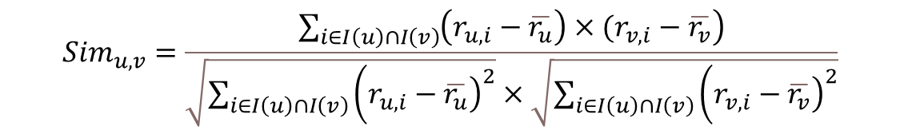
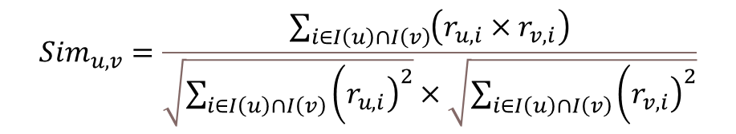
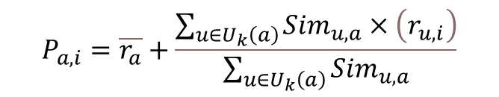
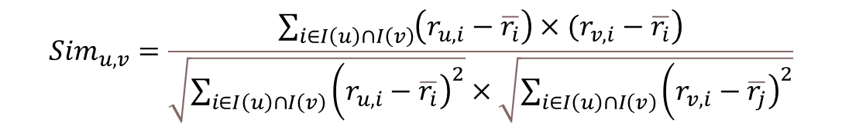
Similarity computation & Predictions
$${Sim}_{u,v}=\frac{\sum_{i∈I\left(u\right)∩I\left(v\right)}{\left(r_{u,i}×r_{v,i}\right)}}{\sqrt{\sum_{i∈I\left(u\right)∩I\left(v\right)}{\left({\left.r_{u,i}\right)}^{2}\right.}}×\sqrt{\sum_{i∈I\left(u\right)∩I\left(v\right)}{\left({\left.r_{v,i}\right)}^{2}\right.}}}$$
$${Sim}_{u,v}=\frac{\sum_{i∈I\left(u\right)∩I\left(v\right)}{\left.\left(r_{u,i}−\overline{r_{u}}\right)×(r_{v,i}−\overline{r_{v}}\right)}}{\sqrt{\sum_{i∈I\left(u\right)∩I\left(v\right)}{\left({\left.r_{u,i}−\overline{r_{u}}\right)}^{2}\right.}}×\sqrt{\sum_{i∈I\left(u\right)∩I\left(v\right)}{\left({\left.r_{v,i}−\overline{r_{v}}\right)}^{2}\right.}}}$$
$${Sim}_{u,v}=\frac{\sum_{i∈I\left(u\right)∩I\left(v\right)}{\left.\left(r_{u,i}−\overline{r_{i}}\right)×(r_{v,i}−\overline{r_{i}}\right)}}{\sqrt{\sum_{i∈I\left(u\right)∩I\left(v\right)}{\left({\left.r_{u,i}−\overline{r_{i}}\right)}^{2}\right.}}×\sqrt{\sum_{i∈I\left(u\right)∩I\left(v\right)}{\left({\left.r_{v,i}−\overline{r_{j}}\right)}^{2}\right.}}}$$
$$P_{a,i}=\overline{r_{a}}+\frac{\sum_{u∈U_{k}\left(a\right)}{{Sim}_{u,a}×\left(r_{u,i}\right)}}{\sum_{u∈U_{k}\left(a\right)}{{Sim}_{u,a}}}$$

Slide 28



r(U1,I3) = ?
$Sim \left(u1,u2\right)=\frac{3∗3+1∗4+3∗6+8∗7}{\sqrt{3^{2}+1^{2} +3^{2}+8^{2}}\sqrt{3^{2}+4^{2}+6^{2}+7^{2}}}$ = 0.911
 | I1 | I2 | I3 | I4 | I5 | I6
u1 | 2 | 3 | ? | 1 | 3 | 8
u2 | 0 | 3 | 1 | 4 | 6 | 7
u3 | 3 | 0 | 0 | 3 | 4 | 6
u4 | 9 | 5 | 1 | 5 | 0 | 7
u5 | 3 | 4 | 6 | 7 | 9 | 9
u6 | 4 | 0 | 1 | 4 | 8 | 0
u7 | 2 | 4 | 0 | 0 | 0 | 8
Sim(U₁,U₃) =
Sim(U₁,U₄) =
Sim(U₁,U₅) =
Sim(U₁,U₆) =
Sim(U₁,U₇) =
$$COS(\vec{A},\vec{B})=\frac{\vec{A} . \vec{B}}{\left\|\vec{A}\right\|\left\|\vec{B}\right\|}$$
Top 3 neighbours of U1 are
$$r\left( U_{1},I_{3}\right)=\frac{ }{}$$

Slide 29








$Sim\left(I1,I3\right)=\frac{9∗1+3∗6+4∗1}{\sqrt{9^{2}+3^{2}+4^{2}}\sqrt{1^{2}+6^{2}+1^{2}}}$ =
r(U1,I3) = ?
 | I1 | I2 | I3 | I4 | I5 | I6
u1 | 2 | 3 | ? | 1 | 3 | 8
u2 | 0 | 3 | 1 | 4 | 6 | 7
u3 | 3 | 0 | 0 | 3 | 4 | 6
u4 | 9 | 5 | 1 | 5 | 0 | 7
u5 | 3 | 4 | 6 | 7 | 9 | 9
u6 | 4 | 0 | 1 | 4 | 8 | 0
u7 | 2 | 4 | 0 | 0 | 0 | 8
$Sim(I_{2},I_{3}$ ) =
$Sim(I_{4},I_{3}$ ) =
$Sim(I_{5},I_{3}$ ) =
$Sim(I_{6},I_{3}$ ) =
$Sim(I_{7},I_{3}$ ) =
$$COS(\vec{A},\vec{B})=\frac{\vec{A} . \vec{B}}{\left\|\vec{A}\right\|\left\|\vec{B}\right\|}$$
Top 3 neighbours of I3 are
$$r\left( U_{1},I_{3}\right)=$$

Slide 30
Benefits of CF Approaches
Among various collaborative recommendation approaches, methods based on nearest-neighbors enjoy a huge amount of popularity
Simplicity
Efficiency
ability for accurate and personalized recommendations.
Nearest neighbours : Cosine similarity, Adjusted cosine similarity, Pearson correlation coefficient, Euclidean distance, Jaccard similarity …
Notes:
The state of the art collaborative filtering techniques are
Nearest Neighbour approaches
Item based approaches
User based approaches
Slope one Predictors
Matrix Factorization approaches

Slide 31





Evaluation metrics used
Data sets: Movielens100k and Jester
To measure accuracy of the predictions, two statistical measures , MAE (Mean Absolute Error), RMSE (Root Mean Square Error) and a decision theoretic metric F1 are used
Notes:
To measure accuracy of the predictions, two statistical measures ,
MAE (Mean Absolute Error), RMSE (Root Mean Square Error)
and a decision theoretic metric F1 are used

Slide 32
Research dimensions
First Rater problem
New item problem
Noise
Sparsity
Shilling attacks - push attack / nuke attack
Novelty
Diversity

Slide 33
Thank you

