Slide 1
Web based IR

Slide 2
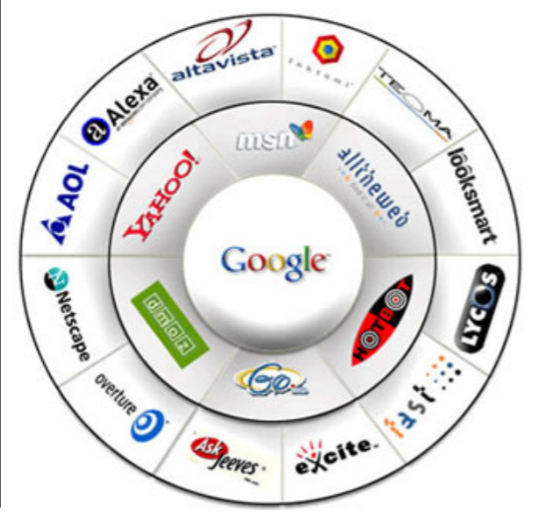
Search Engines

Slide 3
Mission of Search Engine
WSE
Crawl and index billions of pages
Answer hundreds of millions of queries per day
In less than 1 sec. per query
Users
Want to submit short queries (on avg. 2.5 terms) often with orthographic errors
Expect to receive the most relevant results
In a blink of eye

Slide 4
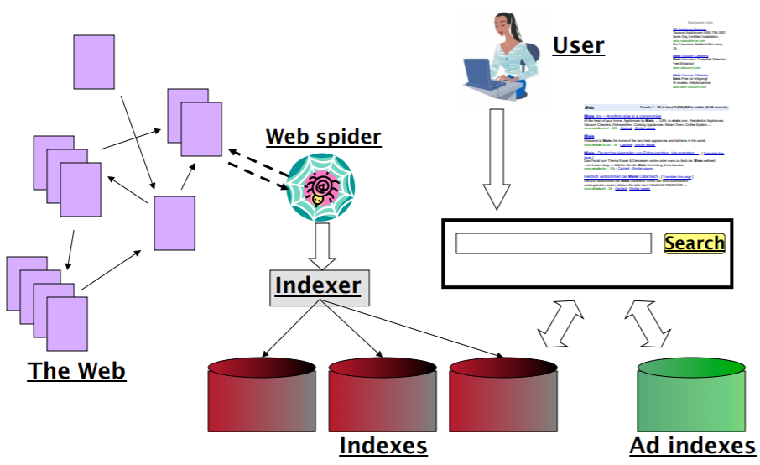
Web Search as a huge IR system

Slide 5
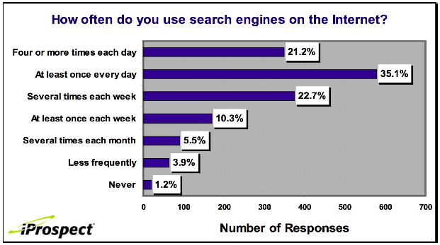
Search is the top activity on the web
5

Slide 6
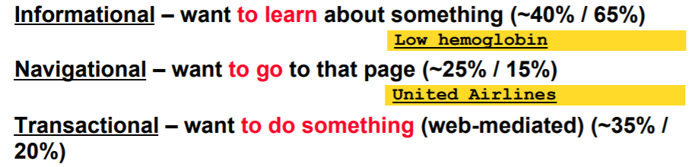
Taxonomy of Search Engine

Slide 7
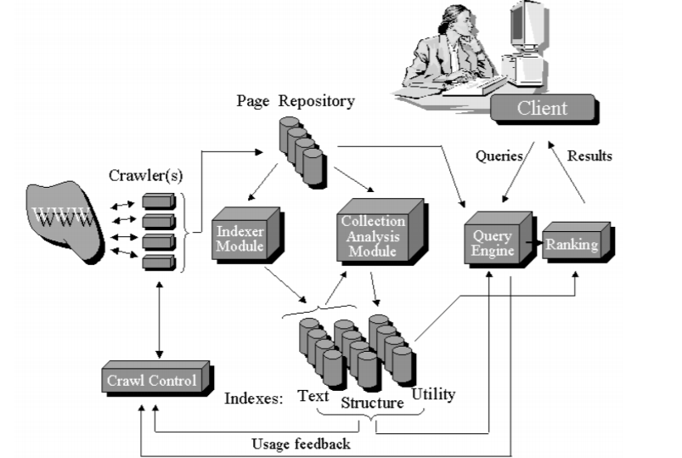
Anatomy of a Web search engine

Slide 8
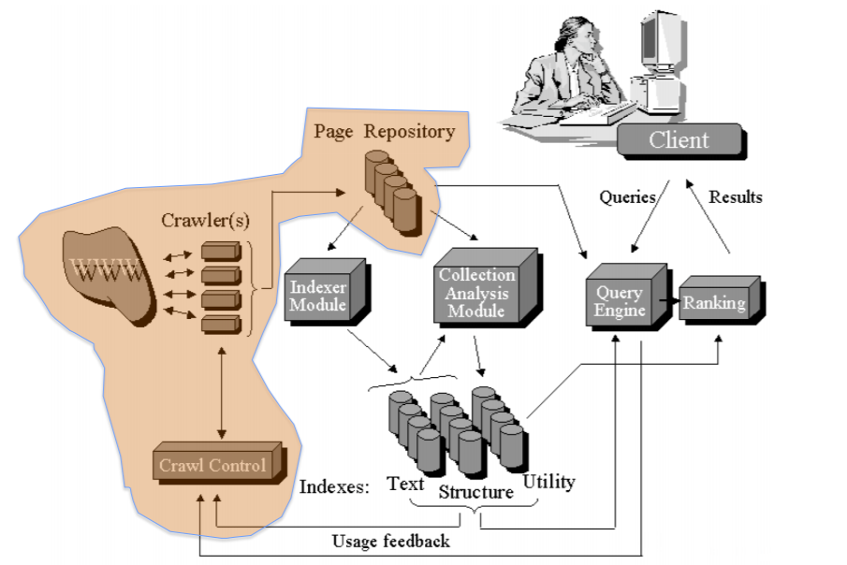
Crawler
It is a program that navigates the Web following the hyperlinks and stores them in a page repository

Slide 9
Crawler
Design Issues of the Crawl module:
– What pages to download
– When to refresh
– Minimize load on web sites
– How to parallelize the process
Page selection during crawling: Importance metric – Given a page P, define how “good” that page is, on the basis of several metrics (combination of them):
Popularity driven: Incoming-link counts (or PageRank)
Location driven: Deepness of the page in a site
Usage driven: Click counts of the pages (feedback)
Interest driven: driven from a query, based on the similarity with page contents (focused crawling)

Slide 10
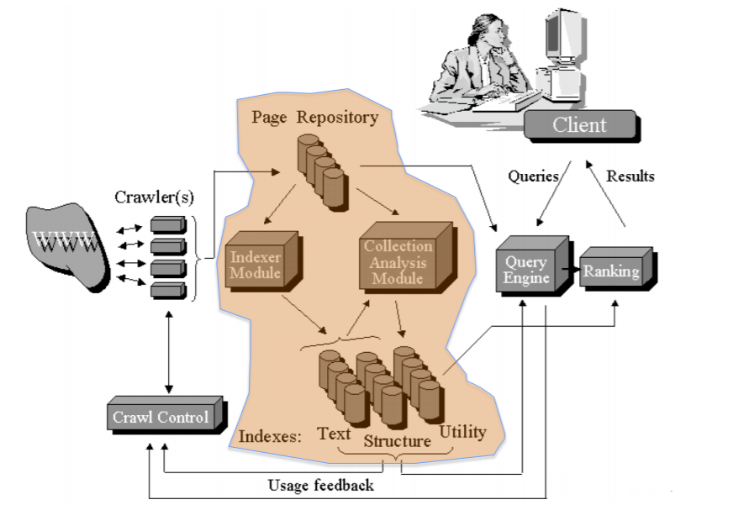
Indexer and page repository

Slide 11
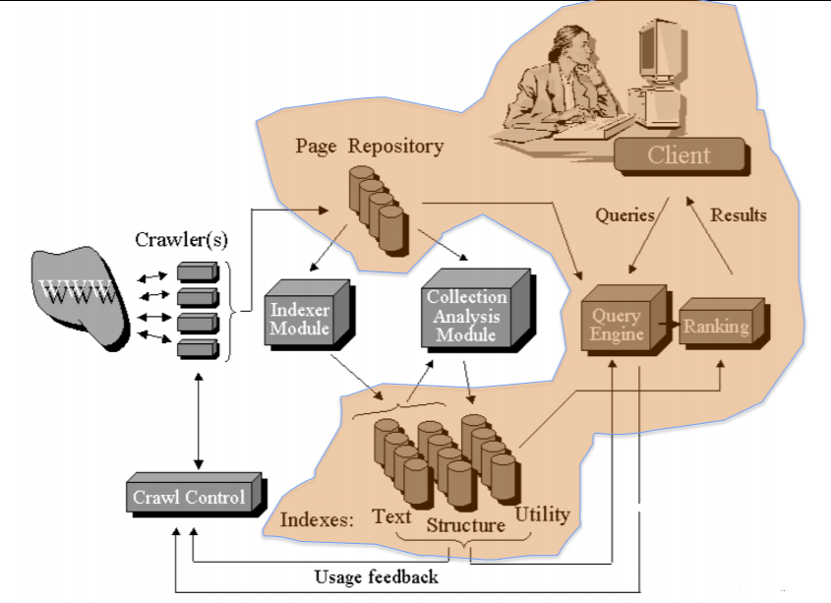
Query Engine

Slide 12
Web Characteristics
Scalability -“how big is the Web?” -By the end of 1995, Altavista reported that it had crawled and indexed approximately 30 million
Index size and estimation - some pages are more informative than others
Static web pages -professor who manually updates his home page every week is considered to have a static web page, but an airport’s flight status page is considered to be dynamic
Trustworthiness - Spam, which - is the manipulation of web page content for the purpose of appearing high up in search results
Content in dozens of (natural) languages and thousands of dialects, thus demanding many different forms of stemming and other linguistic operations - Diversity
Decentralized content publishing - Lack of co-ordination in creation
Web pages exhibited heterogeneity at a - daunting scale
Duplicates the Web contains multiple copies of the same content - 30%

Slide 13
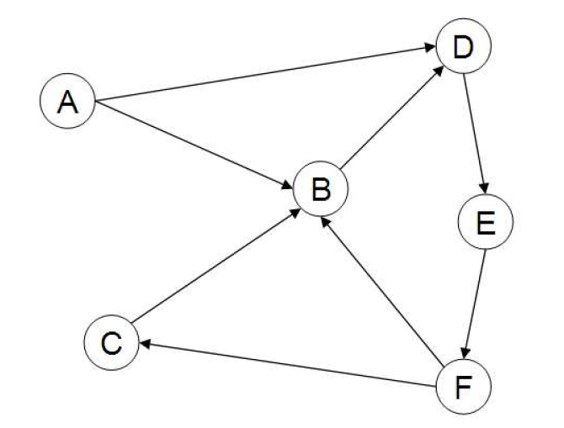
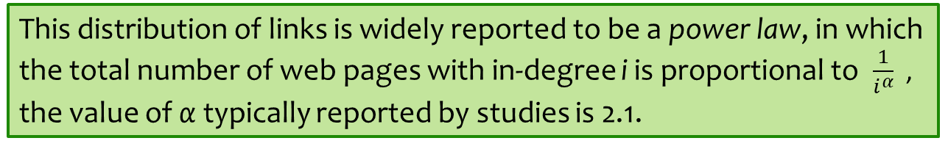
Web Graph
This distribution of links is widely reported to be a power law, in which the total number of web pages with in-degree i is proportional to $\frac{1}{i^{α}}$ , the value of α typically reported by studies is 2.1.

