Slide 1
AI UX
Discovery-to-Prototype
Pipeline
4
specialized phase agents
A governed multi-agent process that turns a Users documents into a human-verified workable prototype.
D1–D4
RUNNABLE PUBLIC DEMO
explicit human gates
https://ai-ux-design-pipeline.streamlit.app/

Slide 2
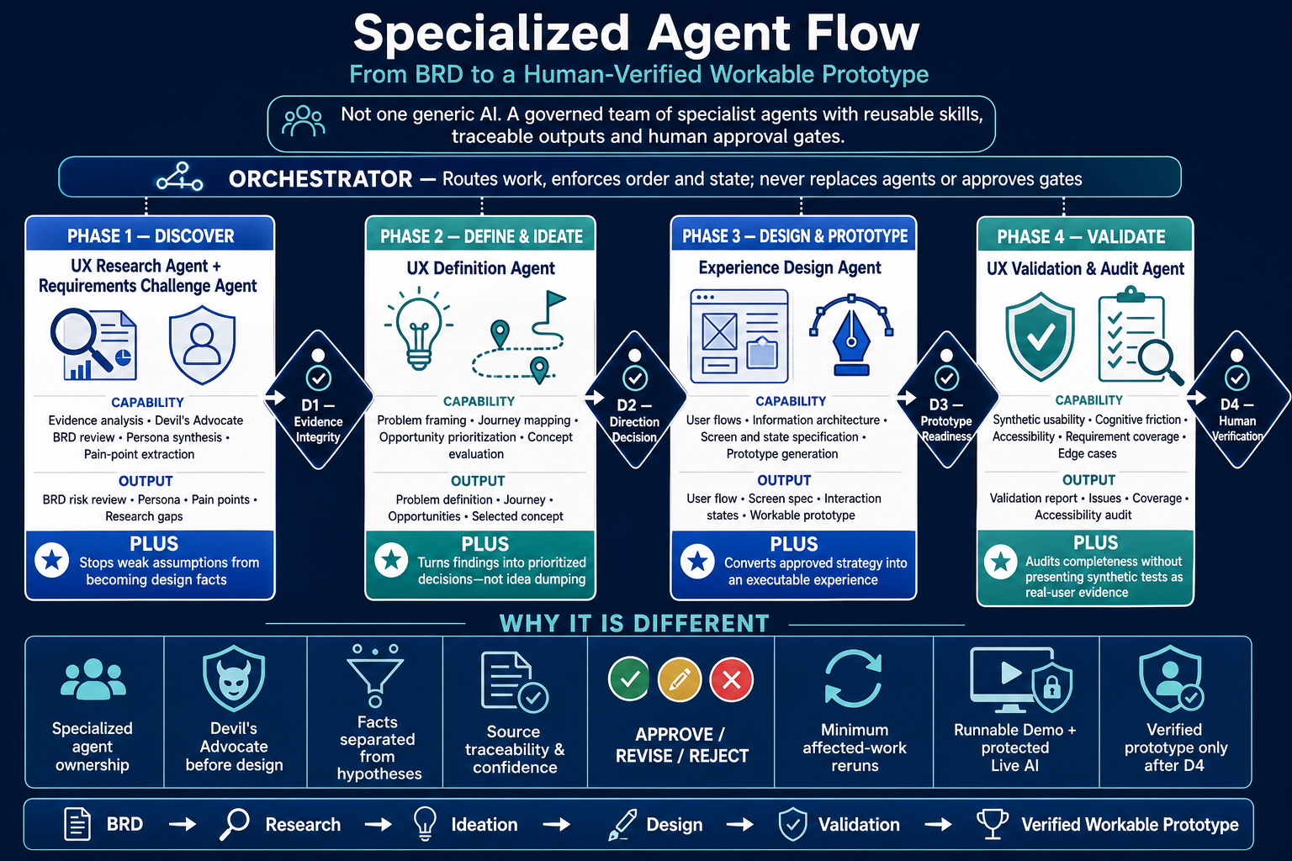
THE DIFFERENTIATOR
Specialized agents own the work; the orchestrator only routes it
Each agent invokes reusable skills and hands traceable artifacts to the next governed stage.
AI UX DESIGN PIPELINE • 02

Slide 3
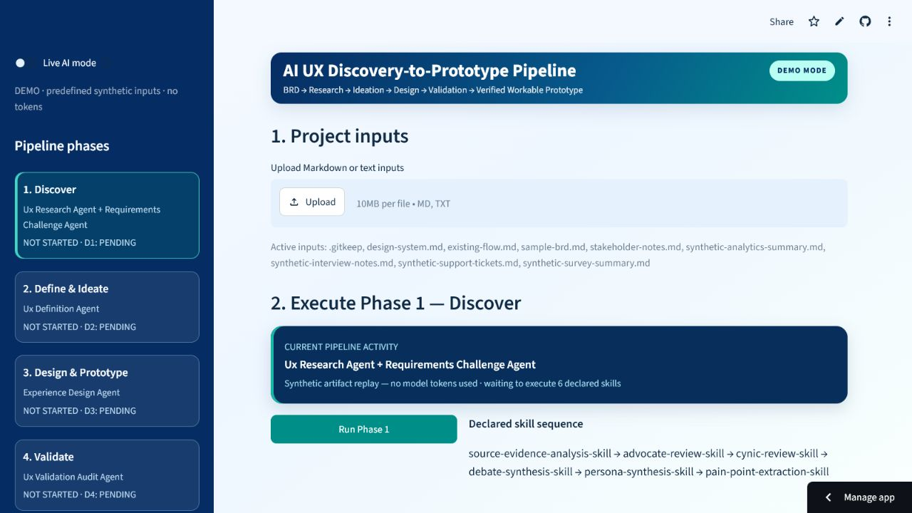
RUNNABLE EXPERIENCE
The public runner makes the architecture visible
Demo mode uses predefined synthetic inputs; Live AI can be protected and configured separately.
01
Mode is always visible
DEMO avoids token use; LIVE exposes secured runner controls.
02
Phases stay in view
The vertical rail shows agent ownership and gate state.
03
Skills are explicit
The declared sequence is visible before execution begins.
AI UX DESIGN PIPELINE • 03

Slide 4
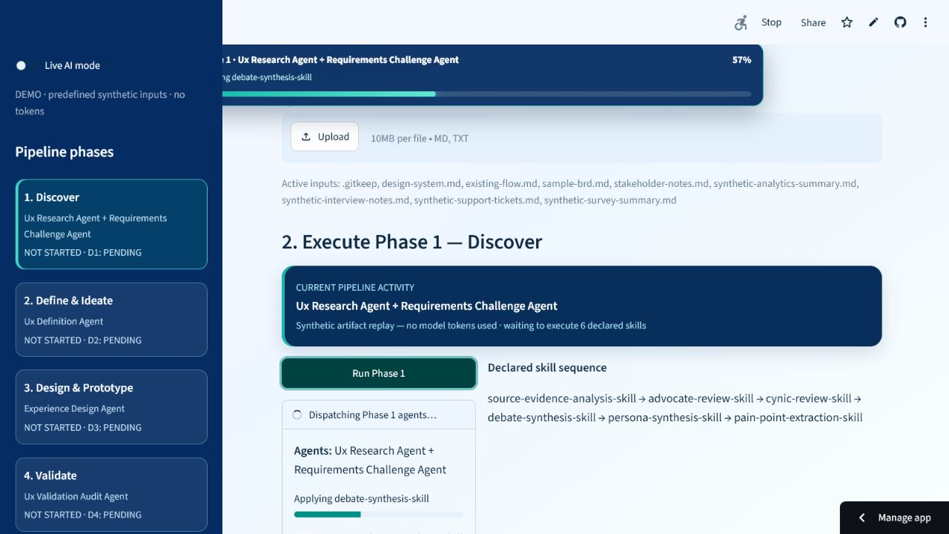
EXECUTION FEELS REAL
Progress exposes the active agent and skill
The runner shows movement without pretending synthetic demo outputs are real research.
57%
active progress
UX Research Agent
+
Requirements Challenge Agent
Current skill:
debate-synthesis-skill
AI UX DESIGN PIPELINE • 04

Slide 5
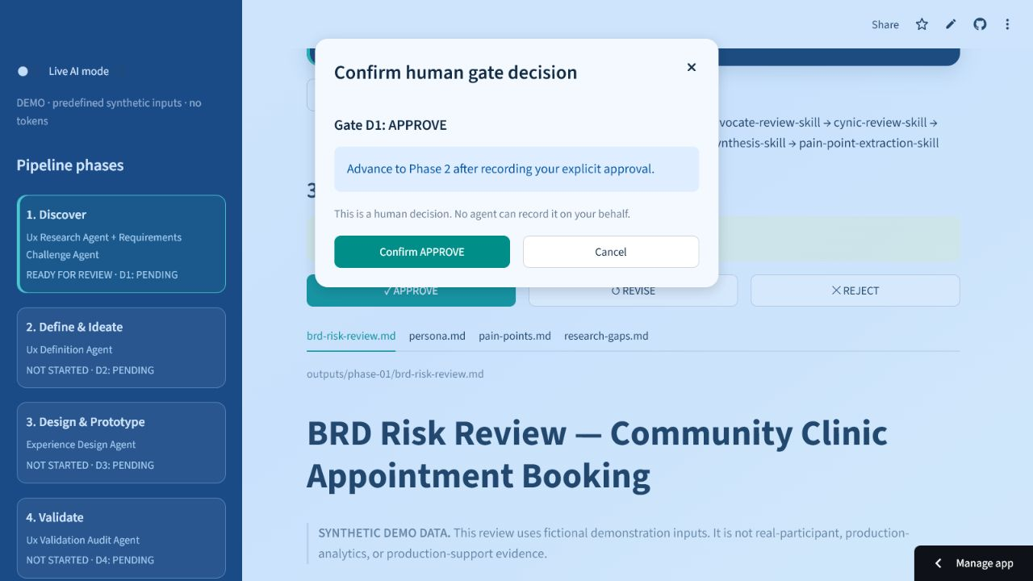
HUMAN GOVERNANCE
No agent can approve its own work
D1–D4 require an explicit reviewer decision before the next phase becomes eligible.
APPROVE
Record the decision and advance exactly one phase.
REVISE
Rerun only the minimum affected downstream work.
REJECT
Block the workflow; no automatic progression.
AI UX DESIGN PIPELINE • 05

Slide 6
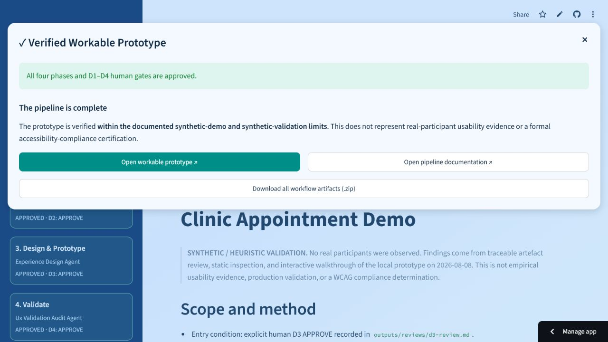
GOVERNED OUTCOME
The prototype is ‘verified’ only after D4 approval
The completion message retains the synthetic-validation and accessibility limitations.
✓
4 phases
4 human gates
1 verified prototype
Verification is scoped—not a claim of real-participant evidence or formal WCAG certification.
AI UX DESIGN PIPELINE • 06

Slide 7
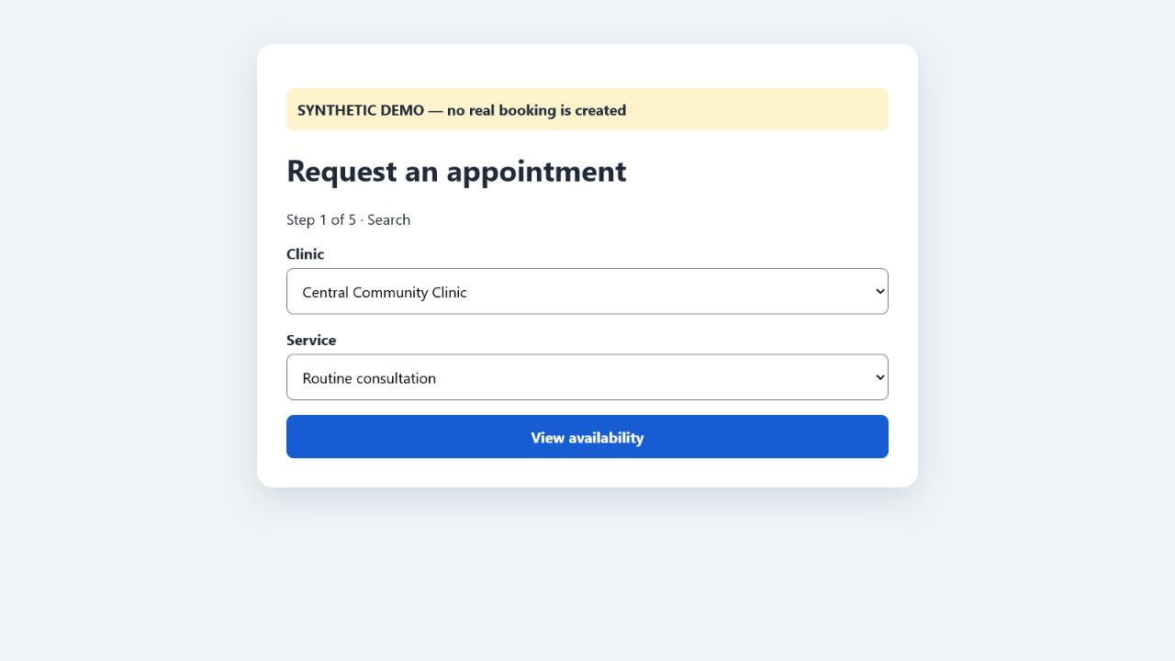
TRY IT NOW
A two-minute demo shows the full governed journey
Start in Demo mode; switch to Live AI only with the configured password and API secret.
DEMO MODE
1 Keep Live AI mode OFF
2 Run each phase
3 Review artifacts at D1–D4
4 Explicitly APPROVE each gate
5 Open the workable prototype
LIVE AI MODE
Switch Live AI ON → enter the access password → use configured Gemini credentials.
https://ai-ux-design-pipeline.streamlit.app/
AI UX DESIGN PIPELINE • 07

