Slide 1
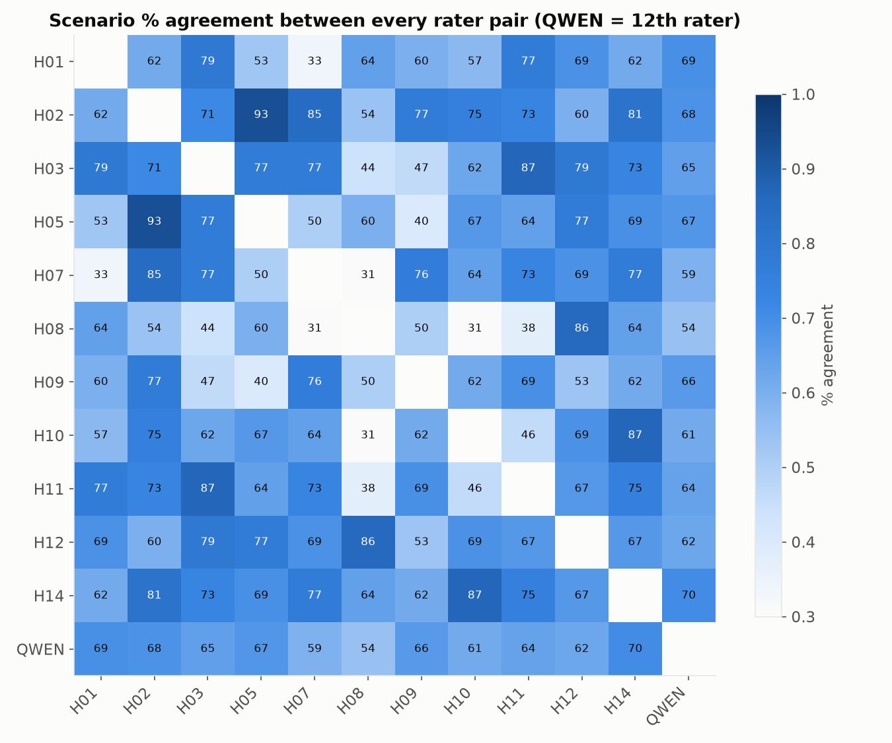
3
Qwen as a 12th Annotator
All 506 clips, scored against 11 human raters using the same pairwise-agreement math applied to the humans themselves
■ Method: Qwen labeled every clip in the shared pool and was compared to each of the 11 human annotators exactly as they are compared to each other — pairwise agreement, Cohen's κ, and majority-vote consensus accuracy.
■ Scenario / condition / noun: Qwen's agreement with each human (54–70%) sits inside the human–human range — some human pairs agree as little as 31–33% of the time.
■ Verb / flavor: clearly below the human envelope (κ = 0.26 vs. 0.62 for verb; 0.26 vs. 0.52 for flavor).
■ Difficulty transfers: 84.6% accuracy on clips humans unanimously agreed on, dropping to 42.6% on clips where humans were split — Qwen struggles on exactly the clips that are hard for humans too.
TAKEAWAY On 3 of 5 fields, Qwen is statistically indistinguishable from a 12th human annotator; verb and flavor remain outside human-level agreement.

Slide 2
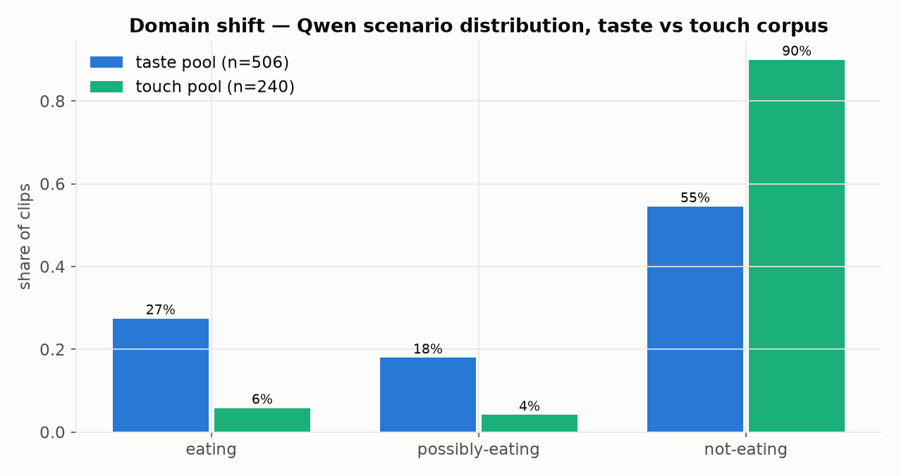
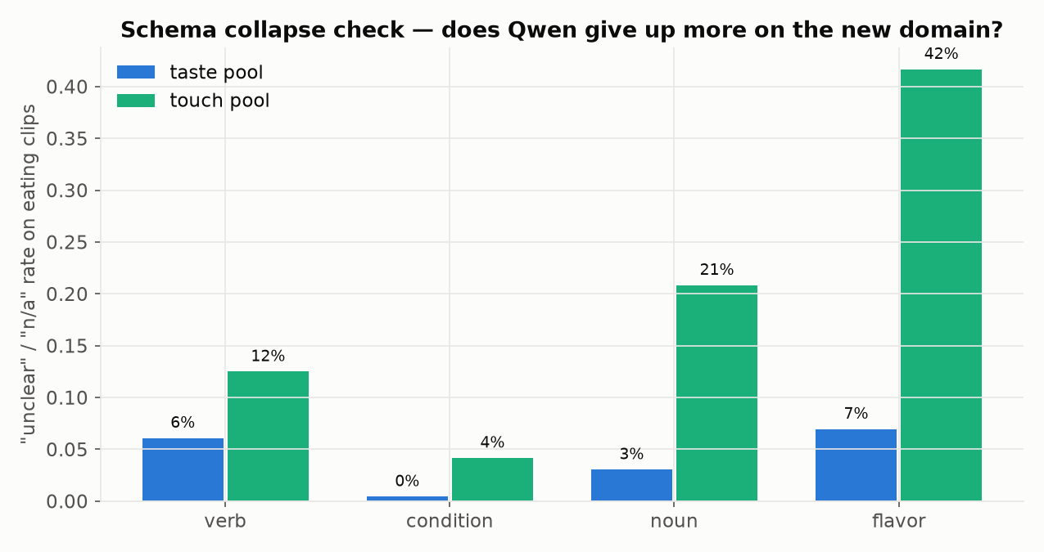
4
Transfer to an Unseen Corpus
240 clips sampled from the 2.2M-clip ivc-ml touch dataset — never labeled with the taste schema before
■ Method: Reservoir-sampled 240 clips from a corpus curated for touch, not eating, and applied the same taste-schema prompt plus a free-text description request — zero fine-tuning.
■ Sensible domain shift: Qwen calls 90% of touch-corpus clips not-eating vs. 55% on the taste pool — exactly what you'd expect when the taste pool was curated specifically for eating content.
■ No schema collapse: "unclear"/"n/a" rates on eating clips stayed comparable to the taste pool rather than spiking, and every clip parsed as valid JSON (0/240 failures).
■ Usable descriptions: every clip got a free-text description (mean 32.1 words) — output doubles as machine pre-annotation a human can verify instead of labeling from scratch.
TAKEAWAY The pipeline transfers cleanly to a brand-new clip pool with no schema-specific fine-tuning — usable today as a pre-annotation pass that a human verifies rather than labels from scratch.

Slide 3
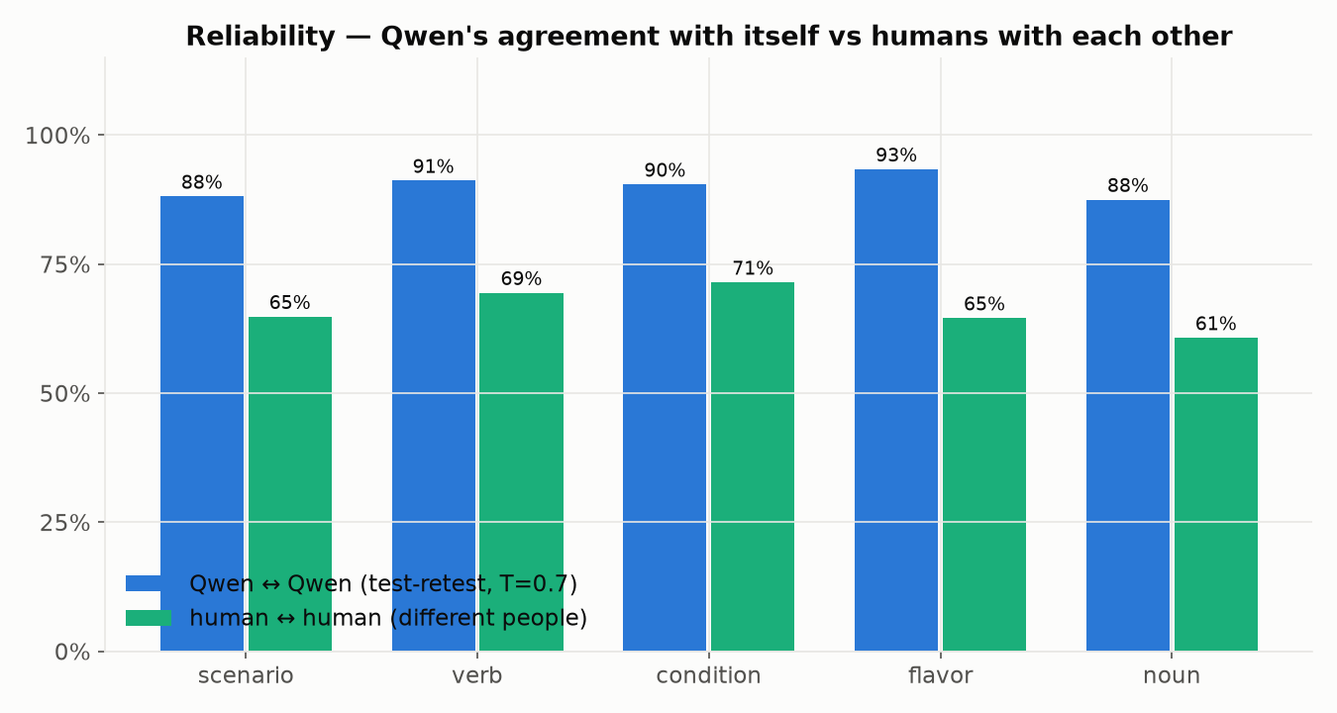
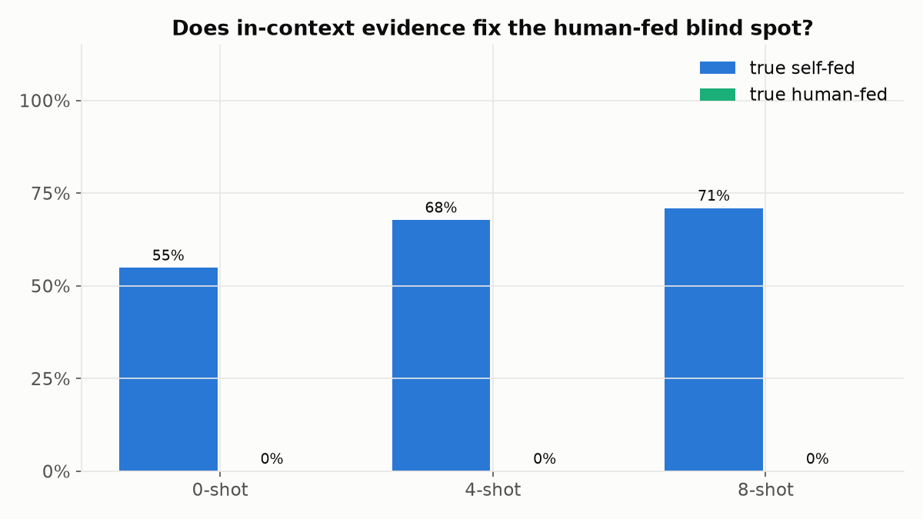
5
Reliability ≠ Accuracy
The scientific test: is Qwen a stable rater, and can in-context examples fix its known blind spot?
■ Part A — test–retest: re-annotating the same 101 clips 3× with sampling (T=0.7), Qwen agrees with itself 88–93% across all fields — higher than humans agree with each other (61–72%).
■ Part B — few-shot: adding 4 and 8 in-context examples (human consensus labels, no leakage) improved flavor (+8–10 pts) and noun (+2–4 pts).
■ The blind spot persists: agency accuracy on true human-fed clips stayed at 0% at 0-shot, 4-shot, AND 8-shot — even with two explicit human-fed examples in context.
■ Why it matters: a model can be maximally self-consistent while being systematically wrong on an entire label class — reliability alone is not evidence of annotation quality.
TAKEAWAY Five independent interventions (Benchmark 2) plus 4- and 8-shot in-context demonstrations (Benchmark 5) all fail to move human-fed accuracy off 0% — strong evidence of a perceptual ceiling, not a prompting gap.

