Slide 1
Qualcomm Maker Challenge 2018
Qraksha
Voice activated ‘smart’ safety device
TEAM
Vanshika Baoni Nikhilendra Gudisa Prajyot Gupta
Karthik Palepu Manikanta Pasumarty

Slide 2
Problem
Violent crimes and cases of assault are all too familiar to all of us. Every person living in today’s world has a sense of insecurity while going out especially when it’s a desolate area.
Crimes against women and children in India especially in metro cities are on the rise, so ensuring their safety has become more important than ever. Although the government is taking steps for women’s safety, technology can play an important part in that too.
It is better to have an auto-triggered safety mechanism which alerts volunteers nearby and Guardians in situations of distress. We propose an umbrella solution that is helpful with eve teasing, rape, medical emergency, panic attack or any kind of potential threat that a man/woman could face.
Our solution offers a way for a person to save himself/herself from any potential danger and also helps in imbuing a sense of confidence and independence.

Slide 3
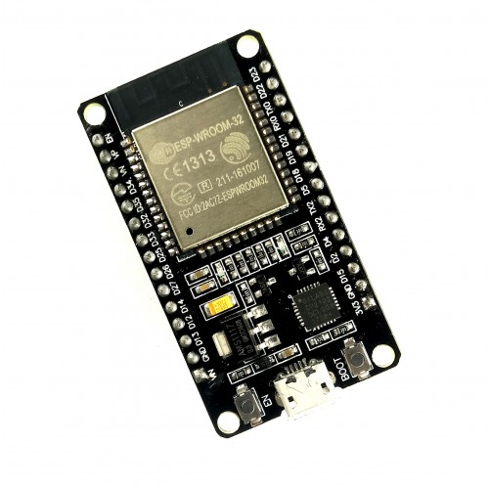
Proposed solution
Our solution has two aspects to it : A wearable device (incorporated into a watch/bracelet/band etc. ) and A ‘voice triggered’ safety app that runs on the person’s smartphone.
The wearable device would have a button that would be activated by long press (say 5 seconds) in order to trigger a series of actions like sending a distress SMS, making an emergency call, sharing the location, calling the Police, making alarm sounds etc. This device will communicate with the smartphone via Bluetooth.
The software counterpart to our product will detect the ‘victim’s’ trigger words/emotions/stress/strain in the voice and will make use of the Qualcomm SNPE to carry out the NL processing to detect a situation of distress on the person’s smartphone.
After the neural engine on the smartphone carries out the audio template matching for detecting a ‘danger’ situation, the app will trigger a set of predefined actions like sending an SOS message to family members, police etc.

Slide 4
State of the art
Safety solutions that are present currently are of two kinds. One which is triggered by screams, that can lead to a lot false alarms and the other which requires the person in distress to trigger the alarm by pressing a button (usually the power switch) on the smartphone.
Competitive edge
Our solution is a lot more versatile in the sense that it is ‘voice triggered’ (with customizable ‘trigger words/phrases’) and decodes ‘natural language conversations’ to send the alert.
Additionally our product will also have a ‘cancellation’ mechanism to reduce the number of false alarms.
We also plan to include emotion/stress detection in the neural network as well so that the detection of a distress situation becomes more robust.
We also have the trigger mechanism with the help of the wearable device in case the person doesn’t have access to the smartphone in the time of distress.
These additional features in our proposed solution minimize the risk of false alarms and maximize the chances of helping the person in a situation of distress.

Slide 5
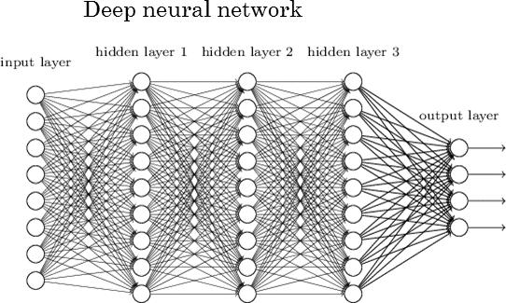
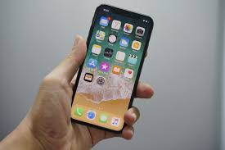
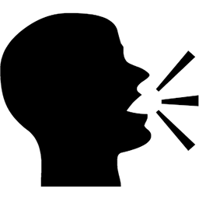
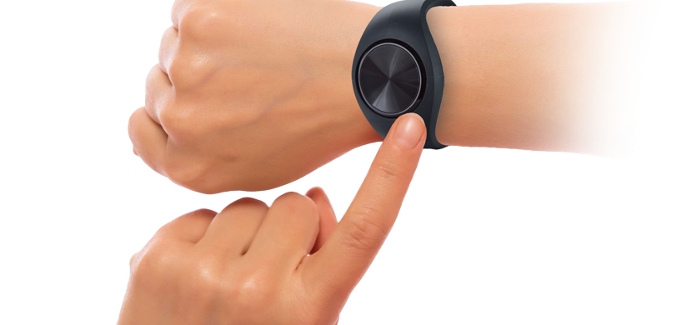
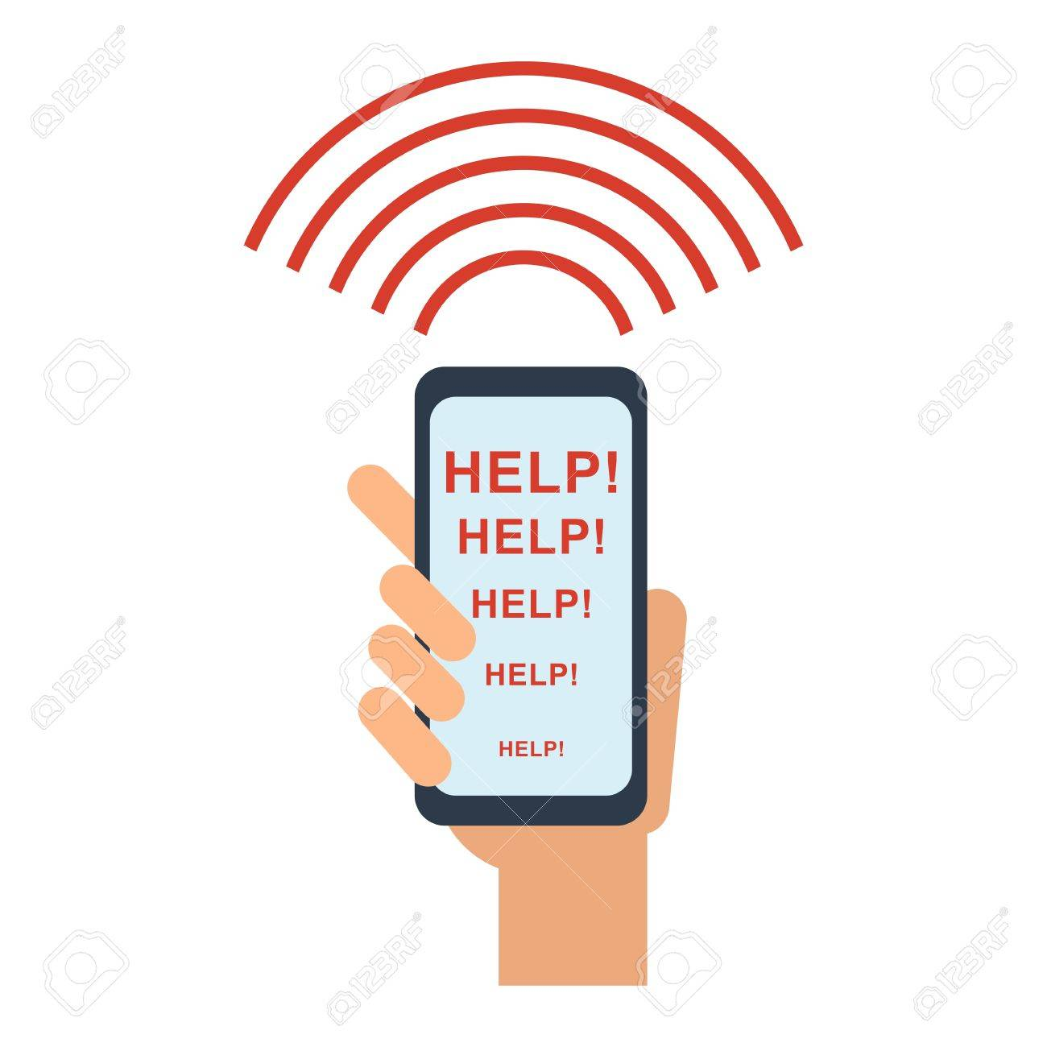
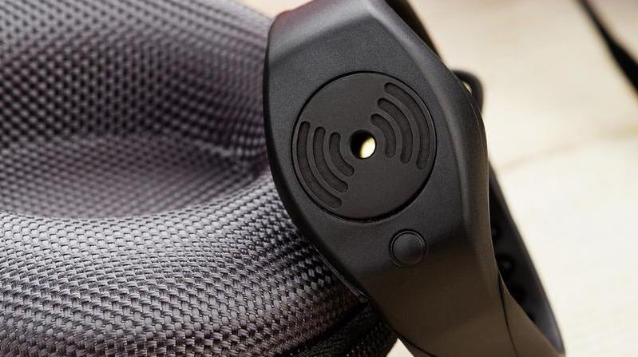
Implementation and project plan
Trigger words (customizable) spoken by victim
2 people would work on the development of the NN (Estimated time: 5-6 weeks)
SNPE helps in audio template matching
List of actions to call for help (customizable)
OR
Victim taps/presses a button on the device to trigger alarm
The device will vibrate to confirm the call for help
The person can cancel the false alarm by following some predetermined steps
2 members would work on designing the various HW modules and ensuring that they work in coherence with all the software modules (Time: 4-5 weeks)
Application development would be done by 1 person (Time: 2 weeks)

Slide 6
Tools and software
HARDWARE:
The external HW device will have sensors (like accelerometer/vibration sensor + microphone etc.), a Power Management system and a Bluetooth module to communicate with the smartphone
SOFTWARE:
Smart Assistants like Alexa, Siri etc. perform voice-text translation pretty accurately. The music apps Soundhound/Shazam carry out audio template matching in order to recognize songs/artists from a small audio snippet. We will leverage this same concept and fine tune it for our use case of matching the pre-defined trigger words with the query phrase
Qualcomm's SNPE will be used for all the NLP.
Accelerometer/Vibration sensor
Once the sensors are activated, the wearable will communicate with the smartphone
BLE + Bluetooth Module
Power Management
System
Vibrator – to confirm the sending of the help call
Microphone

Slide 7
Intermediate milestones
Software
The core neural engine that needs to be developed for audio template matching with the help of SNPE can be extending for various applications like voice detection, speech to text etc.
The whole product in entirety (the accompanying device and the supporting software modules) can be made available to consumers.
The various software modules like the NN for audio template matching and the application to call for help can be incorporated in all the Qualcomm mobile chipsets that we manufacture
Hardware
Circuitry for the Wearable device will be designed and implemented.
Sensors and Bluetooth module can be put together according to our design to make a customized hardware
Required components:
ESP32 : Bluetooth enabled micro controller.
3.3v Power supply.
Sensors

Slide 8
Backup Slides

Slide 9
Popular Safety Gadgets In Market
Product | Cost in INR (Converted to INR for convenience)
Nimb Ring | 18K
Ripple Safety | 7K
Siren Ring | 7K
Roar for Good | 10K
Revolar | 7K
Safelet | 6K
Conclusion:
All the available gadgets are too costly to be accessible for everyone. Our product will be available in
price range of ~1000 Rupees which gives us the advantage of huge market penetration.

Slide 10
Most popular safety apps
Apps | Panic sequence Trigger Principle
Rasksha | Panic button inside App to share GPS location with Guardians.
Himmat | Panic button inside App to share GPS, Audio and Video feed directly with Guardians.
Women Safety | Panic button inside App to share GPS, One Picture from each camera with Guardians.
Shake2Safety | Panic sequence is triggered by Shaking the phone multiple times.
Chilla | Panic sequence triggered by loud shout.
Safetipin | Provides a safety rating of nearby places. Panic sequence triggered based on specified set of rules for the locations.
Conclusion:
There are no safety apps which can trigger panic sequence based on custom key phrases. Our solution will
be the first of its kind in the market.

Slide 11
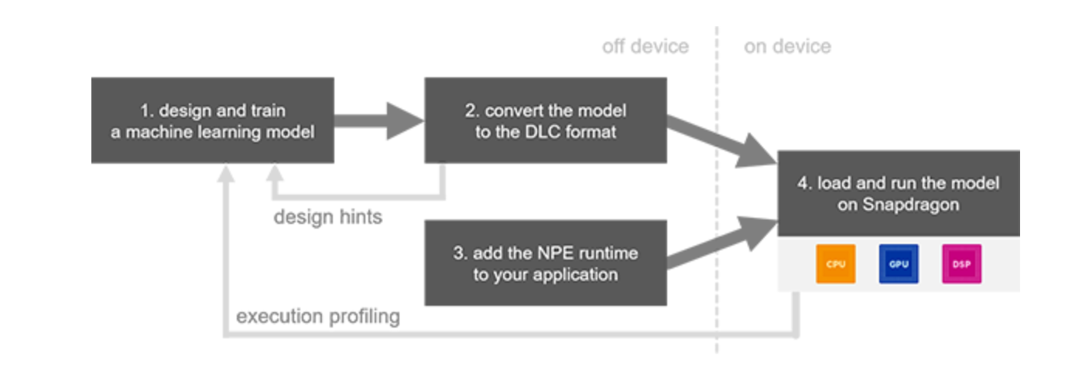
Relevance for Qualcomm
Software
Our solution uses SVA (Snapdragon voice activation) and SNPE (Snapdragon Neural Processing Engine) SDK.
Hardware
For prototyping we will be using an opensource development board, but in the final product we can use QCC5100 series Bluetooth SoC.
With the above Software and Hardware, entire solution can be commercialized by Qualcomm.
SNPE Workflow

Slide 12
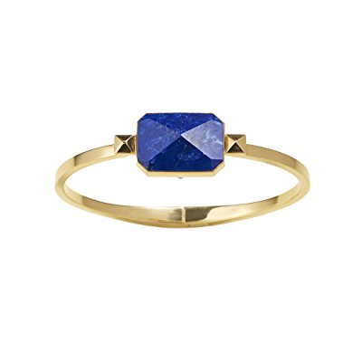
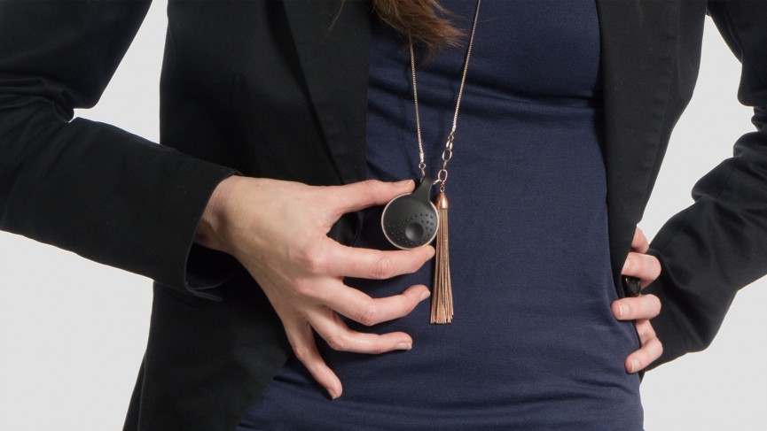
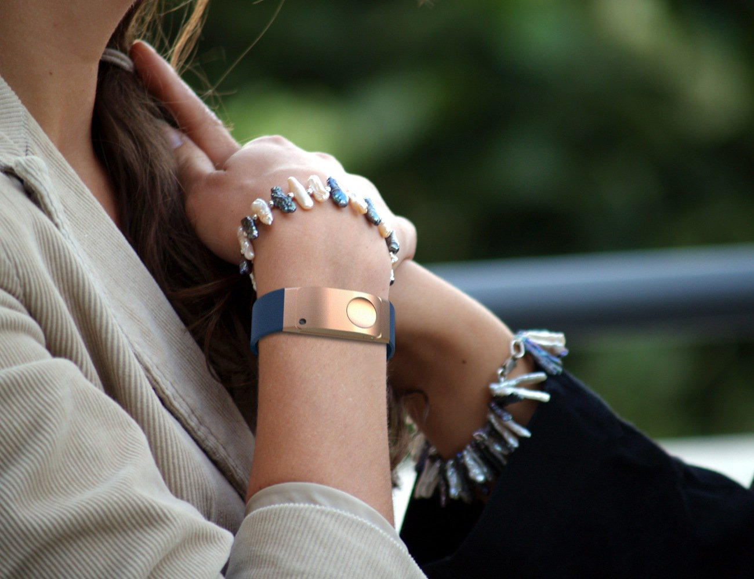
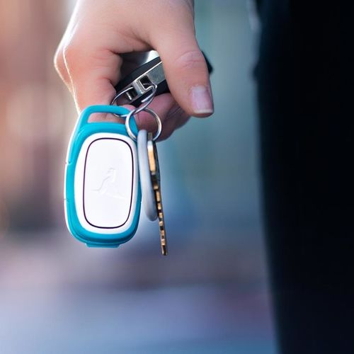
Final product vision
Wearables with the Qualcomm safety hardware
Smartphone with Qraksha App

Slide 13
Final product usage
In distress situations:
Reach out to smartphone and click the Panic button in Qraksha app to trigger the panic sequence.
If not possible:
Shout the custom key phrases, Qraksha app understands the phrases and triggers the panic sequence.
If not possible:
Long press the button on the wearable, button press event is transmitted to Qraksha app via Bluetooth and the panic sequence is triggered.
Sensors on the wearables detect 'stress situation' and communicate to the phone via Bluetooth, triggering the panic sequence

Slide 14
FINAL product TIMELINE
We propose the following timeline for the product from development stage to the market
2-3 months : Basic Functional Prototype (within the Qmaker Challenge timeframe)
4-5 months : Full Proof of Concept (including all the features that we have mentioned)
3-4 months : Trial version with customized HW and industrial design
2-3 months : User Trial and Fine Tuning of the Product
4-5 months : Final version Pilot Production with production ready software
We estimate the full time from scratch development of the product to market to be 1.5-2 years
NOTE: The time mentioned above is incremental

Slide 15
Thank You!!

