Slide 1


DEPARTMENT OF COMPUTER SCIENCE AND ENGINEERING
COUPEX- A Smart Coupon and Discount Management System
PROJECT STUDENT
O KARTHIK SURYA MOULI, 43612038

Slide 2
AGENDA
Abstract
Existing System
Proposed System
Advantages
Disadvantages
Hardware Requirements
Software Requirements
Modules
Module Description
Sample Output(Screenshot)
Conclusion

Slide 3
Abstract
COUPEX is a web-based application designed to help users organize, manage, and track their discount coupons efficiently. It eliminates the hassle of manual tracking by offering a digital platform to add, edit, delete, and filter coupons based on category, expiry date, and usage status. The system ensures users never miss out on discounts or let valuable offers expire.
3

Slide 4
Existing System
In the existing system, users manually record coupons or rely on memory to track expiry dates. This often leads to expired coupons, missed offers, and poor organization. There is also no centralized digital repository for managing multiple coupons from different stores.

Slide 5
Proposed System
The proposed COUPEX system provides a centralized web platform for managing coupons efficiently. It allows users to add, edit, delete, and search coupons easily. Notifications and filtering features help users stay informed about expiring offers and organize coupons effectively.

Slide 6
Advantages
• Easy to use and accessible on any browser
• Eliminates manual coupon tracking
• Provides expiry reminders and categorization
• Improves organization and usability
• Secure local storage of user data
• Reduces the chance of missing offers

Slide 7
Disadvantages
• Limited to local storage (no cloud backup)
• Requires browser access
• Notifications depend on user permissions
• No automatic coupon import from external sites

Slide 8
Hardware Requirements
• Processor: Intel Core i3 or higher
• RAM: 4 GB or more
• Hard Disk: Minimum 100 MB free space
• Display: 1024x768 resolution or higher
• Input Devices: Keyboard and Mouse

Slide 9
Software Requirements
• Operating System: Windows / macOS / Linux
• Browser: Chrome, Firefox, or Edge (latest version)
• Frontend: HTML, CSS, JavaScript
• Backend: LocalStorage (Browser Based)
• Code Editor: VS Code or similar

Slide 10
Modules
1. Login Module
2. Registration Module
3. Coupon Management Module
4. Filter & Search Module
5. Statistics Module
6. Notification Module

Slide 11
Module Description
• Login & Registration Module: Handles user authentication and access control.
• Coupon Management Module: Allows users to add, edit, or delete coupons.
• Filter & Search Module: Helps users quickly locate coupons by name, category, or status.
• Statistics Module: Displays counts of total, active, used, and expired coupons.
• Notification Module: Alerts users when a coupon is near expiry.

Slide 12
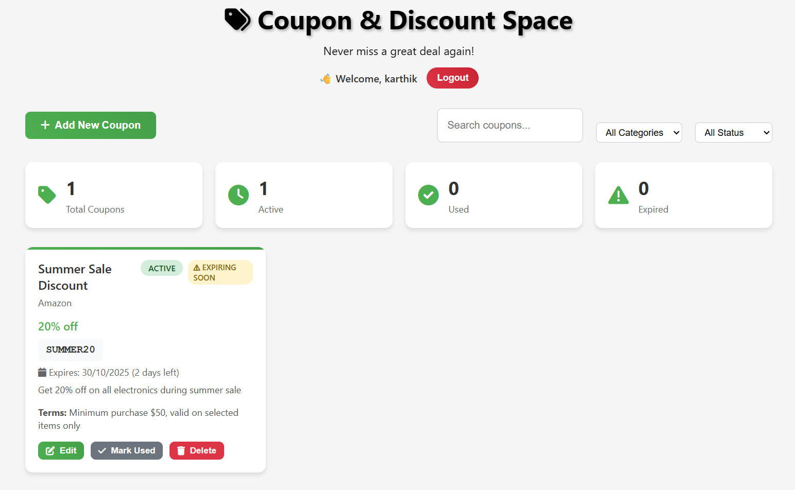
Sample Output(Screenshot)

Slide 13
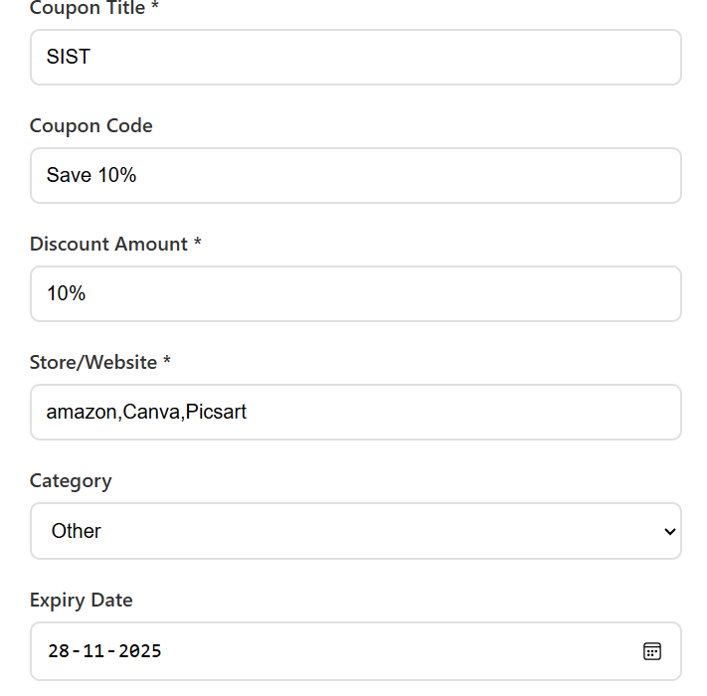
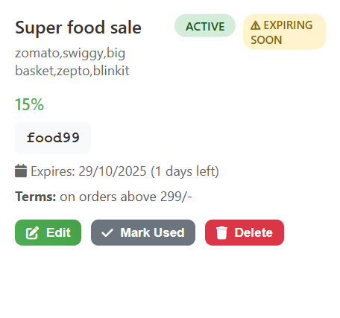
Sample Output(Screenshot)

Slide 14
Conclusion
COUPEX provides a simple yet powerful solution for managing coupons efficiently. It helps users save time and money by organizing their offers digitally. Future enhancements may include cloud synchronization, AI-based offer suggestions, and mobile app integration for broader accessibility.

Slide 15
THANK YOU

