Slide 1
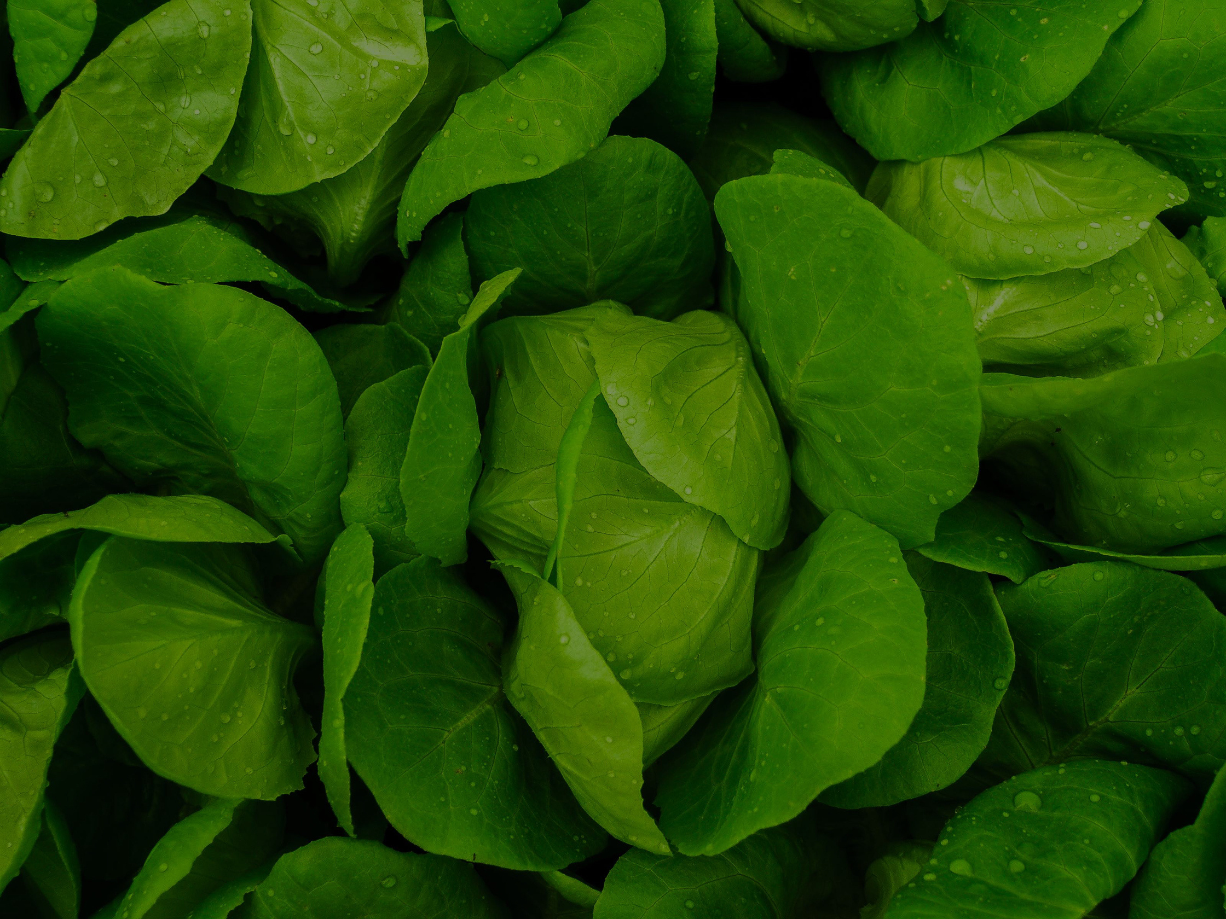
HOME
Crop Recommendation Using Multinomial Logistic Regression
Team members
sec-8
K.Girish - 2520030231
Guide : Shaik Asif Assistant Professor CSE
T.Karthik- 2520030234

Slide 2




Problem Statement
Farmers need to select crops according to soil nutrients and environmental conditions. However, traditional crop selection often depends on experience and manual analysis, which may lead to unsuitable crop selection, reduced productivity, and inefficient resource utilization. Therefore, there is a need for a data-driven machine learning system that can analyze soil and climatic parameters and recommend the most suitable crop.

Slide 3
PROPOSED SOLUTIONS
  Collect soil and weather data.
  Clean and analyze the data using EDA.
  Train a Multinomial Logistic Regression model.
  Give soil and environmental values as input.
  Model predicts the most suitable crop.
  Help farmers make better crop-selection decisions.

Slide 4
OBJECTIVES
  Analyze soil and weather conditions for different crops.
  Perform EDA to find useful patterns in the dataset.
  Preprocess the agricultural data for machine learning.
  Build a crop recommendation model using Multinomial Logistic Regression.
  Predict the most suitable crop based on the given conditions.
  Evaluate the model using Accuracy, Precision, Recall, F1-Score and Confusion Matrix.
  Support farmers in making better crop-selection decisions

Slide 5
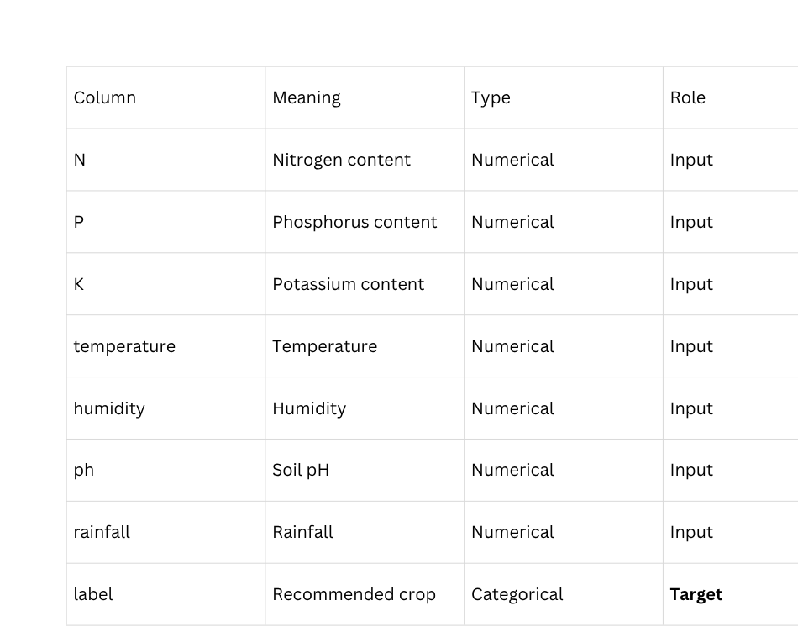
Dataset Overview
Dataset
  Rows: 2,200
  Columns: 8
  Input Features: 7
  Target Column: label
  Target Type: Categorical
  Date/Time Columns: None
  Numerical Columns: 7
  Categorical Columns: 1 (label)

Slide 6
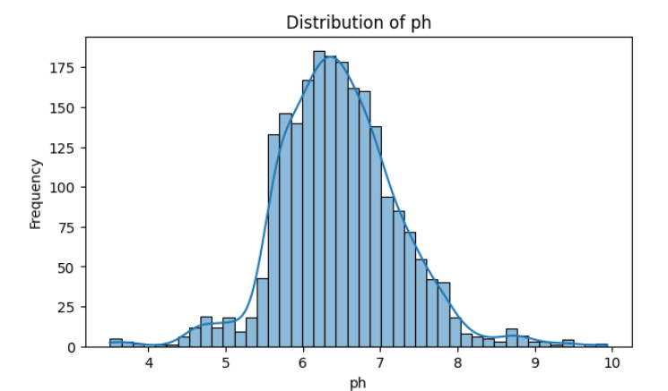
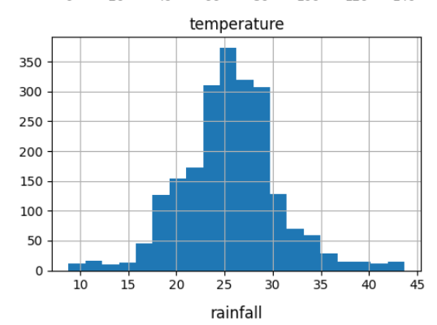
EDA Analysis
EDA was performed to understand the distribution of soil and environmental parameters, identify patterns among crops, and analyze relationships between important features.

Slide 7
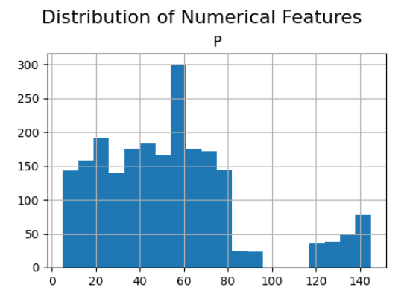
EDA Findings
Some important observations:
  2,200 records across 22 crop classes, with no missing values or duplicates.
  Each crop has exactly 100 samples, so the target is perfectly balanced.
  N (0–140), P (5–145) and K (5–205) vary widely; legumes need far less N than cotton or rice.
  Temperature, humidity, pH and rainfall each span wide, crop-specific ranges (e.g. rainfall 20–299mm).
  P and K are strongly correlated (≈0.74) in the heatmap; N correlates weakly with P.
  Grapes and apple need high P & K, cotton needs the most N, and rice needs high humidity and rainfall.

Slide 8
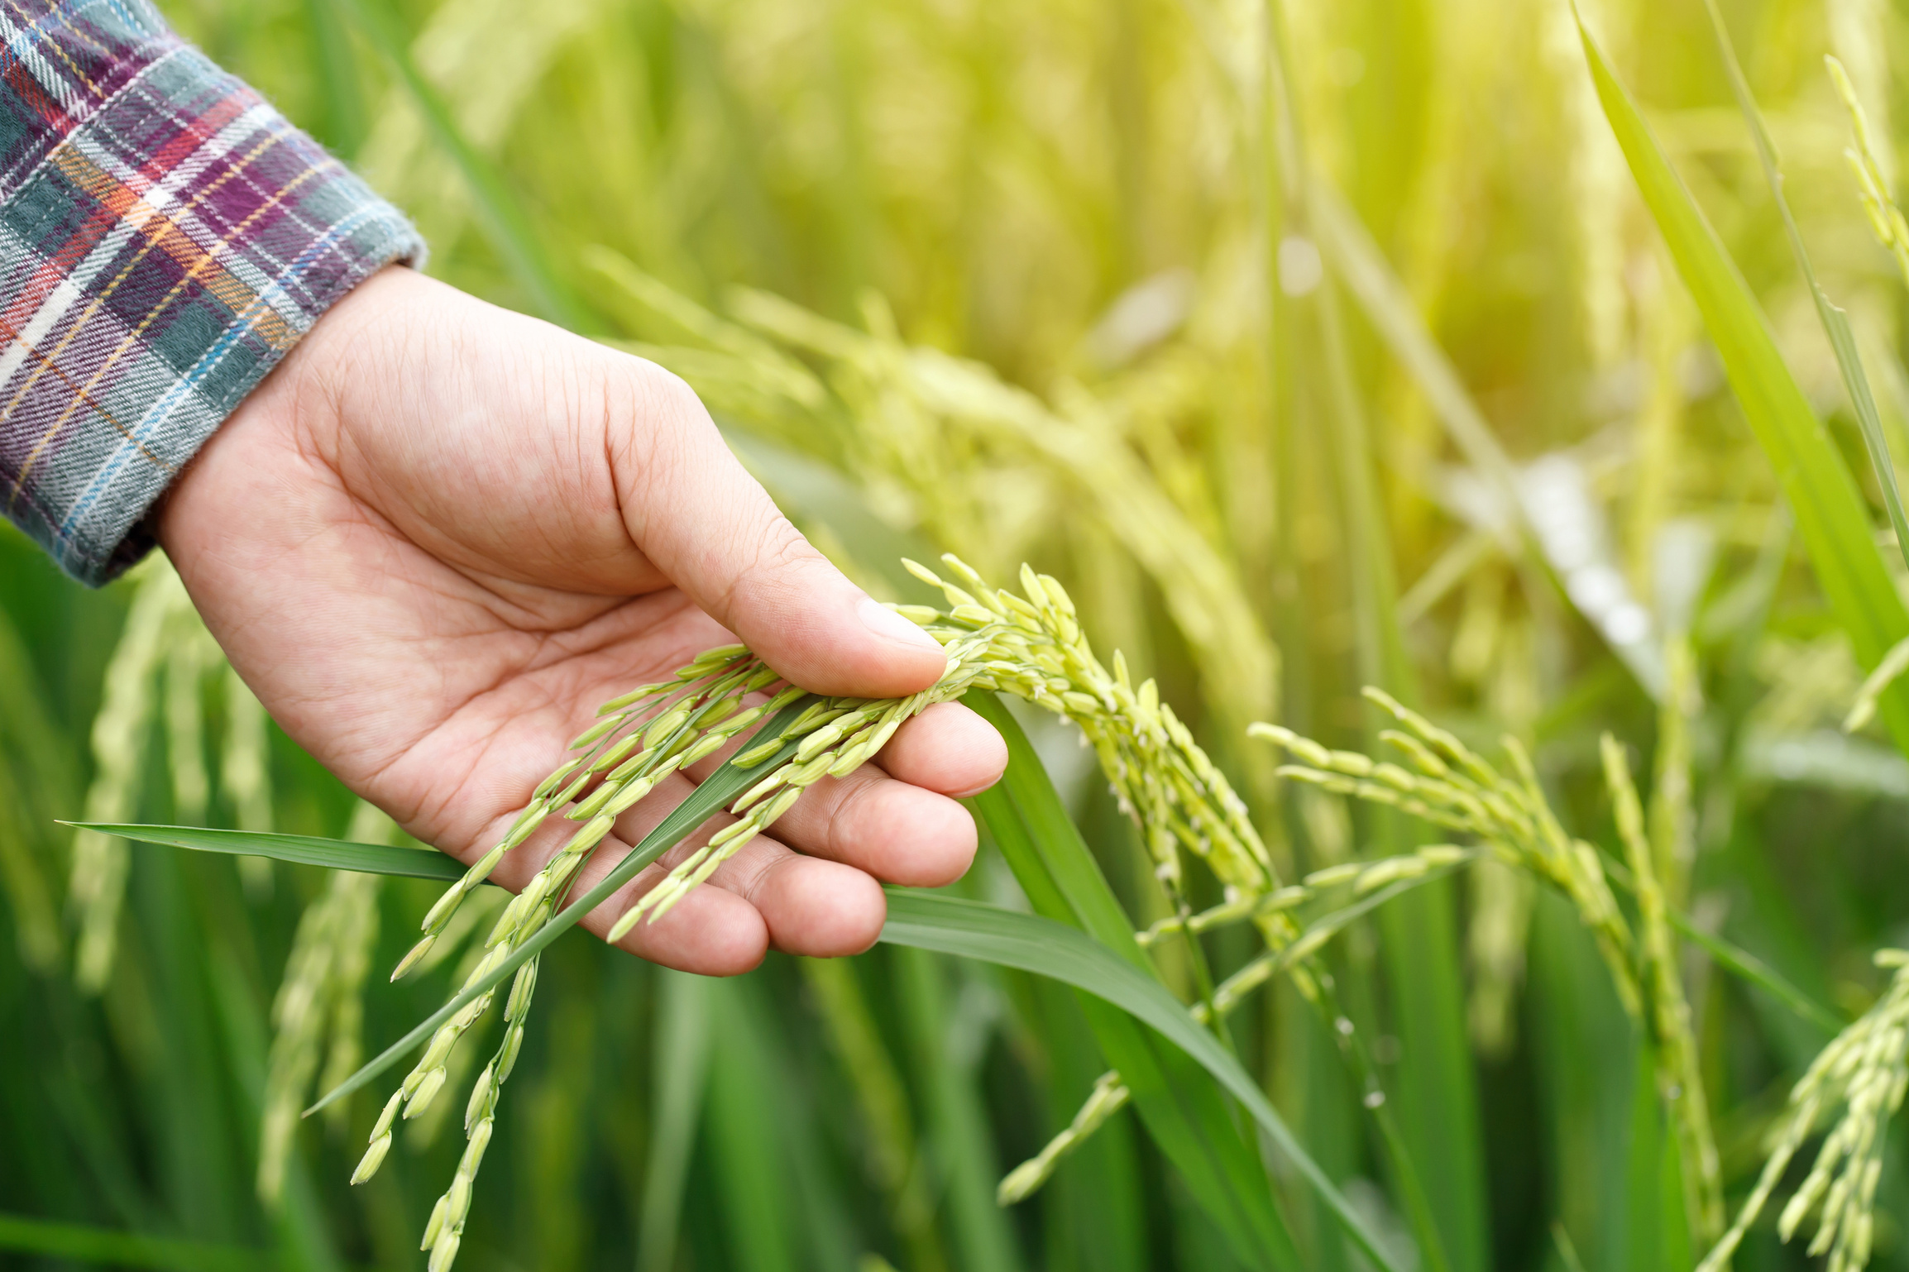
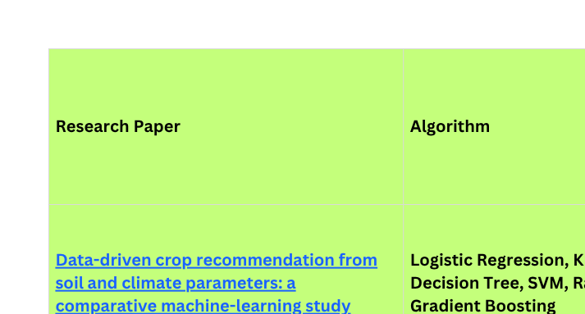
Research Paper Analysis

Slide 9

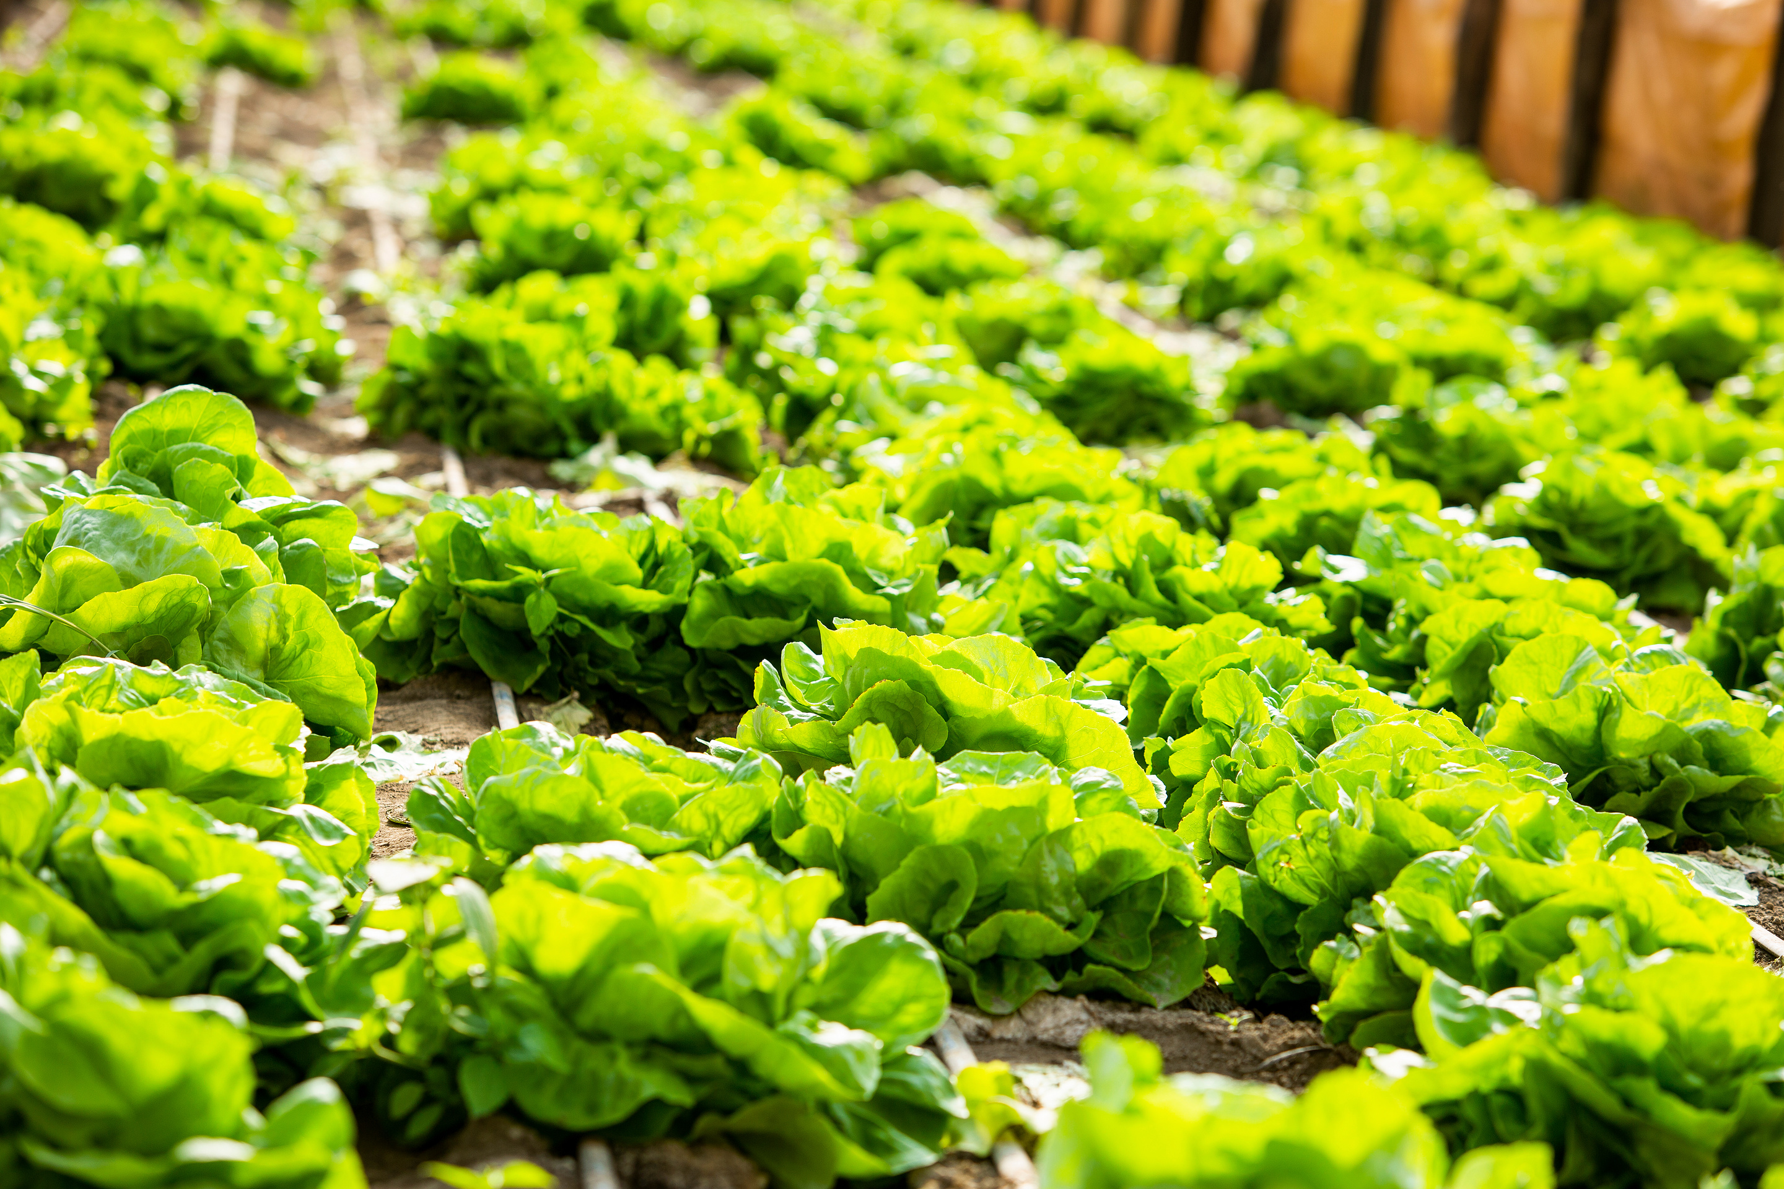
Conclusion
  The project addresses the problem of unsuitable crop selection.
  The selected dataset contains soil and environmental parameters relevant to crop growth.
  EDA helps identify patterns and relationships between agricultural conditions and crops.
  Multinomial Logistic Regression is suitable because the target contains multiple crop categories.
  The model will be evaluated using Accuracy, Precision, Recall, F1-score and Confusion Matrix.
  The system can support data-driven agricultural decision-making.

Slide 10
Thank You!

