Slide 1


Design Patterns
CS6.401 Software Engineering
Dr. Karthik Vaidhyanthan
karthik.vaidhyanathan@iiit.ac.in
https://karthikvaidhyanathan.com

Slide 2
Acknowledgements
The materials used in this presentation have been gathered/adapted/generated from various sources as well as based on my own experiences and knowledge
-- Karthik Vaidhyanathan
Sources:
Design Patterns: Elements of Reusable Object-Oriented Software by Erich Gamma, Richard Helm, Ralph Johnson and John Vlissides
Head first Design Patterns, Second Edition, Eric Freeman and Elisabeth Robson

Slide 3
You can give a command: Command Pattern [Behavioral]

Slide 4
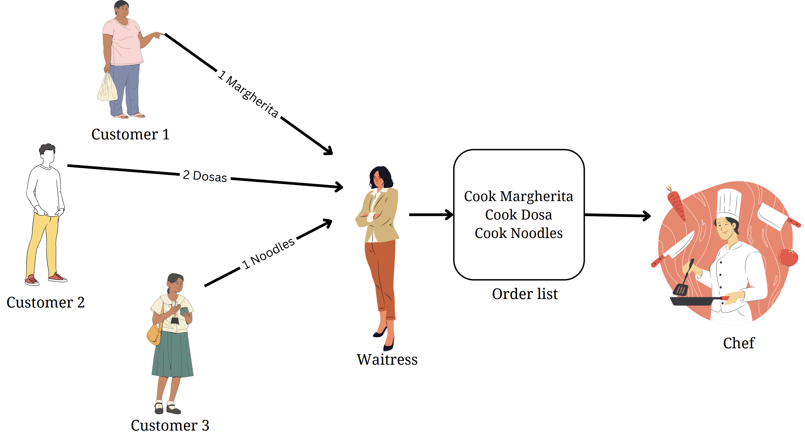
Meet the Command Pattern!

Slide 5
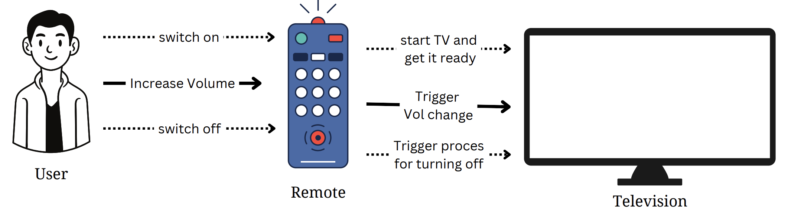
Meet the Command Pattern – A Scenario
Should remote know exactly how the TV work step by step?

Slide 6
Meet the Command Pattern
What if sender need not have to worry about receiver’s internal implementation?
What if some commands needs to be scheduled and executed in order at a later time?
Sender needs to be decoupled from a receiver
Encapsulates everything required to perform an action
Execution of action can happen independently

Slide 7

Command Pattern: Documentation
Intent
Encapsulate a request as an object, allowing parameterization of clients with requests, log or queue request and support undoable operations.
Also Known As: Action, Transaction
Motivation
Sometimes its necessary to request to objects without
details about operation
Objects can be stored and passed around -
Five key objects: Client, Command, Concrete Command, Invoker and Receiver
Example: UI kits [Think about if you want to develop a button class]

Slide 8
Command Pattern: Documentation
Applicability
Parameterize objects by an action to perform – Callbacks in procedural
Specify, queue, execute request at different times
Support undo operations – Think of editors, games [Add another operation in command interface]
Support logging changes – Manage crashes
Sometimes an operation may be composed of primitive operations

Slide 9
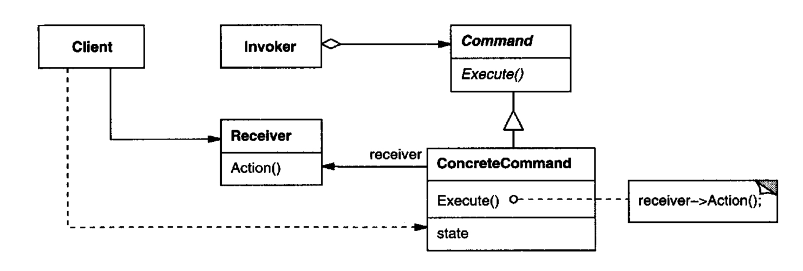
Command Pattern: Documentation
Structure
Image source: Gang of four book

Slide 10

Command Pattern: Documentation
Participants
Command (Command.java)
Interface for executing an operation
ConcreteCommand (TVOnCommand, TVOffCommand,..)
Binding between receiver object and action
Implements the execute by invoking operations on receiver
Receiver (Television)
Knows how to perform the operations associated with a request
Client (RemoteControlDemo)
Create ConcreteCommand object and sets its receiver
Invoker (RemoteControl)
Calls command to execute a request
This Photo by Unknown Author is licensed under CC BY

Slide 11
Command Pattern: Documentation
Consequences
Decoupling client and receiver
Decouples invoke operation from the one that knows how to perform it
Commands as first-class objects
Command can be manipulated and extended like any other object
Composite commands can be formed
Commands can be composed to form a larger command
Code complexity may increase
Not every time this is needed
Introduction of new layer between senders and receivers

Slide 12
Command Pattern: Documentation
Implementation
Check the source code given along: RemoteControlCommand

Slide 13
We can pass on responsibilities: Chain of Responsibilities! [Behavioral]

Slide 14
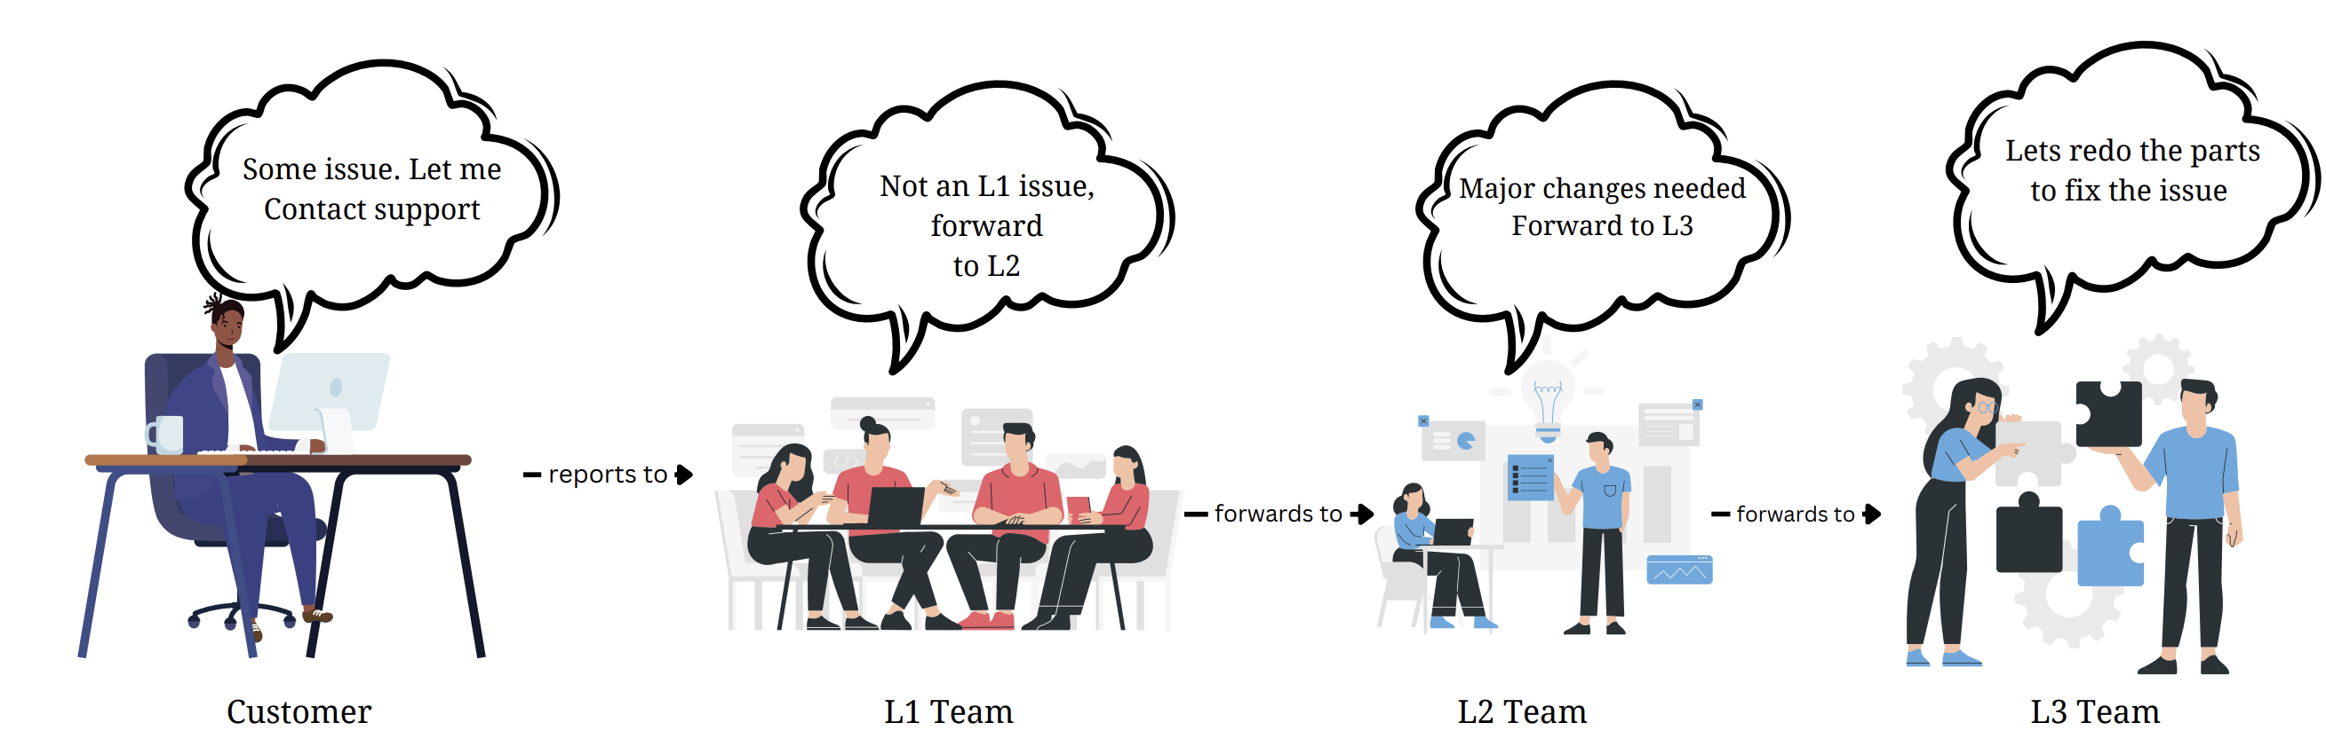
Meet the Chain of Responsibility Pattern!

Slide 15
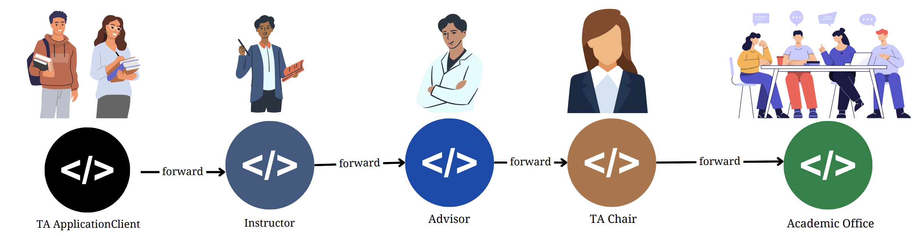
Meet the Chain of Responsibility Pattern - Motivation
TA Application Scenario
How do you implement this ?

Slide 16
Meet the Chain of Responsibility Pattern
What if one single request requires processing by multiple objects?
What if the sender needs to be decoupled from receiver in the form of set of
intermediatory objects?
Sometimes single task may require multiple steps to process
Each step in the process may decide if it needs to be further processed or not

Slide 17
Chain of Responsibility Pattern: Documentation
Intent
Avoid coupling the sender of a request to its receiver by giving more than one object a chance top handle the request. Chain the receiving objects and pass the request along the chain until one handles it
Also Known As: CoR, Chain of Command
Motivation
Request may have to be passed along a chain
Senders and receivers need decoupling
Key objects: Handler, ConcereteHandler and Client
Example: Payment process in an e-commerce system

Slide 18
CoR Pattern: Documentation
Applicability
More than one object may handle a request and handler isn’t known apriori
Issue request to one object without specifying the receiver
The set of objects that can handle a request should be specified dynamically

Slide 19
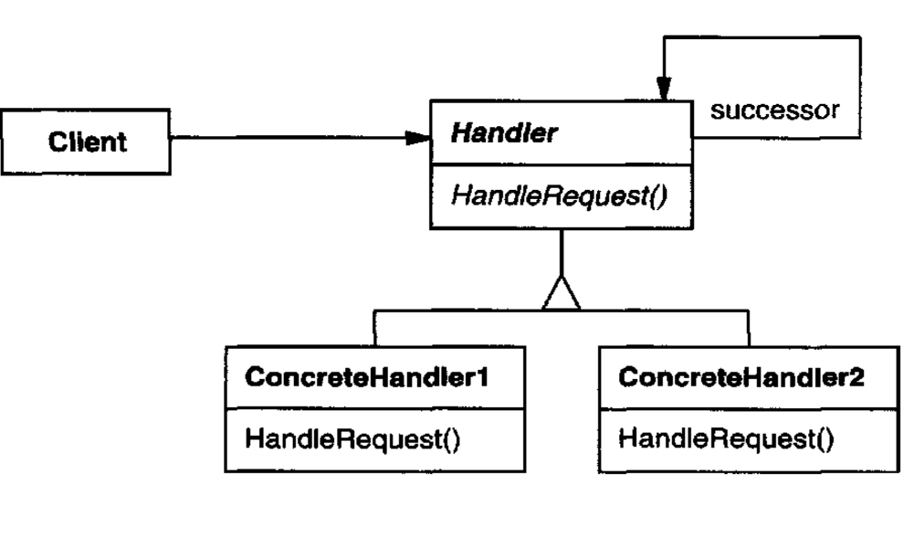
CoR Pattern: Documentation
Structure
Image source: Gang of four book

Slide 20
CoR Pattern: Documentation
Participants
Handler (ApplicationHandler)
Defines an interface for handling requests
ConcreteHandler (InstructorHandler)
Handles requests its responsible for
Can access its successor
Client (StudentDemo)
Initiates the request to a ConcreteHandler object on the chain
This Photo by Unknown Author is licensed under CC BY

Slide 21
CoR Pattern: Documentation
Consequences
Reduced Coupling
Object does not need to worry about which other object handles request
Simplifies object interactions
Flexible assignment of responsibilities
Flexible distribution of responsibilities among objects
Responsibilities of each handler can be changed at run time (chain can be increased)
Receipt isn’t guaranteed
Request has no explicit receiver – No guarantee of handling
Request can go unhandled when chain is not configured properly

Slide 22
CoR Pattern: Documentation
Implementation
Check the source code given along: TA-ApprovalChainOfResponsibility

Slide 23
How about Composing!: Meet the Composite Pattern [Structural]

Slide 24
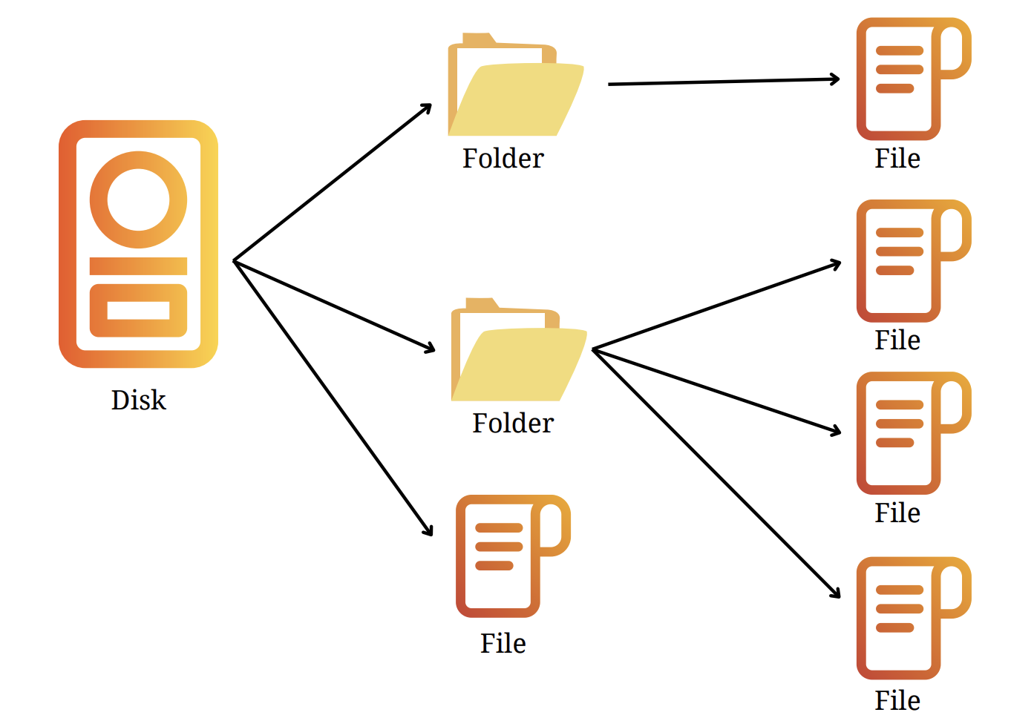
Meet the Composite Pattern!
How to get the total size?

Slide 25

Meet the Composite Pattern
What if a large component is composed of smaller components?
What if the client need not worry about the complex hierarchy?
What if the composition tree needs to be parsed recursively?
Composition may contain primitives and larger components
Have everyone in the tree share some common method

Slide 26
Composite Pattern: Documentation
Intent
Compose objects into tree structures to represent part-whole hierarchies. Composite lets client treat objects and compositions uniformly
Also Known As: Object Tree
Motivation
Enable client to treat primitives and containers identically
Promotes extensibility – Introduce new types
Four key objects: Component, leaf, composite and client
Example: Disk system has folders and files. Each folder has files

Slide 27
Composite Pattern: Documentation
Applicability
Represent part-whole hierarchies of objects
Recurse through the tree in a more controlled manner
Clients should be unaware of the differences
Ignore difference between composition of objects and individual objects
All objects in the composite structure are treated uniformly

Slide 28
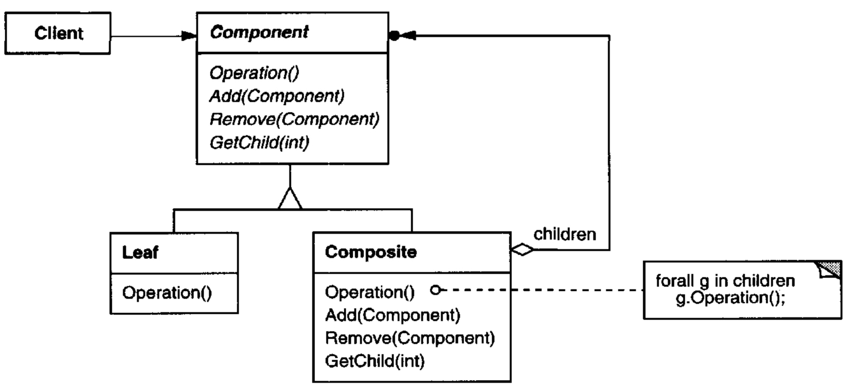
Composite Pattern: Documentation
Structure
Image source: Gang of four book

Slide 29
Composite Pattern: Documentation
Participants
Component (FileSystem)
Declares the interface for objects in the composition
Implements default behavior – also declares interface to access child components
Leaf (File)
Leaf objects in the composition – No children
Behaviour of primitive objects is defined
Composite (Folder)
Defines behavior for components with children
Stores child components
Client (FileSystemDemo)
Manipulates objects in the composition through component interface
This Photo by Unknown Author is licensed under CC BY

Slide 30
Composite Pattern: Documentation
Consequences
Class hierarchies with primitive and composite objects
Primitive objects can be further composed
Client can work with both primitive and composite in same way
Enhance client-side simplicity
Clients are not aware if an object is primitive or composite
No case statement or if conditions needed
Add new components easily
New composite or sub-classes can be added to tree without affecting client
Design can be too general – Also it sometimes can be forcefit
Restricting components of a composite is hard

Slide 31
Composite Pattern: Documentation
Implementation
Check the source code given along: FileSystemComposite

Slide 32

Thank You
Course website: karthikv1392.github.io/cs6401_se
Email: karthik.vaidhyanathan@iiit.ac.in
Web: https://karthikvaidhyanathan.com
Twitter: @karthi_ishere

