Slide 1


Software Modeling: An Overview
CS6.401 Software Engineering
Rudra Dhar
PhD Student
SERC, IIIT-H

Slide 2
Acknowledgements
Sources:
Introduction to MDE, Ludovico Iovino, GSSI, Italy
UML@Classroom, An Introduction to Object-Oriented Modeling by Martina Seidl, Marion Scholz, Christian Huemer and Gerti Kappel
UML Modelling lecture, Dr. Raghu, IIIT Hyderabad
Source: Googe images

Slide 3
UML

Slide 4

Unified Modeling Language (UML): Brief History
No common language to model until 1996
GPL developed by industry consortium in 1997
Introduction of OOP in IT dates back to 1960’s
Required a standard representation: OMG
Three Amigos: Grady Booch, Ivar Jacobson and James Rumbaugh
Based on multiple prior visual modeling languages
Goal was to have a single language that could cover large number of SE tasks
Current version of UML: 2.5.1 (as of Dec 2017)
https://www.omg.org/spec/UML/
Image source: Wikimedia commons

Slide 5
Unified Modeling Language (UML)
Notation for OO Modeling
Use object orientation as basis
Model a system as collection of objects that interact with each other
Graphical diagrams as a way to model systems
More clear (imprecise) than natural language (too detailed)
Capture an overall view of the system
Independent of language or technology

Slide 6

What UML is not?
Not an OO Method or Process
Not a visual programming language
Not a tool specification

Slide 7
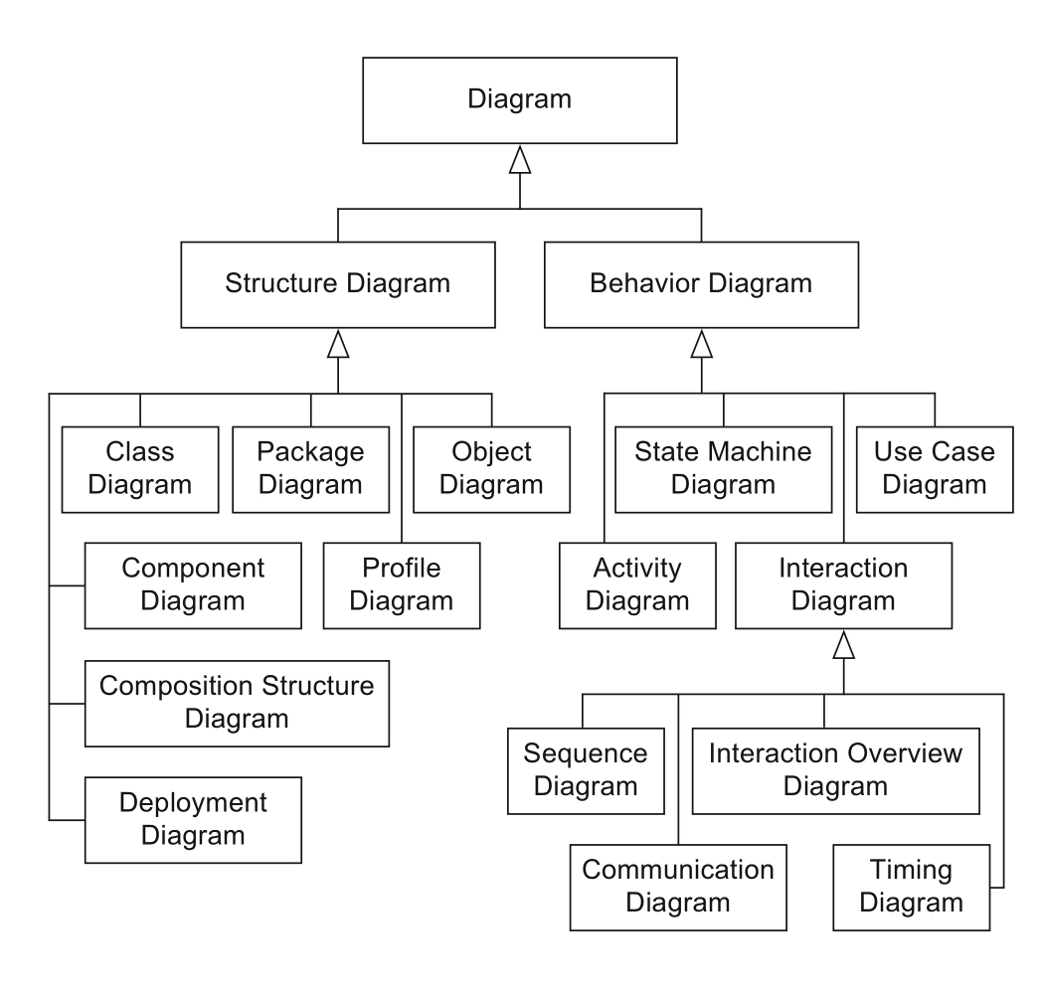
UML Diagrams
14 different diagrams
Structure diagrams
for capturing static aspects of system
Behavior diagrams
for capturing dynamic aspect of system
Image source: UML@classroom
Notes:
Object diagram
Visualize system at a more fine grained level
Represent relationship at a particular instant of time

Slide 8
Static Vs Dynamic Models
Static Model
Describes the static structure of a system
One of the most common diagrams: class diagrams
Dynamic Model
Captures the dynamic behavior of a system
Developed with help of state chart diagrams, sequence diagrams, etc.
In this unit: class diagram (static) and sequence diagram (dynamic)

Slide 9
UML Class Diagram

Slide 10
UML Class Diagram
Most common diagram in OO modeling
Captures the static structure of a system
Intuitively it is like a graph
Nodes represent the classes
Links represent the relationship among classes
Inheritance
Association (aggregation, composition)
Dependency

Slide 11
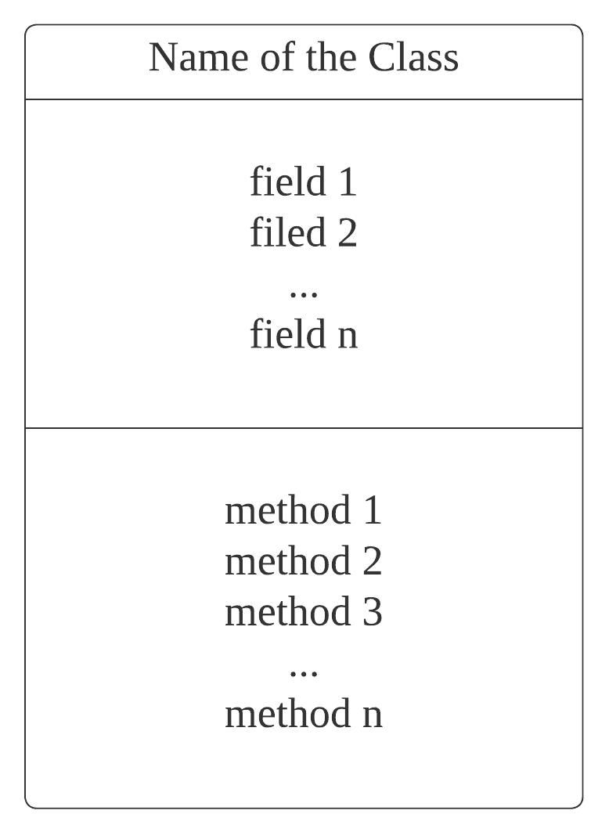
UML Class Diagram: Notation
Consists of three compartments
Class name - Pascal Casing, Singular noun, domain vocabulary
Fields/Attributes (state) - camel casing, name and type at basic level
Methods/operations (behavior) – camel casing, name, parameters, return value

Slide 12
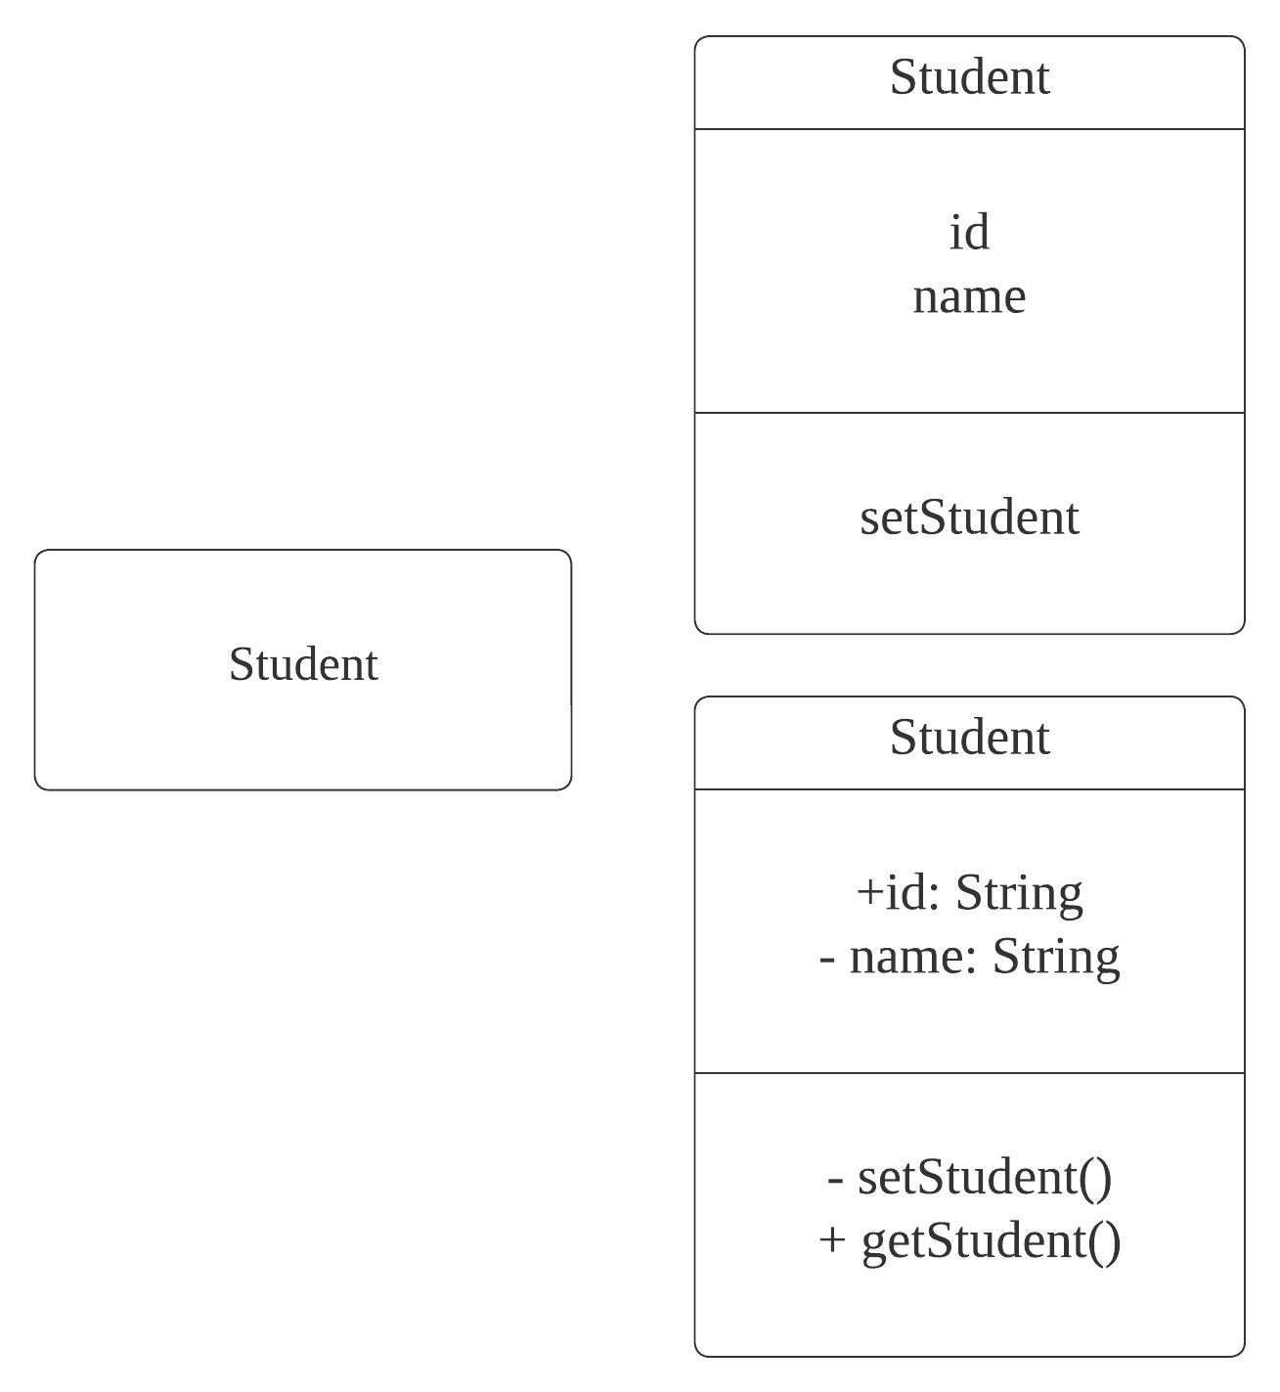
UML Class Diagram: Always make use of abstraction
Model has to be clear and understandable
Detail with respect to the stage of software
development process
More low-level analysis and
development requires detailed
information

Slide 13
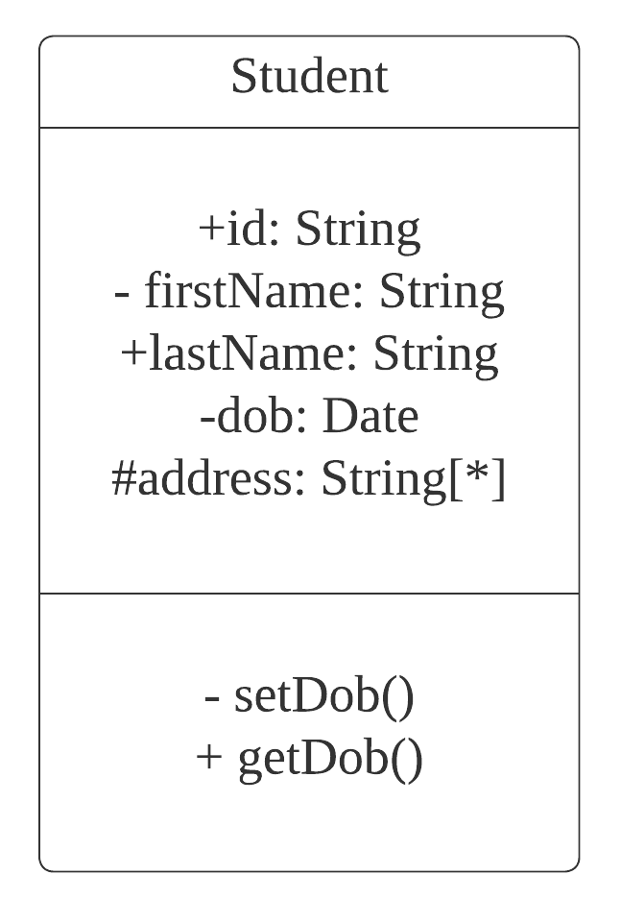
UML Class Diagram: Specifying Attributes and Methods
Name and Symbol | Description
public (+) | Access by objects of any class
Private (-) | Access only within the object
Protected (#) | Access by objects of same classes or sub-classes
Package (~) | Access by objects of the classes which are in same package

Slide 14
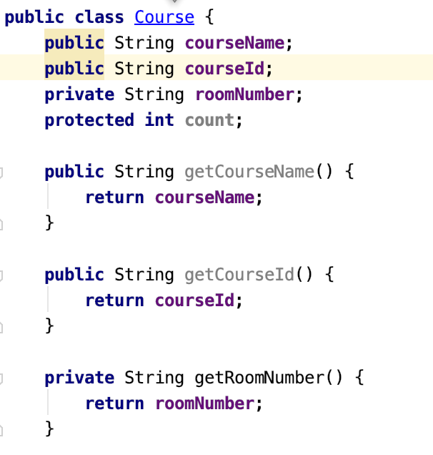
Create a class diagram for the following code

Slide 15
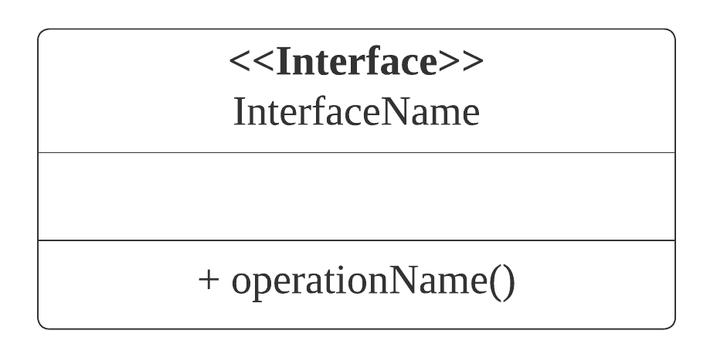
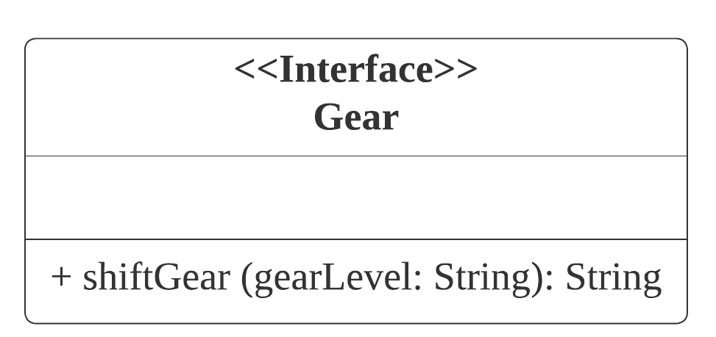
Interface and Notation for Interfaces
In simple terms it’s a contract mechanism – What to do!
Mechanism to achieve abstraction, group classes, enforcer – No instance variables only constants
Class can implement an interface – “implements” keyword (Java)
Vehicles can implement Gear interface

Slide 16
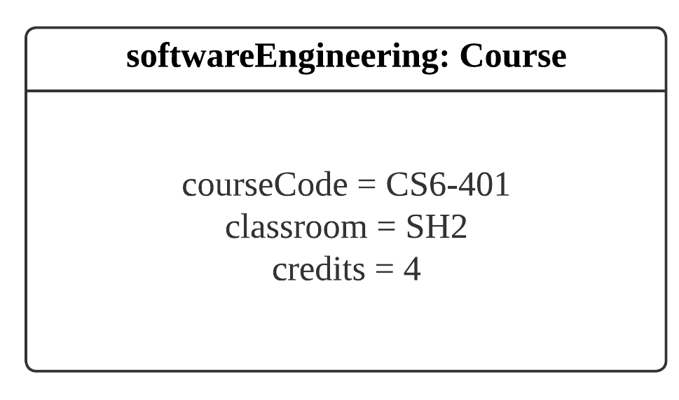
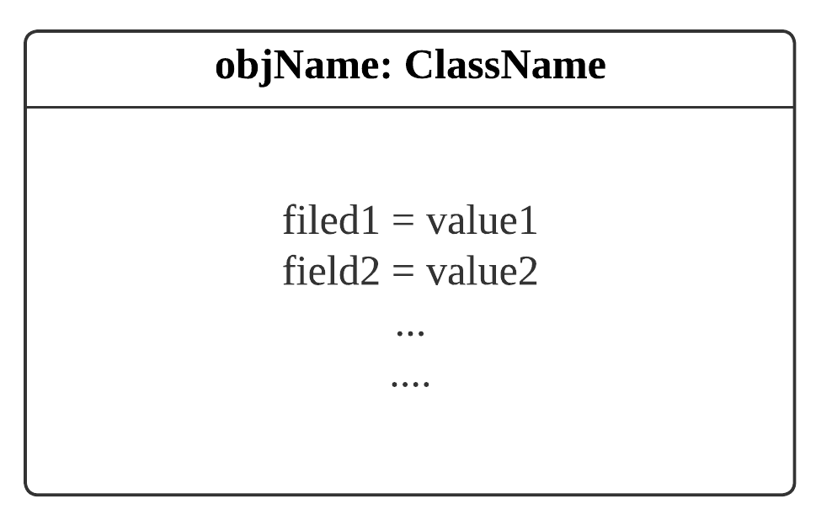
Notation for Objects
Box with one or two compartments
Remember to mention the class name
First part has object name and corresponding class name
Second part has list of fields and values

Slide 17
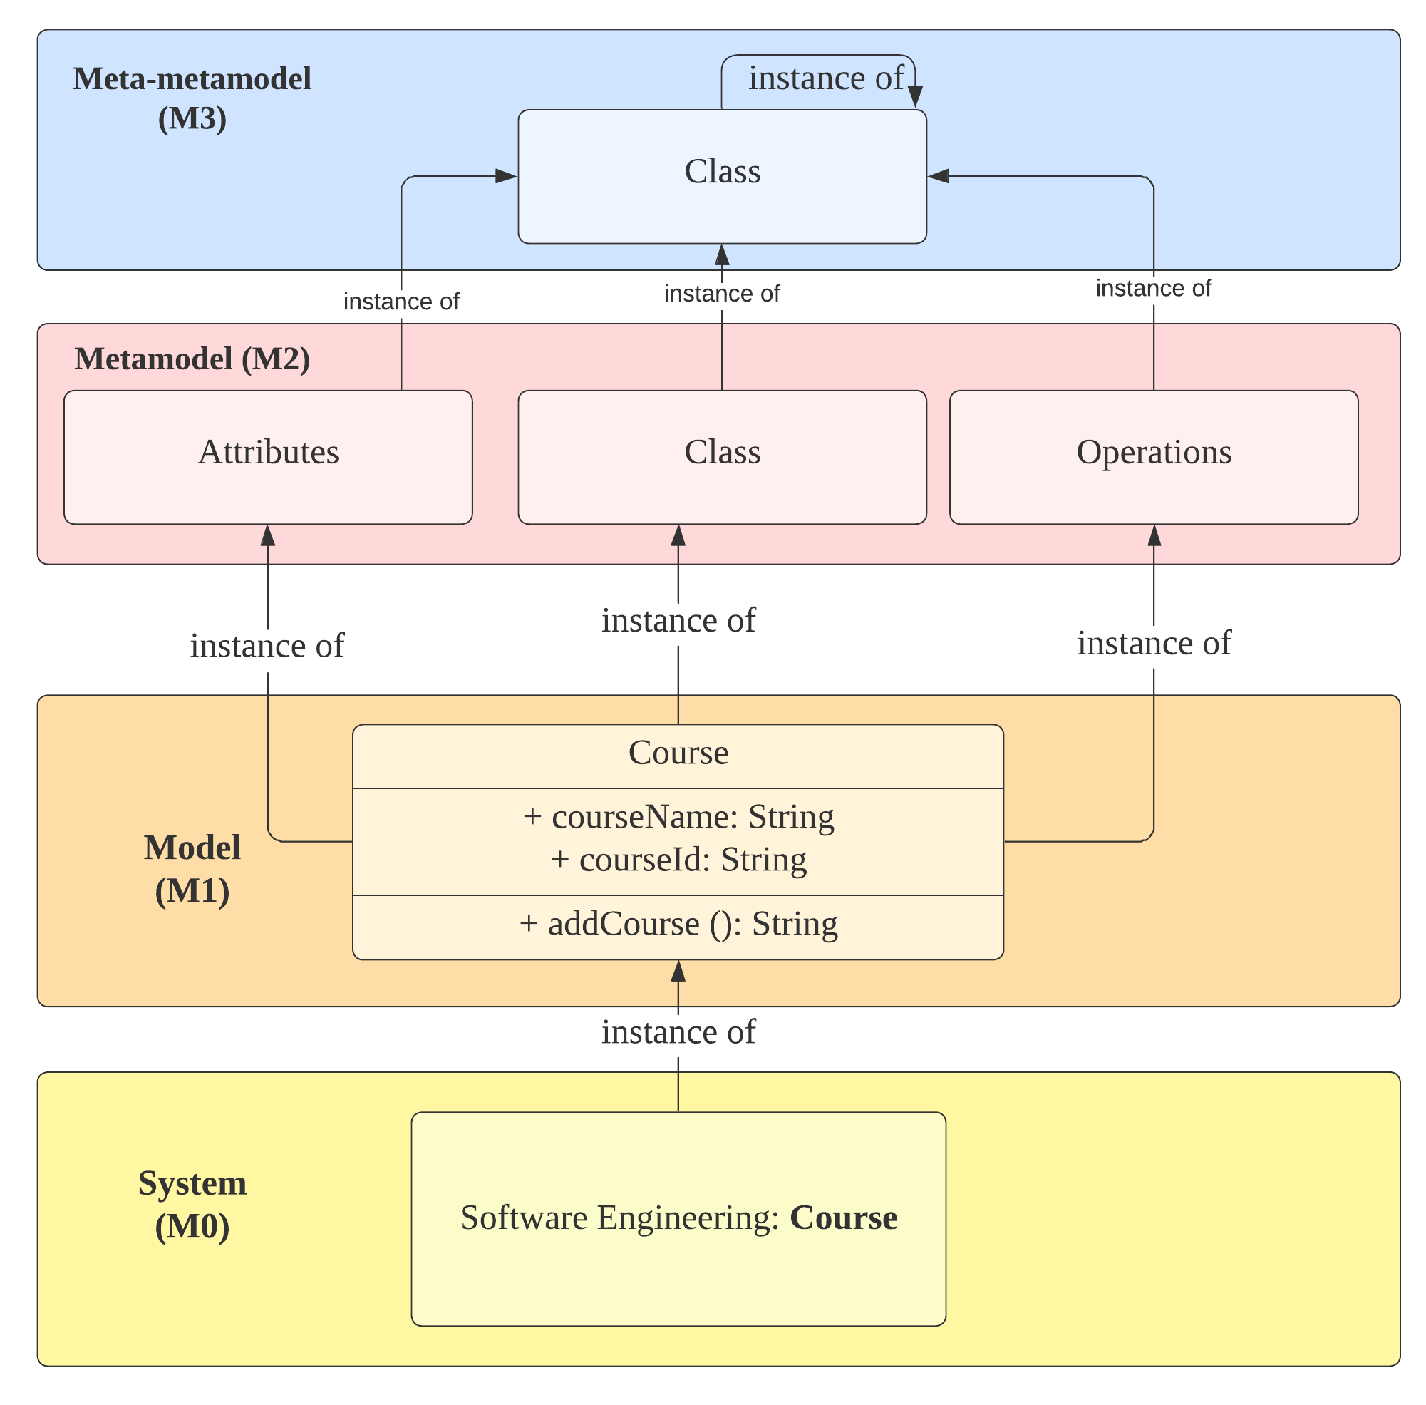
Models and Meta models
Models of models
Defines the rules for the different models
For eg: a class needs to be defined in a particular way

Slide 18
Modeling Relationships using UML

Slide 19
Three main relationships between classes
Dependency
Class A uses Class B
Associations (has-a)
Class A affects Class B
Types: Aggregation and Composition
Generalization (Is-a)
Class A is a kind of Class B

Slide 20
Inheritance in Java
Object acquires properties and behavior of parent object
Create new classes based on existing classes
Derive classes from existing classes (”extends” keyword)
Parent class/super class – Class from which other classes are derived
Child class/sub class – Class that is derived from existing class
Object class is the parent class for every class in java (java.lang.package)
Eg: Vehicle class can be parent of car, bikes, etc.
Each car, bike can themselves be parent class for child classes – How?

Slide 21
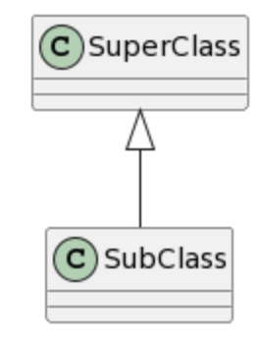
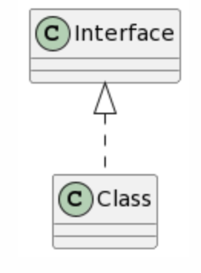
Inheritance in UML
UML provides easy ways to represent inheritance
Extension is called specialization (sub class) and generalization (supper class)
Implementation is called realization
Extension of classes
Realization of interfaces

Slide 22
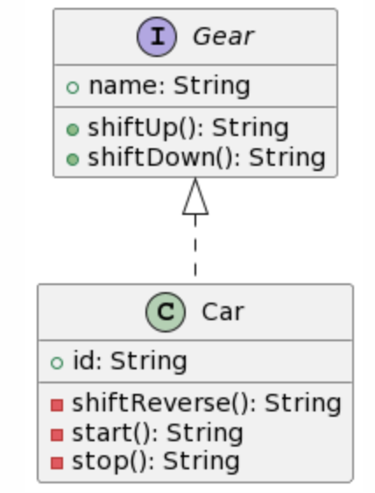
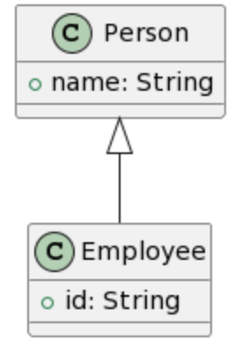
More Concrete Example

Slide 23
Time to be Creative
Draw a UML diagram showing possible inheritance relationship between different types of students in the class. What will be the abstract class (es)?
Hint: We have B.Tech, M.Tech, …..

Slide 24
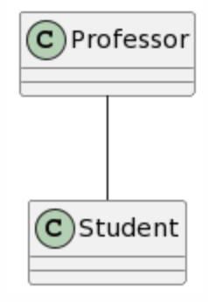
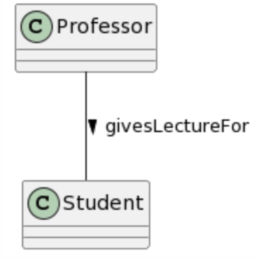
Association
Model links between instances of classes
Identify the communication partners
Use association names and reading directions (solid arrowhead) for labeling
Professors gives lecture
What kind?
What about multiplicity?

Slide 25
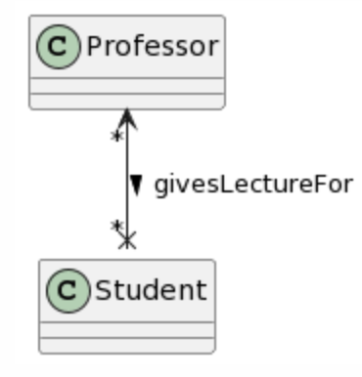
Association – Navigability and Multiplicity
Cardinality of the class in relation to the another - Multiplicity
Navigation from one to another is possible – Navigability
Navigability - Indicates who can access what (not reading direction)
Usual assumption: Bidirectional navigability
Bidirectional
Professor class can access public
parameters/methods of student

Slide 26
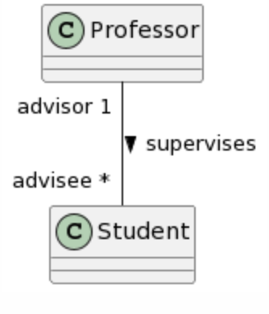
Association – Few more things
May have optional role name
Multiplicity specification is not always mandatory
min…max: closed (inclusive) range of integers
n: single integer
0..*: entire set of non-negative integers

Slide 27
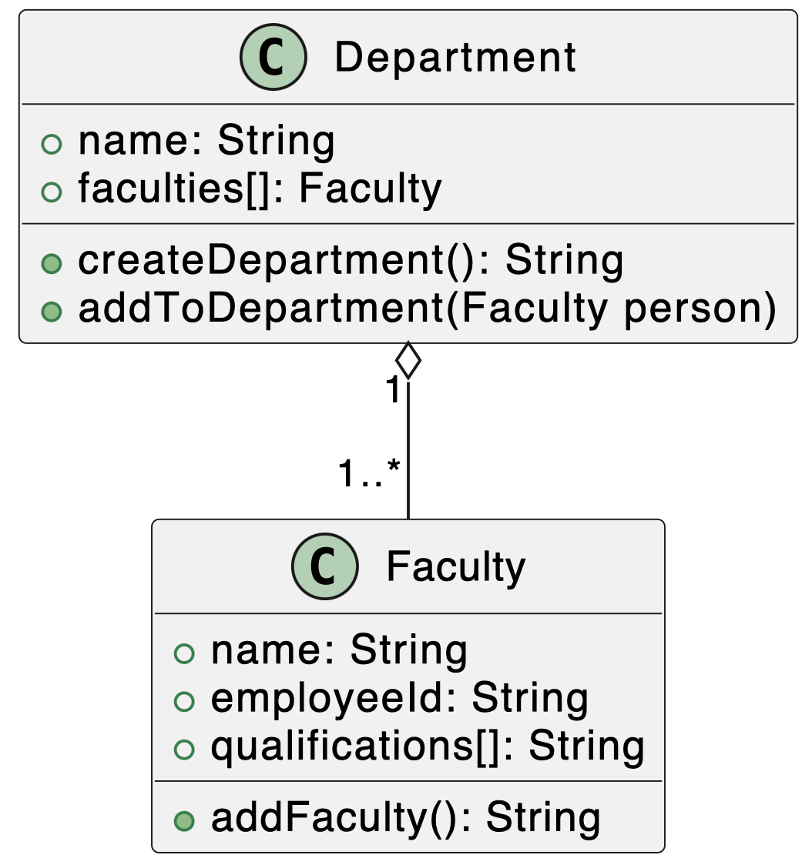
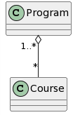
Aggregation
Special form of association - Parts-whole relationship
Used to express that a class is part of another (hollow diamond)
Combination of independent objects (eg: Program and course)
Represented by a hollow diamond
Another example

Slide 28
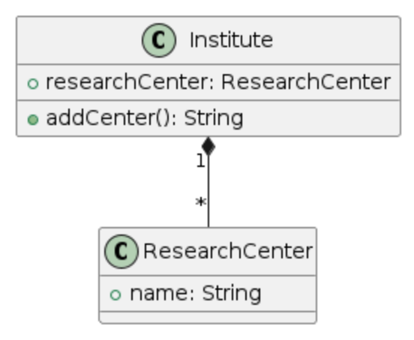
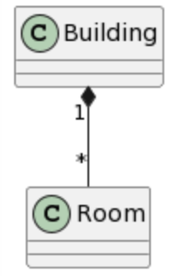
Composition
Dependency between composite objects and its parts
If the composite object is deleted, the parts are also deleted
One part can be contained in at most one composite object at a time
Max multiplicity at the aggregating end is 1 (closed diamond representation)
Building is composed of multiple rooms
Adding centers from Institute

Slide 29
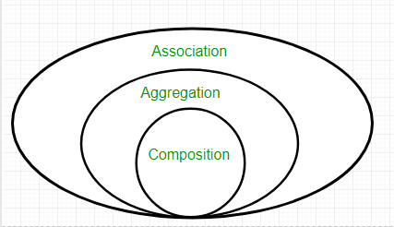
Association Aggregation Composition

Slide 30
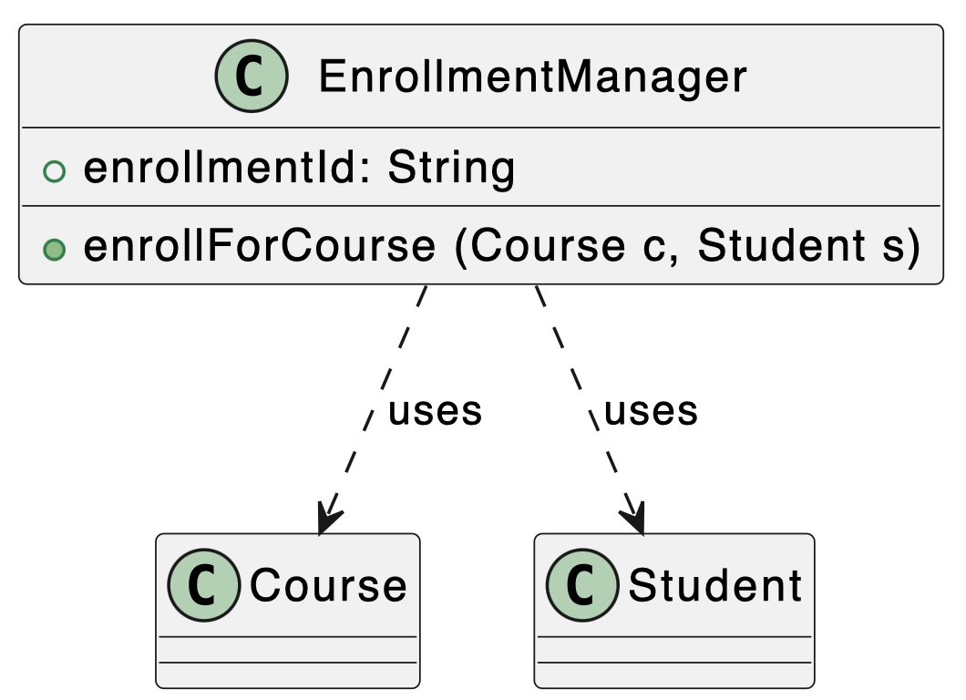
Dependency
One class uses another class <<uses> relationship
There is no conceptual link between the objects of the classes
One may refer the other or vice versa

Slide 31
Time to be Creative
Let’s revisit the case this time with class diagrams:
we want to build a course management portal (think of moodle), what could be some of the classes the corresponding attributes and methods? Can you think of some interfaces?

Slide 32

Thank You
Course website: karthikv1392.github.io/cs6401_se
Web: https://karthikvaidhyanathan.com

