Slide 1


Design Decisions
CS6.401 Software Engineering
Rudra Dhar
PhD Student
SERC, IIIT-H

Slide 2
Let's design ChatGPT
Key functionalities
Tech-stack, (programming language)
Hardware limitations
Team skill
Financial Constraint
Socio-political
Data

Slide 3
Architectural Design Decision

Slide 4
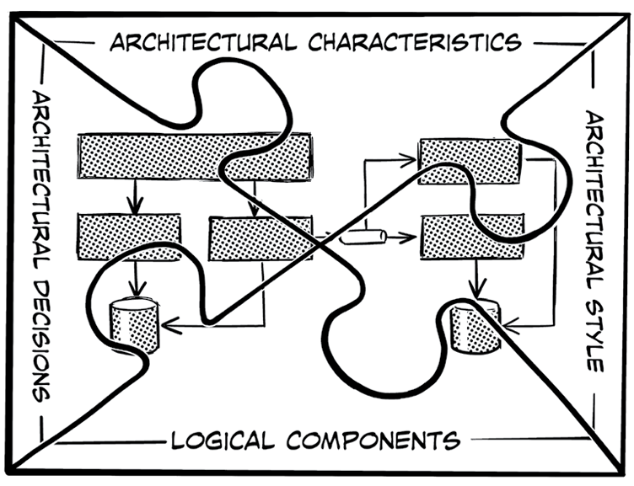
Software Architecture
Software Architecture is the stuff that’s hard to change.
Martin Fowler
Software Architecture =
Components and Connectors
Garlan and Shaw
Software Architecture =
{ Elements, Form, Rationale }
Perry and Wolf
(Foundation of Software Architecture)

Slide 5


Slide 6
Architectural vs Design Decision
Low <-------- Significance -------> High
Low <-------- Effort-------> High
Tactical <---------------> Strategic
<---------------------------------------------------------------------------------------->
Renaming a method or function
Deciding which programing language to use
Migrating your system to cloud

Slide 7
Why record ADDs ?
Lack of clear visibility into the reasons behind the current architecture.
Implicit embedding of design decisions leads to Knowledge Vaporization.
Violation of design rules and constraints during system evolution leads to architectural drift.
Failure to remove obsolete design decisions accelerates system erosion
High cost of change.
Informed Decision making
Improved traceability of design decisions

Slide 8
Architectural Decision Record

Slide 9
Simple ADR
Status
Accepted
Context
We need to decide on whether to use Python as a programming language for our project. Our project involves data analysis, machine learning, and web development.
Decision
We have decided to use Python as our primary programming language for our project.
We chose Python as it is a versatile programming language that is widely used in the areas of data analysis, machine learning, and web development.
Consequences
Python streamlines development with rich libraries and community support for data analysis and machine learning.
But it may suffer from slower runtime performance and higher memory overhead.

Slide 10
How to write proper ADRs
Where to learn from
https://adr.github.io/
https://github.com/joelparkerhenderson/architecture-decision-record
Standard Templates
Nygard - https://cognitect.com/blog/2011/11/15/documenting-architecture-decisions
MADR - https://github.com/adr/madr?tab=readme-ov-file
Sample repositories
https://github.com/arachne-framework/architecture/tree/master
https://github.com/npryce/adr-tools/tree/master/doc/adr
https://github.com/mozilla/fxa/tree/main/docs/adr
Bad example - https://github.com/actions/toolkit/blob/main/docs/adrs/0381-glob-module.md
Recommended best practices
https://docs.aws.amazon.com/prescriptive-guidance/latest/architectural-decision-records/adr-process.html
https://learn.microsoft.com/en-us/azure/well-architected/architect-role/architecture-decision-record

Slide 11
My Research

Slide 12
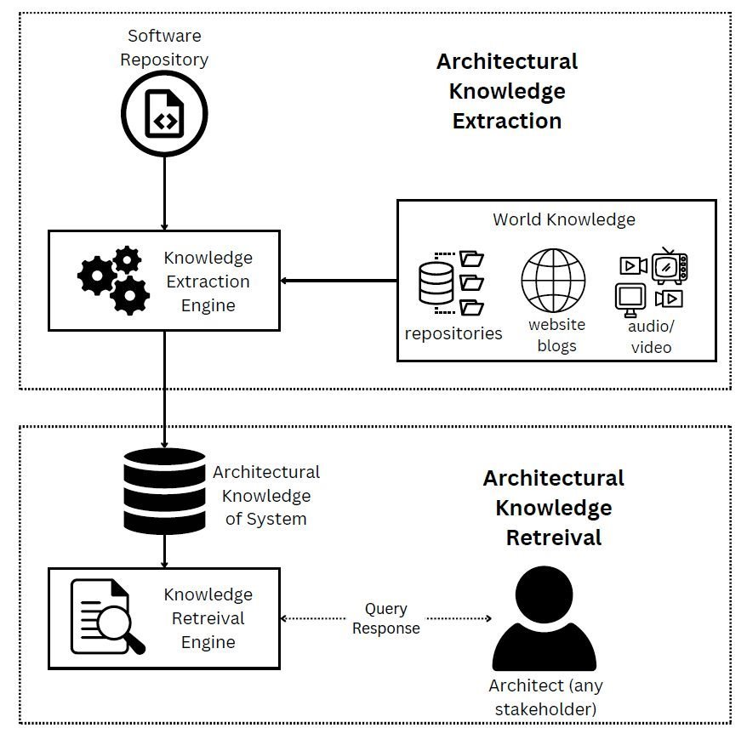
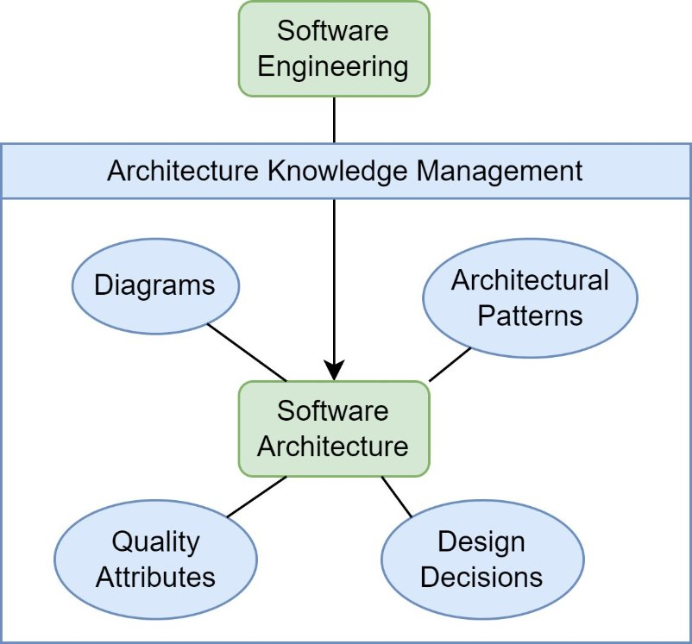
Research Area

Slide 13
Generating Design Decision using LLMs
Context
We need to decide on whether to use Python as a programming language for our project. Our project involves data analysis, machine learning, and web development.
Decision
We have decided to use Python as our primary programming language for our project.
We chose Python as it is a versatile programming language that is widely used in the areas of data analysis, machine learning, and web development.

Slide 14
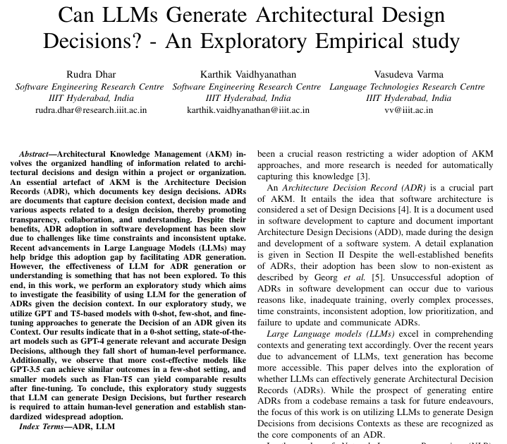

Slide 15
Outcome and future Work
LLM can be used to generate Design Decisions. Next we should generate full ADRs
Many people in the real world don't write proper ADRs
SE students should
Influenced (finetune, or just few shot) by real people (data) :
LLMS often generate bad Design Decisions

Slide 16
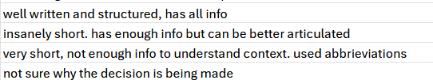
Class Activity – Determine if ADRs are good or not
You will be given 6 ADRs and a google form.
Copy the file name of the ADR as is from the drive to your form response, along with the ".md"
Choose if the ADR is good, bad, or you're unsure
Write a short ~one sentence remark of why YOU think it is good/bad/unsure. Do not use an LLM for this part, it is essential to write your observations
If it is bad/ugly, improve it. Add the section necessary, add more text, etc. You can use an LLM in this step. Upload this improved .md or .txt file in the form.
Example of the remarks you need to write

Slide 17


Class Activity – Determine if ADRs are good or not
Folder containing your files
Form for your responses
https://drive.google.com/drive/folders/1b74dv4hI57LWQWdOk7-oRrzWOltljrEa?usp=sharing
https://docs.google.com/forms/d/e/1FAIpQLScO4L095Bw4eolU_qVyX6WTQOQpR2gBi-bN6Gdmqyn8mtvElg/viewform?usp=sharing

Slide 18
Thank You Rudra Dhar rudra.dhar@research.iiit.ac.in

