Slide 1
Lab 3 Part 1
State Machine

Slide 2
There Are Three State Machines
1. Main light control. States correspond to combinations of red, yellow, and green lights, as we saw with the expansion on the original Harris & Harris model.
2. Lost same-direction demand 5-counter.
Runs only during a green light stage.
Stays on 0 until a demand gap of at least 1 cycle occurs.
Continues to count once it starts.
Causes transition to yellow.
3. Conflicting traffic demand 10-counter.
Runs only during a green light statge.
Stays on 0 until conflicting traffic appears for at least 1 cycle.
Continues to count once it starts.
Causes transition to yellow.

Slide 3
All 3 State Machines Run In Parallel
Think of these as three independent program threads.
Main thread holds Count5 and Count10 in reset / 0 in yellow or all-red (9 of the 12 possible states).
Main thread allows Count5 and Count10 to increment in one of the three green states.
Yellow light transitions are driven by Count5 or Count10 reaching maximum, whichever comes first.

Slide 4
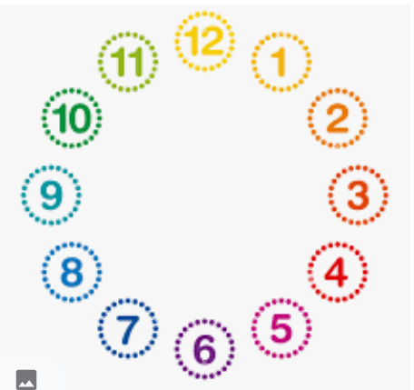
Lab 3 State Machine Diagram
12: RRH, red, EWS priority
01: GRR, EWS green
02,03: YRR, ZRR: EWS yellows
04: HRR, red, EWL priority
05: RGR, EWL green
06,07: RYR, RZR: EWS yellows
08: RHR, red, NS priority
09: RRG, NS green
10,11: RRY, RRZ: NS yellows

Slide 5
Transition arrows
GRR, RGR, RRG: stay put or advance to respective YRR, RYR, RRY
YRR, RYR, RRY: go to respective ZRR, RZR, RRZ
ZRR, RZR, RRZ: go to respective HRR, RHR, RRH
HRR: go to RGR, else RRG, else GRR, else stay put (HRR)
RHR: go to RRG, else GRR, else RGR, else stay put
RRH: go to GRR, else RGR, else RRG, else stay put

