Slide 1
CSE 140: Components and Design Techniques for Digital Systems
Lecture 8:
Sequential Networks and Finite State Machines
John Eldon
Dept. of Computer Science and Engineering
University of California, San Diego

Slide 2
Outline
Specification: Finite State Machine
  State Table, State Diagram, Behavior
Implementation
  Excitation Table
  Mealy and Moore Machines
  Examples

Slide 3
Sequential Networks
Y
Combinational
A
B
C
D
X
S(t)
CLK
CLK
RTL: Register-Transfer Level Description
CLK
Components F-Fs
Specification
Implementation: Excitation Table

Slide 4
Specification
Combinational Logic
  Truth Table
  Boolean Expression
  Logic Diagram (No feedback loops)
Sequential Networks:
  State Diagram, State Assignment, State Table
  Excitation Table and Characteristic Expression
  Logic Diagram (FFs and feedback loops)

Slide 5
Implementation: Design Flow
Input Output Relation
State Diagram (Transition of states)
State Assignment (Map states into binary code)
State Table (Truth table of states)
Excitation Table (Truth table of FF inputs)
Boolean Expression
Logic Diagram

Slide 6
Implementation: Design Flow
Input Output Relation
State Diagram (Transition of states)
  State minimization (Reduction)
  Finite state machine partitioning
State Assignment (Map states into binary code)
  Binary code, Gray encoding, One hot encoding, Coding optimization
State Table (Truth table of states)
Excitation Table (Truth table of FF inputs)

Slide 7
Implementation: Examples
Example 1: a circuit with D Flip Flops
Example 2: a circuit with other Flip Flops
Example 3: analysis of a sequential machine

Slide 8
State: What is it? Why do we need it?
Behavior over time
Symbol/ Circuit
Free running 2 bit Counter
CLK
time
Q₀
Q₁
What is the expected output of the counter over time?

Slide 9
Finite State Machines: Describing circuit behavior over time
Diagram that depicts behavior over time
Symbol/ Circuit
2 bit Counter

Slide 10
Implementing the 2 bit counter
State Diagram
State Table: Symbol
S₀
Current state | Next State
S₀ | S₁
S₁ | S₂
S₂ | S₃
S₃ | S₀
S₃
S₁
S₂
State Assignment
State | Q₁ | Q₀
S₀ | 0 | 0
S₁ | 0 | 1
S₂ | 1 | 0
S₃ | 1 | 1
Q₁(t) | Q₀(t) | Q₁(t+1) | Q₀(t+1)
State Table: Binary

Slide 11
Implementing the 2 bit counter
S₀
Current state | Next State
S₀ | S₁
S₁ | S₂
S₂ | S₃
S₃ | S₀
S₃
S₁
S₂
State Diagram
Q₁(t) | Q₀(t) | Q₁(t+1) | Q₀(t+1)
0 | 0 | 0 | 1
0 | 1 | 1 | 0
1 | 0 | 1 | 1
1 | 1 | 0 | 0
State Table

Slide 12
State Table
Q₁(t) | Q₀(t) | Q₁(t+1) | Q₀(t+1)
0 | 0 | 0 | 1
0 | 1 | 1 | 0
1 | 0 | 1 | 1
1 | 1 | 0 | 0
D₀(t) = Q₀(t)’
D₁(t) = Q₀(t) Q₁(t)’ + Q₀(t)’ Q₁(t)
Q₀(t)
D
Q
Combinational circuit
Q’
Q₁(t)
D
Q
Q’
CLK
Circuit with 2 flip flops

Slide 13
Q₁(t) | Q₀(t) | Q₁(t+1) | Q₀(t+1)
0 | 0 | 0 | 1
0 | 1 | 1 | 0
1 | 0 | 1 | 1
1 | 1 | 0 | 0
Truth table→K map→Switching function
Q₀(t+1) = Q₀(t)’
Q₁(t+1) = Q₀(t) Q₁(t)’ + Q₀(t)’ Q₁(t)
State Table
D
Q
We store the current state using D-flip flops so that:
Inputs to the combinational circuit don’t change while the next output is being computed
The transition to the next state ooccurs only at rising edge of clock
Q’
Q₀(t)
D
Q
Q’
CLK
Q₁(t)
Implementation of 2-bit counter

Slide 14
Generalized Model of Sequential Circuits
Y
X
S(t)
CLK

Slide 15
Let’s implement our free running 2-bit counter using T-flip flops
S₀
S₃
S₁
S₂
State Table
PS
Next state
S₀
S₁
S₂
S₃
S₁
S₂
S₃
S₀

Slide 16
Let’s implement our free running 2-bit counter using T-flip flops
S₀
S₃
S₁
S₂
State Table with Assigned
Encoding
State Table
Current
Next
S₀
S₁
S₂
S₃
0 0
0 1
1 0
1 1
01
10
11
00
S₁
S₂
S₃
S₀

Slide 17
Let’s implement our free running 2-bit counter using T-flip flops
Excitation table
id | Q₁(t) | Q₀(t) | T₁(t) | T₀(t) | Q₁(t+1) | Q₀(t+1)
0 | 0 | 0 |  |  | 0 | 1
1 | 0 | 1 |  |  | 1 | 0
2 | 1 | 0 |  |  | 1 | 1
3 | 1 | 1 |  |  | 0 | 0

Slide 18
Let’s implement our free running 2-bit counter using T-flip flops
Excitation table
id | Q₁(t) | Q₀(t) | T₁(t) | T₀(t) | Q₁(t+1) | Q₀(t+1)
0 | 0 | 0 | 0 | 1 | 0 | 1
1 | 0 | 1 | 1 | 1 | 1 | 0
2 | 1 | 0 | 0 | 1 | 1 | 1
3 | 1 | 1 | 1 | 1 | 0 | 0

Slide 19
Let’s implement our free running 2-bit counter using T-flip flops
Excitation table
id | Q₁(t) | Q₀(t) | T₁(t) | T₀(t) | Q₁(t+1) | Q₀(t+1)
0 | 0 | 0 | 0 | 1 | 0 | 1
1 | 0 | 1 | 1 | 1 | 1 | 0
2 | 1 | 0 | 0 | 1 | 1 | 1
3 | 1 | 1 | 1 | 1 | 0 | 0
T₀(t) =
T₁(t) =
Q₀(t+1) = T₀(t) Q’₀(t)+T’₀(t)Q₀(t)
Q₁(t+1) = T₁(t) Q’₁(t)+T’₁(t)Q₁(t)

Slide 20
Let’s implement our free running 2-bit counter using T-flip flops
Excitation table
id | Q₁(t) | Q₀(t) | T₁(t) | T₀(t) | Q₁(t+1) | Q₀(t+1)
0 | 0 | 0 | 0 | 1 | 0 | 1
1 | 0 | 1 | 1 | 1 | 1 | 0
2 | 1 | 0 | 0 | 1 | 1 | 1
3 | 1 | 1 | 1 | 1 | 0 | 0
T₀(t) = 1
T₁(t) = Q₀(t)

Slide 21
Free running counter with T flip flops
1
Q₀
Q
T
Q’
Q
Q₁
T
T₁
Q’
T₀(t) = 1
T₁(t) = Q₀(t)

Slide 22
Example 3 Circuit with T Flip-Flops
X
T₀
Q₀
Q
T
Q’
y
Q
Q₁
T
T₁
Q’
y(t) = Q₁(t)Q₀(t)
T₀(t) = x(t) Q₁(t)
T₁(t) = x(t) + Q₀(t)

Slide 23
Logic Diagram => Excitation Table => State Table
y(t) = Q₁(t)Q₀(t)
T₀(t) = x(t) Q₁(t)
T₁(t) = x(t) + Q₀(t)
Q₀(t+1) = T₀(t) Q’₀(t)+T’₀(t)Q₀(t)
Q₁(t+1) = T₁(t) Q’₁(t)+T’₁(t)Q₁(t)
Excitation Table:
Truth table of the F-F inputs
id | Q₁(t) | Q₀(t) | x | T₁(t) | T₀(t) | Q₁(t+1) | Q₀(t+1) | y
0 | 0 | 0 | 0 | 0 | 0 | 0 | 0 | 0
1 | 0 | 0 | 1 | 1 | 0 | 1 | 0 | 0
2 | 0 | 1 | 0 | 1 | 0 | 1 | 1 | 0
3 | 0 | 1 | 1 | 1 | 0 | 1 | 1 | 0
4 | 1 | 0 | 0 | 0 | 0 | 1 | 0 | 0
5 | 1 | 0 | 1 | 1 | 1 | 0 | 1 | 0
6 | 1 | 1 | 0 | 1 | 0 | 0 | 1 | 1
7 | 1 | 1 | 1 | 1 | 1 | 0 | 0 | 1
Notes:
All these forms are equivalent. Given one, we can derive the others.

Slide 24
Excitation Table Question
In excitation table, the inputs of the flip flops are used to produce
The present state
The next state

Slide 25
Excitation Table =>State Table => State Diagram
id | Q₁(t) | Q₀(t) | x | T₁(t) | T₀(t) | Q₁(t+1) | Q₀(t+1) | y
0 | 0 | 0 | 0 | 0 | 0 | 0 | 0 | 0
1 | 0 | 0 | 1 | 1 | 0 | 1 | 0 | 0
2 | 0 | 1 | 0 | 1 | 0 | 1 | 1 | 0
3 | 0 | 1 | 1 | 1 | 0 | 1 | 1 | 0
4 | 1 | 0 | 0 | 0 | 0 | 1 | 0 | 0
5 | 1 | 0 | 1 | 1 | 1 | 0 | 1 | 0
6 | 1 | 1 | 0 | 1 | 0 | 0 | 1 | 1
7 | 1 | 1 | 1 | 1 | 1 | 0 | 0 | 1
State Assignment
S0 00
S1 01
S2 10
S3 11
PS\Input | X=0 | X=1
S0
S1
S2
S3
Notes:
All these forms are equivalent. Given one, we can derive the others.

Slide 26
Excitation Table =>State Table => State Diagram
id | Q₁(t) | Q₀(t) | x | T₁(t) | T₀(t) | Q₁(t+1) | Q₀(t+1) | y
0 | 0 | 0 | 0 | 0 | 0 | 0 | 0 | 0
1 | 0 | 0 | 1 | 1 | 0 | 1 | 0 | 0
2 | 0 | 1 | 0 | 1 | 0 | 1 | 1 | 0
3 | 0 | 1 | 1 | 1 | 0 | 1 | 1 | 0
4 | 1 | 0 | 0 | 0 | 0 | 1 | 0 | 0
5 | 1 | 0 | 1 | 1 | 1 | 0 | 1 | 0
6 | 1 | 1 | 0 | 1 | 0 | 0 | 1 | 1
7 | 1 | 1 | 1 | 1 | 1 | 0 | 0 | 1
State Assignment
S0 00
S1 01
S2 10
S3 11
PS\Input | X=0 | X=1
S0 | S0,0 | S2,0
S1 | S3,0 | S3,0
S2 | S2,0 | S1,0
S3 | S1,1 | S0,1
S0
S1
S3
last digit =
&PS
S2
Notes:
All these forms are equivalent. Given one, we can derive the others.

Slide 27
Excitation Table =>State Table => State Diagram
id | Q₁(t) | Q₀(t) | x | T₁(t) | T₀(t) | Q₁(t+1) | Q₀(t+1) | y
0 | 0 | 0 | 0 | 0 | 0 | 0 | 0 | 0
1 | 0 | 0 | 1 | 1 | 0 | 1 | 0 | 0
2 | 0 | 1 | 0 | 1 | 0 | 1 | 1 | 0
3 | 0 | 1 | 1 | 1 | 0 | 1 | 1 | 0
4 | 1 | 0 | 0 | 0 | 0 | 1 | 0 | 0
5 | 1 | 0 | 1 | 1 | 1 | 0 | 1 | 0
6 | 1 | 1 | 0 | 1 | 0 | 0 | 1 | 1
7 | 1 | 1 | 1 | 1 | 1 | 0 | 0 | 1
State Assignment
S0 00
S1 01
S2 10
S3 11
1/1
0/0
PS\Input | X=0 | X=1
S0 | S0,0 | S2,0
S1 | S3,0 | S3,0
S2 | S2,0 | S1,0
S3 | S1,1 | S0,1
S0
0/1
S1
S3
1/0
0, 1/0
1/0
S2
0/0
Notes:
All these forms are equivalent. Given one, we can derive the others.

Slide 28
Netlist ⬄ State Table ⬄ State Diagram ⬄ Input Output Relation
PS\Input | X=0 | X=1
S0 | S0,0 | S2,0
S1 | S3,0 | S3,0
S2 | S2,0 | S1,0
S3 | S1,1 | S0,1
1/1
0/0
S0
0/1
S1
S3
1/0
0, 1/0
1/0
S2
Example: Output sequence
0/0
Time | 0 | 1 | 2 | 3 | 4 | 5
Input | 0 | 1 | 1 | 0 | 1 | -
State | S0
Output
Notes:
All these forms are equivalent. Given one, we can derive the others.

Slide 29
Netlist ⬄ State Table ⬄ State Diagram ⬄ Input Output Relation
PS\Input | X=0 | X=1
S0 | S0,0 | S2,0
S1 | S3,0 | S3,0
S2 | S2,0 | S1,0
S3 | S1,1 | S0,1
1/1
0/0
S0
0/1
S1
S3
1/0
0, 1/0
1/0
S2
Example: Output sequence
0/0
Time | 0 | 1 | 2 | 3 | 4 | 5
Input | 0 | 1 | 1 | 0 | 1 | -
State | S0 | S0 | S2 | S1 | S3 | S0
Output | 0 | 0 | 0 | 0 | 1 | 0
Notes:
All these forms are equivalent. Given one, we can derive the others.

Slide 30
Implementation
State Diagram => State Table => Logic Diagram
Canonical Form: Mealy and Moore Machines
  Mealy machines: General
  Moore machines: Output is independent of current input (subset of Mealy).
Excitation Table
  Truth Table of the F-F Inputs
  Boolean algebra, K-maps for combinational logic
Examples
Timing

Slide 31
Canonical Form: Mealy and Moore Machines
x(t)
y(t)
Combinational
Logic
CLK
x(t)
C2
y(t)
x(t)
C1
C2
y(t)
C1
CLK
CLK

Slide 32
Canonical Form: Mealy and Moore Machines
Mealy Machine: y_{i}(t) = f_{i}(X(t), S(t))
Moore Machine: y_{i}(t) = f_{i}(S(t))
s_{i}(t+1) = g_{i}(X(t), S(t))
x(t)
x(t)
C1
C2
y(t)
C1
C2
y(t)
S(t)
CLK
CLK
S(t)
Moore Machine
Mealy Machine
often C2=wire →
output is synchronous w/ CLK

Slide 33
Canonical Form: Mealy and Moore Machines
Mealy Machine: y_{i}(t) = f_{i}(X(t), S(t))
Moore Machine: y_{i}(t) = f_{i}(S(t))
s_{i}(t+1) = g_{i}(X(t), S(t))
x(t)
x(t)
C1
C2
y(t)
C1
C2
y(t)
CLK
S(t)
CLK
Mealy Machine
Moore Machine
S(t)
 | Input
PS | NS, output
 | Input
PS | NS | Output
S
Sj
S
input
Sj
output
Si
input/output
Si
output

Slide 34

Life on Mars?
Mars rover has a binary input x. When it receives the input sequence x(t-2, t) = 001 from its life detection sensors, it means that it has detected life on Mars ☺ and the output y(t) = 1; otherwise y(t) = 0 (no life on Mars ☹).
Implement the Life-on-Mars Pattern Recognizer!

Slide 35
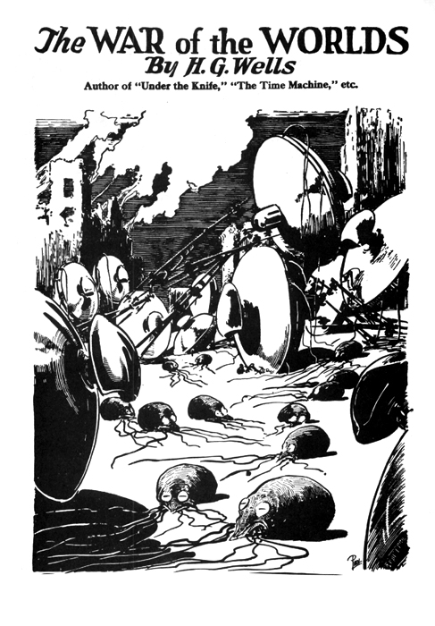

Slide 36
Mars Life Recognizer FSM
Which of the following diagrams is a correct Mealy solution for the 001 pattern recognizer on the Mars rover?
1/1
A.
S0
0/0
S1
0/0
1/0
S2
0/0
1/0
B.
0/0
S0
0/0
S1
1/1
Input/output
1/0
S2
1/0
0/0
C. Both A and B are correct
D. None of the above

Slide 37
Mars Life Recognizer FFs
Pattern Recognizer ‘001’
Mealy Machine
x(t)
1/0
1/1
C1
C2
y(t)
S0
0/0
S1
0/0
S2
CLK
S(t)
1/0
0/0
What does state table need to show to design controls of C1?
next state S(t+1) vs. input x(t), and present state S(t)
output y(t) vs. input x(t), and present state S(t)
output y(t) vs. present state S(t)
None of the above

Slide 38
State Diagram => State Table with State Assignment
1/1
x(t)
C1
C2
y(t)
S0
0/0
S1
0/0
1/0
S2
0/0
CLK
S(t)
1/0
Mealy Machine
S(t)\x | 0 | 1
S0 | S1,0 | S0,0
S1 | S2,0 | S0,0
S2 | S2,0 | S0,1
State Assignment
S0: 00
S1: 01
S2: 10
S(t)\x | 0 | 1
00 | 01,0 | 00,0
01 | 10,0 | 00,0
10 | 10,0 | 00,1
Q₁(t+1)Q₀(t+1), y

Slide 39
State Diagram => State Table => Excitation Table => Circuit
Q₁(t) Q₀(t)\x | 0 | 1
00 | 01,0 | 00,0
01 | 10,0 | 00,0
10 | 10,0 | 00,1
id | Q₁Q₀x | D₁ | D₀ | y
0 | 000 | 0 | 1 | 0
1 | 001 | 0 | 0 | 0
2 | 010 | 1 | 0 | 0
3 | 011 | 0 | 0 | 0
4 | 100 | 1 | 0 | 0
5 | 101 | 0 | 0 | 1
6 | 110
7 | 111
x(t)
C1
C2
y(t)
CLK
S(t)
Mealy Machine

Slide 40
State Diagram => State Table => Excitation Table => Circuit
id | Q₁Q₀x | D₁ | D₀ | y
0 | 000 | 0 | 1 | 0
1 | 001 | 0 | 0 | 0
2 | 010 | 1 | 0 | 0
3 | 011 | 0 | 0 | 0
4 | 100 | 1 | 0 | 0
5 | 101 | 0 | 0 | 1
6 | 110
7 | 111
Q₁(t) Q₀(t)\x | 0 | 1
00 | 01,0 | 00,0
01 | 10,0 | 00,0
10 | 10,0 | 00,1
x(t)
C1
C2
y(t)
CLK
S(t)
Mealy Machine
Fill in rows 6 and 7 of excitation table
All 0s
All 1s
All Don’t Cares

Slide 41
State Diagram => State Table => Excitation Table => Circuit
id | Q₁Q₀x | D₁ | D₀ | y
0 | 000 | 0 | 1 | 0
1 | 001 | 0 | 0 | 0
2 | 010 | 1 | 0 | 0
3 | 011 | 0 | 0 | 0
4 | 100 | 1 | 0 | 0
5 | 101 | 0 | 0 | 1
6 | 110 | X | X | X
7 | 111 | X | X | X
D1(t):
Q₀
0 2 6 4
0 1 X 1
1 3 7 5
x(t)
0 0 X 0
Q₁
D1(t) = x’Q0 + x’Q1
D0 (t)= Q’1Q’0 x’
y= Q₁x

Slide 42
State Diagram => State Table => Excitation Table => Circuit
Q’₁
D0
Q0
Q’₀
Q
D
x’
Q’
x’
Q1
y
D1
Q
D
Q₀
Q’
Q1
x
x(t)
C1
C2
y(t)
D1(t) = x’Q0 + x’Q1
D0 (t)= Q’1Q’0 x’
y= Q₁x
CLK
S(t)
Mealy Machine

Slide 43
Moore FSM for the Mars Life Recognizer
Which of the following diagrams is a correct Moore solution to the ‘001’ pattern recognizer?
input/output
1/1
A.
1/0
S0
0/0
S1
0/0
S2
0/0
1/0
B.
1
0
1
0
0
1
S3
1
S0
0
S1
0
S2
0
input
1
0
output
C. Both A and B are correct
D. None of the above

Slide 44
Moore Mars Life Recognizer: FF Input Specs
Pattern Recognizer ‘001’
x(t)
C1
C2
y(t)
S(t)
1
0
1
S0
0
0
S1
0
0
S2
0
1
S3
1
CLK
Moore Machine
1
0
What does state table need to show to design controls of C2?
(current input x(t), current state S(t) vs. next state, S(t+1))
(current input, current state vs. current output y(t))
(current state vs. current output y(t) and next state)
(current state vs. current output y(t) )
None of the above

Slide 45
Moore Mars Life Recognizer: State Table
1
0
1
S0
0
0
S1
0
0
S2
0
1
S3
1
1
ID | Q₁Q₀x | D₁ | D₀ | y
0 | 000 | 0 | 1 | 0
1 | 001 | 0 | 0 | 0
2 | 010 | 1 | 0 | 0
3 | 011 | 0 | 0 | 0
4 | 100 | 1 | 0 | 0
5 | 101 | 1 | 1 | 0
6 | 110 | 0 | 1 | 1
7 | 111 | 0 | 0 | 1
S(t)\x | 0 | 1
S0 | S1,0 | S0,0
S1 | S2,0 | S0,0
S2 | S2,0 | S3,0
S3 | S1,1 | S0,1
0
Q₁Q₀\x | 0 | 1
00 | 01,0 | 00,0
01 | 10,0 | 00,0
10 | 10,0 | 11,0
11 | 01,1 | 00,1
Q₁(t+1)Q₀(t+1), y

Slide 46
Mars Life Recognizer: Circuit Design
D1(t):
Q₀
0 2 6 4
0 1 0 1
1 3 7 5
x(t)
0 0 0 1
id | Q₁Q₀x | D₁ | D₀ | y
0 | 000 | 0 | 1 | 0
1 | 001 | 0 | 0 | 0
2 | 010 | 1 | 0 | 0
3 | 011 | 0 | 0 | 0
4 | 100 | 1 | 0 | 0
5 | 101 | 1 | 1 | 0
6 | 110 | 0 | 1 | 1
7 | 111 | 0 | 0 | 1
Q₁
D0(t):
Q₀
0 2 6 4
1 0 1 0
1 3 7 5
x(t)
0 0 0 1
Q₁
y(t):
Q₀
0 2 6 4
0 0 1 0
1 3 7 5
x(t)
0 0 1 0
Q₁

Slide 47
Mars Life Recognizer Circuit Implementation
State Diagram => State Table => Excitation Table => Circuit
D0
Q0
Q
y
D
Q’
Q1
D1
Q
D
Q’
x(t)
C1
C2
y(t)
D₁(t)= Q₁(t)Q₀(t)’+Q₁(t)’Q₀(t) x(t)
D₀(t)= Q₁(t)’Q₀(t)’x(t)’+
Q₁(t)Q₀(t) x(t)’+Q₁(t)Q₀(t)’ x(t)
y(t)= Q₁(t)Q₀(t)
CLK
S(t)
Moore Machine

Slide 48
Conversion from Mealy to Moore Machine
1/1
1
0
1
S0
0
0
S1
0
0
S2
0
1
S3
1
S0
0/0
S1
0/0
1/0
S2
0/0
1
0
1/0
S(t)\x | 0 | 1
S0 | S1,0 | S0,0
S1 | S2,0 | S0,0
S2 | S2,0 | S0,1
S(t)\x | 0 | 1
S0 | S1,0 | S0,0
S1 | S2,0 | S0,0
S2 | S2,0 | S3,0
S3 | S1,1 | S0,1

Slide 49
Conversion from Mealy to Moore Machine
S(t)\x | 0 | 1
S0 | S1,0 | S0,0
S1 | S2,0 | S0,0
S2 | S2,0 | S0,1
S(t)\x | 0 | 1 | y
S0 | S1 | S0 | 0
S1 | S2 | S0 | 0
S2 | S2 | S3 | 0
S3
Algorithm
1. Identify distinct (NS, y) pair
2. Replace each distinct (NS, y) pair with distinct new states
3. Insert rows of present state = new states

Slide 50
Conversion from Mealy to Moore Machine
Mealy
S(t)\x | 0 | 1
S0 | S1,0 | S0,0
S1 | S2,0 | S0,0
S2 | S2,0 | S0,1
S(t)\x | 0 | 1 | y
S0 | S1 | S0 | 0
S1 | S2 | S0 | 0
S2 | S2 | S3 | 0
S3
Moore
1. Find distinct NS, y
2. Add new states to represent distinct NS, y
For the above Moore machine, what are the next states with respect to present state S3?
S2, S3, 1
S2, S0, 1
S1, S0, 1
S1, S0. 0
None of the above.

Slide 51
Conversion from Mealy to Moore Machine
1/1
1
0
1
S0
0
0
S1
0
0
S2
0
1
S3
1
S0
0/0
S1
0/0
1
1/0
S2
0/0
0
1/0
S(t)\x | 0 | 1
S0 | S1,0 | S0,0
S1 | S2,0 | S0,0
S2 | S2,0 | S3,0
S3 | S1,1 | S0,1
S(t)\x | 0 | 1
S0 | S1,0 | S0,0
S1 | S2,0 | S0,0
S2 | S2,0 | S0,1
Time | 0 | 1 | 2 | 3 | 4 | 5 | 6 | 7 | 8
x | 0 | 1 | 0 | 0 | 1 | 1 | 0 | 0 | 1
Smealy | S0 | S1 | S0 | S1 | S2 | S0 | S0 | S1 | S2
ymealy
Smoore | S0
ymoore

Slide 52
Conversion from Mealy to Moore Machine
1/1
1
0
1
S0
0
0
S1
0
0
S2
0
1
S3
1
S0
0/0
S1
0/0
1/0
S2
0/0
1
1/0
0
S(t)\x | 0 | 1
S0 | S1,0 | S0,0
S1 | S2,0 | S0,0
S2 | S2,0 | S3,0
S3 | S1,1 | S0,1
S(t)\x | 0 | 1
S0 | S1,0 | S0,0
S1 | S2,0 | S0,0
S2 | S2,0 | S0,1
Time | 0 | 1 | 2 | 3 | 4 | 5 | 6 | 7 | 8
x | 0 | 1 | 0 | 0 | 1 | 1 | 0 | 0 | 1
Smealy | S0 | S1 | S0 | S1 | S2 | S0 | S0 | S1 | S2
ymealy
Smoore | S0
ymoore
iClicker S_{moore}[0-5]
S0,S1,S0,S1,S2,S3
S0,S1,S0,S1,S2,S0
S3,S1,S0,S1,S2,S3
S3,S1,S0,S1,S2,S0
E. None of the above

Slide 53
Conversion from Mealy to Moore Machine
1/1
1
0
1
S0
0
0
S1
0
0
S2
0
1
S3
1
S0
0/0
S1
0/0
1/0
S2
0/0
1
1/0
0
S(t)\x | 0 | 1
S0 | S1,0 | S0,0
S1 | S2,0 | S0,0
S2 | S2,0 | S3,0
S3 | S1,1 | S0,1
S(t)\x | 0 | 1
S0 | S1,0 | S0,0
S1 | S2,0 | S0,0
S2 | S2,0 | S0,1
Time | 0 | 1 | 2 | 3 | 4 | 5 | 6 | 7 | 8
x | 0 | 1 | 0 | 0 | 1 | 1 | 0 | 0 | 1
Smealy | S0 | S1 | S0 | S1 | S2 | S0 | S0 | S1 | S2
ymealy
Smoore | S0
ymoore
y_{moore}[0-5]
0,0,0,0,1,0
0,0,0,0,0,1
0,1,0,0,0,0
0,0,0,0,0,0,
None of the above

Slide 54
Conversion from Mealy to Moore Machine
Algorithm
1. Identify distinct (NS, y) pair
2. Replace each distinct (NS, y) pair with distinct new states
3. Insert rows of present state = new states
4. Append each present state with its output y

Slide 55
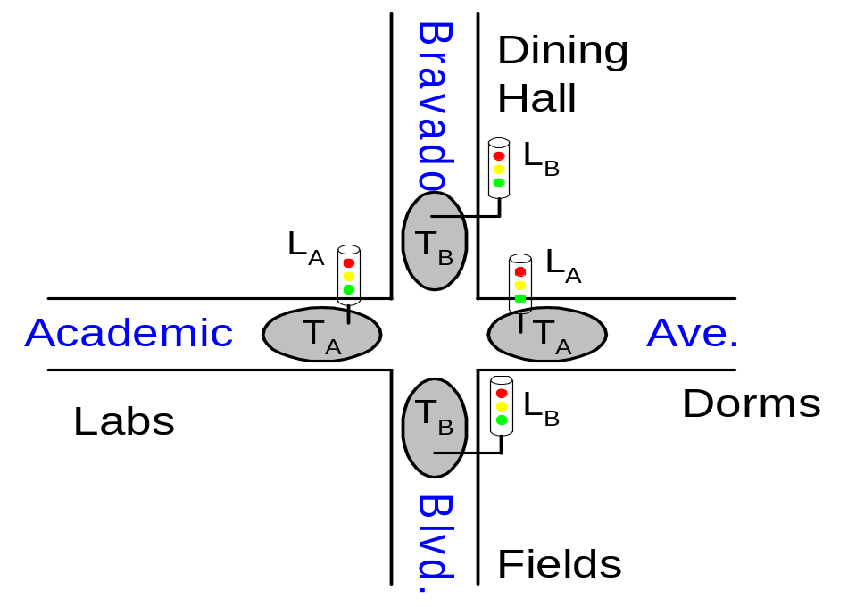
Finite State Machine Example
Traffic light controller
  Traffic sensors: T_{A}, T_{B} (TRUE when there’s traffic)
  Lights: L_{A}, L_{B}

Slide 56
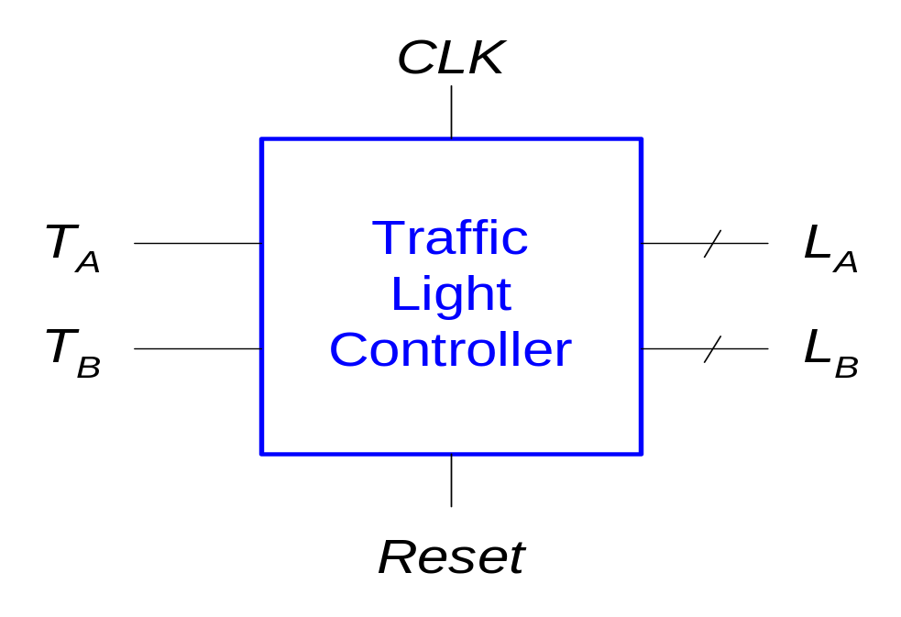
FSM Black Box
Inputs: CLK, Reset, T_{A}, T_{B}
Outputs: L_{A}, L_{B}

Slide 57
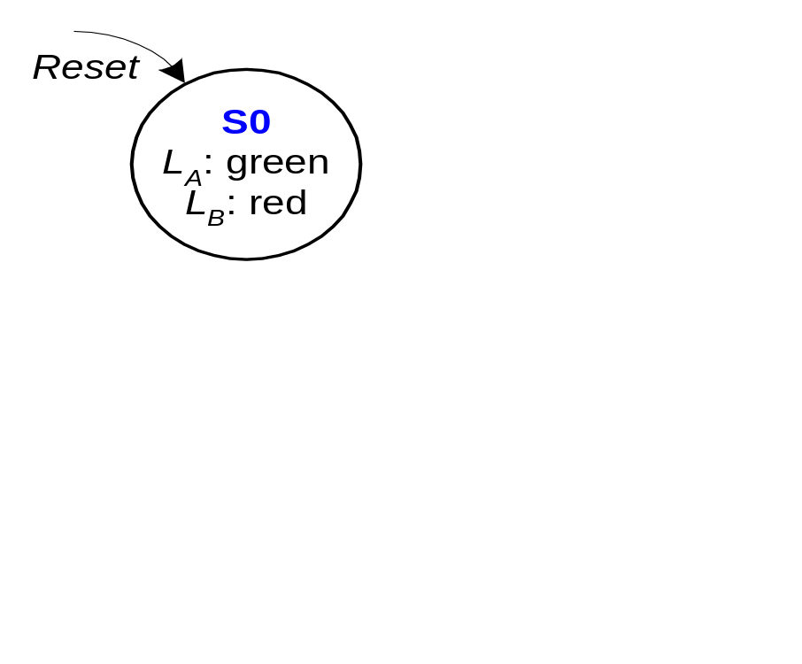
FSM State Transition Diagram
Moore FSM: outputs labeled in each state
States: Circles
Transitions: Arcs

Slide 58
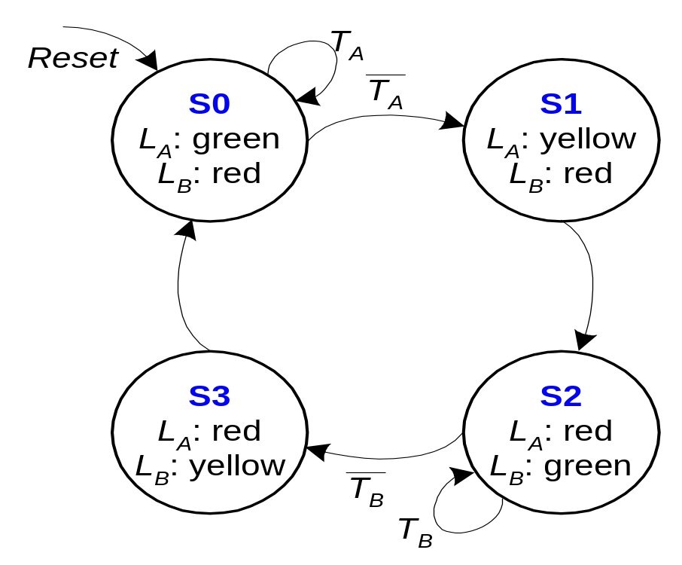
FSM State Transition Diagram
Moore FSM: outputs labeled in each state
States: Circles
Transitions: Arcs

Slide 59
FSM State Transition Table
PS | Inputs |  | NS
 | T_{A} | T_{B}
S0 | 0 | X | S1
S0 | 1 | X | S0
S1 | X | X | S2
S2 | X | 0 | S3
S2 | X | 1 | S2
S3 | X | X | S0

Slide 60
State Transition Table
PS |  | Inputs |  | NS
Q₁(t) | Q₀(t) | T_{A} | T_{B} | Q₁(t +1) | Q₀(t +1)
0 | 0 | 0 | X | 0 | 1
0 | 0 | 1 | X | 0 | 0
0 | 1 | X | X | 1 | 0
1 | 0 | X | 0 | 1 | 1
1 | 0 | X | 1 | 1 | 0
1 | 1 | X | X | 0 | 0
State | Encoding
S0 | 00
S1 | 01
S2 | 10
S3 | 11
Q₁(t+1)= Q₁(t)⊕Q₀(t)
Q₀(t+1)= Q’₁(t)Q’₀(t)T’_{A} + Q₁(t)Q’₀(t)T’_{B}

Slide 61
FSM Output Table
PS |  | Outputs
Q₁ | Q₀ | L_{A1} | L_{A0} | L_{B1} | L_{B0}
0 | 0 | 0 | 0 | 1 | 0
0 | 1 | 0 | 1 | 1 | 0
1 | 0 | 1 | 0 | 0 | 0
1 | 1 | 1 | 0 | 0 | 1
Output | Encoding
green | 00
yellow | 01
red | 10
L_{A1} = Q₁
L_{A0} = Q’₁Q₀
L_{B1} = Q’₁
L_{B0} = Q₁Q₀

Slide 62
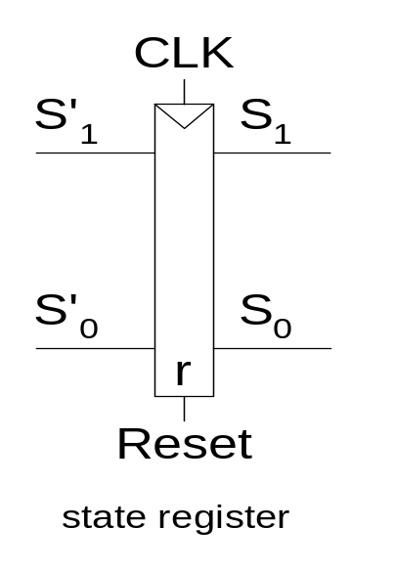
FSM Schematic: State Register

Slide 63
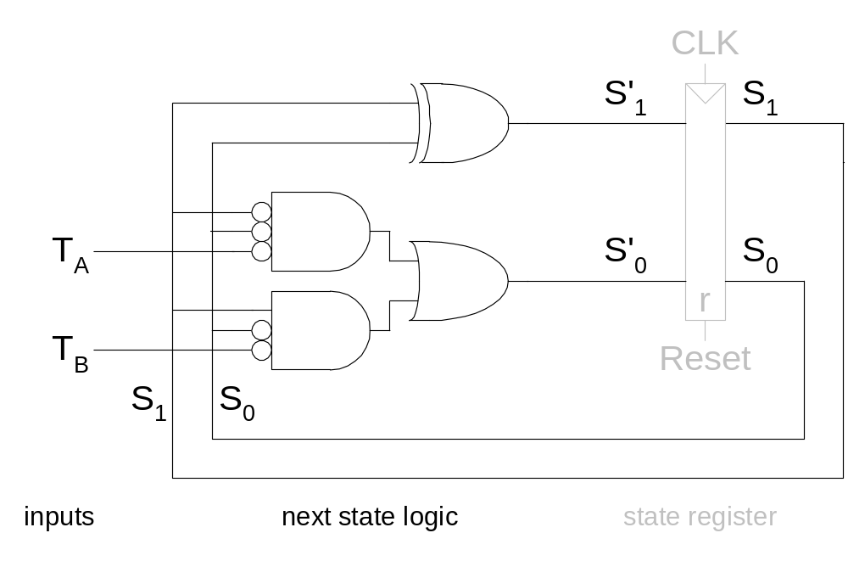
Logic Diagram

Slide 64
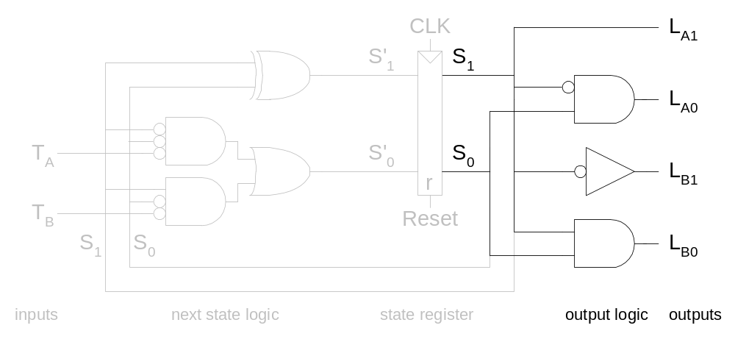
FSM Schematic: Output Logic

Slide 65
Summary: Implementation
Set up canonical form
  Mealy or Moore machine
Identify the next states
  state diagram ⇨ state table
  state assignment
Derive excitation table
  Inputs of flip flops
Design the combinational logic
  don’t care set utilization

