Slide 1
Brightspeed Chatbot
Team-2

Slide 2
Team-2
Nikhil Sai – Vertex AI, Chat History
Daniel Mitchell – Agents, Prompt
Akash Kumar – Langsmith, Streamlit
Afshan Jabeen – Creating & Managing Pinecone (Vector db)
Divya – Data Gathering, Data Cleaning

Slide 3
Overview of Project
The project involves building a chatbot application using Retrieval Augmented Generation (RAG), with the chat interface provided by Streamlit and core functionality achieved via LangChain Agent, an open-source LLM equipped with tools.
Objectives:
Implement a chatbot that can interact with users,
provide contextual responses,
Retrieve information.

Slide 4
Problem Statement
The project aims to address the need for an intelligent chatbot that can understand user queries, provide accurate responses, and retrieve relevant information from external sources to enhance user experience and engagement.
Solution
The project proposes to develop a chatbot application using Retrieval Augmented Generation (RAG), combining LangChain Agent with tools for document retrieval and embedding models to enhance the chatbot's capabilities. Additionally, the model was fine-tuned and deployed in GCP Vertex AI to optimize performance and scalability.

Slide 5
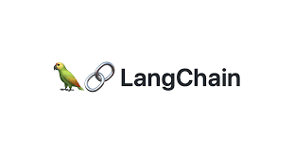
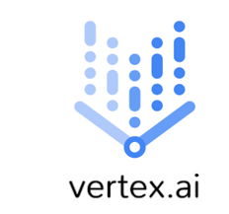




Technologies Used

Slide 6
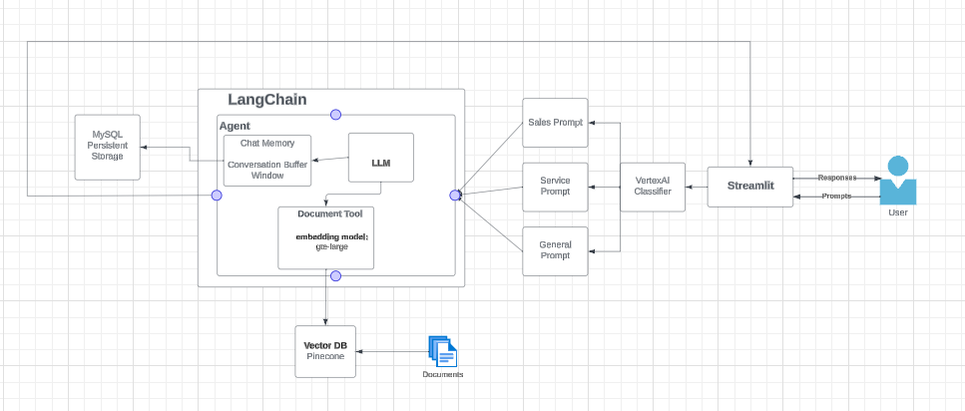
Architecture

Slide 7
Functionalities
The chatbot can understand and respond to various types of questions, making conversations more natural and enjoyable.
It can retrieve information and provide users with accurate and relevant answers.
The chatbot maintains a memory of past interactions, allowing it to remember context and provide more personalized responses.
Users can interact with the chatbot through a user-friendly interface, making it accessible to people of all technical levels.

Slide 8

Data preparation

Slide 9
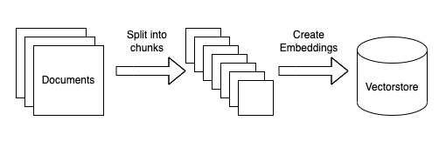
Creating Pinecone

Slide 10
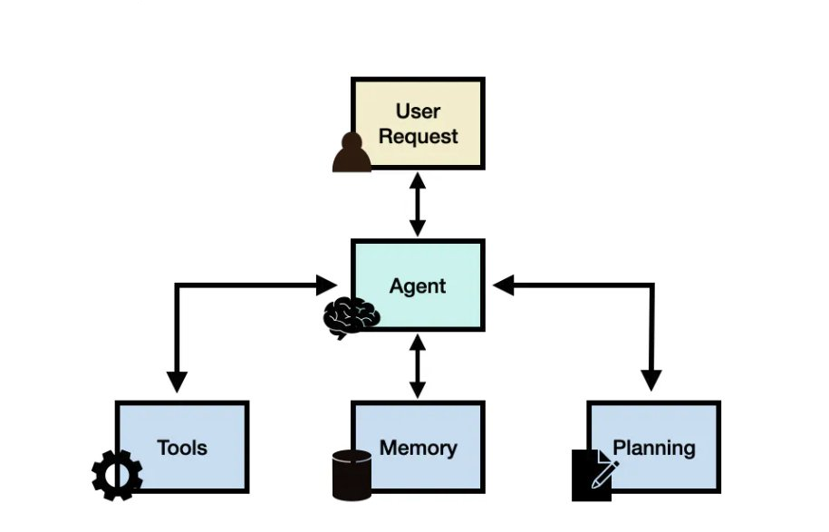
Agent

Slide 11
Challenges faced
Integrating the chatbot with external data sources posed a significant challenge, requiring collaborative problem-solving across multiple teams.
Ensuring the accuracy and relevance of the chatbot's responses, particularly when retrieving information from the internet, presented another hurdle that required careful consideration and testing.
Implementing conversational memory to enable the chatbot to remember past interactions and maintain context during conversations was a complex task that taught us the importance of thorough testing and iteration.
These challenges provided valuable insights into the complexities of building and deploying chatbot solutions, emphasizing the need for meticulous planning, collaboration, and continuous improvement.

Slide 12
Future Enhancements
In the future, we plan to enhance the chatbot's capabilities by adding support for more languages to make it accessible to a broader audience.
We also aim to improve the chatbot's ability to retrieve information from external sources, such as implementing more advanced search algorithms and expanding the range of supported data formats.
Additionally, we will continue to refine the chatbot's conversational memory and personalization features to provide users with a more tailored and engaging experience.
These enhancements will further solidify the chatbot's position as a valuable tool for providing accurate information and assistance to users across various domains.

Slide 13
Conclusion
In conclusion, the development of our intelligent chatbot using Retrieval Augmented Generation (RAG) represents a significant milestone in our pursuit of creating advanced conversational agents. Through the integration of cutting-edge natural language processing techniques, robust data retrieval mechanisms, and sophisticated conversational memory capabilities, we have successfully engineered a chatbot solution that not only understands user queries but also provides accurate, contextually relevant responses.

Slide 14
THANK YOU

