Slide 1

Title: Online Restaurant E-Menu Realm
Student Name: V.Karthik
Student ID: 2520030053
Cluster:1
Section: 3
Under the Guidance of
Supervisor Name: N.M. Deepika
Assistant Professor
Department of CSE

Slide 2
Abstract
This project presents a modern restaurant web application called “Tasty Bites”, developed using HTML, CSS, and JavaScript to provide an interactive online food ordering experience.
The website showcases a well-structured digital menu that categorizes food items into vegetarian, non-vegetarian, and desserts or refreshments, each displayed with images, descriptions, and prices.
Users can browse through the menu, add items to a shopping cart, adjust item quantities, and view the total cost dynamically.
The interface includes a sticky navigation bar, visually appealing food cards, and responsive layouts to enhance usability and user experience.

Slide 3
Existing System
The existing restaurant ordering system is mainly manual and paper-based, where orders are written by waiters.
Customers must verbally tell their order, and the waiter records it manually.
Managing menu details, prices, and availability becomes difficult when done manually.
There is a high chance of human errors while writing or communicating orders.
Sometimes orders may be misplaced or misunderstood, causing delays in service.

Slide 4
Proposed System
The proposed system is a web-based Online Restaurant E-Menu and Food Ordering System that automates restaurant ordering operations.
It provides a digital menu interface where customers can easily view food items with images, descriptions, and prices.
Customers can add items to the cart and modify quantities before placing the order.
The system allows customers to place orders by entering their details and selecting dine-in or delivery options.

Slide 5
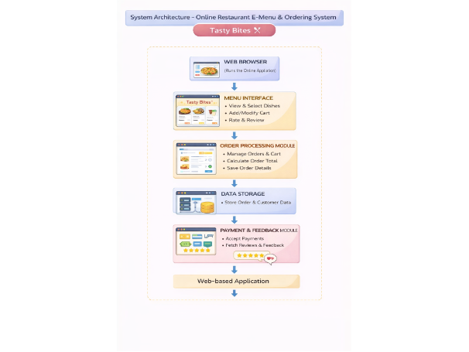
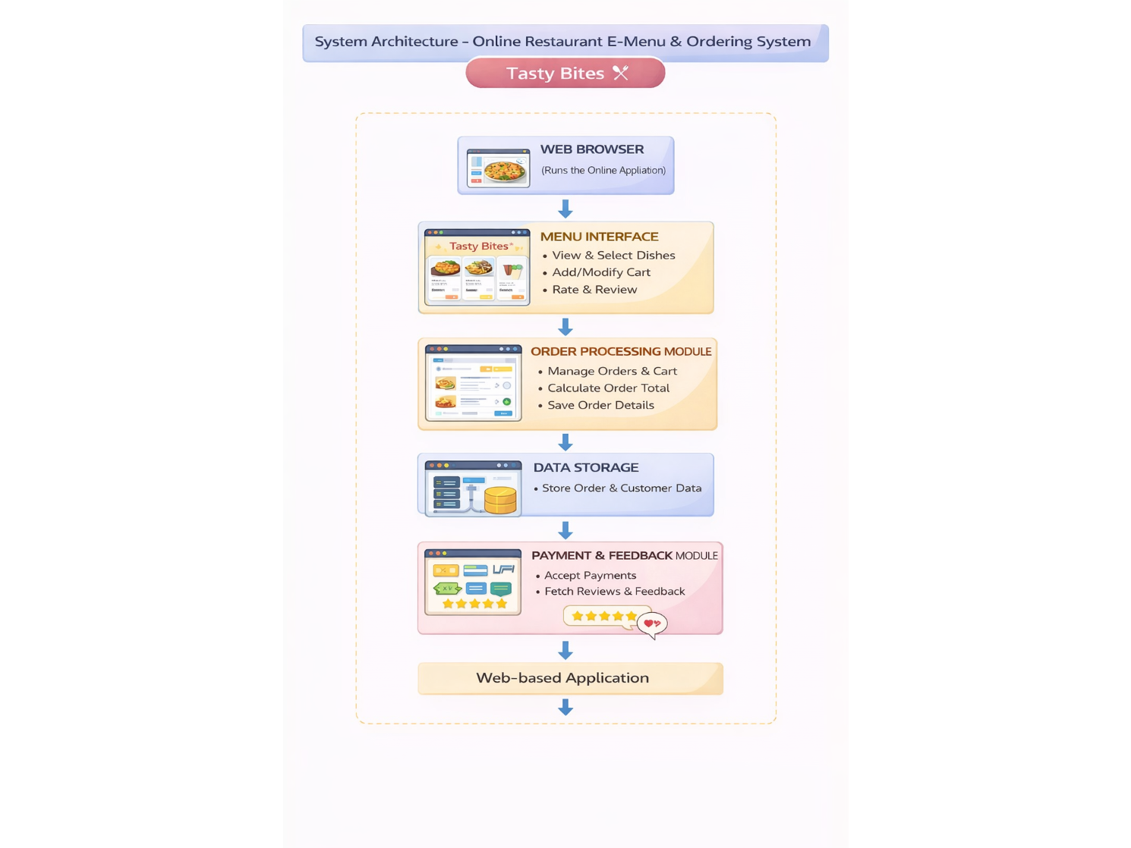
System Architecture

Slide 6
Project Modules
Menu Display Module
• Displays the complete restaurant menu with food images, descriptions, and prices. • Allows customers to browse different categories such as vegetarian, non-vegetarian, and desserts.
Cart Management Module
• Allows users to add food items to the cart and modify quantities. • Automatically updates the cart total and displays selected items.
Order Processing Module
• Enables customers to confirm their order with personal details. • Calculates the total bill and prepares the order summary.

Slide 7
Order Type Selection Module
Allows customers to choose between dine-in and home delivery options. Displays additional fields such as table number or delivery address based on the selection.
Payment Module
Provides multiple payment options such as Cash, Card, and UPI. Displays the payment method and order confirmation details.
Customer Review Module
Allows customers to rate their experience using a star rating system. Enables users to submit feedback about the food and service.
Data Storage Module
Stores order details, cart information, and customer feedback using browser storage. Ensures quick access and retrieval of order data.

Slide 8
Objectives
To develop a web-based online restaurant ordering system for customers.
To allow users to view the digital menu with food images, descriptions, and prices.
To enable customers to add items to cart and manage their food orders easily.
To provide a system that automatically calculates the total order cost.
To allow customers to choose order types such as dine-in or home delivery.
To provide multiple payment options like Cash, Card, and UPI for convenience.

Slide 9
Co’s Attainments - FWD
CO1: Internet Fundamentals, HTML, Intro CSS
Basics of internet and web: HTTP/HTTPS, client-server model, browsers, hosting, domains.
HTML structure and core content tags: document skeleton, headings, paragraphs, links.
Intro CSS: syntax, selectors, typography, colors, and spacing fundamentals (margin, padding, border).
CO2: Forms, Semantic HTML, Advanced CSS Layout
HTML forms: form elements, input types/attributes, and validation basics.
Structured content: semantic tags, tables, media elements, and accessibility attributes.
CSS in depth: advanced selectors, Flexbox, Grid, block layout, media queries, transitions, animations, CSS functions, custom properties, Bootstrap utilities, SCSS basics, and responsive/themed UI design.

Slide 10
CO3: JavaScript Programming Essentials
Core JavaScript: operators, conditions, loops, functions, arrow functions, callbacks.
Data structures and OOP basics: objects, inheritance concepts, arrays and array methods.
Number formats: hexadecimal and scientific literals.
CO4: JavaScript Interactivity and DOM
DOM and event handling: selecting/updating elements and responding to user actions.
Browser storage and async JS: local/session storage, asynchronous programming, and Promises.
CO5: Advanced Web Dev and Deployment
Error handling and ES6 modules.
Dynamic forms and API integration with JavaScript.

Slide 11
Co’s Attainments - DSA
CO1: Algorithm Analysis, Searching, and Basic Sorting
Algorithm analysis foundations: mathematical background, computational model, and running-time calculations.
Searching techniques: Linear Search and Binary Search with analysis.
Sorting introduction with basic methods: Bubble Sort, Insertion Sort, Selection Sort.
CO2: Advanced Sorting Techniques
Divide-and-conquer sorting methods: Merge Sort and Quick Sort.
Comparative understanding of sorting algorithms based on time complexity and use cases.

Slide 12
CO3: Lists and Linked List ADTs
Abstract Data Types (ADTs) and List ADT concepts.
Linked list implementations: singly, doubly, and circular linked lists.
Applications of lists and introduction to Polynomial ADT representation.
CO4: Stacks and Queues
Stack ADT: operations and applications.
Expression-related applications: infix to postfix conversion, arithmetic expression evaluation, balancing symbols.
Queue ADT: operations, Circular Queue, Dequeue (Deque).
Implementing stacks and queues using linked lists.
CO5: Priority Queues, Hashing, and Trees-Related Structures
Priority Queues (Heaps): model, simple implementations, binary heap, and applications.
Hashing: introduction, hash functions, collision handling through Separate Chaining and Open Addressing.

Slide 13
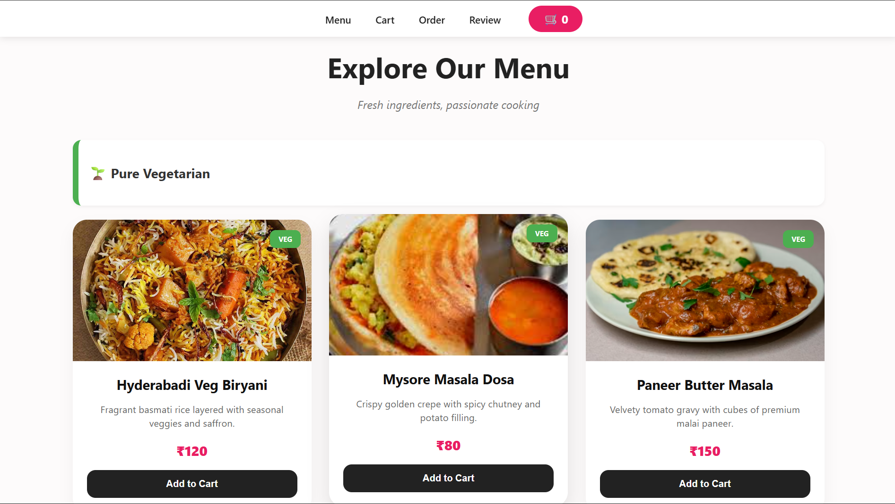
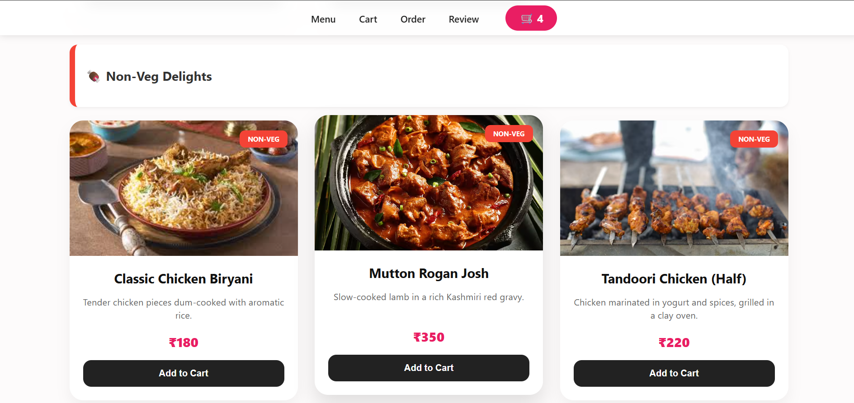
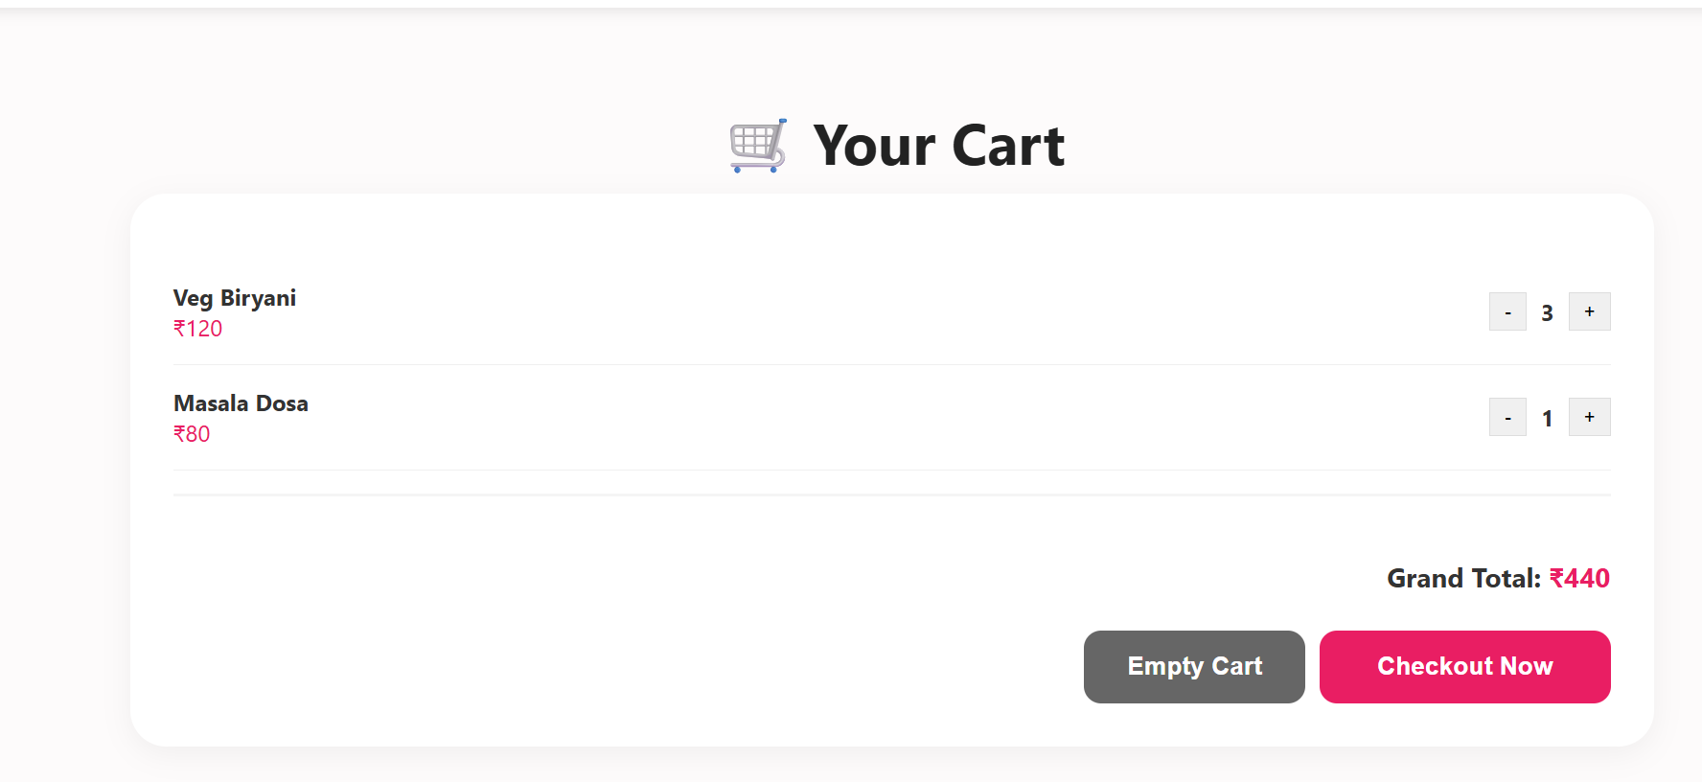
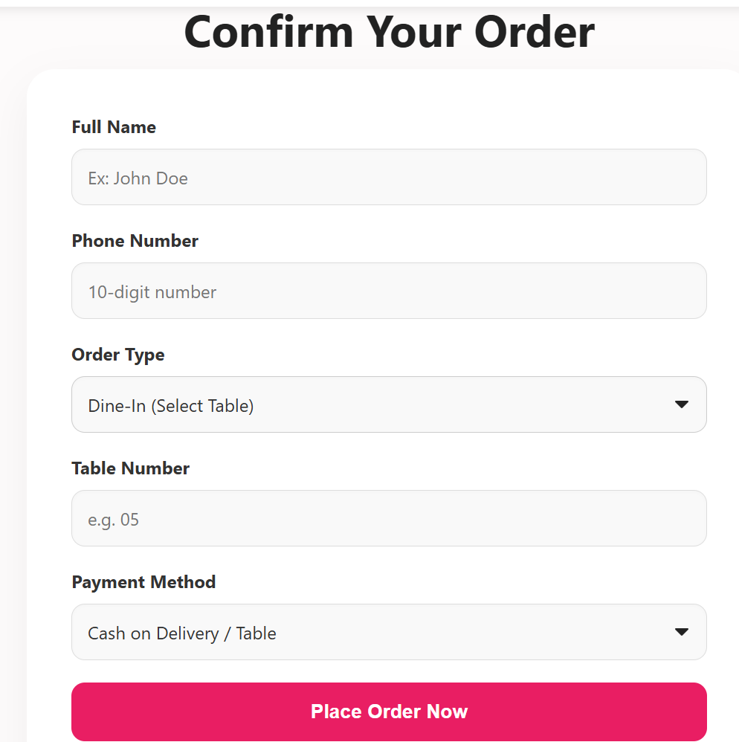
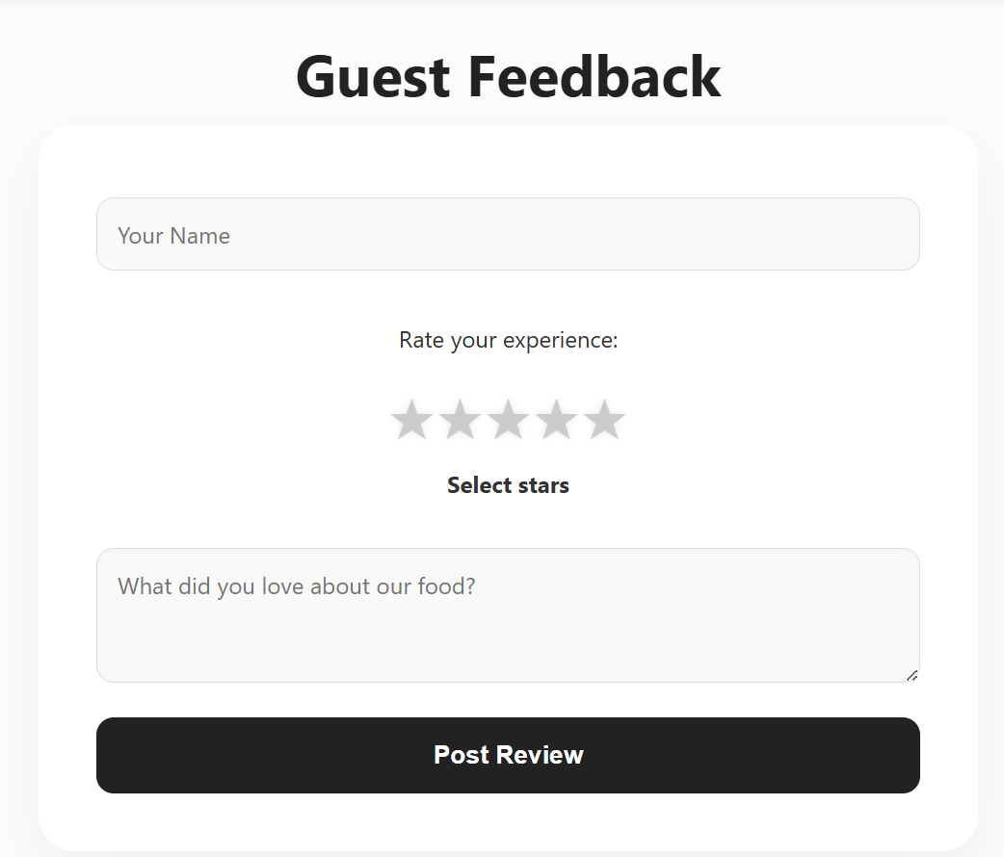
Screenshots for FWD & DSA

Slide 14
Conclusion
The Tasty Bites Online Restaurant E-Menu & Ordering System provides an efficient and user-friendly platform for managing restaurant orders digitally.
The system allows customers to browse the digital menu, select dishes, manage their cart, and place orders easily through a centralized web interface.
It enables users to choose order types such as dine-in or home delivery and select convenient payment methods.
The system also allows customers to rate food and share feedback, helping improve service quality and customer satisfaction.
All order and customer information is stored digitally, reducing manual work and improving order accuracy.

Slide 15
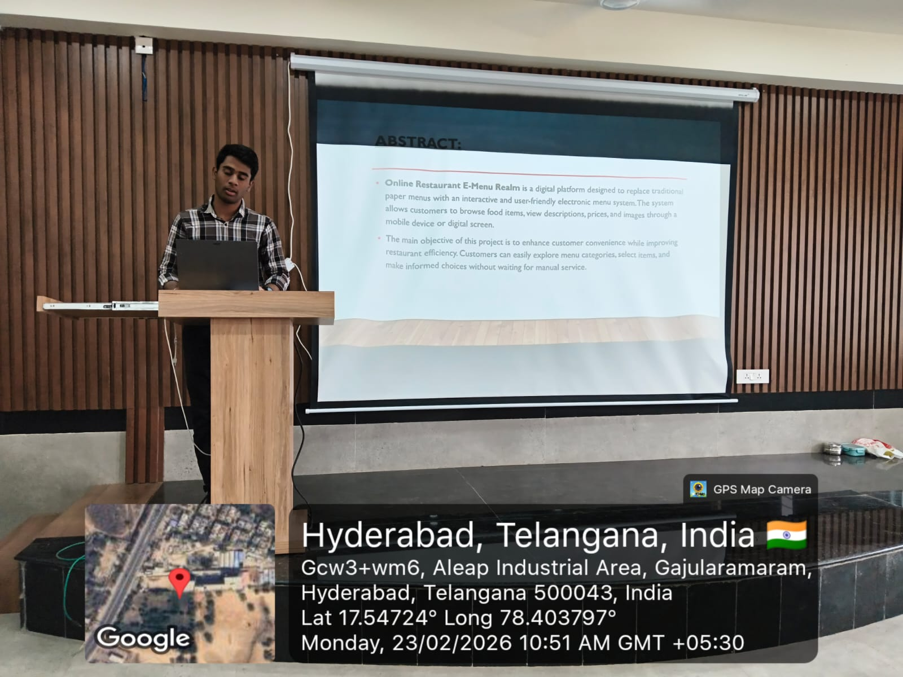
Geo- Tag Photos

Slide 16
THANK YOU

