Slide 1
State of the Art in Coverage Navigation Planning
Exploring and Implementing Advanced Algorithms
B. Karthikeya Varma
Automation and Robotics Engineer

Slide 2
INTRODUCTION
Coverage path planning refers to the process of determining an optimal path for a robot, drone, or other autonomous vehicle to traverse an area while ensuring that every point or region within that area is visited or covered. The goal is to efficiently and systematically cover the entire designated region while minimizing redundant movements and maximizing area coverage.

Slide 3
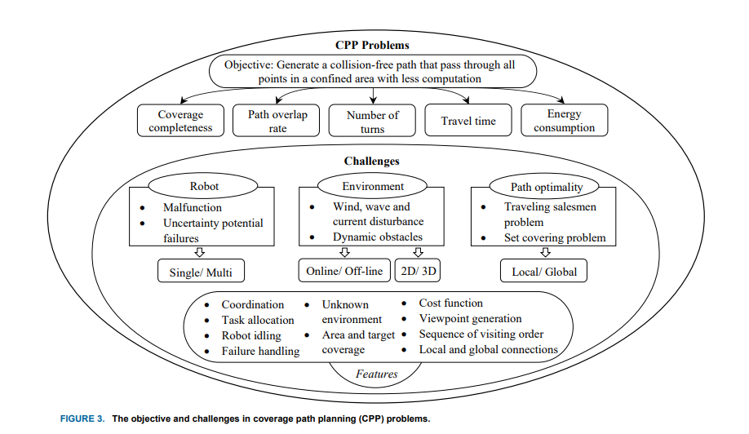
Challanges

Slide 4
Types of coverage path planning algorithms :-
1.Boustrophedon Coverage Path Planning
2.Grid TSP (Travelling Salesman Problem)
3.Neural Network-based Coverage Path Planning
4.Grid-based Local Energy Coverage Path Planning
5.Contour Line Coverage Path Planning
6. Convex SPP (Self-Propelled Particle) Coverage Path Planning

Slide 5
Algorithms for Different Envirnoment
1. Indoor Environments:
- Grid-based Coverage
- Boustrophedon Coverage
- Spanning Tree Coverage
- Potential Field Method
2. Outdoor Environments:
- Voronoi Diagrams
- Artificial Potential Fields
- Randomized Coverage
- Spiral Coverage
3. Dynamic Environments:
- Reactive Path Planning
- Predictive Modeling
- Decentralized Multi-agent Systems
4. Aerial Environments:
- Dubins Paths
- A* with Altitude
- Energy-based Planning
- Visibility Graphs
5. Underwater Environments:
- Hydrodynamic Models
- Buoyancy and Depth Control
- Spiral Patterns
- Sonar-based Navigation

Slide 6
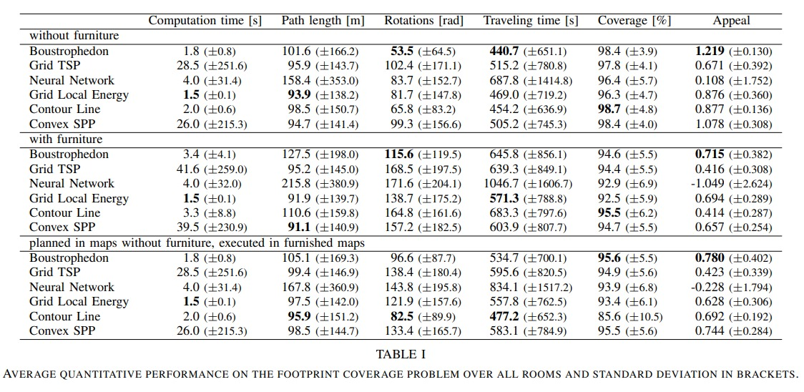
Comparison of Algorithms

Slide 7
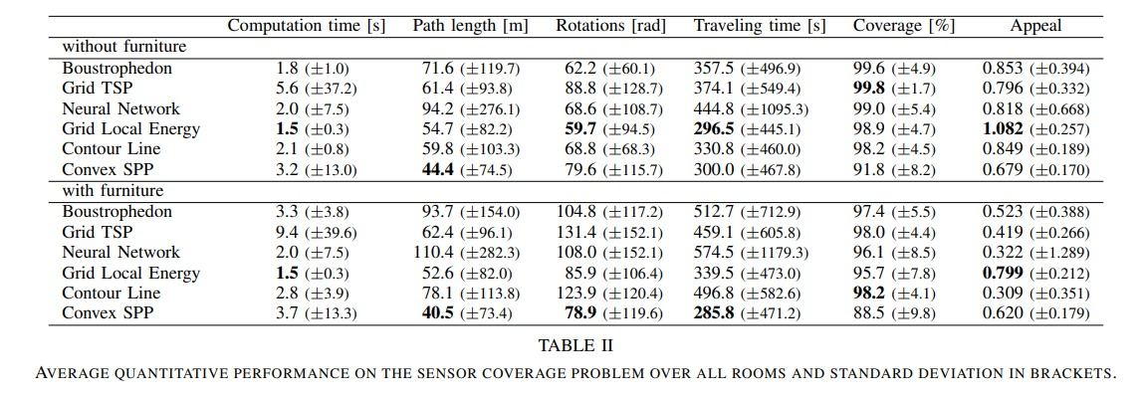
Comparison of Algorithms

Slide 8
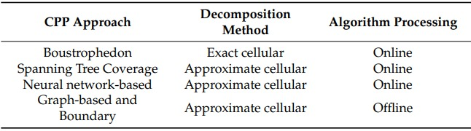
Comparison of Algorithms

Slide 9
Advantages and disadvantages
1. Boustrophedon Coverage Path Planning:
- Advantages:
- Simple and intuitive algorithm.
- Well-suited for grid-based environments.
- Can handle obstacles efficiently.
- Disadvantages:
- May not be optimal in irregular environments.
- Limited scalability in complex spaces.
- Requires tuning for optimal performance in varying environments.
2. Grid TSP (Travelling Salesman Problem):
- Advantages:
- Mathematically guarantees complete coverage.
- Suitable for grid-based environments.
- Can be optimized for efficiency.
- Disadvantages:
- NP-hard problem, computationally expensive.
- Optimality may not be practical for large grids.
- Sensitivity to grid size and resolution.
3. Neural Network-based Coverage Path Planning:
- Advantages:
- Adaptability to various environments and robot types.
- Learning capability from real-world data.
- Potential for optimizing complex objectives.
- Disadvantages:
- Training data requirement.
- Computational complexity during training and deployment.
- Interpretability and explainability challenges.
4. Grid-based Local Energy Coverage Path Planning:
- Advantages:
- Efficient exploration of unknown areas.
- Real-time adaptability to changing environments.
- Handles dynamic obstacles well.
- Disadvantages:
- Sensitivity to grid resolution.
- Difficulty in defining accurate energy functions.
- Limited scalability in highly cluttered environments.
5. Contour Line Coverage Path Planning:
- Advantages:
- Smooth paths that adapt to terrain elevation.
- Effective in hilly or uneven terrains.
- Can handle non-grid environments.
- Disadvantages:
- Computationally intensive for large-scale environments.
- Sensitivity to noise in elevation data.
- Difficulty in handling complex obstacles.
6. Convex SPP (Self-Propelled Particle) Coverage Path Planning:
- Advantages:
- Decentralized and scalable approach.
- Robustness to individual particle failure.
- Flexibility in adapting to dynamic environments.
- Disadvantages:
- Lack of global optimality guarantees.
- Complexity in parameter tuning.
- Potential for suboptimal coverage in irregular spaces.

Slide 10
Why I choose Boustrophedon Coverage
Complete Coverage
Efficiency
Simplicity
No Need for Complex Sensors
Adaptability to Irregular Shapes
Robustness
Scalability
Conservative Energy Usage
Predictability
Real-time Adaptation

Slide 11
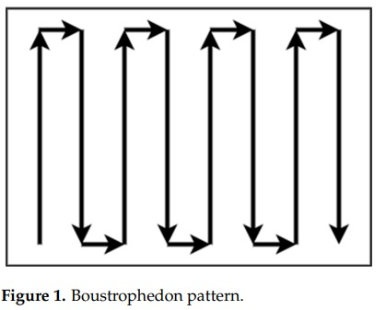
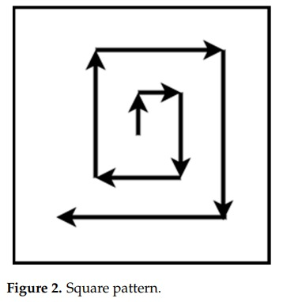
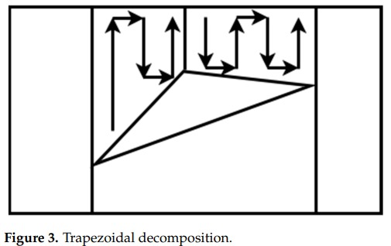
Types of Boustrophedon Coverage Patterns

Slide 12
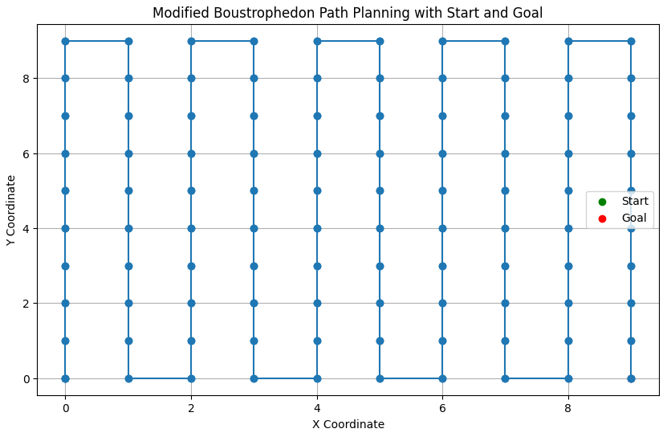
IMPLEMENTATION

Slide 13
Implementation of 1st algorithm Boustrophedon Coverage
1st Try Failed to work

Slide 14
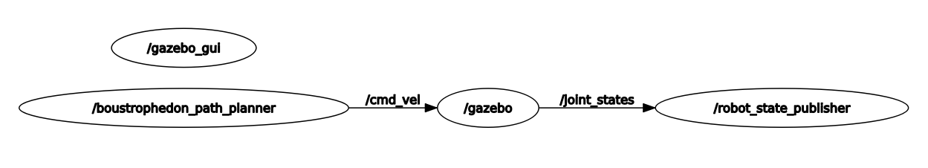
BLOCK DIAGRAM

Slide 15
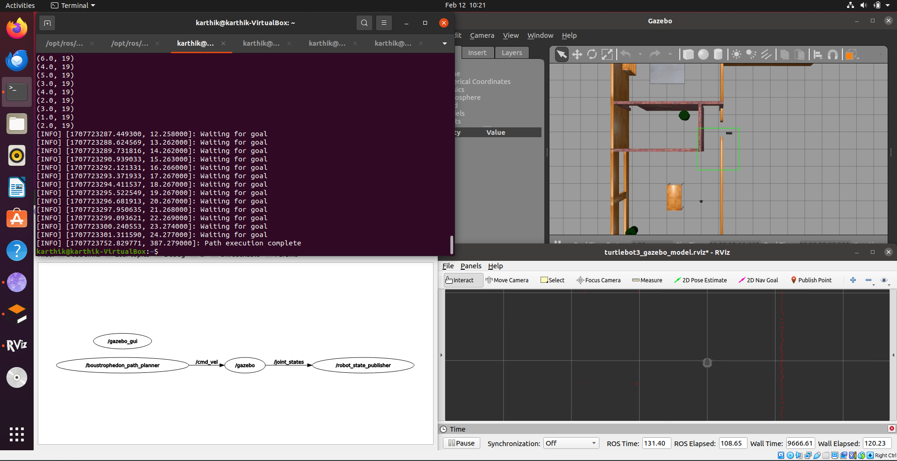
IMPLEMENTATION

Slide 16
Implementation of 2nd algorithm Boustrophedon Coverage
2nd Try few errors with amcl

Slide 17
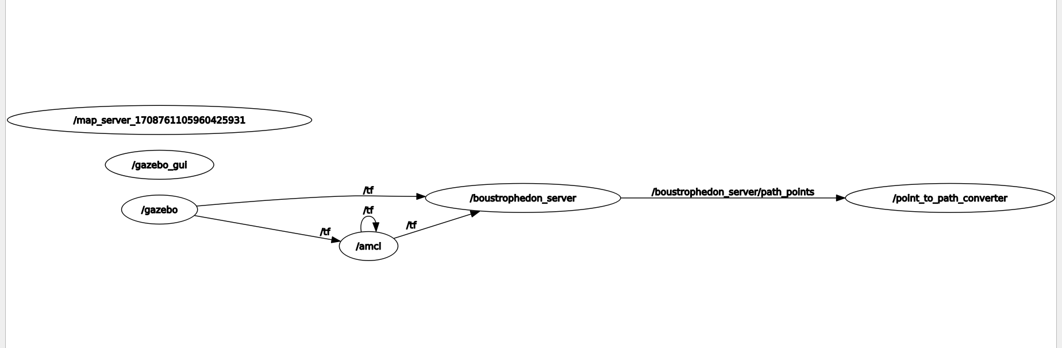
BLOCK DIAGRAM

Slide 18
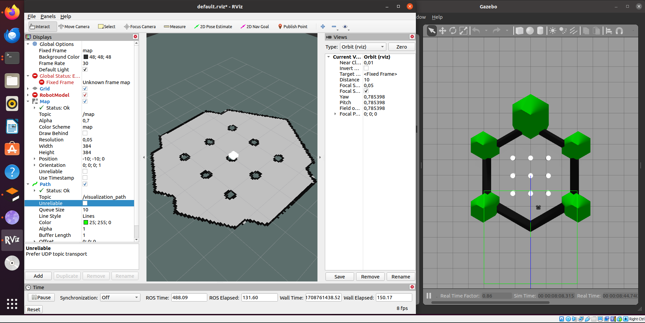
IMPLEMENTATION

Slide 19
CONCLUSION
In summary, my research focused on coverage path planning algorithms, leading me to choose the Boustrophedon algorithm. While I successfully implemented it in Python on Colab, initial trials in ROS didn't yield desired results. However, with more time, I'm confident I can optimize the implementation for ROS, utilizing Gazebo and RViz for visualization.

Slide 20
REFERENCES
[1] Fevgas, G.; Lagkas, T.; Argyriou, V.; Sarigiannidis, P. Coverage Path Planning Methods Focusing on Energy Efficient and Cooperative Strategies for Unmanned Aerial Vehicles. Sensors 2022, 22, 1235. https://doi.org/10.3390/s22031235
[2] R. Bormann, F. Jordan, J. Hampp and M. Hägele, "Indoor Coverage Path Planning: Survey, Implementation, Analysis," 2018 IEEE International Conference on Robotics and Automation (ICRA), Brisbane, QLD, Australia, 2018, pp. 1718-1725, doi: 10.1109/ICRA.2018.8460566. keywords: {Path planning;Cleaning;Robot sensing systems;Planning;Traveling salesman problems},
[3] C. S. Tan, R. Mohd-Mokhtar and M. R. Arshad, "A Comprehensive Review of Coverage Path Planning in Robotics Using Classical and Heuristic Algorithms," in IEEE Access, vol. 9, pp. 119310-119342, 2021, doi: 10.1109/ACCESS.2021.3108177.
keywords: {Robots;Robot sensing systems;Collision avoidance;Robot kinematics;Planning;Three-dimensional displays;Task analysis;Coverage path planning;exploration;heuristic algorithm;deep reinforcement learning},
[4] Mier, Gonzalo & Valente, João & Bruin, Sytze. (2023). Fields2Cover: An Open-Source Coverage Path Planning Library for Unmanned Agricultural Vehicles. IEEE Robotics and Automation Letters. PP. 1-8. 10.1109/LRA.2023.3248439. [5] Macenski, Steve & Martín, Francisco & White, Ruffin & Ginés Clavero, Jonatan. (2020). The Marathon 2: A Navigation System.

