Slide 1
Thermodynamic Manifold Inference
Karthik Srinivasan

Slide 2
Dimensionality reduction
Matrix Factorisation methods
Examples: PCA, SVD, NMF
Data is represented as a product of multiple simpler matrices
Allows for approximate reconstruction of data
Can not tell us anything about the manifold
Manifold learning methods
Examples: diffusion maps, Isomaps, tSNE, UMAP, Laplacian Eigenmaps
Assumes that the data lies on a much lower dimensional embedded manifold
Uses kernel based approaches
Allows inference of manifold
Can not represent the data using approximate reconstruction

Slide 3
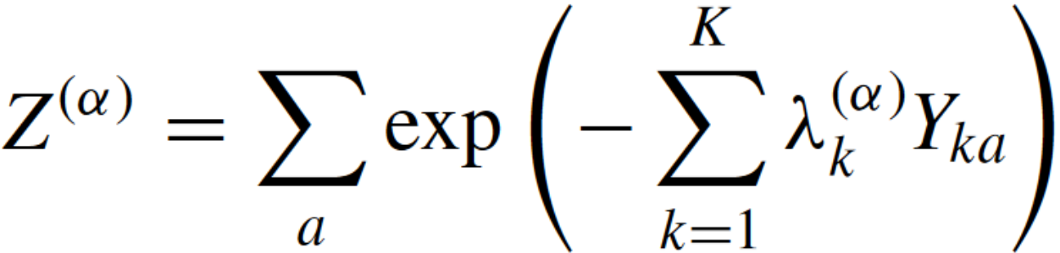
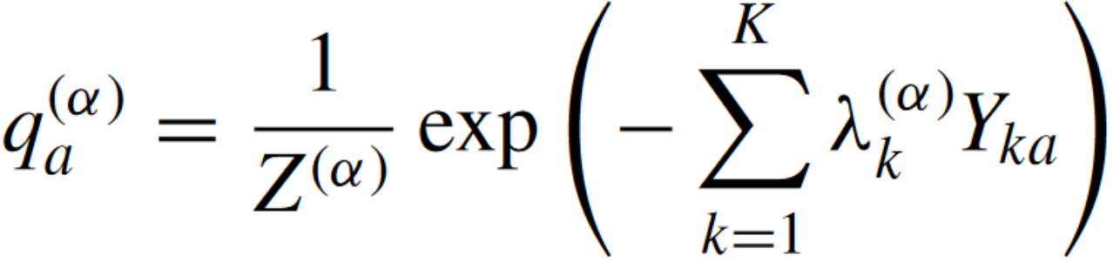
Thermodynamic manifold inference
Based on statistical physics
Offers physically interpretable solution to dimensionality reduction
Assumes that the data can be represented by a Gibbs-Boltzmann distribution
It has modeled probabilities in a variety of complex systems such as such as ensembles of protein sequences, signal networking, collective firing of neurons, collective motion of birds

Slide 4
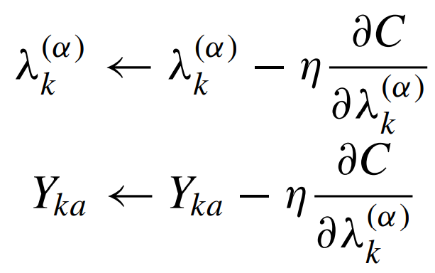
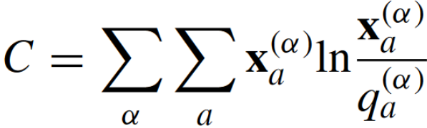
Gradient descent

Slide 5
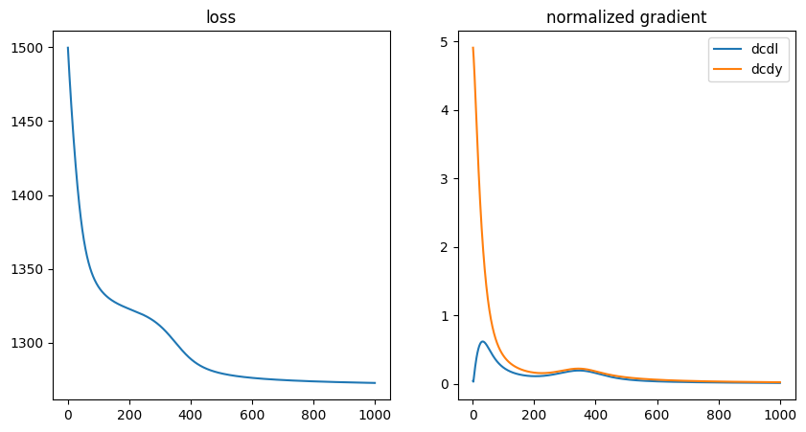
Metrics

Slide 6
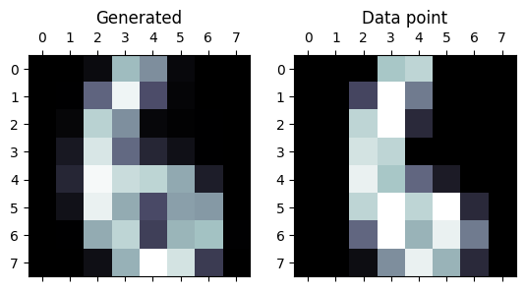
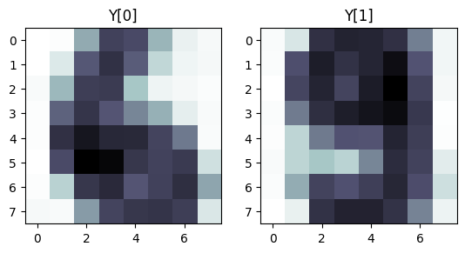
My Results
Data reconstruction
Physical interpretation of Y

Slide 7
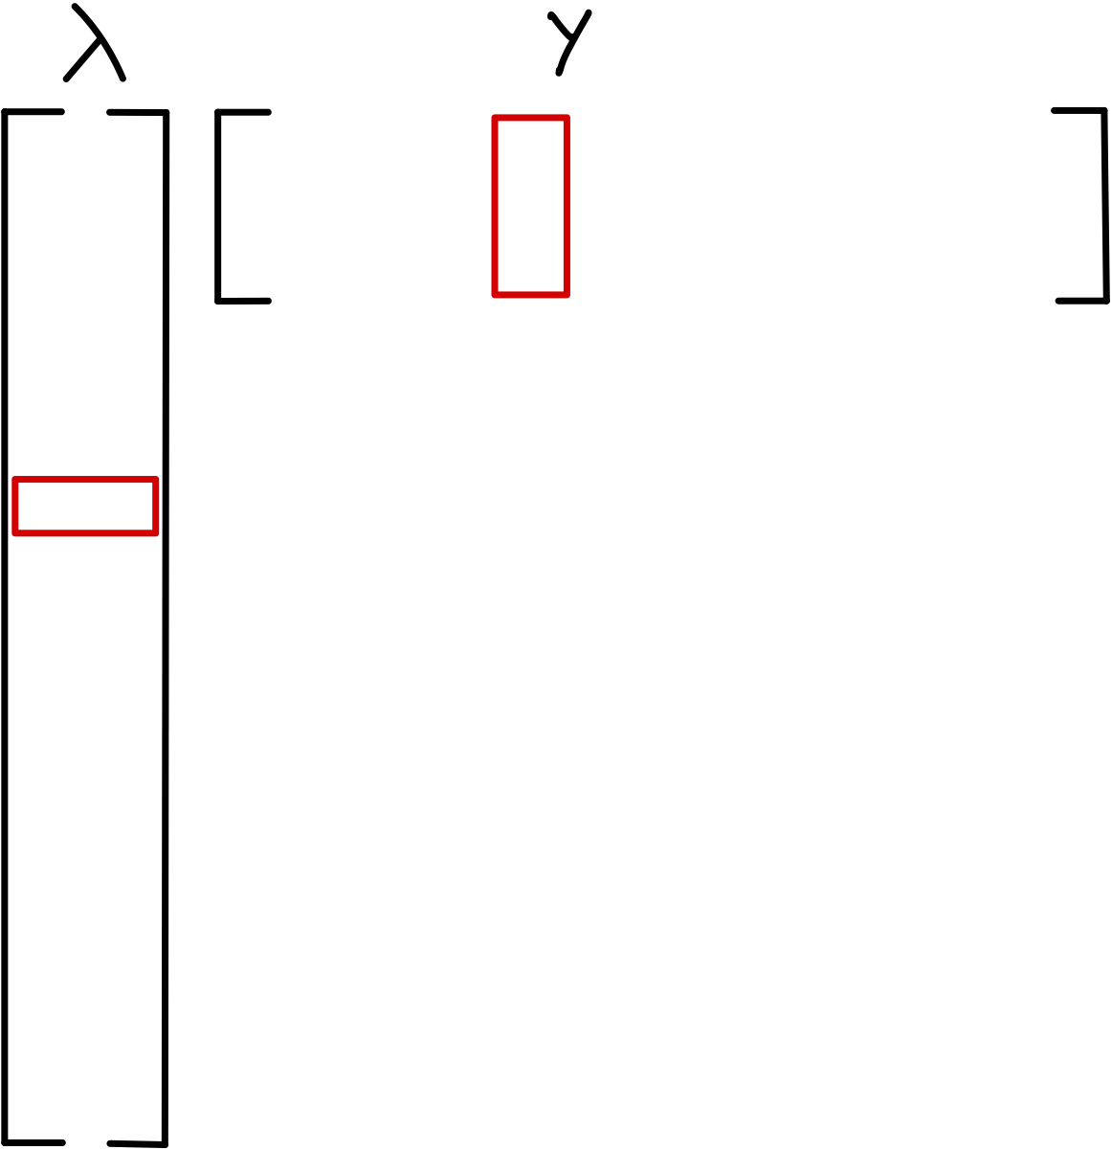
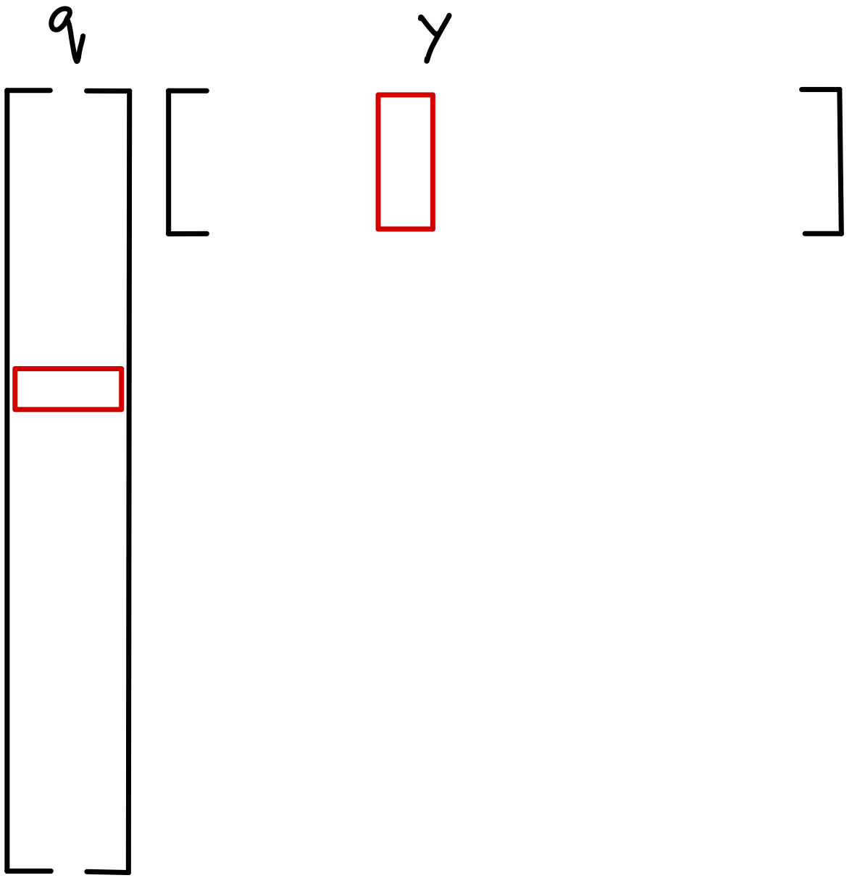
Intensive and Extensive variables
Each entry of the matrix q conveys how much the data point represents a 6 and 9 respectively.
Each entry of Y conveys the intensity of each feature for each class.

Slide 8
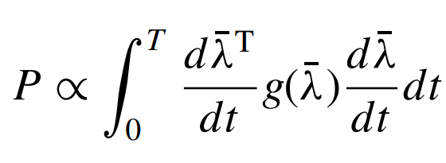
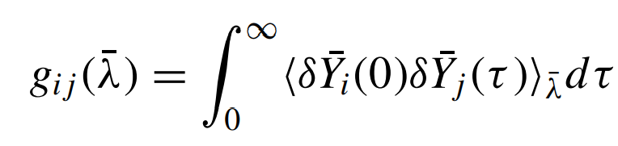
Riemannian distance metric metric
Defined on the space of intensive variable
The metric on the space of intensive variables defines a notion of distance between the distributions as well as the “number of points” in any given volume element

Slide 9
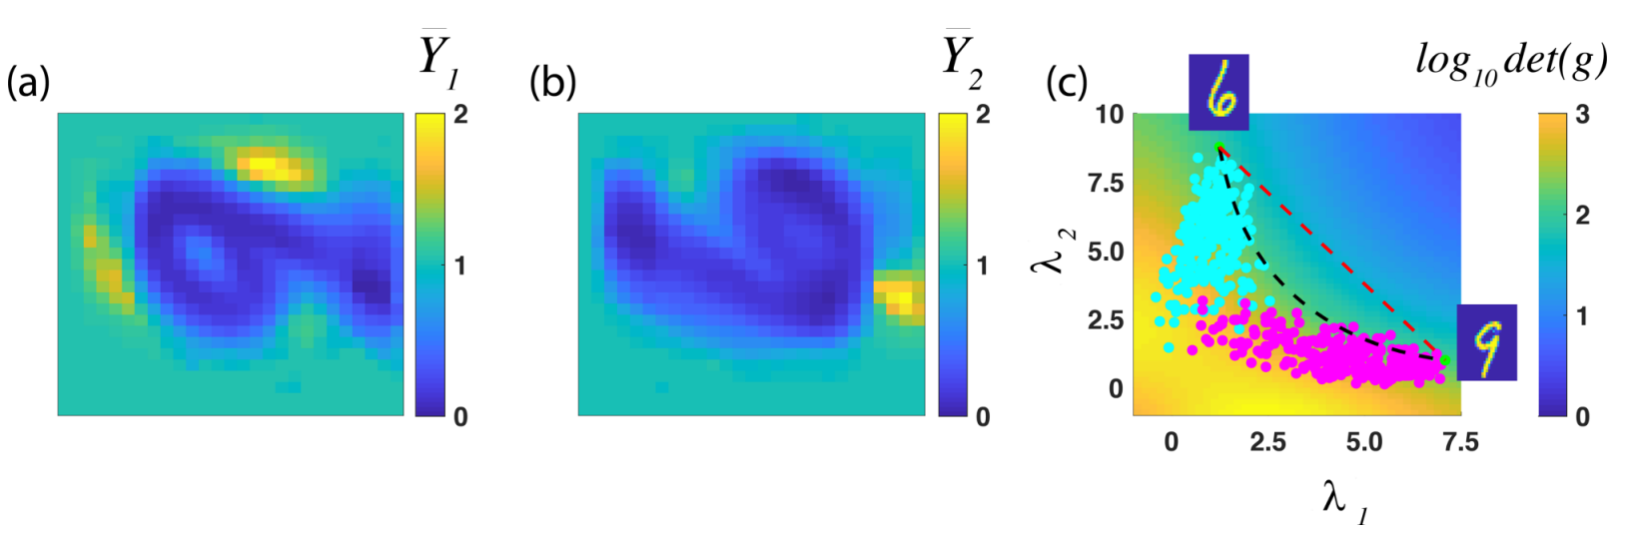
Paper results

Slide 10
Thank you!

