Slide 1

Operational Risk Management Application for Financial Banks
Leveraging AWS for Scalable, Secure, and Compliant Solutions

Slide 2
Agenda
Introduction to Operational Risk
Application Overview
AWS-Based Architecture
Key Features
Data Flow
Scalability & Reliability
Example Use Case
Technologies Used
Conclusion

Slide 3

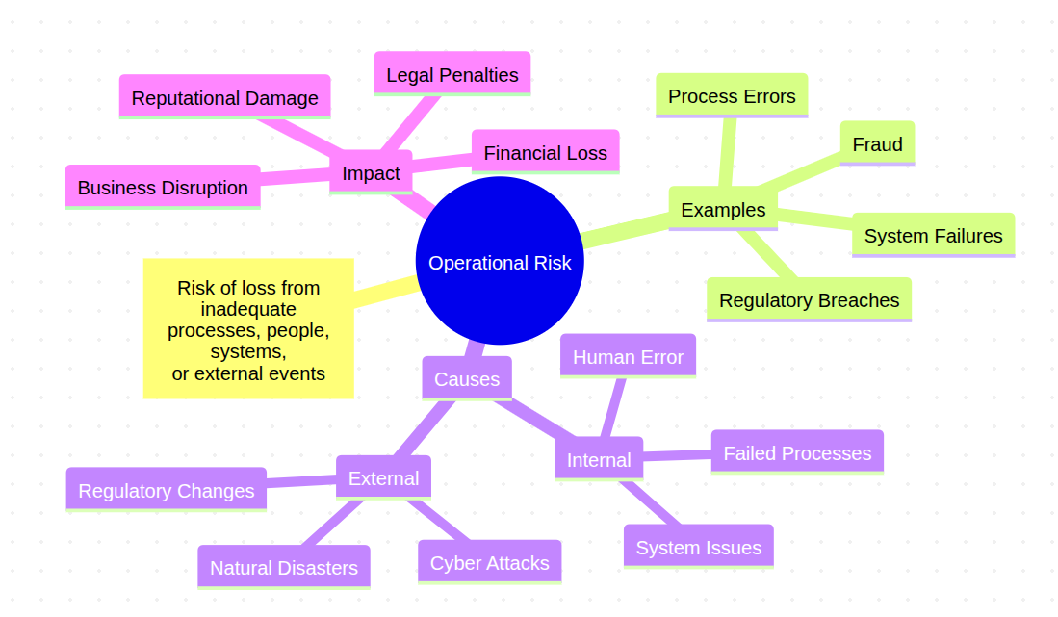
Introduction to Operational Risk

Slide 4
Application Overview
Purpose: Manage operational risks through identification, assessment, monitoring, and mitigation.
Key Functions:
Risk event capture
Real-time monitoring
Reporting & analytics
Notifications & workflows

Slide 5
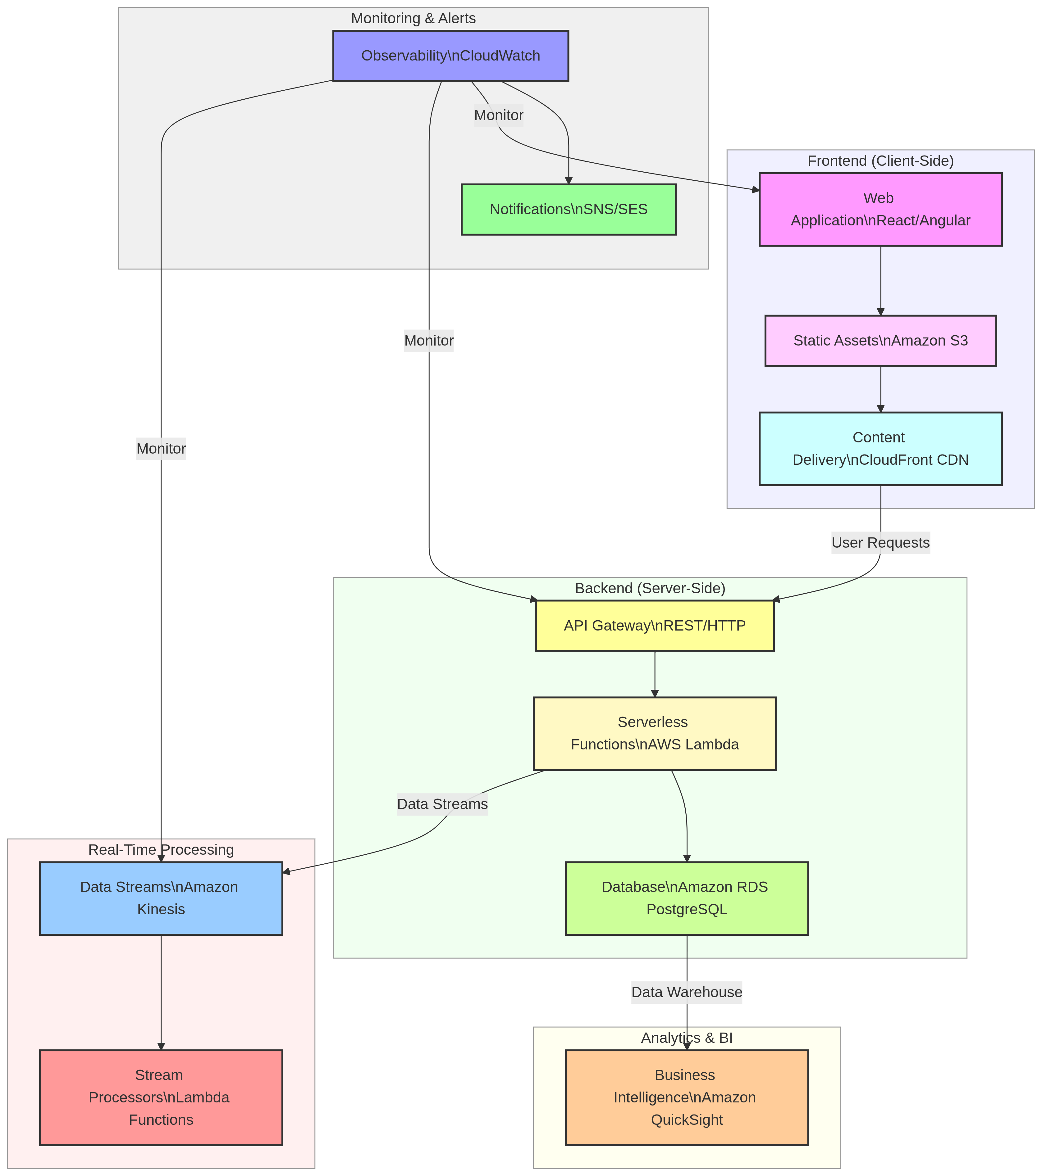
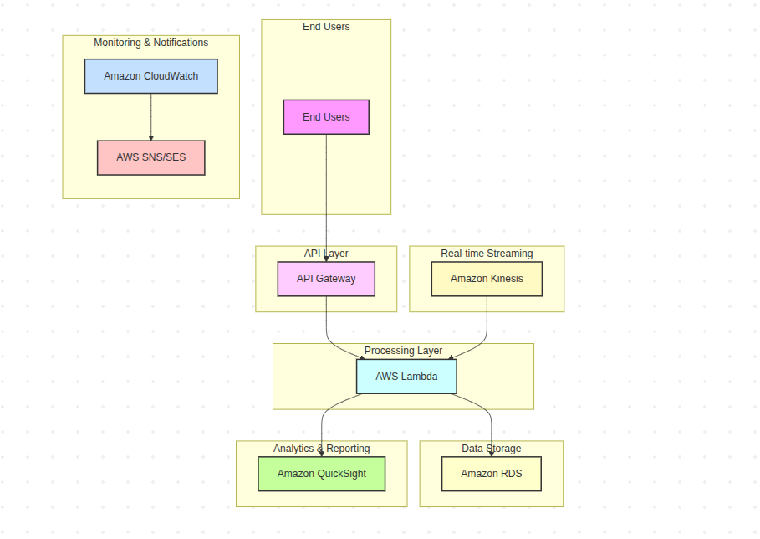
AWS-Based Architecture

Slide 6
Key Features
Risk Event Capture: Log incidents via web app.
Risk Assessment: Calculate impact and likelihood using Lambda.
Real-time Monitoring: Stream data with Kinesis and trigger alerts.
Reporting: Interactive dashboards with QuickSight.
Notifications: Automated alerts via SNS/SES.
Workflows: Orchestrate mitigation processes with Step Functions.

Slide 7
Data Flow
Event Logging: Users log risks → Data stored in RDS.
Real-time Processing: Kinesis streams data → Lambda analyzes.
Risk Assessment: Lambda updates risk scores in RDS.
Monitoring: CloudWatch triggers alerts for anomalies.
Reporting: QuickSight generates dashboards.
Notifications: SNS sends alerts to stakeholders.

Slide 8
Scalability & Reliability
Serverless: Lambda and API Gateway for auto-scaling.
High Availability: RDS Multi-AZ deployment.
Auto Scaling: For Kinesis and Lambda to handle workloads.
Security: IAM, KMS, AWS Config for compliance.

Slide 9
Example Use Case
Event logged in the application.
Kinesis streams data to Lambda for analysis.
Lambda calculates risk impact and updates RDS.
QuickSight updates dashboard.
SNS sends alerts to IT and risk teams.
Step Functions triggers incident resolution workflow.

Slide 10
Technologies Used
Frontend: React/Angular, S3, CloudFront.
Backend: API Gateway, Lambda, RDS (PostgreSQL).
Streaming: Amazon Kinesis.
Analytics: Amazon QuickSight, SageMaker.
Monitoring: CloudWatch, SNS/SES.
Security: IAM, KMS, AWS Config.

Slide 11
Conclusion
Benefits:
Real-time risk monitoring.
Scalable and secure architecture.
Regulatory compliance and audit readiness.
Next Steps:
Pilot implementation.
Integration with existing systems.
Continuous improvement based on feedback.

Slide 12
Q&A
Questions? Thank you for your attention!
Karthikvx@gmail.com

