Slide 1

Banking Credit Risk Management : AWS Services Use Case
Building Enterprise-Scale Risk Platforms

Slide 2

Agenda
Data Ingestion & Real-time Streaming
Data Storage & Management Architecture
Machine Learning & Analytics Platform
Compute & Processing Services
Integration & API Management
Security & Compliance Framework
Cost Optimization Strategies

Slide 3

Business Requirements Overview
Regulatory Compliance
CCAR/DFAST Stress Testing
Basel III Capital Adequacy
CECL Forward-looking Provisions
Risk Analytics
PD/LGD/EAD Model Deployment
Portfolio Risk Monitoring
Economic Capital Calculations
Operational Excellence
Real-time Credit Scoring
Automated Regulatory Reporting
Risk-adjusted Pricing

Slide 4

Data Ingestion & Streaming Services
Amazon Kinesis Data Streams
Transaction data ingestion (millions/sec)
Market data feeds integration
Payment processing streams
Amazon Kinesis Data Firehose
Automated S3 data lake delivery
Data transformation on-the-fly
Error record handling
AWS Lambda Functions
Event-driven credit calculations
Data validation & cleansing
Real-time alert generation

Slide 5

Data Storage Architecture
Amazon S3 - Data Lake
Historical loan portfolios
Regulatory report archives
ML model artifacts & versions
Amazon RDS/Aurora
Customer profiles & transactions
Risk policy parameters
Audit trails & decision logs
Amazon DynamoDB
Real-time credit scores lookup
Dynamic risk limits
Session management

Slide 6

Machine Learning Platform
Amazon SageMaker
PD/LGD/EAD model development
A/B testing for model validation
Real-time inference endpoints
Automated model retraining
Model Types Supported
Logistic regression for PD
Neural networks for complex patterns
Ensemble methods for robustness
Time-series for economic forecasting

Slide 7

Data Processing & ETL
AWS Glue
Automated ETL pipelines
Data catalog for governance
Schema evolution management
Amazon EMR
Stress testing calculations
Monte Carlo simulations
Portfolio optimization algorithms
Basel III risk-weighted assets
AWS Batch
Regulatory report generation
Overnight batch processing
Auto-scaling compute resources

Slide 8
Integration & API Services
Amazon API Gateway
Credit scoring API exposure
Rate limiting & throttling
API versioning & documentation
AWS Step Functions
Credit approval workflows
Model validation orchestration
Multi-step regulatory submissions
Third-party Integrations
Credit bureau connections
Market data provider APIs
Regulatory submission portals

Slide 9

Real-time Analytics
Amazon Kinesis Analytics
Real-time VaR calculations
Concentration risk monitoring
Early warning system alerts
Amazon ElasticSearch/OpenSearch
Executive risk dashboards
Audit trail searching
Performance monitoring
Custom risk visualizations
Amazon CloudWatch
System health monitoring
Custom business metrics
Automated alerting

Slide 10

Security & Compliance Framework
AWS KMS (Key Management)
Customer data encryption
Automated key rotation
Audit trail for key usage
AWS CloudTrail
Complete API audit logs
Regulatory examination evidence
Security incident investigation
AWS Config
Infrastructure compliance monitoring
Configuration drift detection
Automated remediation

Slide 11
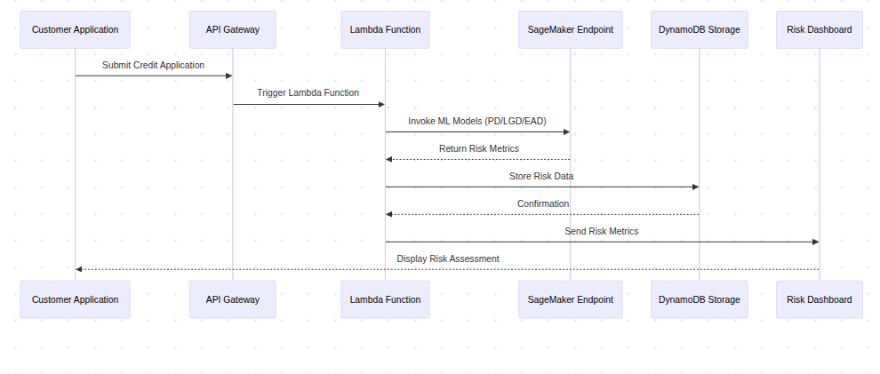
Architecture Pattern - Real-time Scoring
Performance Targets
Sub-100ms response time
99.9% availability
Auto-scaling capacity

Slide 12
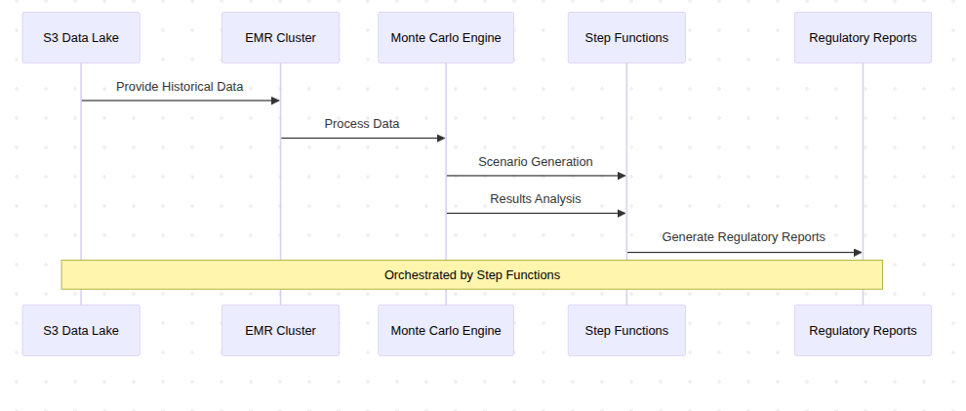
Architecture Pattern - Stress Testing
Capabilities
1000+ economic scenarios
Portfolio-wide impact analysis
Automated report generation

Slide 13
Cost Optimization Strategies
Compute Optimization
Spot instances for batch processing (60% savings)
Auto-scaling for variable workloads
Reserved instances for baseline capacity
Storage Optimization
S3 Intelligent Tiering
Glacier for compliance archival
EBS optimization for databases
Data Transfer
VPC endpoints to reduce costs
CloudFront for global distribution

Slide 14
Regulatory Compliance Benefits
CCAR/DFAST Compliance
Automated stress test execution
Scenario generation & analysis
Capital adequacy reporting
Basel III Implementation
Risk-weighted asset calculations
Capital ratio monitoring
Leverage ratio compliance
Model Risk Management
Version control & governance
Back-testing automation
Model performance monitoring

Slide 15
Implementation Roadmap
Phase 1
Months 1-3)
Data lake setup (S3, Glue)
Basic ETL pipelines
Core security framework
Phase 2
Months 4-6)
ML platform deployment (SageMaker)
Real-time scoring APIs
Risk dashboard development
Phase 3
Months 7-9)
Stress testing platform
Regulatory reporting automation
Performance optimization

Slide 16

Success Metrics
Operational Metrics
50% reduction in manual risk reporting
Sub-second credit decision response
99.9% system availability
Business Impact
30% improvement in model accuracy
Faster regulatory submission cycles
Enhanced capital optimization
Cost Benefits
40% reduction in infrastructure costs
Improved resource utilization
Scalable growth capacity

Slide 17
Questions & Discussion
Email: karthikvx@gmail.com
Key Takeaways
Comprehensive AWS-based risk platform
Regulatory compliance by design
Scalable and cost-effective solution
Modern ML/AI capabilities

Slide 18

Appendix - Service Details
Core AWS Services Used
Kinesis (streaming), Lambda (compute)
SageMaker (ML), EMR (analytics)
S3 (storage), RDS (database)
API Gateway (integration)
CloudTrail (audit), KMS (security)
Integration Points
Credit bureaus, market data providers
Core banking systems
Regulatory submission portals
Risk management platforms

