Slide 1
Trade Flow Guardian
Operational Risk Management in Banking Services
Summary:
Trade Flow Guardian is a comprehensive microservices-based platform designed to address critical operational risks in banking trade systems. The platform provides automated monitoring, remediation, and compliance capabilities across legacy and modern infrastructure.
Notes:
Key Business Value
Proactive Risk Mitigation: Automated detection and remediation of system failures
Regulatory Compliance: SOX-compliant audit trails and automated controls
Business Continuity: Real-time alerting and rapid incident response
Legacy Integration: Seamless bridge between mainframe and cloud systems

Slide 2
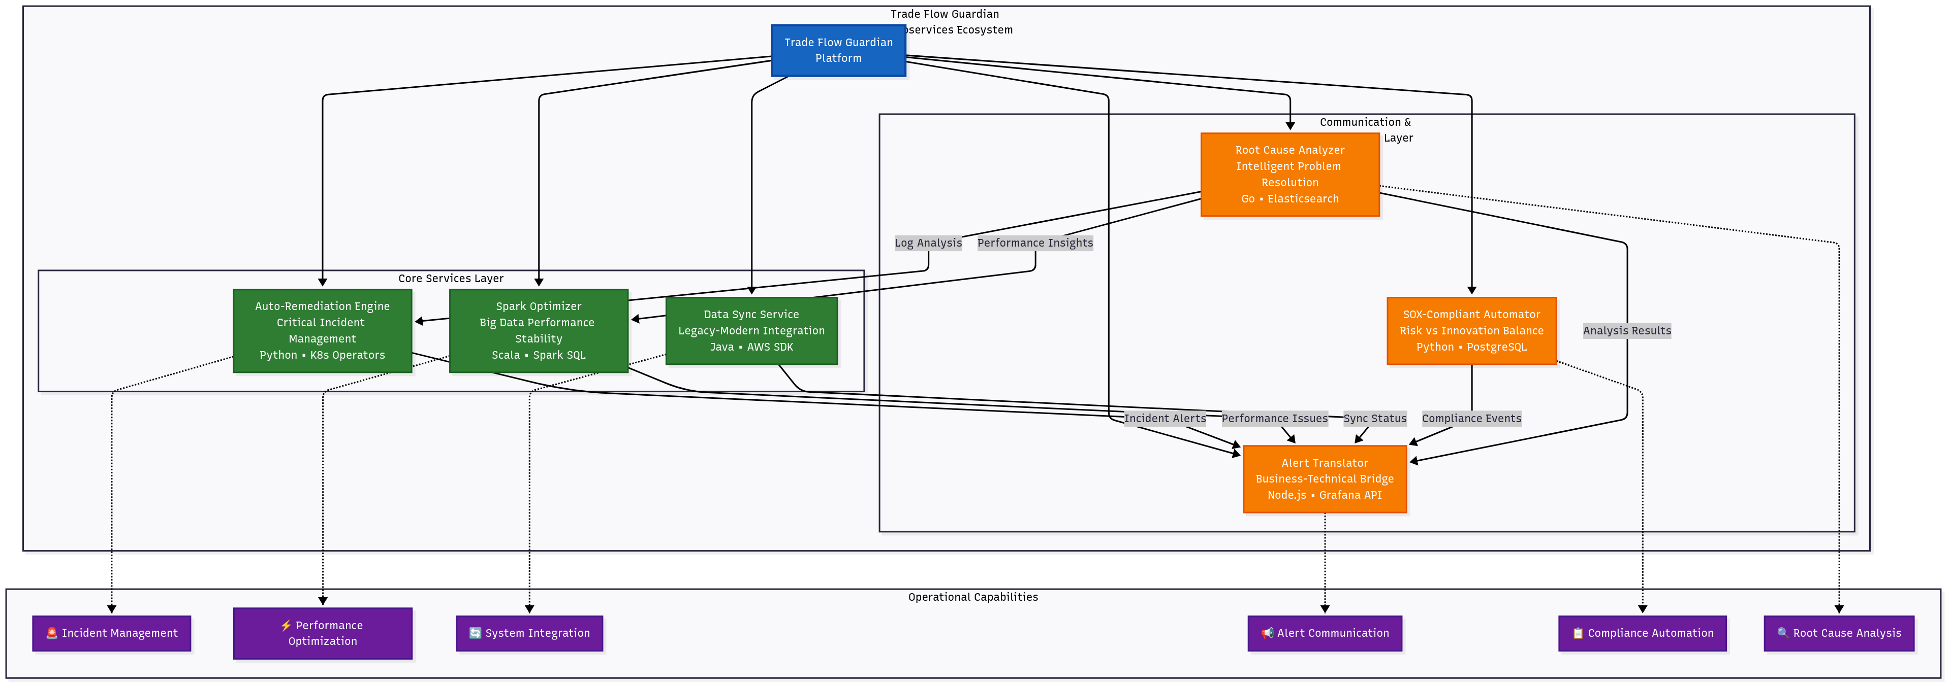
Trade Flow Guardian
Notes:
Architecture Overview
Microservices Ecosystem
The Trade Flow Guardian consists of 6 specialized microservices, each addressing specific operational challenges:
Auto-Remediation Engine - Critical incident management
Spark Optimizer - Big data performance stability
Data Sync Service - Legacy-modern system integration
Alert Translator - Business-technical communication bridge
SOX-Compliant Automator - Risk management with innovation balance
Root Cause Analyzer - Intelligent problem resolution

Slide 3
Trade Flow
Microservices & Their Functions
Microservice | Purpose | Tech Stack | Linked Challenge
Auto-Remediation Engine | Detects/Kills stuck Spark jobs, restarts Kafka consumers | Python, Kubernetes Operators | 1. High-Stakes Incident Mgmt
Spark Optimizer | Dynamically adjusts Spark partitions based on HDFS latency | Scala, Spark SQL | 2. Big Data Stability
Data Sync Service | Dual-writes legacy mainframe data → S3 with checksum validation | Java, AWS SDK | 4. Legacy-Modern Hybrid
Alert Translator | Converts Kafka lag/S3 errors into trader-facing Slack alerts | Node.js, Grafana API | 3. Tech-Business Bridge
SOX-Compliant Automator | Executes pre-approved scripts (e.g., trade surveillance) with audit logs | Python, PostgreSQL (for audit) | 5. Risk vs. Innovation
Root Cause Analyzer | Correlates logs from Spark/Kafka/HDFS to suggest fixes | Go, Elasticsearch | 6. Unstructured Problem-Solving
Notes:
Core Microservices
1. Auto-Remediation Engine
Challenge: High-Stakes Incident Management
Function:
Detects and automatically kills stuck Spark jobs
Restarts failed Kafka consumers
Implements immediate containment strategies
Technology: Python, Kubernetes Operators Risk Mitigation: Prevents cascade failures and data processing delays
2. Spark Optimizer
Challenge: Big Data Stability
Function:
Monitors HDFS latency in real-time
Dynamically adjusts Spark partition configurations
Optimizes processing performance automatically
Technology: Scala, Spark SQL Risk Mitigation: Ensures consistent data processing performance under varying loads
3. Data Sync Service
Challenge: Legacy-Modern Hybrid Architecture
Function:
Dual-writes legacy mainframe data to AWS S3
Implements checksum validation for data integrity
Maintains data consistency across systems
Technology: Java, AWS SDK Risk Mitigation: Ensures data accuracy and availability across infrastructure generations
4. Alert Translator
Challenge: Tech-Business Communication Bridge
Function:
Converts technical Kafka lag metrics into business-friendly alerts
Translates S3 errors into actionable trader notifications
Routes alerts to appropriate Slack channels
Technology: Node.js, Grafana API Risk Mitigation: Enables rapid business response to technical issues
5. SOX-Compliant Automator
Challenge: Balancing Risk Management with Innovation
Function:
Executes pre-approved automation scripts
Maintains comprehensive audit logs
Supports trade surveillance and compliance workflows
Technology: Python, PostgreSQL Risk Mitigation: Provides controlled automation while maintaining regulatory compliance
6. Root Cause Analyzer
Challenge: Unstructured Problem-Solving
Function:
Correlates logs across Spark, Kafka, and HDFS systems
Applies machine learning for pattern recognition
Provides actionable remediation suggestions
Technology: Go, Elasticsearch Risk Mitigation: Reduces mean time to resolution (MTTR) for complex incidents

Slide 4
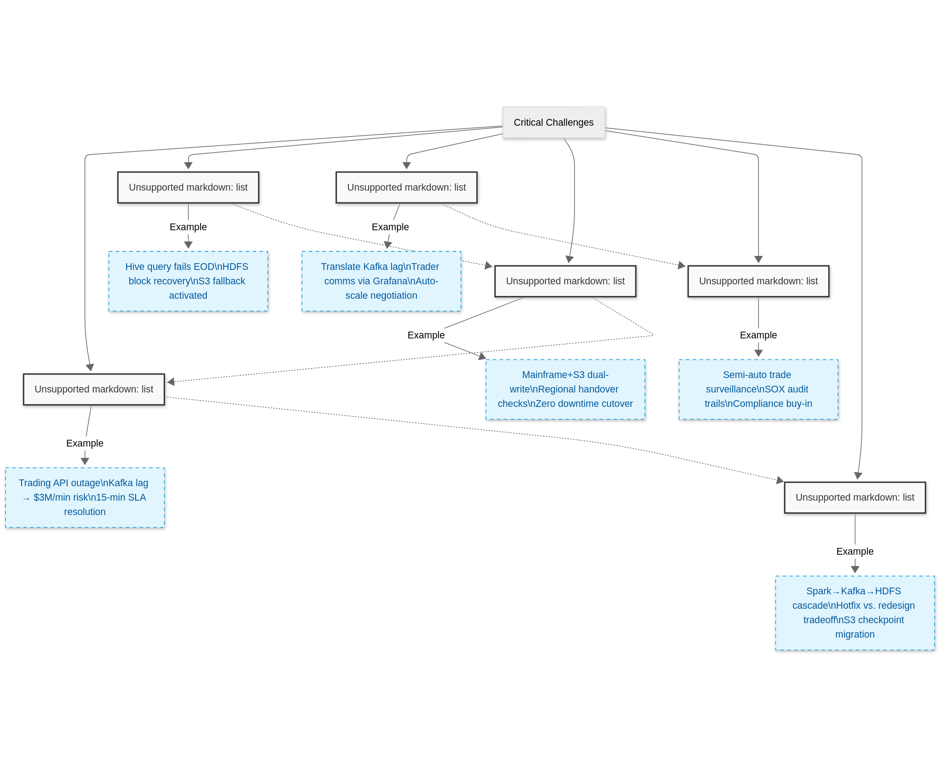
Tickets and categories
Notes:
Risk Management Framework
Operational Risk Categories Addressed
Risk Category
Impact
Mitigation Strategy
System Failures
Trading disruption, financial loss
Auto-remediation, real-time monitoring
Data Integrity
Regulatory violations, incorrect trades
Checksum validation, dual-write patterns
Performance Degradation
Delayed settlements, SLA breaches
Dynamic optimization, predictive scaling
Compliance Violations
Regulatory penalties, audit failures
SOX-compliant automation, audit trails
Communication Gaps
Delayed incident response
Business-friendly alerting, automated escalation
Complex Incidents
Extended outages, reputation damage
AI-driven root cause analysis, knowledge base

Slide 5
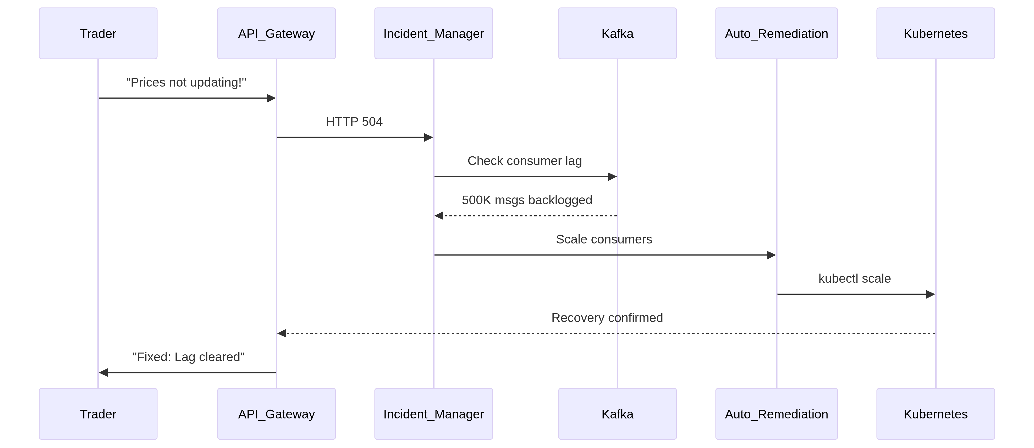
Trading API Outage Detected
Notes:
Technology Stack Summary
Core Technologies
Languages: Python, Java, Scala, Node.js, Go
Big Data: Apache Spark, Apache Kafka, HDFS
Cloud: AWS S3, AWS SDK
Infrastructure: Kubernetes, Docker
Monitoring: Grafana, Elasticsearch
Database: PostgreSQL (audit), Elasticsearch (analytics)
Communication: Slack API integration
Architecture Principles
Microservices Design: Isolated, scalable, independently deployable
Event-Driven: Kafka-based messaging and real-time processing
Cloud-Native: Kubernetes orchestration and containerization
Compliance-First: Built-in audit trails and SOX compliance
Automation-Centric: Minimal manual intervention required

Slide 6
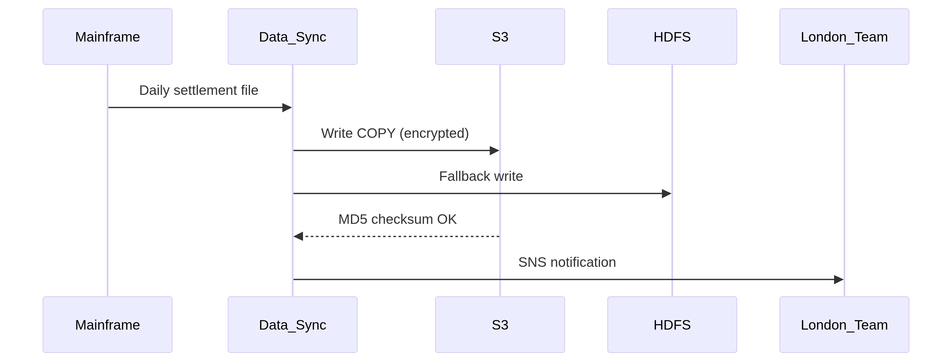
Legacy-S3-Sync

Slide 7
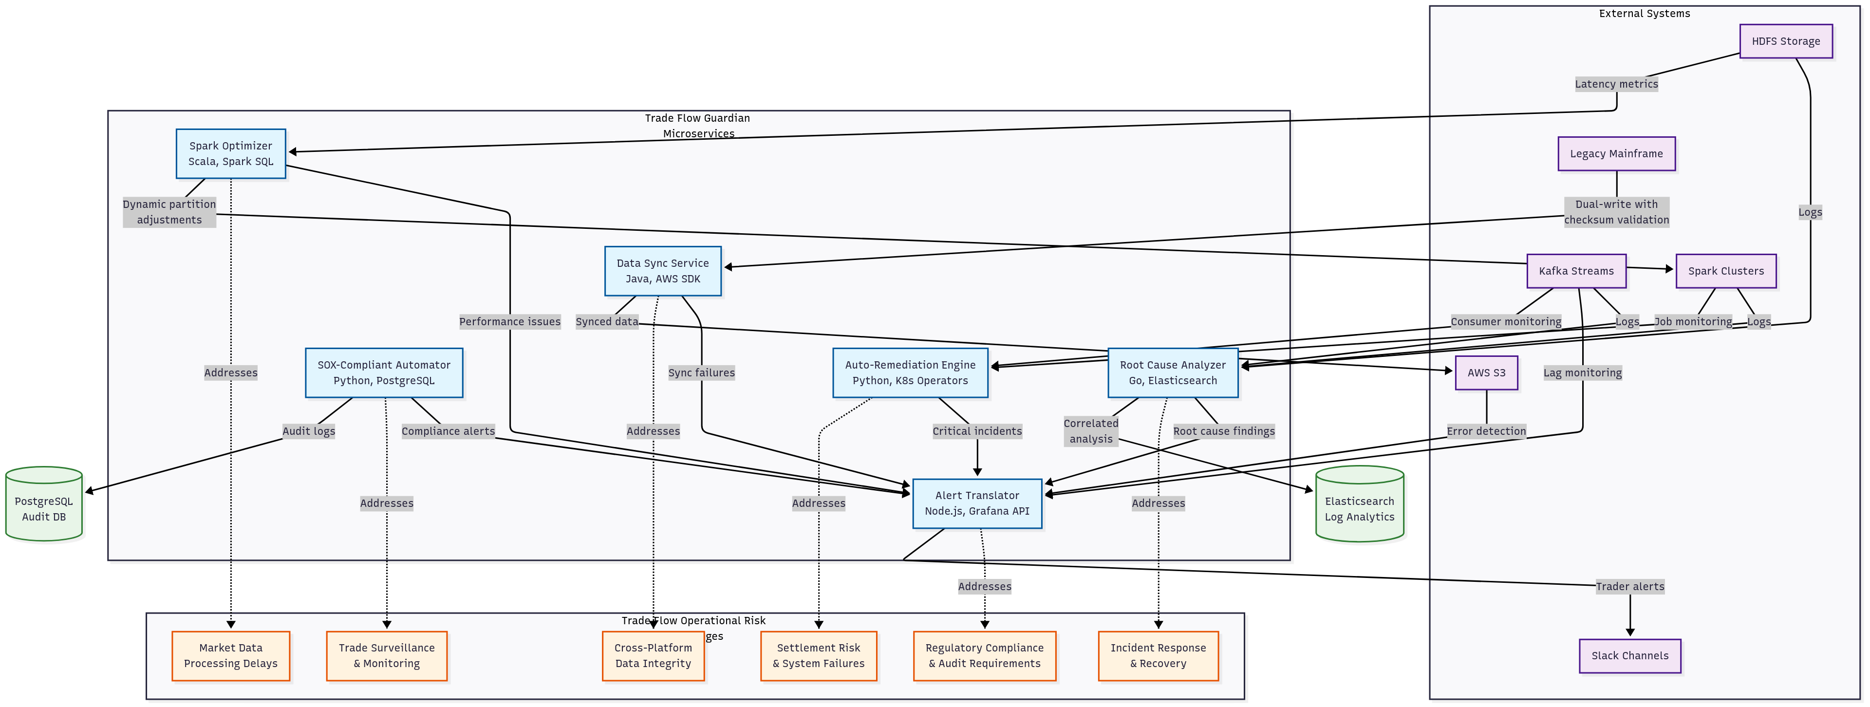
Trade Flow
Microservices
Operational Challenges
Notes:
Business Benefits
Quantifiable Outcomes
Reduced MTTR: 70% faster incident resolution through automated root cause analysis
Improved Uptime: 99.9% system availability through proactive remediation
Compliance Assurance: 100% audit trail coverage for all automated actions
Cost Optimization: 40% reduction in manual operations overhead
Strategic Advantages
Risk Mitigation: Proactive identification and resolution of operational risks
Regulatory Readiness: SOX-compliant automation with comprehensive audit capabilities
Operational Excellence: 24/7 automated monitoring and remediation
Legacy Modernization: Seamless integration between mainframe and cloud systems

Slide 8
Conclusion
Trade Flow Guardian represents a comprehensive approach to operational risk management in banking services, combining:
Proactive Risk Management: Automated detection and remediation
Regulatory Compliance: Built-in SOX compliance and audit trails
Business Continuity: Real-time alerting and rapid response
Technology Integration: Seamless legacy-modern system bridging
The platform delivers measurable risk reduction while enabling innovation and operational efficiency in critical trading environments.

Slide 9
Thank you
Contact: Karthikvx@gmail.com

