Slide 1
A Strategic Initiative to Automate and Optimize Model-Automation Framework
OUR VISION
To transform mortgage risk management through automation, real-time analytics, and a cloud-native architecture.
KEY OBJECTIVES
EXPECTED IMPACT
🎯 Automate loan underwriting with >95% accuracy.
↓ 40% <br> Reduction in Loan Processing Time
⚙️ Enable real-time distressed loan decision-making.
↑ 25% <br> Improvement in Risk Prediction Accuracy
📈 Streamline regulatory capital calculations.
📊 Provide comprehensive financial reporting & forecasting.

Slide 2
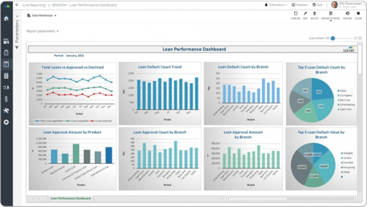
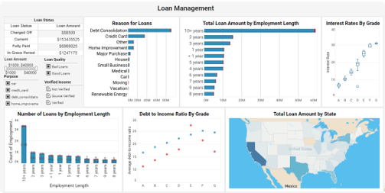
Business Challenges & Opportunities
Pain Points:
- Manual underwriting: 72-hour average processing time
- Reactive risk management with limited visibility
- Complex regulatory compliance
- Data silos limiting holistic risk view
Opportunities:
- $7.2T mortgage market
- Demand for automated compliance
- Faster loan origination
- Dynamic risk pricing needs

Slide 3
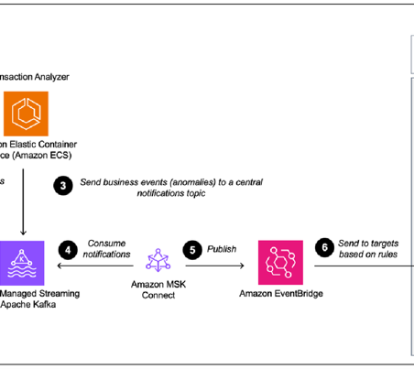
Solution Architecture Overview
Our Event-Driven Architecture (EDA) provides a scalablefoundation for real-time risk assessment and automateddecision-making across the mortgage lifecycle.
Distributed Cloud Infrastructure with microservices forscalability and resilience
Real-time Data Pipeline using Apache Kafka, AWS Lambda,and Kinesis
Multi-tier Storage leveraging S3, RDS, and DynamoDB forstructured and unstructured data
Advanced Analytics powered by Amazon EMR and Redshiftfor risk modeling

Slide 4
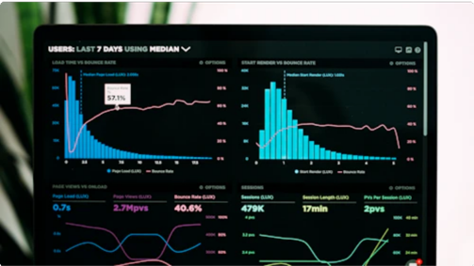

Core Capability: Automated Loan Underwriting
Objectives: Reduce processing time to under 4 hours, 95%+ accuracy
ML-powered decision engine: XGBoost, Random Forest, OCR+NLP, AVM
Real-time FICO, DTI calculations, property comparables
Regulatory compliance checks (QM, ATR)

Slide 5
Core Capability: Distressed Loan Decisions
Objectives: Early identification of at-risk loans
Predictive analytics pipeline: payment patterns, survival analysis
Automated workout strategy recommendations
Loss mitigation waterfall automation, foreclosure optimization

Slide 6
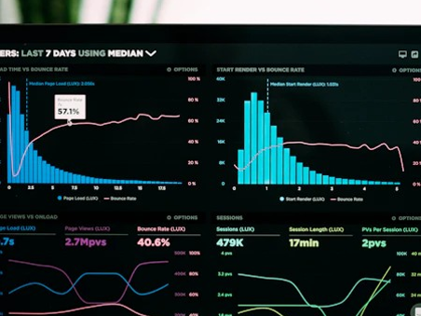
Core Capability: Capital Calculations
Objectives: Real-time monitoring, stress testing, reporting automation
Basel III compliant risk-weighted assets, Monte Carlo simulations
CECL allowance, market risk VaR, regulatory submission automation

Slide 7
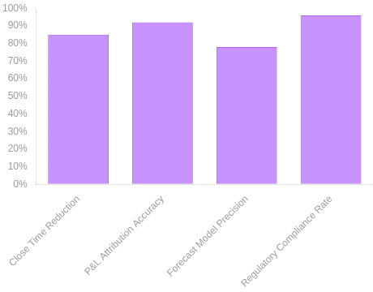
Core Capability: Financial Reporting & Forecasting
Objectives: Automated close, real-time P&L attribution, predictive modeling
Financial pipeline: data integration, P&L, Balance Sheet, Cash Flow
Scenario modeling, liquidity risk reporting, fair value calculations

Slide 8
Technology Stack
Event-Driven Architecture
Scalable event processing with Apache Kafka for high-throughputdata streaming, AWS Lambda for serverless compute, and AmazonKinesis for real-time data capture and processing across mortgageoperations.
Storage Solutions
Multi-tiered storage strategy with Amazon S3 for document storage,RDS for relational data, and DynamoDB for high-performance NoSQLcapabilities supporting loan data and regulatory documents.
Analytics Platform
Comprehensive data analytics with Amazon EMR for large-scaleprocessing and Redshift for data warehousing, enabling real-timebusiness intelligence and mortgage portfolio analysis.
Machine Learning & AI
Advanced decision systems using XGBoost for predictive modeling, Optical Character Recognition (OCR) with Natural Language Processing (NLP) for document analysis, and Automated Valuation Models (AVM) for property assessments.
Security Framework
Enterprise-grade security with end-to-end encryption, AWS Identity and Access Management (IAM), and comprehensive monitoring systems ensuring data protection and regulatory compliance.
Integration Architecture
Flexible API ecosystem with microservices architecture enabling seamless integration between internal systems and external partners for streamlined mortgage processing workflows.
_{C}

Slide 9
Implementation Roadmap
Phase 1 : Cloud infra, data pipeline, security framework
Phase 2 : Underwriting, risk engines, reporting
Phase 3 : Distressed loans, advanced capital calcs, dashboards
Phase 4 : Optimization, advanced ML, automation deployment

Slide 10
Risk Management & Compliance
Model Risk Management: validation, monitoring, documentation
Data Governance: quality, lineage, privacy, audit trails
Regulatory Compliance: SOX automation, fair lending, consumer checks

Slide 11
Success Metrics & KPIs
Operational Efficiency: underwriting time 72h→4h, 40% cost reduction
Risk Management: 92%+ default prediction accuracy, 25% recovery improvement
Business Impact: $50M+ revenue, 2% market share growth, 90% satisfaction

Slide 12
Thank you
Karthikvx@gmail.com

