Slide 1
"Implementing Real-Time Trade Settlement on AWS"
*"Event-Driven Architecture with Kafka, Microservices, and Sub-300ms Latency"*

Slide 2

Core Stack
Event Streaming:
Amazon MSK (Managed Kafka) – Replace self-managed Kafka clusters.
Kinesis (Alternative for high-throughput but simpler use cases).
Microservices:
AWS EKS (Kubernetes) or ECS Fargate – Host Spring Boot apps.
Lambda – For lightweight enrichment/validation.
Databases:
Amazon Aurora (PostgreSQL) – Transactional data.
DynamoDB – For low-latency reference data.
Settlement & Compliance:
Amazon QLDB (Immutable ledger for DvP).
AWS Fraud Detector (AML/risk checks).

Slide 3

Implementation steps
Phase 1
Foundation Setup
VPC Design:
Isolated subnets for Kafka/MSK (private), microservices (private), and public APIs.
Kafka on AWS:
Deploy Amazon MSK with 3 brokers (multi-AZ).
Configure topics: trade-events, settlement-queue, dlq.
Infrastructure as Code (IaC):
Use AWS CDK or Terraform to automate provisioning.
Phase 2
Microservices Deployment
Trade Validation Service: Spring Boot app on EKS with auto-scaling.
Enrichment Service: Pull reference data from DynamoDB (TTL caching).
Clearing Engine: Use AWS Step Functions for orchestration.
Phase 3
Settlement & Resilience
Settlement Service:
Connect to QLDB for DvP and SWIFT Gateway via AWS PrivateLink.
Dead Letter Queue (DLQ):
SQS + Lambda for retries.
Monitoring:
CloudWatch for latency metrics.
X-Ray for tracing.
Notes:
Pattern AWS Service Your Application
Event Sourcing DynamoDB Streams Rebuild account state from payment events
CQRS DynamoDB + Elasticsearch Real-time risk dashboards
Time-Series Timestream Trading volume analytics

Slide 4

Latency Optimization
Key Metrics:
Trade Ingestion: <50ms (MSK with enhanced fan-out).
Validation + Clearing: <100ms (Aurora Optimized Reads).
End-to-End Settlement: <300ms (QLDB + EKS low-latency pods).
AWS Features Used:
MSK Tiered Storage: Reduce cost for historical data.
ElastiCache (Redis): Cache reference data.

Slide 5
Security and Compliance
Data Encryption:
TLS 1.3 for in-transit (MSK), KMS for at-rest.
Access Control:
IAM roles for services, VPC endpoints to avoid public internet.
Audit:
AWS CloudTrail + QLDB for immutable logs.

Slide 6
Cost Optimization
Example Pricing:
MSK: ~$0.10/hour per broker (3 brokers = $2,160/month).
EKS: ~$0.10/hour per node (10 nodes = $720/month).
Savings: Spot Instances for non-critical microservices.
Notes:
Cost Optimization
Your Strategies:
DynamoDB Autoscaling:
bash
aws application-autoscaling register-scalable-target \ --service-namespace dynamodb \ --scalable-dimension "dynamodb:table:WriteCapacityUnits" \ --min-capacity 100 --max-capacity 10000
ElastiCache Reserved Nodes: 1-year term for stable workloads
======================
DynamoDB For:
High-velocity data: Payment events (10K+ TPS)
Predictable scaling: Merchant holiday traffic
Serverless ops: No DBA overhead
==================
Security & Compliance
Your Configurations:
Encryption: KMS CMKs for DynamoDB at rest
Access Control: IAM policies with fine-grained DynamoDB permissions
Audit: CloudTrail logs for all NoSQL API calls
===========================

Slide 7
Migration Roadmap
Timeline:
Week 1-2: PoC (MSK + 1 microservice).
Week 3-4: Full deployment + load testing.
Week 5: Go-live with rollback plan.

Slide 8
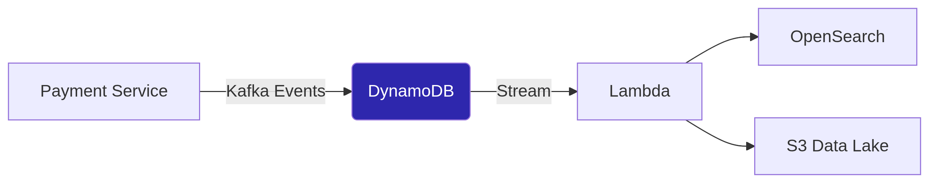
Key Analysis, Patterns( Event Sourcing, CQRS)
Service | Banking Use Case | Your Implementation | Pros/Cons
DynamoDB | High-speed transaction logging | Payment events with TTL for GDPR | ✅ Single-digit ms latency ❌ No SQL joins
DocumentDB | Loan application documents (JSON) | Replaced MongoDB in VPC for HIPAA | ✅ MongoDB compatible ❌ Higher cost
Keyspaces | Audit trails with Cassandra API | Trade history (time-series) | ✅ Serverless ❌ Limited secondary indexes
QLDB | Immutable ledger for settlements | DvP (Delivery vs Payment) records | ✅ Cryptographic verification ❌ No native Kafka integration
ElastiCache | Real-time reference data (Redis) | FX rates, fraud patterns | ✅ Sub-millisecond reads ❌ Ephemeral data
Notes:
Regulatory :
Immutable Workflow:
Kafka event → Lambda → QLDB (INSERT)
Stream to S3 for analytics (Athena)
=====================
Core Banking Use Cases for Hibernate
Feature
Banking Application
Your Implementation
Entity Relationships
Trade ↔ Settlement (OneToMany)
@OneToMany(cascade=ALL, orphanRemoval=true)
Caching
Reference data (FX rates, currencies)
L2 Cache (Ehcache) + @Cache(usage=READ_WRITE)
Batch Processing
EOD reconciliation
hibernate.jdbc.batch_size=50 + @Id sequence
Audit Logging
Regulatory compliance (MiFID II)
@PreUpdate + Kafka event publishing
=======================
Deployment Factors
Criticality: Kubernetes for core payments (self-healing), Lambda for background checks
Compliance: Isolated namespaces for PCI data, Terraform for audit trails
Cost: Serverless for spiky workloads, reserved instances for steady-state
==========================
Model
Use Case
Tech Stack You've Used
Pros/Cons
Kubernetes (EKS/OpenShift)
High-scale trading platforms
AWS EKS, Red Hat OpenShift
✅ Auto-scaling, multi-AZ ❌ Complex networking
Serverless (Lambda)
Event-driven tasks (e.g., fraud checks)
AWS Lambda + SQS/Kafka
✅ Zero ops, pay-per-use ❌ Cold starts
VM-Based
Legacy systems with strict compliance
EC2 + Auto Scaling Groups
✅ Full control ❌ Manual scaling
Hybrid
Gradual cloud migration
EKS + On-prem OpenShift
✅ Flexibility ❌ Increased complexity
=============================
Banking App specific strategies
key strategies:
Protocol Choice: gRPC over REST for internal calls (40ms latency).
Caching: Redis for reference data, Hibernate L2 cache for DB entities.
Async Processing: Kafka for settlement with exactly-once semantics. *At JPM Chase, this handled 10K+ trades/sec with <100ms E2E latency.*"*
*"Defense in depth:
Resilience4j: Circuit breakers on downstream calls.
Kubernetes: Pod limits + HPA.
Kafka: Rate-limiting producers.
======================================

Slide 9
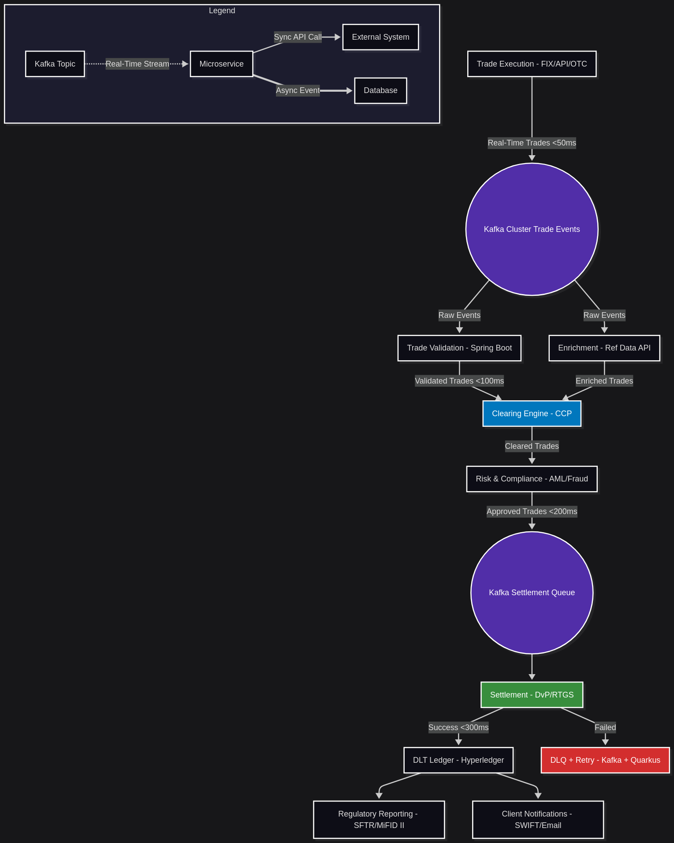
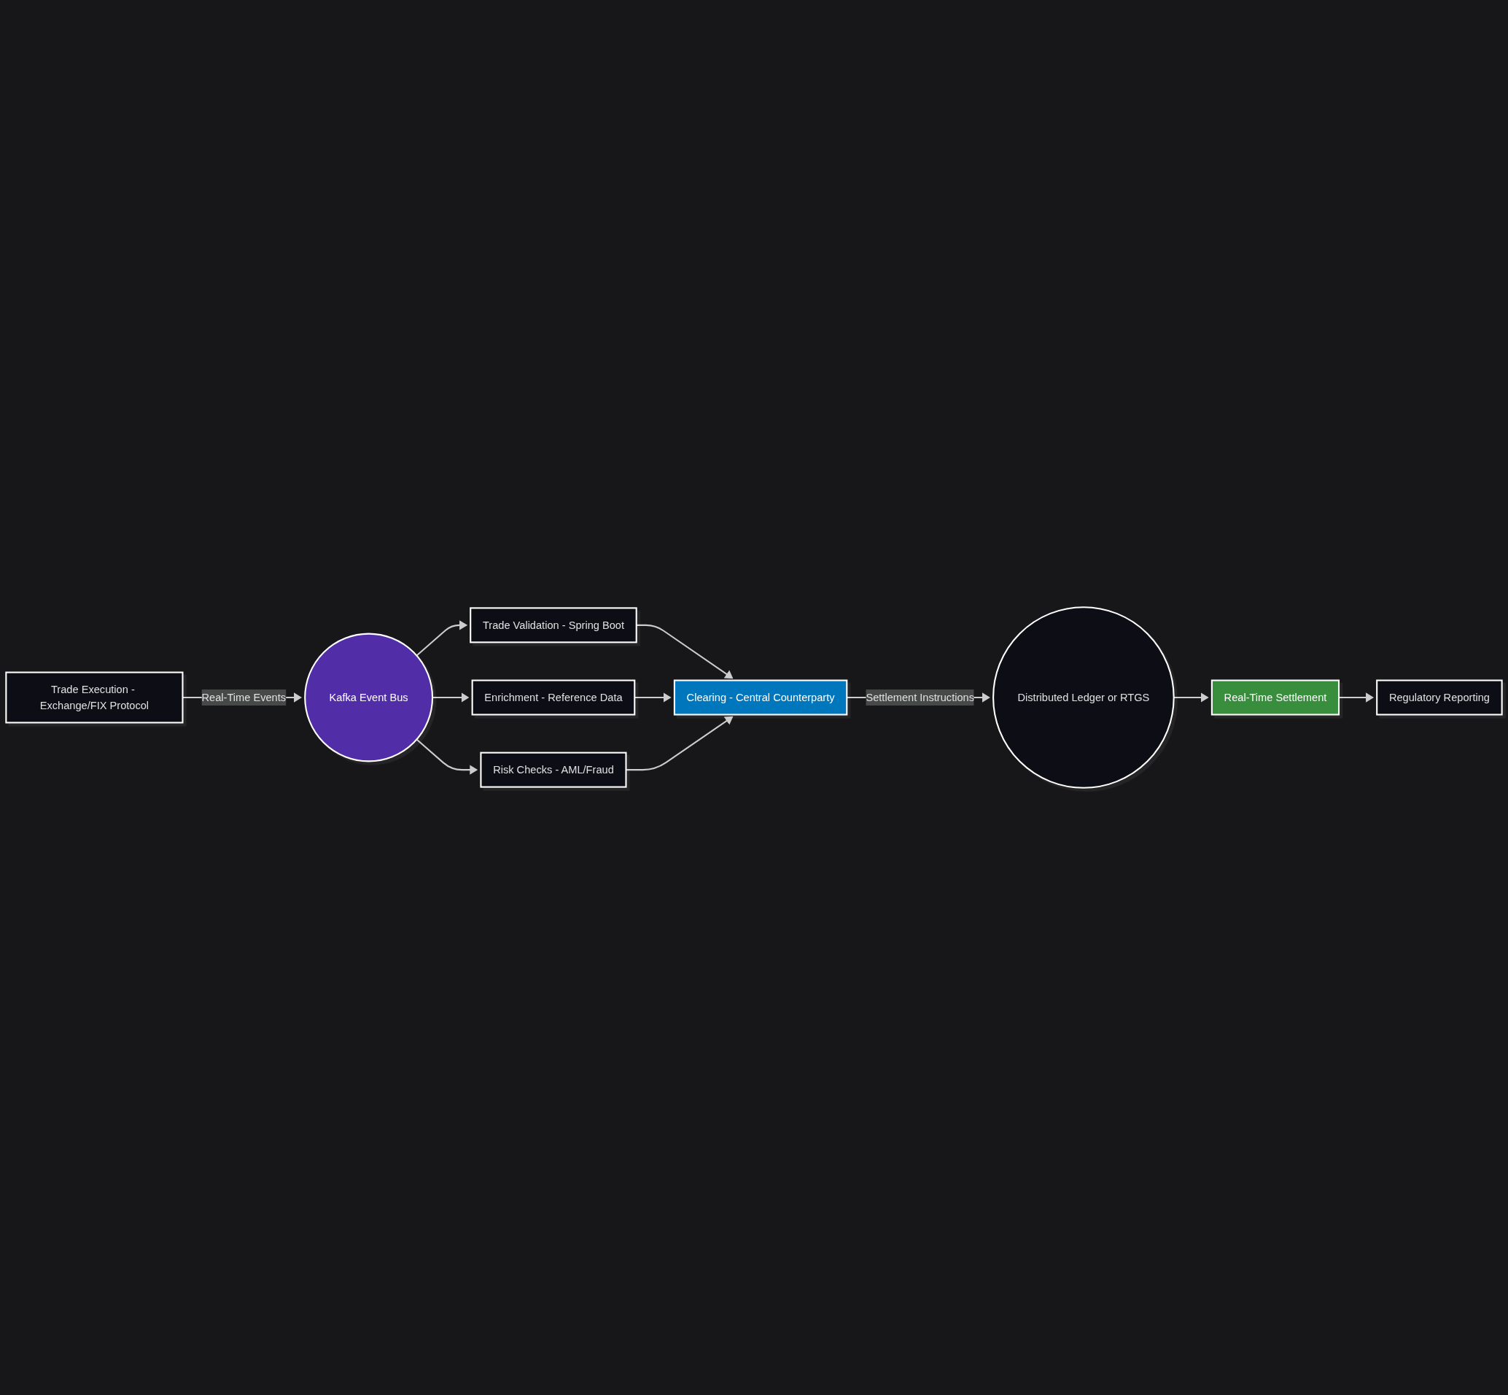
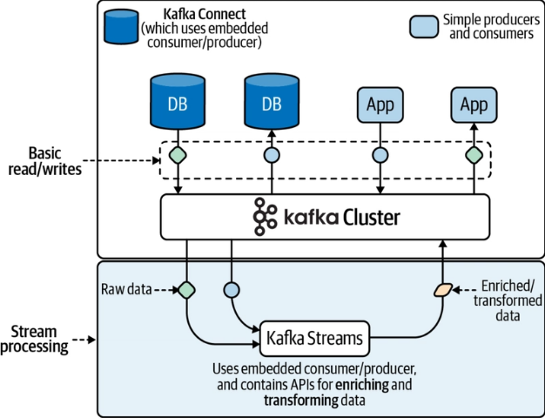
APP Over view
Bounded Contexts: Payments, Trading, Risk, Reporting.
Scenario | Protocol | Implementation
Real-time payments | Kafka | Avro schemas for contract enforcement
Low-latency risk checks | GRPC | Protocol buffers, http/2
External partner apis | Rest | OpenAPI specs + mTLS

Slide 10
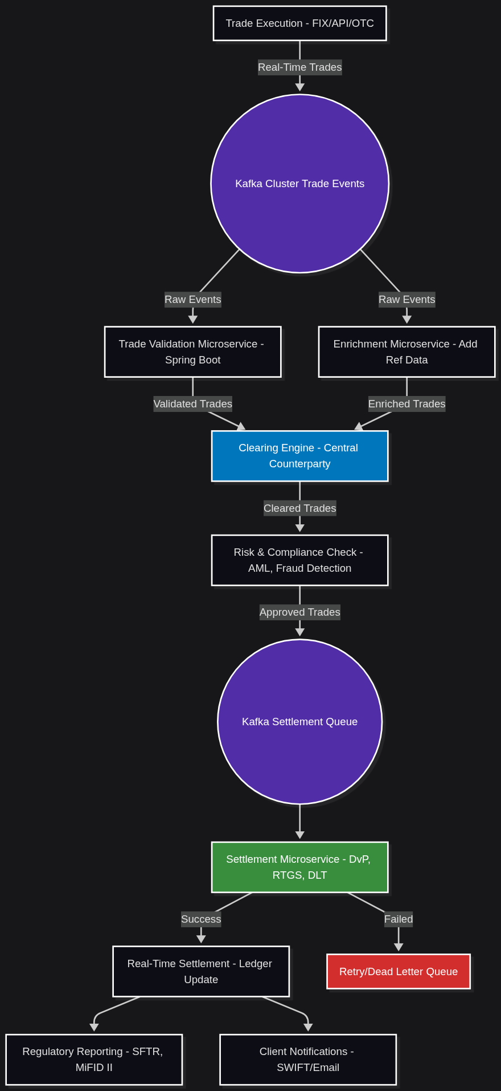
Work Flow
Kafka as the backbone for 100K+ TPS trade ingestion.
Spring Boot microservices for atomic scaling (e.g., risk checks during volatility).
Hyperledger/RTGS for immutable settlement (DvP).
DLQ + Retry ensures 99.99% SLA even during outages.
Notes:
Event Sourceing
Complete Audit Trail: Every state change is an immutable event.
Real-Time Processing: Kafka enables sub-second settlement.
Fault Recovery: Replay events to rebuild state after failures. Use Case Example:
"Reconstruct the exact state of a $1B FX trade settlement after a system crash."
Settlement Service Workflow:
Consume TradeEvent from Kafka.
Validate: Check funds, counterparty limits.
Emit:
SettlementInitiatedEvent → Notify ops team.
SettlementCompletedEvent → Update ledger. Code Snippet (Kafka Streams):
java
KStream<String, TradeEvent> trades = builder.stream("trades.raw"); trades.filter((k, v) -> "FX".equals(v.getProductType())) .mapValues(trade -> new SettlementEvent(trade)) .to("settlements.processed");
Failure Handling & Idempotency
Patterns:
Dead Letter Queue (DLQ): Route malformed events to trades.dlq.
Idempotent Writes: Use event_id to dedupe in databases.
State Recovery: Rebuild state from Kafka topic (e.g., after outage).
Visual:
text
Kafka Topic (trades.raw) │ ├─▶ Success: Settlement Service └─▶ Failure: DLQ → Lambda (Alerts + Retry)
Compliance & Audit
Key Features:
Immutable Log: Kafka retention = 7+ years (regulatory requirement).
Lineage Tracking: Each event links to source trade.
Reconciliation: Nightly batch job verifies Kafka vs. ledger.
Tooling:
AWS MSK (Managed Kafka) with TLS encryption.
Splunk for real-time event monitoring.
Performance Optimization
Tactics:
Partitioning: By trade_id for parallel processing.
Compression: Snappy for high-volume settlements.
Caching: Redis for frequent counterparty checks.
Metrics to Monitor:
end-to-end-latency (95% < 1s)
settlement-throughput (10K+ events/sec)
Faster FX Settlements
Before:
Batch processing → T+1 settlement.
No audit trail for intermediate states.
After:
Real-time event sourcing → T+0 settlement.
100% replayability for disputes.

Slide 11

PaymentService (spring boot + kafka)
Performance Metrics
Metric | Value | How We Achieved It
Throughput | 15K TPS | Kafka batching + 10 consumer threads
REST API Latency (P99) | 50ms | Async fire-and-forget pattern
Fraud Check Latency | 20ms | gRPC over HTTP/2
Error Rate | <0.01% | DLQ + exponential backoff retries
Notes:
Banking-Grade Enhancements
Idempotency:
java
@Id @GeneratedValue private String paymentId; // Natural key for deduplication @Version private Integer version; // Optimistic locking
Regulatory Compliance:
java
@Entity @Table(name = "payments") @Audited // Hibernate Envers for audit logs public class Payment { // ... }
Chaos Engineering Ready:
java
@KafkaListener(/*...*/) @Retryable(maxAttempts=3, backoff=@Backoff(delay=1000, multiplier=2)) public void processPaymentEvent(PaymentEvent event) { ... }
==================
Production Envronment specific:
DynamoDB TTL for Compliance:
javascript
// Auto-delete records after 7 years (FINRA) { "ttl": Math.floor(Date.now()/1000) + 220752000 }
DocumentDB Index Strategy:
javascript
// Compound index for loan queries db.loans.createIndex({ "customerId": 1, "status": 1 })
Disaster Recovery:
DynamoDB Global Tables for active-active
Regular S3 exports for QLDB
======================
Bank Specific Optimization...
Kafka Configuration (application.yml):
yaml
spring: kafka: producer: acks: all # Durability compression-type: snappy # Throughput batch-size: 16384 # Batch writes linger-ms: 5 # Wait for batch consumer: auto-offset-reset: earliest enable-auto-commit: false # Manual commits max-poll-records: 500 # Throughput fetch-max-wait-ms: 500
Thread Pool Tuning:
java
@Configuration public class KafkaConfig { @Bean public ConcurrentKafkaListenerContainerFactory<String, PaymentEvent> kafkaListenerContainerFactory( ConsumerFactory<String, PaymentEvent> consumerFactory) { ConcurrentKafkaListenerContainerFactory<String, PaymentEvent> factory = new ConcurrentKafkaListenerContainerFactory<>(); factory.setConsumerFactory(consumerFactory); factory.setConcurrency(10); // Match Kafka partitions factory.getContainerProperties().setAckMode(ContainerProperties.AckMode.MANUAL_IMMEDIATE); return factory; } }
gRPC Fraud Check Client:
java
@GrpcClient("fraud-service") private FraudServiceGrpc.FraudServiceBlockingStub fraudClient; public FraudResponse check(PaymentEvent event) { FraudCheckRequest request = FraudCheckRequest.newBuilder() .setPaymentId(event.getPaymentId()) .setAmount(event.getAmount().doubleValue()) .setCurrency(event.getCurrency()) .build(); return fraudClient.checkFraud(request); }
=======================
Demo App
Payment Processing Service
Features:
Kafka consumer for high-volume payment events
REST endpoint for synchronous payment initiation
Optimized for 10K+ TPS with async/sync hybrid flow
java
@SpringBootApplication @EnableKafka public class PaymentServiceApplication { public static void main(String[] args) { SpringApplication.run(PaymentServiceApplication.class, args); } } @RestController @RequestMapping("/payments") public class PaymentController { @Autowired private PaymentProcessor paymentProcessor; // REST API for immediate payment initiation @PostMapping public ResponseEntity<PaymentResponse> createPayment(@RequestBody PaymentRequest request) { String paymentId = paymentProcessor.initiatePayment(request); return ResponseEntity.accepted() .body(new PaymentResponse(paymentId, "Processing")); } } @Service public class PaymentProcessor { private static final Logger log = LoggerFactory.getLogger(PaymentProcessor.class); @Autowired private KafkaTemplate<String, PaymentEvent> kafkaTemplate; @Autowired private PaymentRepository paymentRepo; @Autowired private FraudCheckClient fraudCheckClient; // gRPC/REST client // High-throughput async processing @KafkaListener(topics = "${kafka.topic.payments}", groupId = "${kafka.group-id}") @Transactional public void processPaymentEvent(PaymentEvent event) { try { // 1. Sync fraud check (low-latency) FraudResponse fraudResponse = fraudCheckClient.check(event); if (fraudResponse.isApproved()) { // 2. Process payment Payment payment = PaymentMapper.toEntity(event); paymentRepo.save(payment); // 3. Publish settlement event kafkaTemplate.send("settlements", payment.getPaymentId(), new SettlementEvent(payment.getPaymentId(), payment.getAmount())); } } catch (Exception e) { log.error("Payment failed: {}", event.getPaymentId(), e); kafkaTemplate.send("payment-dlq", event.getPaymentId(), event); // DLQ } } public String initiatePayment(PaymentRequest request) { String paymentId = UUID.randomUUID().toString(); kafkaTemplate.send("payments", paymentId, new PaymentEvent(paymentId, request.getAmount(), request.getCurrency())); return paymentId; } } // DTOs public record PaymentRequest(BigDecimal amount, String currency) {} public record PaymentResponse(String paymentId, String status) {} public record PaymentEvent(String paymentId, BigDecimal amount, String currency) {} public record SettlementEvent(String paymentId, BigDecimal amount) {}

Slide 12
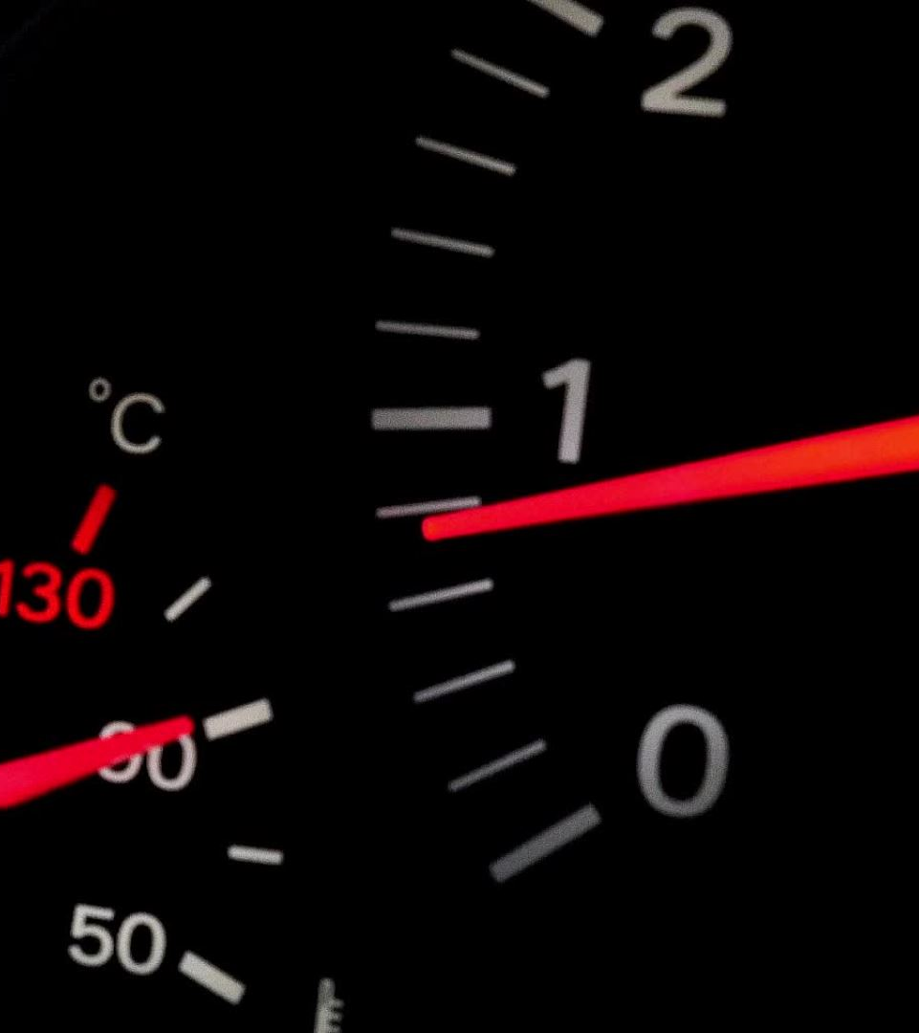

Demo and Next step
Demo Suggestion:
Show CloudWatch Dashboard with live latency metrics.
Sample Trade Flow: From FIX → MSK → Settlement.
Next Steps:
Pilot with non-critical trades.
Partner with AWS for Well-Architected Review.
Notes:
@SpringBootApplication
@EnableKafka
public class PaymentServiceApplication {
public static void main(String[] args) {
SpringApplication.run(PaymentServiceApplication.class, args);
}
}
@RestController
@RequestMapping("/payments")
public class PaymentController {
@Autowired
private PaymentProcessor paymentProcessor;
// REST API for immediate payment initiation
@PostMapping
public ResponseEntity<PaymentResponse> createPayment(@RequestBody PaymentRequest request) {
String paymentId = paymentProcessor.initiatePayment(request);
return ResponseEntity.accepted()
.body(new PaymentResponse(paymentId, "Processing"));
}
}
@Service
public class PaymentProcessor {
private static final Logger log = LoggerFactory.getLogger(PaymentProcessor.class);
@Autowired
private KafkaTemplate<String, PaymentEvent> kafkaTemplate;
@Autowired
private PaymentRepository paymentRepo;
@Autowired
private FraudCheckClient fraudCheckClient; // gRPC/REST client
// High-throughput async processing
@KafkaListener(topics = "${kafka.topic.payments}", groupId = "${kafka.group-id}")
@Transactional
public void processPaymentEvent(PaymentEvent event) {
try {
// 1. Sync fraud check (low-latency)
FraudResponse fraudResponse = fraudCheckClient.check(event);
if (fraudResponse.isApproved()) {
// 2. Process payment
Payment payment = PaymentMapper.toEntity(event);
paymentRepo.save(payment);
// 3. Publish settlement event
kafkaTemplate.send("settlements", payment.getPaymentId(),
new SettlementEvent(payment.getPaymentId(), payment.getAmount()));
}
} catch (Exception e) {
log.error("Payment failed: {}", event.getPaymentId(), e);
kafkaTemplate.send("payment-dlq", event.getPaymentId(), event); // DLQ
}
}
public String initiatePayment(PaymentRequest request) {
String paymentId = UUID.randomUUID().toString();
kafkaTemplate.send("payments", paymentId,
new PaymentEvent(paymentId, request.getAmount(), request.getCurrency()));
return paymentId;
}
}
// DTOs
public record PaymentRequest(BigDecimal amount, String currency) {}
public record PaymentResponse(String paymentId, String status) {}
public record PaymentEvent(String paymentId, BigDecimal amount, String currency) {}
public record SettlementEvent(String paymentId, BigDecimal amount) {}

Slide 13
Thank you
Karthikvx@gmail.com

