Slide 1
Predictive Modeling for Car Insurance Claims
Assessing Claim Probability for Better Risk Management
Your Name
Date

Slide 2
Problem Statement
Develop a predictive model to assess the claim probability for car insurance policies.
Objective: Understand factors influencing claim frequency and severity to help insurance companies assess risk and determine appropriate premiums.

Slide 3
Objective
Develop a machine learning model to predict the probability of insurance claims.
Use the model to identify key factors affecting claims.
Provide actionable insights for risk management and premium calculation.

Slide 4
Dataset Description
Overview of the dataset including features and target variable.
Key Features: Policy tenure, age of car, age of policyholder, car make, fuel type, etc.
Target Variable: `is_claim` (1 indicates a claim, 0 indicates no claim)

Slide 5
Data Preprocessing
Handling missing values using imputation.
Encoding categorical variables.
Scaling numerical features.

Slide 6
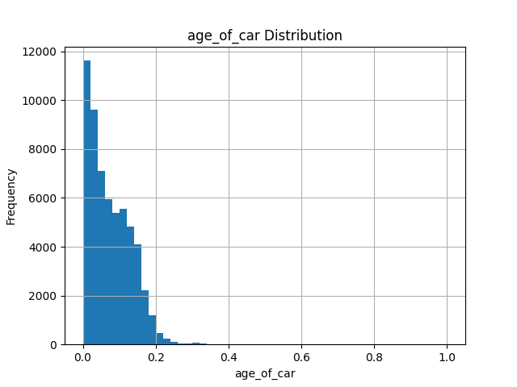
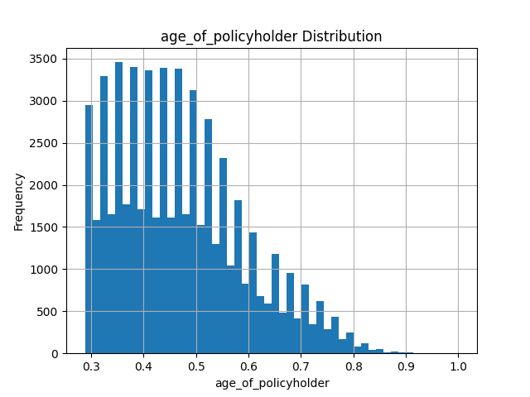
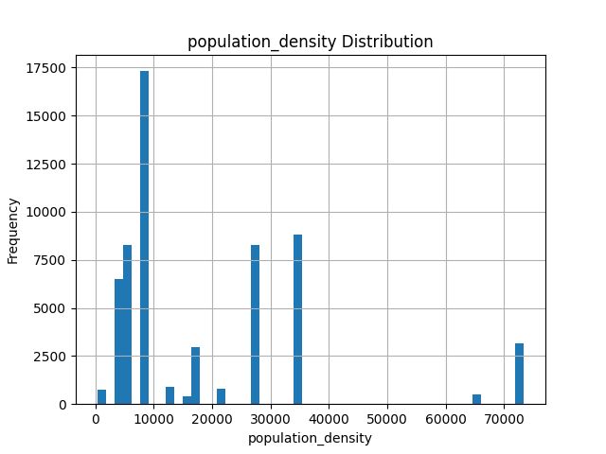
Exploratory Data Analysis
Summary statistics of the data. Distribution of target variable. Relationships between features and target variable.

Slide 7
Feature Engineering
Chi-squared test for categorical features.
ANOVA test for numerical features.

Slide 8
Handling Imbalanced Data
Issue of class imbalance in `is_claim` (55000 '0' and 4000 '1').
Use of SMOTE (Synthetic Minority Over-sampling Technique) to balance the dataset.

Slide 9
Model Building
Selected algorithms: Logistic Regression, Random Forest, Gradient Boosting, AdaBoost, Decision Tree, XGBoost.
Pipeline setup for model training and evaluation.

Slide 10
Hyperparameter Tuning
GridSearchCV for tuning XGBoost Classifier.
Best parameters and cross-validation scores.

Slide 11
Model Evaluation
Metrics used: Accuracy, Precision, Recall, F1 Score, ROC AUC.
Evaluation of different models on test data.

Slide 12
Results Comparison
Comparing the performance of different models.
Identification of the best model based on ROC AUC score.

Slide 13
Key Insights
Important factors influencing insurance claims.
Recommendations for risk management.
Implications for premium calculation.

Slide 14
Conclusion
Summary of findings.
Effectiveness of the predictive model in assessing claim probability.
Potential impact on insurance company operations.

Slide 15
Questions & Answers
Open the floor for questions.
Provide contact information for further queries.

