Slide 1
MAINTAINING WEB SEARCH PRIVACY WITH RECEPTIVITY
By:
Agrajit Bhowmik (1BG13CS004)
Karthik R (1BG13CS041)
Kripa Sindhu (1BG13CS043)
Nikhil Agrawal (1BG13CS062)
Guide:
Dr. Vibha Lakshmikantha

Slide 2
CONTENTS
Introduction
Literature Survey
Problem Statement
System Design
Data Flow Diagram
Results
Test Cases
References

Slide 3
INTRODUCTION

Slide 4
What is Personalized Web Search (PWS)?
Personalized web search (PWS) is a general category of search techniques aiming at providing better search results
PWS are tailored for individual user needs. User information such as location and content is collected and analyzed to figure out the user intention behind the issued query

Slide 5
LITERATURE SURVEY

Slide 6
LITERATURE SURVEY
[1] A.Smilien Rophie and Dr.A.Anitha, “Survey on Personalized Web Search Engine”, International Journal for Research in Applied Science & Engineering Technology (IJRASET), Volume 4 Issue 3, March 2016, ISSN: 2321-9653
METHOD: The user has a separate profile. The hierarchical structure can be followed in user profile. The profile can be updated in the PWS client.
ADVANTAGE: Increases the search quality
LIMITATION: The main drawback is tradeoff between personalization and privacy.

Slide 7
LITERATURE SURVEY
[2] Alexandre Viejo and Jordi Castell`a-Roca, “Using Social Networks to Distort Users Profiles Generated by Web Search Engines”, ComputerNetworks, vol 54, no.9, pp.1343-1357, 2010
METHOD: The implemented method uses legacy social networks instead of third party to provide a distorted user profile to the web search engine.
ADVANTAGE: Propose a new scheme designed to protect the privacy of the users from a web search engine that tries to profile them.
LIMITATION : The shortcomings of current solutions is the high cost introduced due to computation and communication.

Slide 8
LITERATURE SURVEY
[3] Chanchala Joshi, Teena Jaiswal, Himanshu Gaur, “An Overview Study of Personalized Web Search ”, International Journal of Scientific and Research Publications, Volume 3, Issue 1, January 2013, ISSN 2250-3153
METHOD: Using Content Based Personalized Search
ADVANTAGE: Search results are filtered or re-ranked by checking the similarity of topics between search results and user profiles
LIMITATION : The topical interest based personalized search algorithms implemented were not stable.

Slide 9
LITERATURE SURVEY
[4] Greeshma A S and Lekshmy P. L, “Privacy Protection in Personalized Web Search”, International Journal of Innovative Research in Advanced Engineering (IJIRAE), ISSN: 2349-2163 Issue 6, Volume 2, June 2015
METHOD: Using click-log-based methods and profile-based methods.
ADVANTAGE: Significantly reduces the risk of attack and performs better as compared to others.
LIMITATION : When a new query is entered by user, click log based method will not provide any precise search results, which is one of the major drawback.

Slide 10
LITERATURE SURVEY
[5] Yun Zhu and Li Xiong, “Anonymizing User Profiles for Personalized Web Search”, Technical Report, TR-2010-007, 2010
METHOD: A Bayes-optimal privacy based principle is proposed to bound the prior and posterior probability of associating a user with an individual term in the anonymized user profile set. A novel bundling technique is proposed that clusters user profiles into groups by taking into account the semantic relationships between the terms while satisfying the privacy constraint.
ADVANTAGE: The search using anonymized user groups achieves good precision and provides significant improvement over non-personalized search.
LIMITATION : The current dataset places many limitations for extracting user’s specific interests.

Slide 11
PROBLEM STATEMENT
World Wide Web is vast and growing rapidly in size everyday and has huge number of webpages that contain information on different topics. Users search the desired information by giving the query to the search engine which yields in both relevant and irrelevant pages. Hence PWS is proposed whose objectives are:
Improving the quality of search services on the internet
Hides the privacy contents existing in the user profile
Reduce search time
Satisfying user with relevant information
Constraints:
Limited to a database

Slide 12
SYSTEM DESIGN

Slide 13
Existing System
The problems with the existing systems are:
The existing profile-based PWS do not support runtime profiling
The existing methods do not take into account the customization of privacy requirements
Many personalization techniques require iterative user interactions when creating personalized search results
To overcome these limitations PWS is implemented for faster information and web page access

Slide 14
Proposed System
Proposed Modules:
User customizable Privacy-preserving Search Frame Work (UPS)
Ontology Management System
Hash Tag Generation for Query Terms and Privacy Data
Personal Behavior Collections using SPY NB Algorithm
Personalized Searching using Adaptive Ranking Technique

Slide 15
User customizable Privacy-preserving Search Frame Work (UPS)
A privacy-preserving personalized web search framework is proposed
UPS can generalize profiles for each query according to user specified privacy requirements

Slide 16
Ontology Management System
Location Ontology:
The predefined location ontology is used to associate location information with the search results
All of the keywords and key-phrases from the documents returned for query q are extracted
If a keyword or key-phrase in a retrieved document d matches a location name in our predefined location ontology, it will be treated as a location concept of d

Slide 17
Ontology Management System(contd.)
B) Content Ontology:
Similar to the location ontology, the content ontology together with click through data are used to create feature vectors containing the user location preferences
Feature vectors will then be transformed into a location weight vector to rank the search results according to the user’s location preferences

Slide 18
Hash Tag Generation for Query Terms and Privacy Data
User location and query’s are stored into server which is hash coded by MD5 (One way encryption)
The abbreviation "MD" stands for “Message Digest”
The MD5 algorithm is a widely used hash function producing a 128-bit hash value
MD5 digests have been widely used in the software world to provide some assurance that a transferred file has arrived intact
The 128-bit (16-byte) MD5 hashes (also termed message digests) are typically represented as a sequence of 32 hexadecimal digits

Slide 19
Personal Behavior Collections using SPY NB Algorithm
Spy NB makes use of user behavior models from preferences extracted from click through data
Assuming that users only click on documents that are of interest to them, Spy NB treats the clicked documents as positive samples, and predict reliable negative documents from the unlabeled (i.e., un clicked) documents
To do the prediction, the “spy” technique incorporates a novel voting procedure into Naive Bayes classifier to predict a negative set of documents from the unlabeled document set

Slide 20
Personalized Searching using Adaptive Ranking Technique
Ranking SVM(Support Vector Machine) is employed to learn a personalized ranking function for rank adaptation of the search results according to the user content and location preferences
For a given query, a set of content concepts and a set of location concepts are extracted from the search results as the document features
Since each document can be represented by a feature vector, it can be treated as a point in the feature space
Using the preference pairs as the input, RSVM aims at finding a linear ranking function, which holds for as many document preference pairs as possible.

Slide 21
Advantages of Proposed System
PWS system profiles both of the user’s content and location preferences in the ontology-based user profiles, which are automatically learned from the click-through and GPS data without requiring extra efforts from the user
Existing works on personalization do not address the issues of privacy preservation
PWS system addresses this issue by controlling the amount of information in the client’s user profile being exposed to the PWS system server using two privacy parameters, which can control privacy smoothly, while maintaining good ranking quality
It enhances the stability of the search quality
It avoids the unnecessary exposure of the user profile

Slide 22
SYSTEM ARCHITECTURE

Slide 23
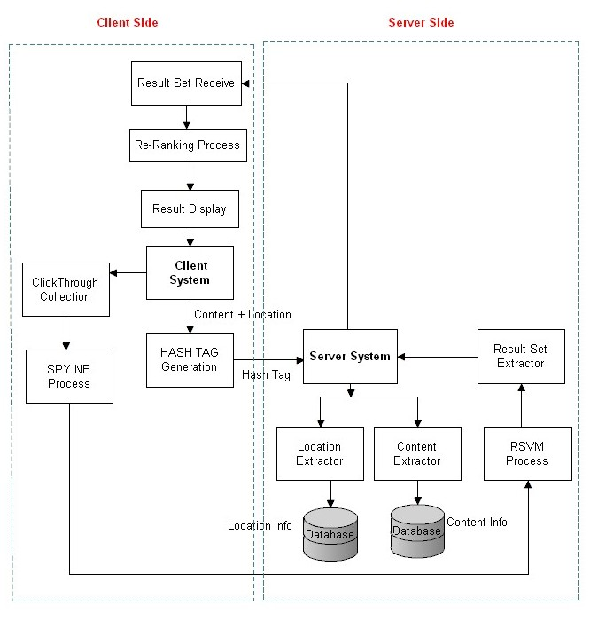
SYSTEM ARCHITECTURE

Slide 24
Data Flow Diagram Level 0
PASSWORD

Slide 25
Level 1

Slide 26
Level 2

Slide 27
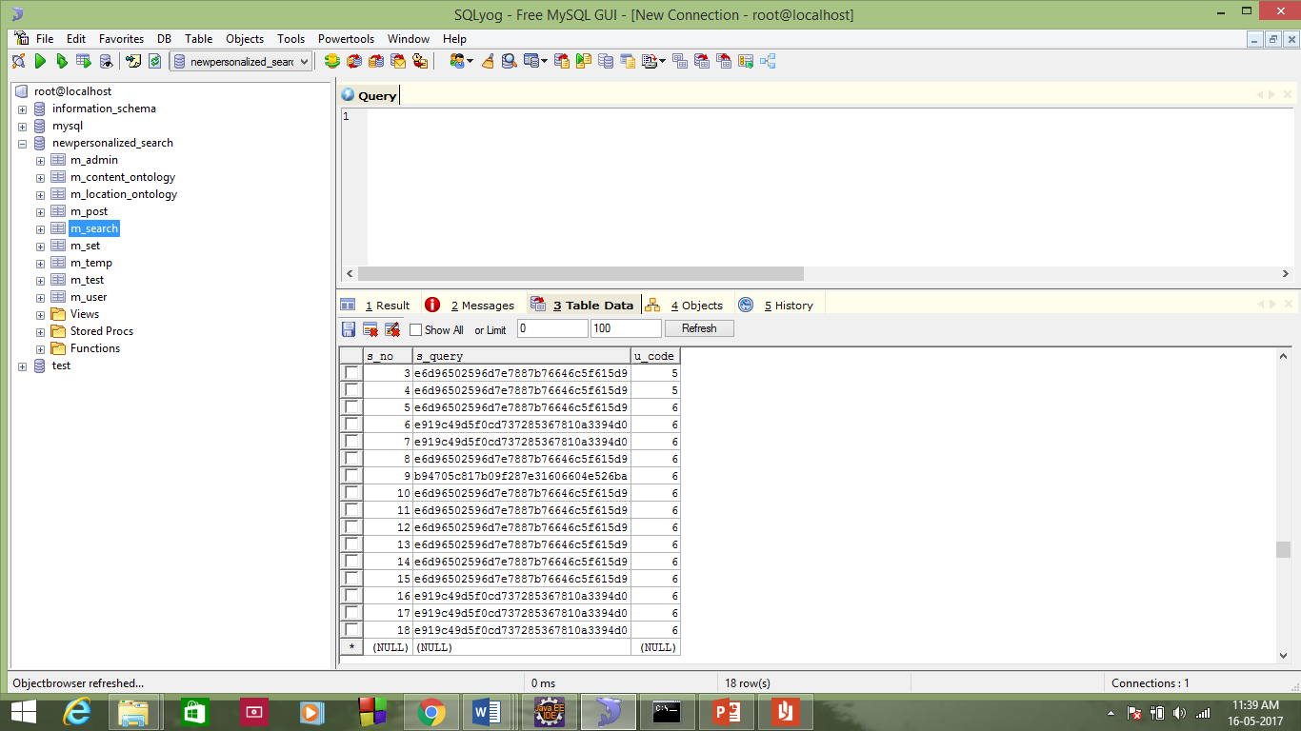
RESULTS
Fig. Hash coded query

Slide 28
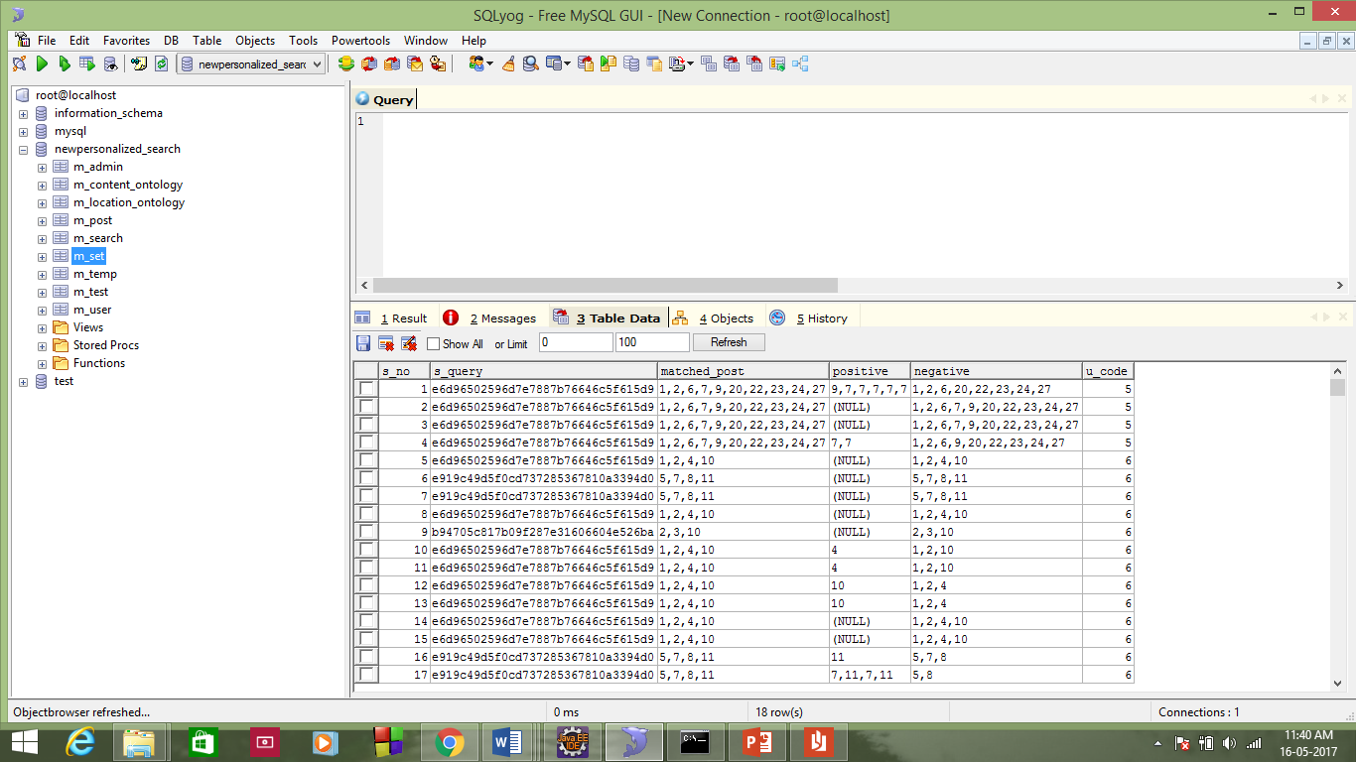
Fig. SPY-NB process

Slide 29
TEST CASES
Test Case Id | UTC_1
Test Input | Click on the link “Admin Login” Enter correct username and password click on login button
Expected Result | Admin should be navigated to homepage
Actual Result | Admin is navigated to homepage
Remarks | Success
Test Case Id | UTC _2
Test Input | Admin enters the location and content details in the database
Expected Result | The location and content details should be saved in the database
Actual Result | The location and content details are saved and the content details gets encrypted
Remarks | Success

Slide 30
Test Case Id | UTC _3
Test Input | Click on the link “Admin Logout”
Expected Result | Admin should be navigated to login page
Actual Result | Admin is navigated to login page
Remarks | Success
Test Case Id | UTC _4
Test Input | User performs a simple search
Expected Result | Search results should be displayed to the user
Actual Result | Search results are displayed to the user and searched content is encrypted
Remarks | Success

Slide 31
Test Case Id | UTC _5
Test Input | User performs a personalized search
Expected Result | Personalized search results should be displayed to the user
Actual Result | Search results are monitored, re-ranked and displayed to the user and searched content is encrypted
Remarks | Success
Test Case Id | UTC _6
Test Input | Click on the link “Register”
Expected Result | User registration should be successful if the entered details are correct
Actual Result | User has been registered successfully
Remarks | Success

Slide 32
REFERENCES
[1] A.Smilien Rophie and Dr.A.Anitha, “Survey on Personalized Web Search Engine”, International Journal for Research in Applied Science & Engineering Technology (IJRASET), Volume 4 Issue 3, March 2016, ISSN: 2321-9653
[2] Alexandre Viejo and Jordi Castell`a-Roca, “Using Social Networks to Distort Users Profiles Generated by Web Search Engines”, ComputerNetworks, vol 54, no.9, pp.1343-1357, 2010
[3] Chanchala Joshi, Teena Jaiswal, Himanshu Gaur, “An Overview Study of Personalized Web Search ”, International Journal of Scientific and Research Publications, Volume 3, Issue 1, January 2013, ISSN 2250-3153

Slide 33
[4] Greeshma A S and Lekshmy P. L, “Privacy Protection in Personalized Web Search”, International Journal of Innovative Research in Advanced Engineering (IJIRAE) ISSN: 2349-2163 Issue 6, Volume 2, June 2015
[5] Yun Zhu and Li Xiong, “Anonymizing User Profiles for Personalized Web Search”, Technical Report, TR-2010-007, 2010

Slide 34
THANK YOU ☺

